Slide 1
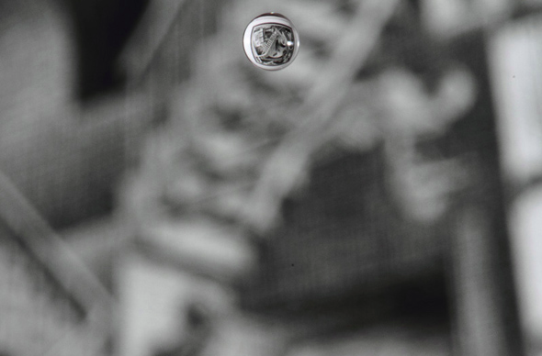
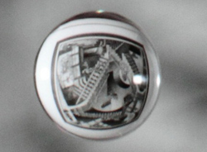
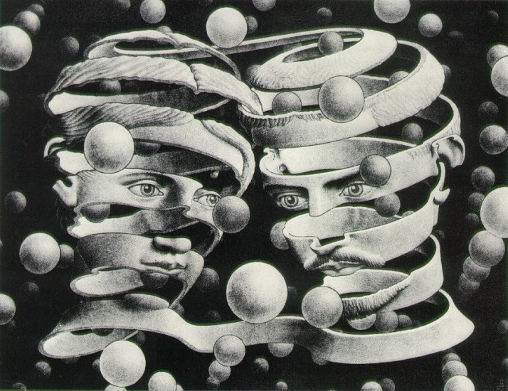
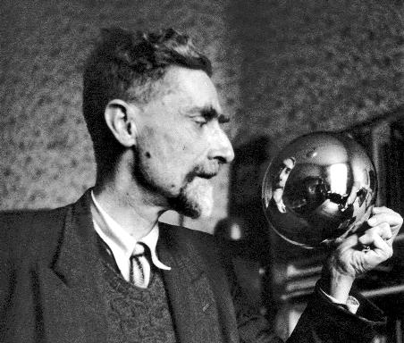
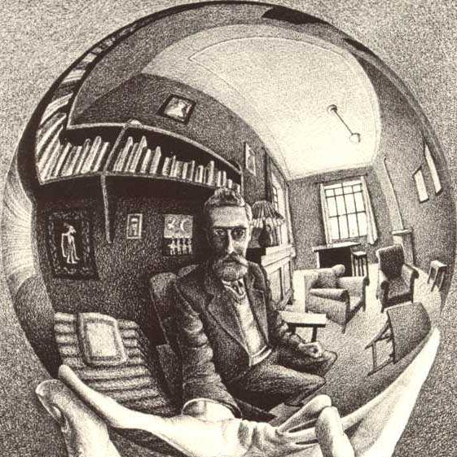
How is Escher Art made?
By: Alanna Aboulafia, Deniera Carter, and Brittany Jones.

Slide 2
Background Info
Maurits Cornelis Escher was born in Leeuwarden, Holland in 1898. Once he grew older, Escher began to explore his talents with art.
- Illustrated books, design postage stamps, murals and tapestries.
This was just the beginning of his success in the arts. Because of repeated failures on several high school exams, he signed up to join the School for Architecture and Decorative Arts in Haarlem.
In 1924, Escher traveled to Italy and met his wife Jetta Umiker. They then settled in Rome.

Slide 3
Art Background info.
Parents wanted him to become an architect like father.
Bad grades led to no solid career.
He began to specialize in woodcarving and lithographics.
**Lithography: The process of printing from a flat surface treated so as to repel the ink except where it is required for printing.

Slide 4
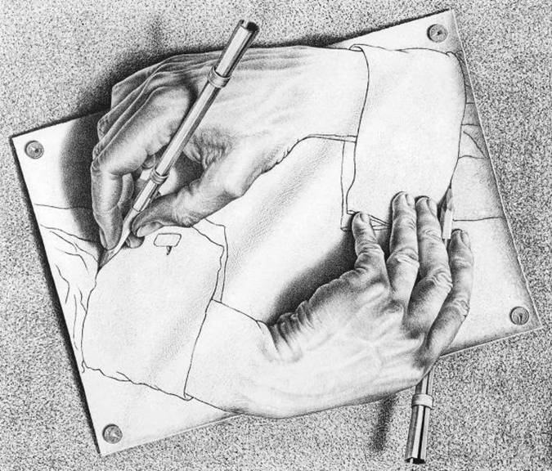
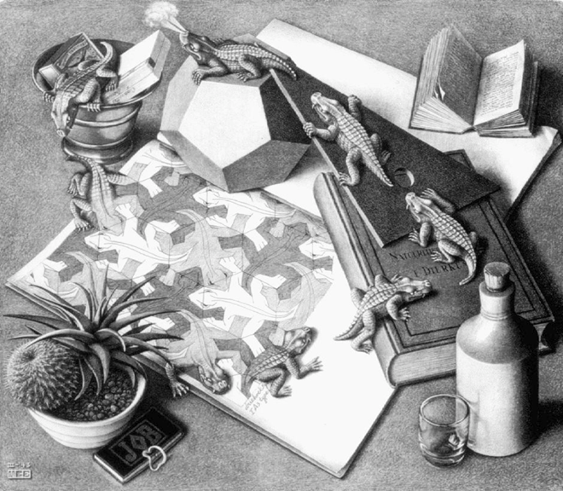
Works of art
He is most famous for his impossible structures. Some examples of these impossible structures are: “Drawing Hands” and “Reptiles.”

Slide 5
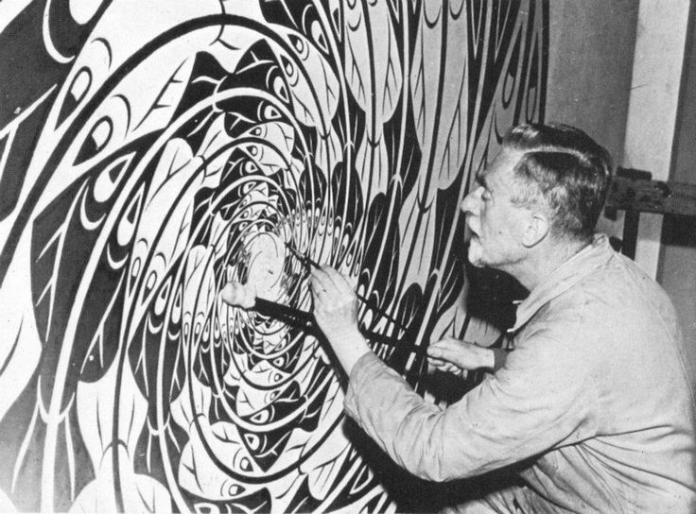
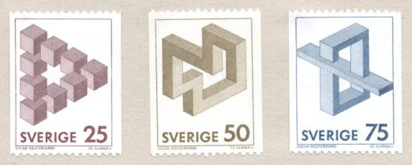
Other works of art he created
This picture shows Escher working on a mural in the third cemetery in Utrecht, Netherlands. 1958
This is a picture of the stamps Escher made.

Slide 6
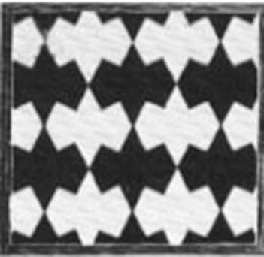
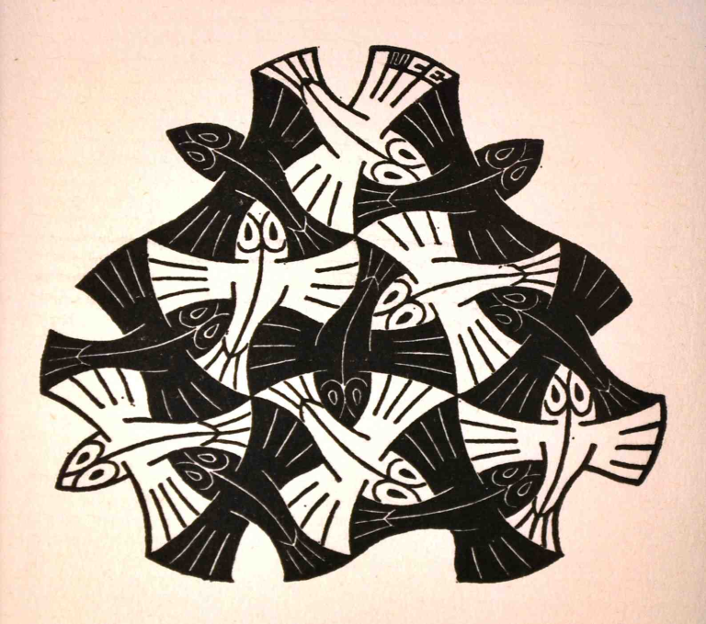
What is the math behind Escher Art?
He described that there are four types of symmetry in a plane:
*A shape that has been simply translated across a piece of paper that has been drawn again in another place.
*Shows the shape the same alignment and is not flipped, or turned.

Slide 7
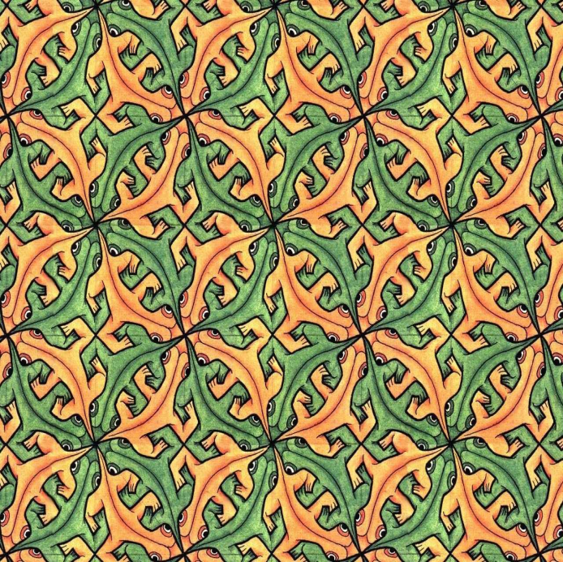
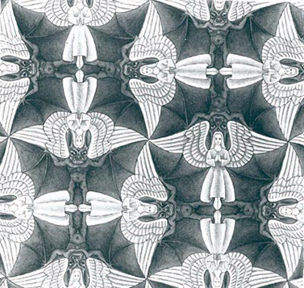
Math behind Escher Art: Cont.
Reflection:
*A shape that had been flipped.
*Usually flipped to the left or right (over the x or y-axis), but they can also be flipped or placed at an angle.
*If you draw a line through the shapes they should be symmetrical.

Slide 8
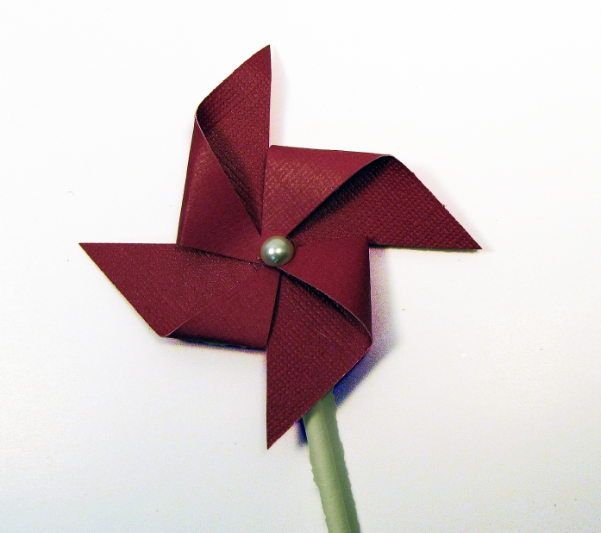
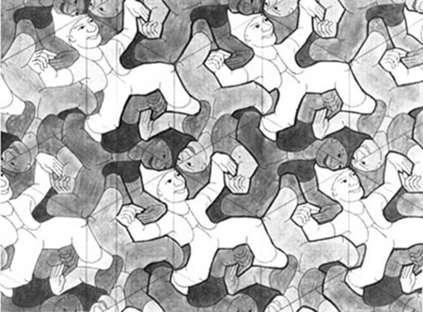
Math behind Escher Art: Cont.
Rotation:
*A shape that has been spun around in a circular fashion around a center point which doesn’t move.
EX: On a pinwheel when it spins the middle stays the same.
*Always has a center and an angle of rotation.

Slide 9
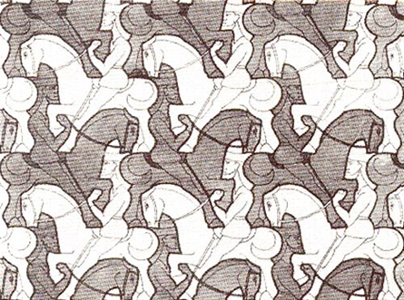
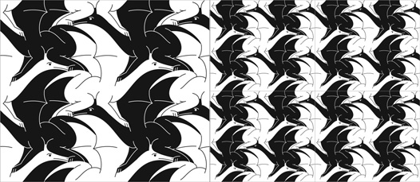
Math behind Escher Art: Cont.
Glide Reflection:
*When a piece of art has a known shape but no real way they are put together.
*This is not reflection, symmetry, or rotation.

Slide 10
Mobius strips in Escher’s work
In Escher's art a lot of the time Mobius strips are re used to capture allusions in his works.
This is done through mathematical grids; created and drawn before art was made.
Escher usually plays around with the amount of loops and twist so that his allusion can become real.

Slide 11
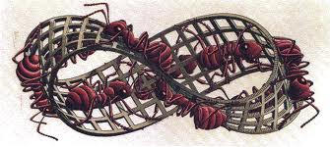
“Insects”
In his piece called insects he made a 3/2 twist in the Mobius strip instead of the generic 1/2 twist of a Mobius strip

Slide 12
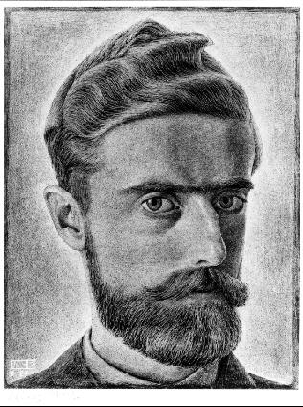
“Ribbon”
Escher made a half strip Mobius twist from a transparent strip of plastic with Mobius written on it.

Slide 13
Annotated Bibliography
M.C. Escher. Carey Eskridge Lybarger, 2000. Web. 3 Apr. 2012.http://www.math.wichita.edu/history/men/escher.html Information on Escher.
https://www.google.com/search?q=lithographic&oq=lithographic&aqs=chrome..69i57j0l5.2675j0j1&sourceid=chrome&espv=210&es_sm=122&ie=UTF-8#q=define+lithography Definition of “lithography”
Ernst, Bruno. Impossible Worlds. N.p.: Taschen GmbH, 2002. Print. Information on the kind of work he did.
Moebius (Möbius) strip in art and culture. N.p., 3 Feb. 2009. Web. 13 Jan. 2014. http://nuclear-imaging.info/site_content/2009/02/03/ moebius-mobius-strip-in-art-and-culture/ Information on the mobius strip.
Tessellations. Linda Pearce, n.d. Web. 13 Jan. 2014. http://www.csun.edu/ ~lmp99402/Math_Art/Tesselations/tesselations.html Information on tessellations and math behind Escher Art.

