Slide 1
Recycling Aluminum in Yogurt Lids
By Alanna Aboulafia, Molly Baker, Regan Gore, and Najah Soudan

Slide 2
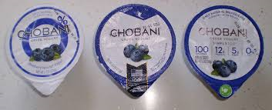
Aluminum in Yogurt Lids
GOAL: To extract aluminum from yogurt lids
PROBLEM: Yogurt containers can be recycled, but the aluminum could be reused as well if it was extracted from the lids.

Slide 3
Mechanical Removal
By Molly Baker and Regan Gore

Slide 4
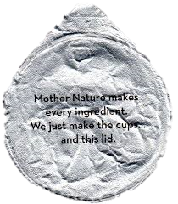
Original Plans/Thoughts
Chobani Greek Yogurt lids
Are predominately aluminum (75.13%)
Layer of heat seal over ink
Heat lacquer seal must be removed
Ink writing blocks aluminum
on both sides

Slide 5
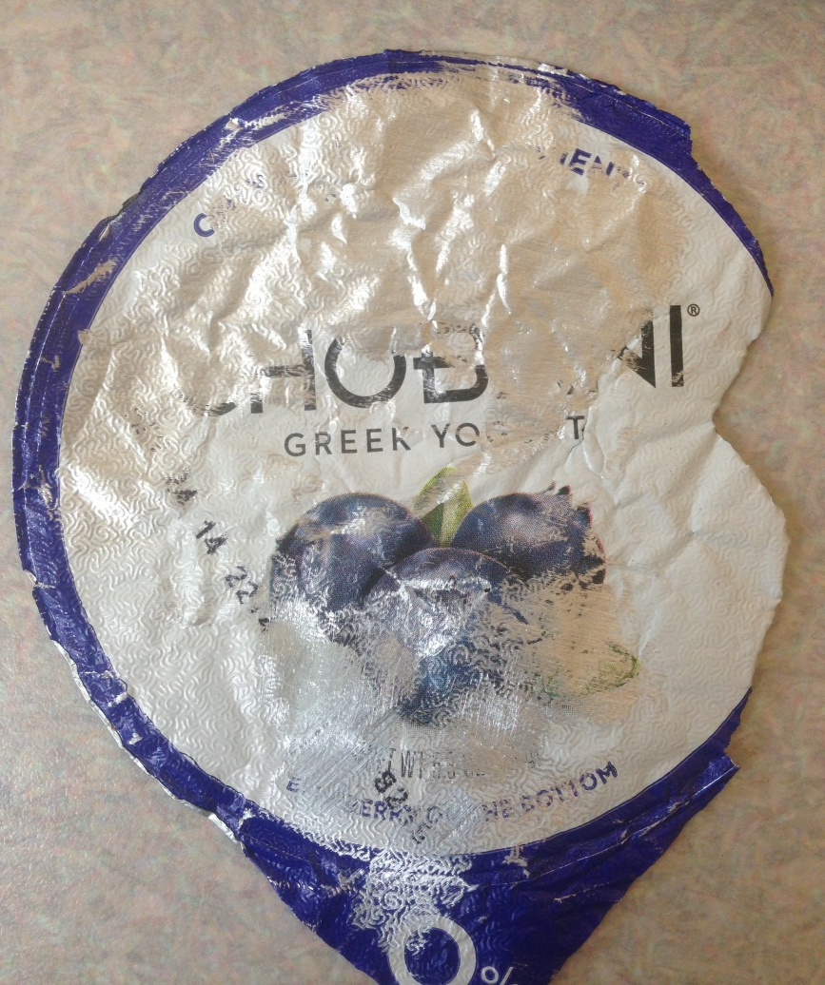
Procedure for Extraction
Sandpaper
60 grade
100 grade
220 grade
Heat Removal
Heat in the oven at 320°F to remove seal
Cold Water Removal
Soak lid in 15°C water overnight in fridge

Slide 6
Sandpaper Results
60 Grade | 100 Grade | 220 Grade
Too harsh Ripped the lid Quickly removed color | Worked very well Few tears; more as progress was made Removed color | Removed color very well Very few tears Slow process

Slide 7
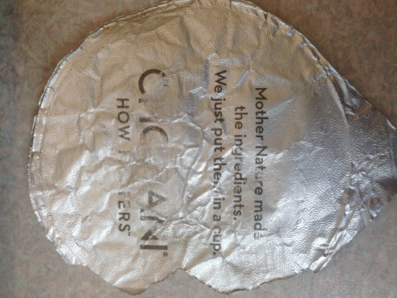
Other Test Results
Heat Removal
Water Removal
Lid placed in oven for 15 minutes at 320°F
Did not separate the aluminum
Slightly burned lid
Not useful for extraction
Lid was placed in small dish with cool water in fridge for 42 hours
No impact on lid
Water is too similar to yogurt → made to withstand liquid
Not useful for extraction
* Ink removal was from sandpaper; heat/water did not remove writing

Slide 8
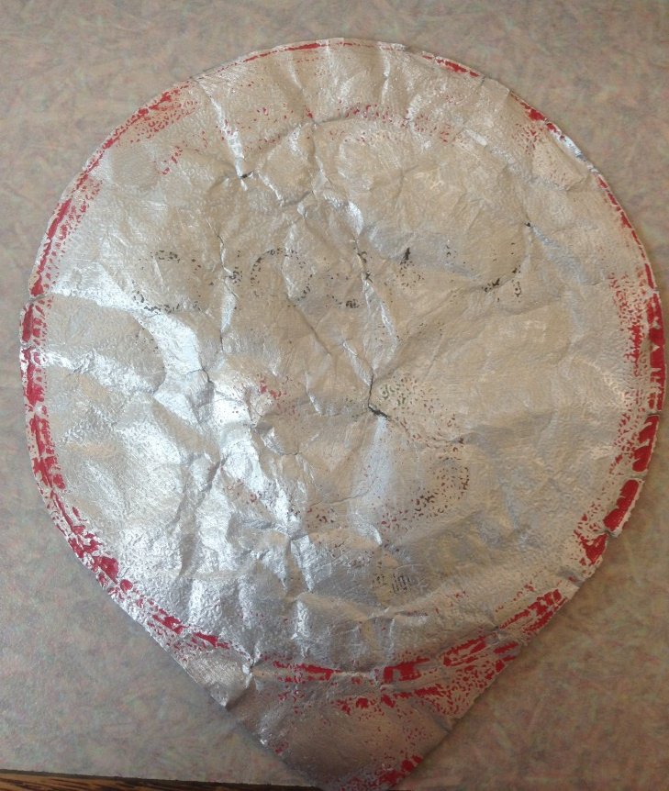
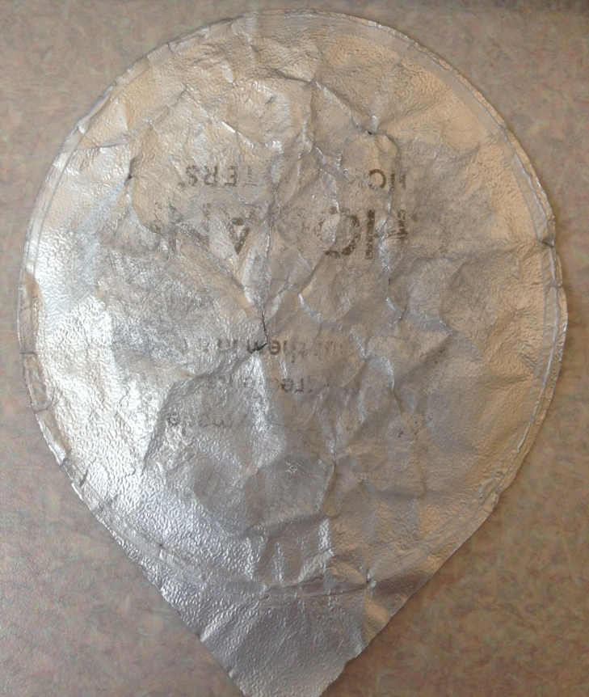
Final Aluminum Extraction
Used 100 grade sandpaper to remove most of ink
Finished removing ink with 220 grade for less tears
Notes:
The final procedure for extracting the aluminum did not have to be altered very much because the sandpaper worked very well the first time we test it and since the other two procedures did not work at all, there was no need to change anything, just to abandon those ideas.

Slide 9
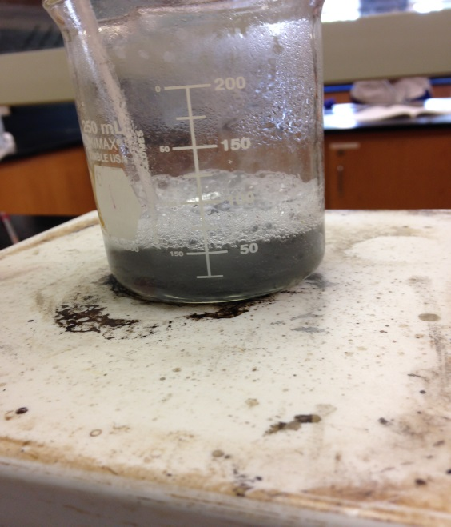
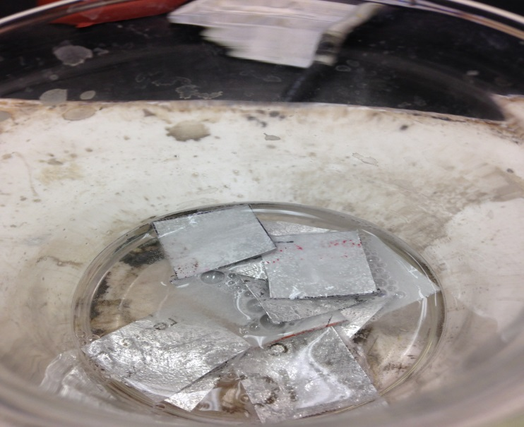
Chemical Removal
By Alanna Aboulafia and Najah Soudan

Slide 10
Original Plans/Thoughts
We planned on putting the lids into the beaker containing 1.4ml of potassium hydroxide, and just letting it sit there.
We believed that the chemicals would just separate the plastic from the aluminum. It did. Took a lot of time.
We concluded that we needed to speed up the process of separating the two materials to make it more efficient.

Slide 11
Procedure for Extraction
Step 1-The aluminum package was cut into small squares and each square had to have the same dimensions
Step 2- measure the mass of the package piece which should be between 0.9 and 1.2 grams
Step 3-Put aluminum pieces in 250 milliliter beaker
Step 4-Put 40 milliliters of 1.4M potassium hydroxide into a graduated cylinder

Slide 12
Procedure for Extraction (Continued)
Step 5-Place the beaker on a hot plate and heat it on there until the chemical reaction is complete(there a no visible piece of aluminum metal)
Step 6-put funnel with filter paper in a 250 L beaker
Step 7-Slowly pour the solution through the funnel and separate liquid from package pieces
Step 8-let package pieces dry
Step 9-use an electronic balance to measure the mass of dry pieces
Step 10-Observe the to see if there is any leftover aluminum on the funnel paper

Slide 13
Sandpaper Results
The mechanical group first used 100 grit sandpaper on the aluminum lids. Their reasoning for this was to extract the ink and the extrinsic materials.
Hopefully, this would speed up the process of separating the plastic from the aluminum.
It did. Initially (without using sand paper), it took 17 minutes to extract the aluminum. Using sand paper, almost all of the aluminum was removed after 9 minutes. After 14 minutes, all of it was separated. The use of sandpaper shaved off 3 minutes from the original time.

Slide 14
Day 1
Data Table:
Date | Dimensions of package Piece (cm x cm) | Mass of package pieces (g) | Setting on hot plate | Temperature obtained (Celsius) | Total time solution heated (min) | Mass of filter paper (g) | Mass of package pieces (g) after procedure
5/7 | 4 x 3 (4 pieces) | 0.6194g | 6 | 45 degrees | 7 min | 0.75g | 0.1645g

Slide 15
Day 2
Data Table
**It was during our second trial that was realized that the more submerged into
the liquid the pieces are, the faster the aluminum separates.
Date | Dimensions of package Piece (cm x cm) | Mass of package pieces (g) | Setting on hot plate | Temperature obtained (Celsius) | Total time solution heated (min) | Mass of filter paper (g) | Mass of package pieces (g) after procedure
5/9 | 2 x 2 (11 pieces) | 0.6072g | 6 | 57 degrees | 17 min | .75g | 0.1476g

Slide 16
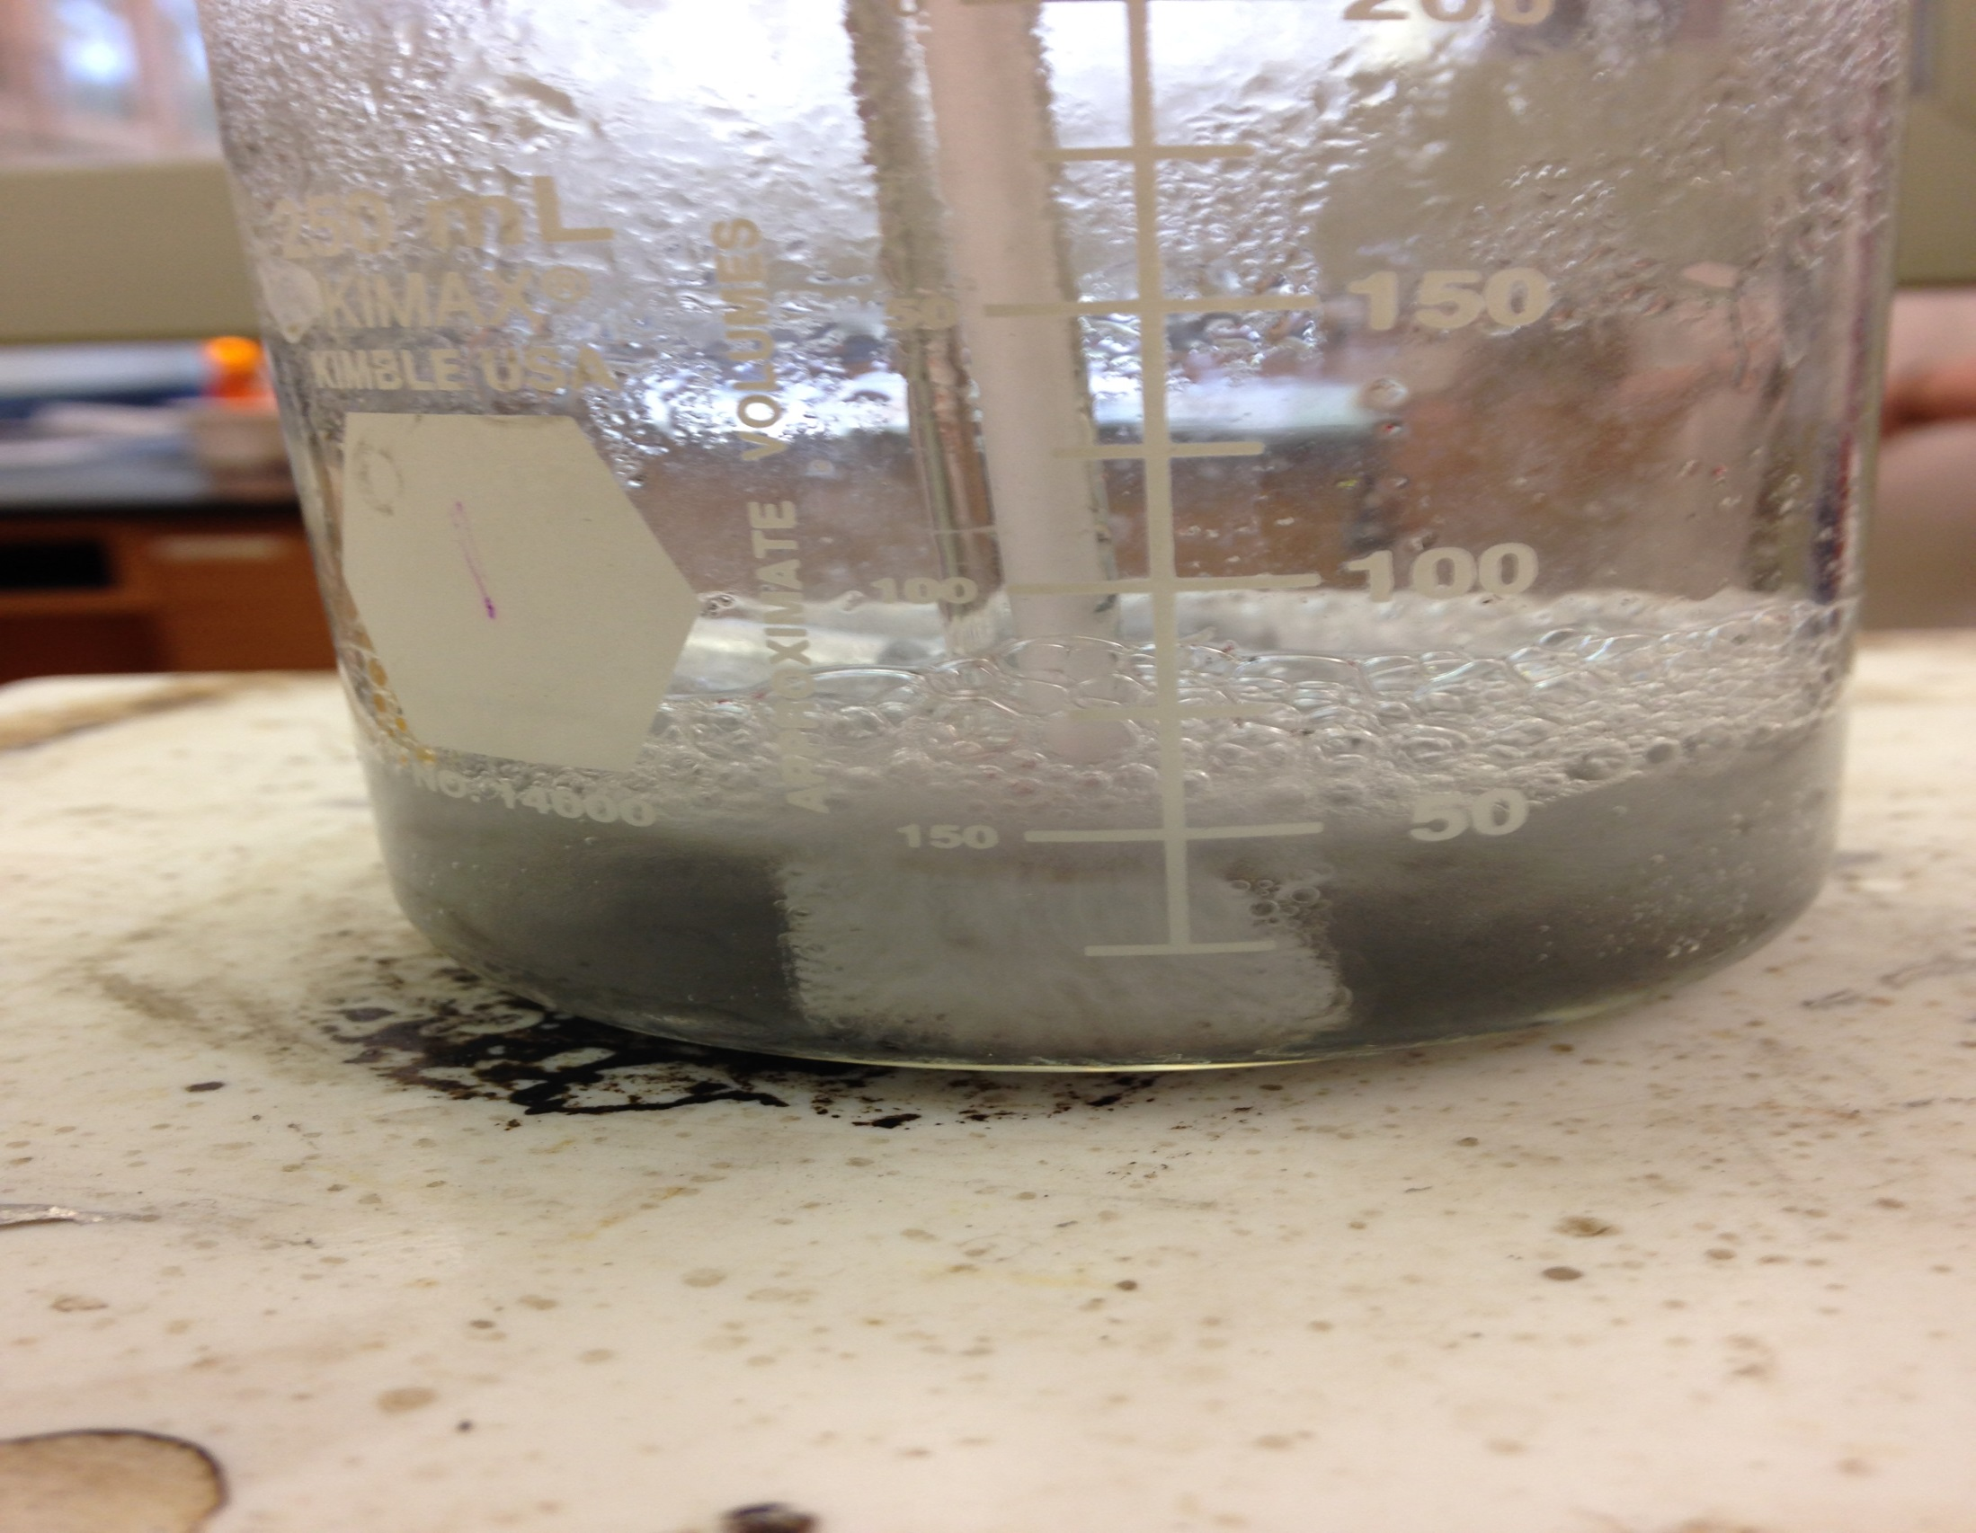

Slide 17
Day 3
Data Table
**It was during our third trial that we collaborated with the mechanical group and used sand paper on our 11 2 x 2 cm pieces of aluminum.
Date | Dimensions of package Piece (cm x cm) | Mass of package pieces (g) | Setting on hot plate | Temperature obtained (Celsius) | Total time solution heated (min) | Mass of filter paper (g) | Mass of package pieces (g) after procedure
5/15 | 2 x 2 (11 pieces) | 0.531g | 6 | 70 degrees | 14 min | 0.75g | 0.168g

Slide 18
Day 4
Data Table
Date | Dimensions of package Piece (cm x cm) | Mass of package pieces (g) | Setting on hot plate | Temperature obtained (Celsius) | Total time solution heated (min) | Mass of filter paper (g) | Mass of package pieces (g) after procedure
5/22 | 2 x 2 (11 pieces) | 0.696g | 6 | 95 degrees | 14 min | 0.75g | .130g

Slide 19
Final Aluminum Extraction
The final procedure for extracting the aluminum did not undergo severe alterations. Because the sandpaper worked very well the first time we tested it and since the other two procedures took more time to separate the two materials, we concluded that it would be wiser to choose the extraction that took less time to preform.

Slide 20
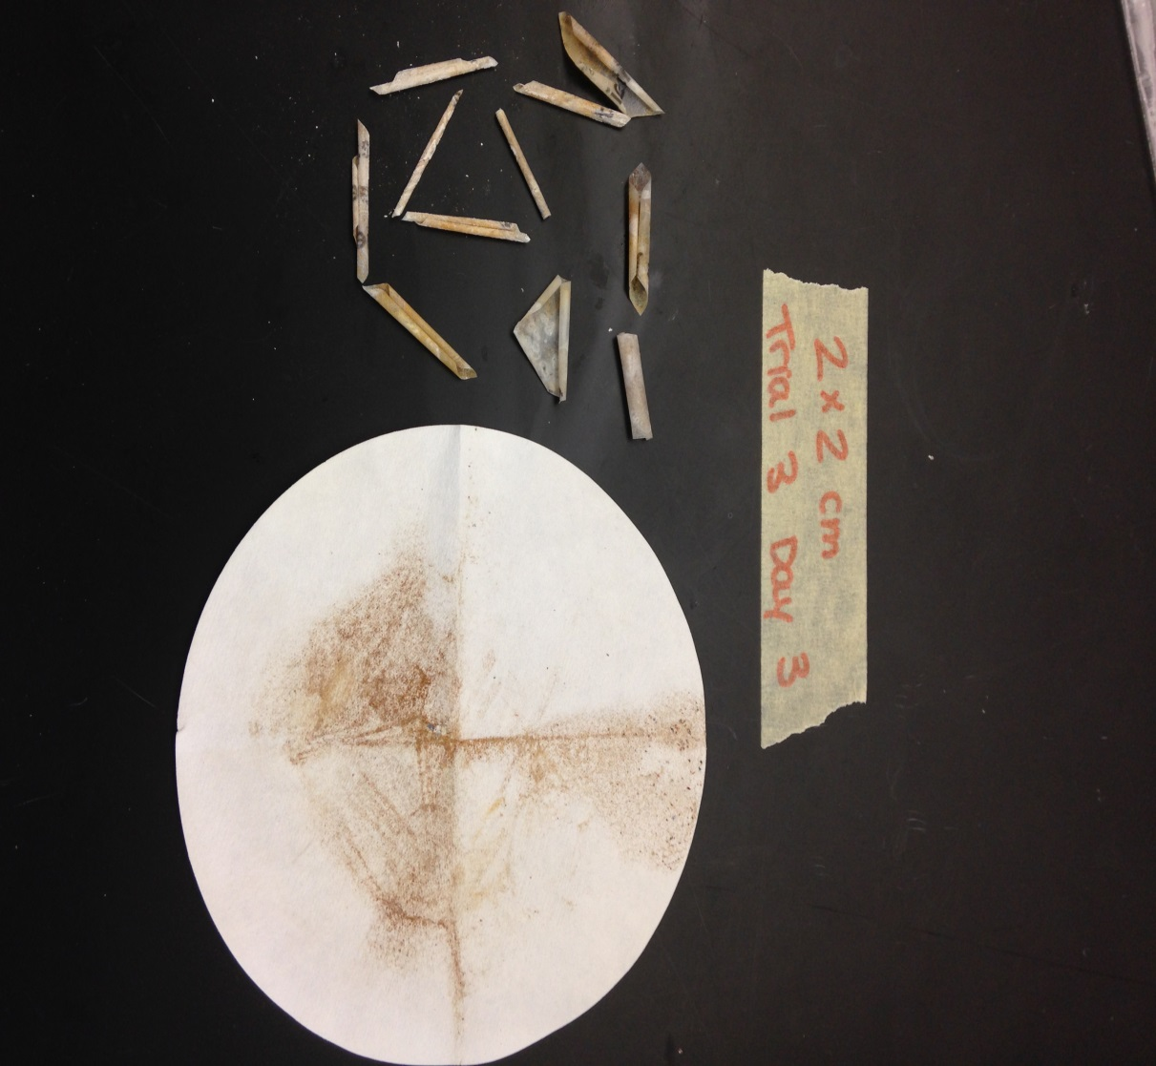
Collaboration
When we used the sandpaper on our 2 x 2 cm pieces of aluminum, the plastic and aluminum separated quicker.
Dissolved aluminum
Plastic Pieces

Slide 21
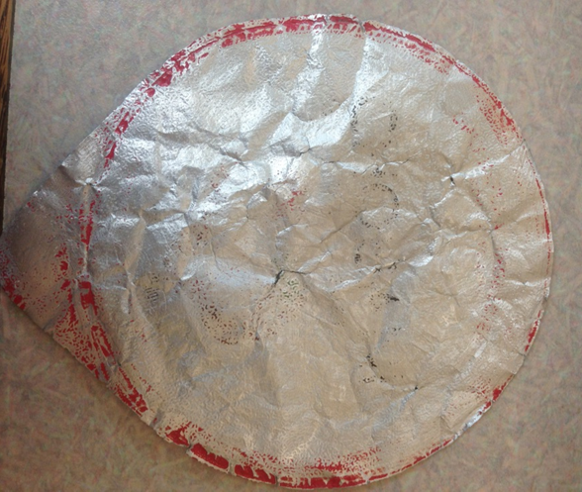
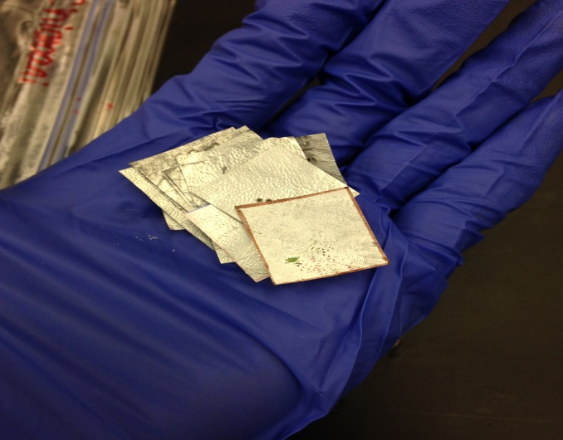
Final Procedure
Mechanical
Chemical
Used final method for removing ink/lacquer
Used the sandpaper to prepare lids for chemical testing
Used sandpapered lids for final tests
Took less time to extract aluminum with the ink already removed

Slide 22
Future Work
Figure out how to remove ink in a larger scale.
Find a faster way of using the sandpaper to remove the ink.
Create a weight that is covered in a similar material like sandpaper and allow it to move to extract the ink, while weighing the aluminum pieces down.

