Slide 1
ALUM from Waste Aluminum Packages
Briana Davis and Jordan Tapp

Slide 2
What is the Problem?
How can we recycle a Hamburger wrapper?

Slide 3
Why does this Problem Exist?
This problem exists because the hamburger wrappers are believed to be recycled. Our goal for this experiment was to discover if the aluminum on the wrapper could be recycled in a different way.

Slide 4
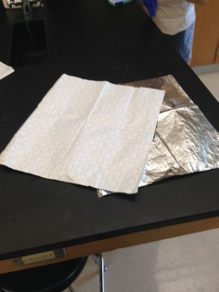
Why Did we choose Hamburger wrappers?
We chose to tra-
nsform the sandwich wrappers because they are used daily in the Roland Park community.

Slide 5
How did we go about Solving this Problem?
To solve this problem, we used a chemical procedure that transforms the scrap aluminum into a compound called ALUM.
ALUM can be used in the dyeing of fabrics, manufacture of pickles, canning certain foods, as coagulant in water purification, waste-water treatment plants and in the paper industry.

Slide 6
Materials Used In the Experiment
Potassium Hydroxide, KOH, 1.4 M solution
Distilled water
Qualitative filter paper
250 mL beaker
Graduated cylinder
Glass Funnel
Stirring Rod
Electronic Balance
Hot Plate
Thermometer
Scissors
Ruler

Slide 7
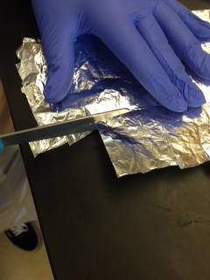
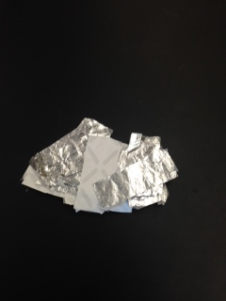
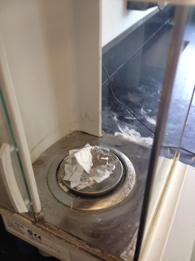
Original Procedure
Using scissor, cut the aluminum package into the same amount of small squares. Record the dimension of the square in your table.
Be sure to cut enough squares so that the mass of all the squares together weigh at least 1 gram. Record this measurement.

Slide 8
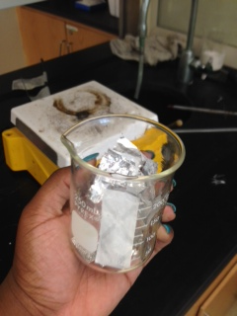
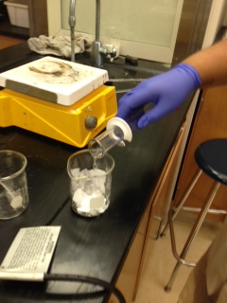
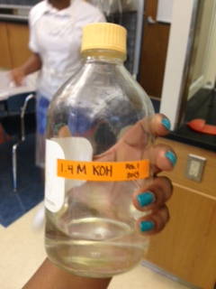
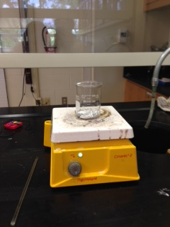
3. Place the pieces into a 250 mL beaker.
4. Using graduated cylinder, measure 50 mL of potassium hydroxide and pour this solution into the 250 mL beaker with the scraps.
5. Under a fume hood, place the beaker on a hot plate and heat it so it is hot, but not boiling. Record the setting on the hot plate.
*Bubbles of hydrogen should form*

Slide 9
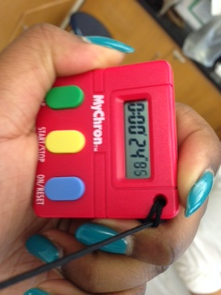
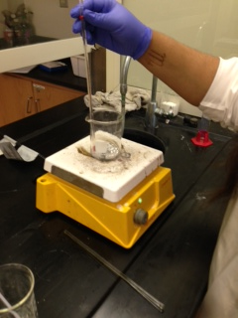
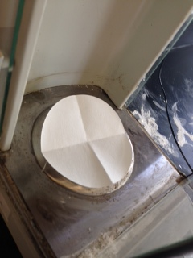
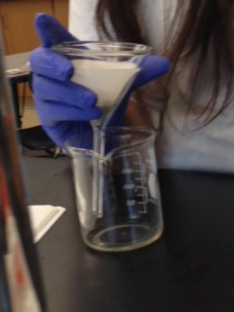
6. The reaction is complete when the hydrogen evolution stops and there are no visible pieces of aluminum metal.
7. Record the amount of time it took the reaction to complete.
8. Take a piece of filter paper and weigh it on the electronic balance
9. Place a funnel with qualitative filter paper in another 250 mL beaker

Slide 10
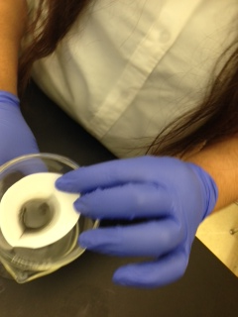
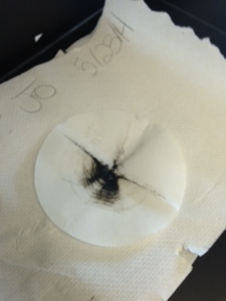
10. Slowly pour the solution through the funnel separating the liquid from your package pieces
11. Allow the filter paper an package pieces to dry
12. Once the filter paper and package are fully dry, use the electronic balance to determine its mass. Record this value.

Slide 11
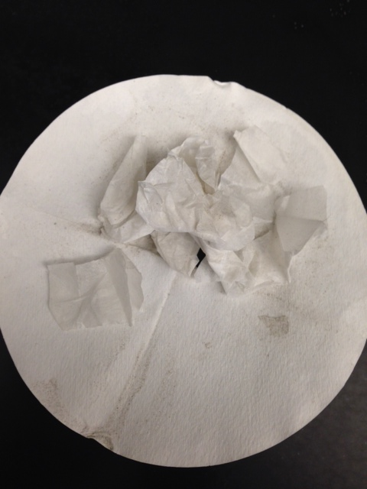
How did the Original Procedure work on the Sandwich Wrappers?
The original procedure worked exceptionally well for the sandwich wrappers.
← this image shows no aluminum scrap due to the fact all of it was transformed into ALUM

Slide 12
Where did we go from there?
Because the original procedure worked so well, we thought how we could alter the procedure so that we could fulfill the same goal, but use less solution since the first procedure was extremely successful.

Slide 13
Specific Alterations to Procedure
Trial # | Alteration
1 | Use 50 mL of solution
2 | Use 50 mL of solution
3 | Use 40 mL of solution
4 | Use 30 mL of solution
5 | Use 20 mL of Solution
Each of the following trials we performed with the above alterations had the same results that the original procedure had → no aluminum scraps were left behind due to the fact it was transformed into ALUM.

Slide 14
Data Table
Date | Dimensions of package pieces (cm x cm) | (m₁) Mass of package pieces (g) | Hot plate setting | Total time solution heated (min) | Mass of filter paper (g) | Mass of filter paper and package pieces (g) | (m₂) Mass of remaining pieces (g) | Mass of aluminum (m₁ –m₂)
5/7/14 | 5.5 * 2.3 | 0.9412 | 6 | 4 min+ | 0.73 | 1.8670 | 0.7177 | 0.2235
5/9/14 | 5.5 * 2.3 | 0.9521 | 6 | 5:47 | 0.7551 | 1.8702 | 0.7182 | 0.2339
5/13/14 | 5.5 * 2.3 | 0.9463 | 6 | 10:00 | 0.7534 | 1.9382 | 0.6852 | 0.2611
5/15/14 | 5.5 * 2.3 | 1.0105 | 6 | 11:00 | 0.7585 | 1.9007 | 0.7568 | 0.2537
5/23/14 | 5.5 * 2.3 | .9278 | 6 | 11:00 | 0.7501 | 2.0301 | 0.8054 | 0.1224

Slide 15
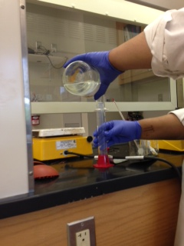
Solution
The best solution would be to follow the procedure using 50 mL of solution.

Slide 16
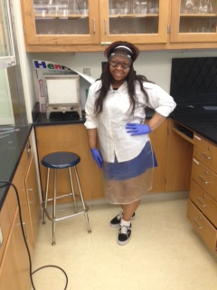
Future
For future research we would perform more procedures in order to examine if we could use:
Less solution
Less time

Slide 17
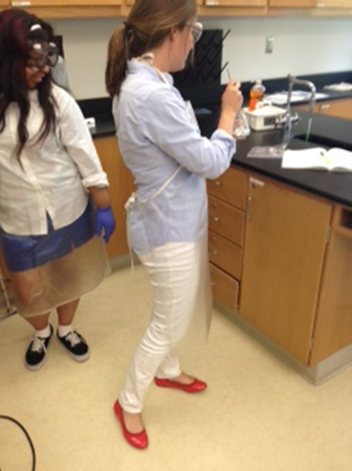
Special Thanks to …
Mrs. Popp ☺

