Slide 1
Platonic Solids Presentation
By: Blaire Miran, Najah Soudan, and Jordan Tapp

Slide 2
Investigation Question
What are the general characteristics of platonic sides and why do they work?

Slide 3
History on Platonic Solids
Discovered by the Ancient Greeks
Called the Platonic Solids after the Ancient Greek Philosopher Plato (430 B.C.)
Pythagoreans already knew about the tetrahedron, cube, and dodecahedron (by 450 B.C.)
Theaetetus added the octahedron and the icosahedron
Plato believed that the five solids were fundamental components of the physical universe

Slide 4
What are the five Platonic Solids?

Slide 5
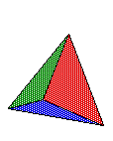
The Tetrahedron

Slide 6
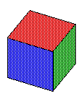
The Cube

Slide 7
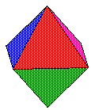
The Octahedron

Slide 8
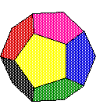
The Dodecahedron

Slide 9
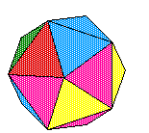
The Icosahedron

Slide 10
CHARACTERISTICS ABOUT EACH PLATONIC SOLID

Slide 11
Tetrahedron
3 triangles meet in each point
It has four faces
It has four vertices
It has 6 edges
The net has 4 faces, 9 edges, the edges that have the dotted lines are the ones that you bend
Equations:
Surface area=$√3x\left(Edge Length\right)$²
Volume= ($√2) /12 x (Edge length)$³

Slide 12
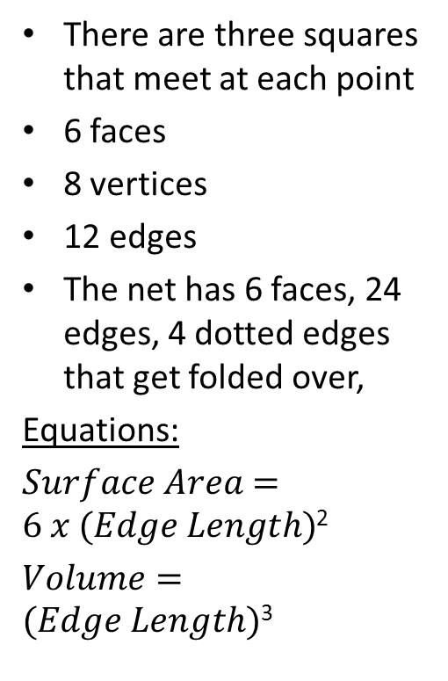
Cube
There are three squares that meet at each point
6 faces
8 vertices
12 edges
The net has 6 faces, 24 edges, 4 dotted edges that get folded over,
Equations:
$Surface Area=6 x (Edge Length)$²
$Volume=(Edge Length)$³

Slide 13
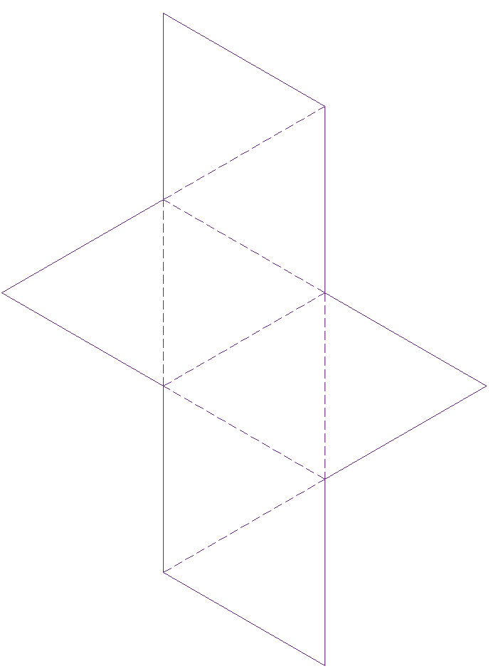
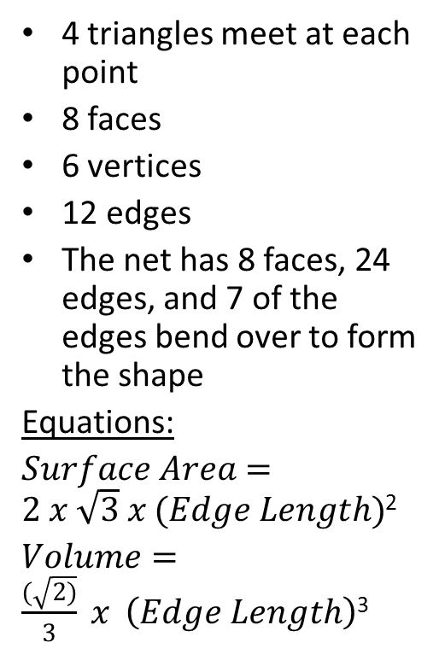
Octahedron
4 triangles meet at each point
8 faces
6 vertices
12 edges
The net has 8 faces, 24 edges, and 7 of the edges bend over to form the shape
Equations:
$Surface Area=2 x \sqrt{3} x (Edge Length)$²
$Volume=\frac{(\sqrt{2)}}{3} x \left(Edge Length\right)$³

Slide 14
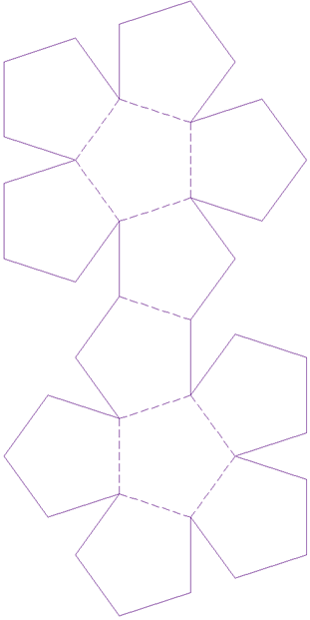
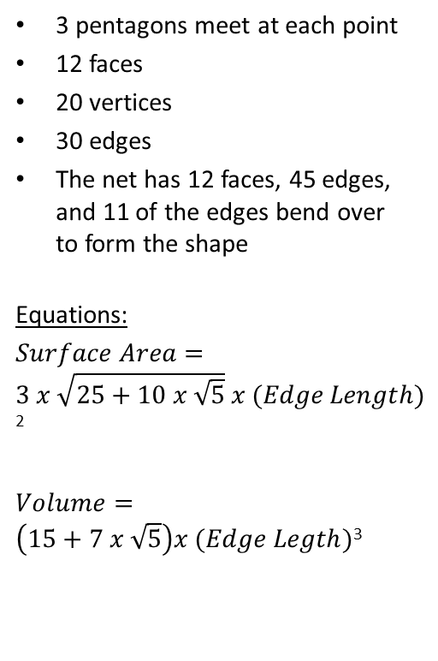
Dodecahedron
3 pentagons meet at each point
12 faces
20 vertices
30 edges
The net has 12 faces, 45 edges, and 11 of the edges bend over to form the shape
Equations:
$Surface Area=3 x \sqrt{25+10 x \sqrt{5}} x (Edge Length)$²
$Volume=\left(15+7 x \sqrt{5}\right)x (Edge Legth)$³

Slide 15
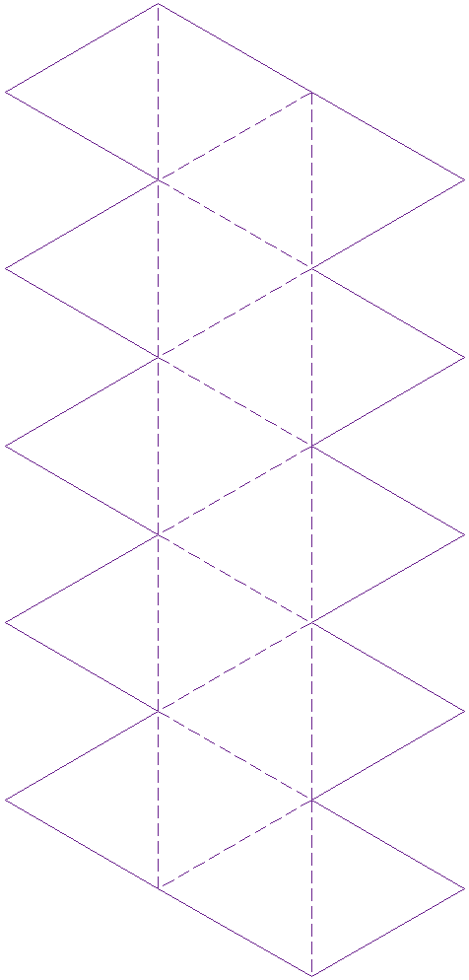
Icosahedron
5 triangles meet at each point
20 faces
12 vertices
30 edges
The net has 20 faces, 60 edges, and 19 edges bend over to from a net
Equations:
$Surface Area=5 x \sqrt{3} x \left(Edge Length\right)$²
$Volume=5 x\frac{3+ \sqrt{5}}{12}x \left(Edge length\right)$³

Slide 16
Comparison of all Platonic Solids
Platonic Solid | F=# faces | E=# edges | V=# vertices | Which polygon? | Interior angle of polygon | # Faces at vertex | How many edges meet at vertex | Sum of interior angles at vertex
Tetrahedron | 4 | 6 | 4 | Triangle | 60° | 3 | 3 | 180°
Cube | 6 | 12 | 8 | Square | 90° | 3 | 3 | 270°
Octahedron | 8 | 12 | 6 | Triangle | 60° | 4 | 4 | 240°
Dodecahedron | 12 | 30 | 20 | Pentagon | 108° | 3 | 3 | 324°
Icosahedron | 20 | 30 | 12 | Triangle | 60° | 5 | 5 | 300°

Slide 17
Constraints of Platonic Solids
1. The vertices of P all lie on a sphere.
2. All the dihedral angles are equal.
3. All the vertex figures are regular polygons.
4. All the solid angles are equivalent.
5. All the vertices are surrounded by the same number of faces.

Slide 18
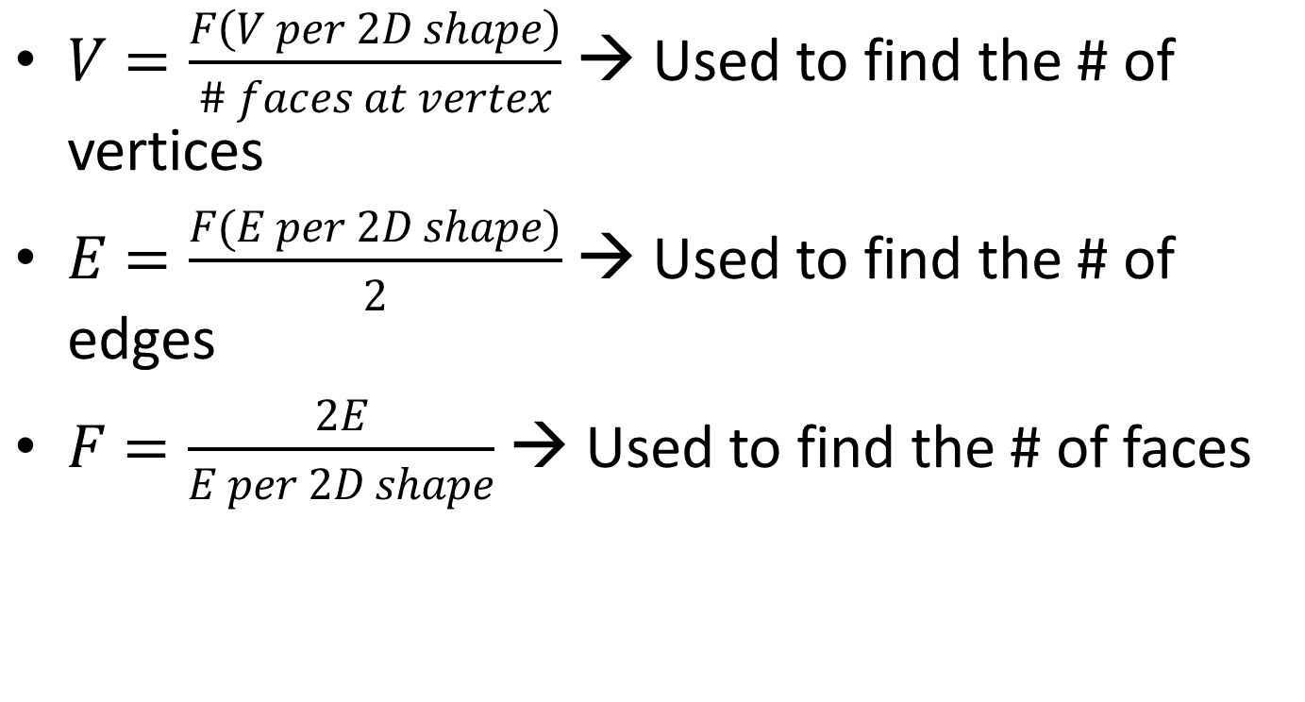
Equations Used for Platonic Solid Shapes
$V=\frac{F\left(V per 2D shape\right)}{\# faces at vertex}$ → Used to find the # of vertices
$E=\frac{F(E per 2D shape)}{2}$ → Used to find the # of edges
$F=\frac{2E}{E per 2D shape}$ → Used to find the # of faces

Slide 19
Euclid’s Proof of Platonic Solids
1. Each vertex of the solid must be formed by joining three or more faces.
2. The sum of the angles formed by the faces at a vertex must be less than 360°.
3. Since the angles at all vertices of all faces of a Platonic solid are identical, and at least three faces are joined at a vertex, the size of the angle of each face must be less than 360°/3=120°.
4. Regular polygons of six or more sides have only angles of 120° or more. This means that the shape of the face is limited to either a triangle, square, or a pentagon.

Slide 20
Duals
What is a dual?
A dual is formed from a polyhedron by creating a vertex at the center of each face, and then connecting vertices on adjacent faces. This process is hard for most people to visualize without a model, and even with a static model, it can still seem abstract.

Slide 21
Examples of duals

Slide 22
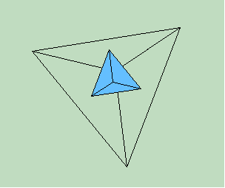
Tetrahedron in a Tetrahedron

Slide 23
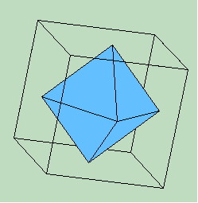
Octahedron in a Cube

Slide 24
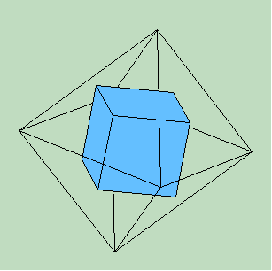
Cube in a Octahedron

Slide 25
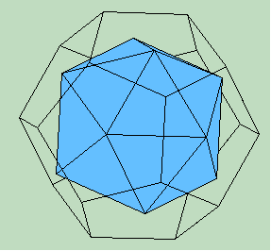
Icosahedron in a Dodecahedron

Slide 26
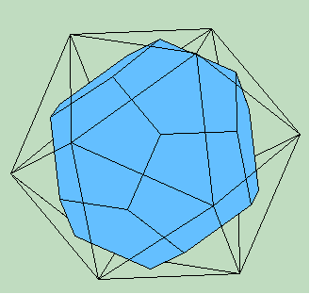
Dodecahedron in a Icosahedron

Slide 27
Bibliography
http://personal.maths.surrey.ac.uk/st/H.Bruin/image/PlatonicSolids.gif
http://www.enchantedlearning.com/math/geometry/solids/
http://www.geom.uiuc.edu/~sudzi/polyhedra/platonic.html
http://www.mathsisfun.com/geometry/platonic-solids-why-five.html
http://mathworld.wolfram.com/PlatonicSolid.html
http://home.adelphi.edu/~stemkoski/mathematrix/platonic.html
http://www.wfu.edu/~parslerj/math165/platonic-inclass.pdf
http://www.mathsisfun.com/platonic_solids.html
http://debraborkovitz.com/2013/04/duals-of-platonic-solids-videos/
http://www.santarosa.edu/~gsturr/M10/Platonic_Solids.pdf

