Slide 1
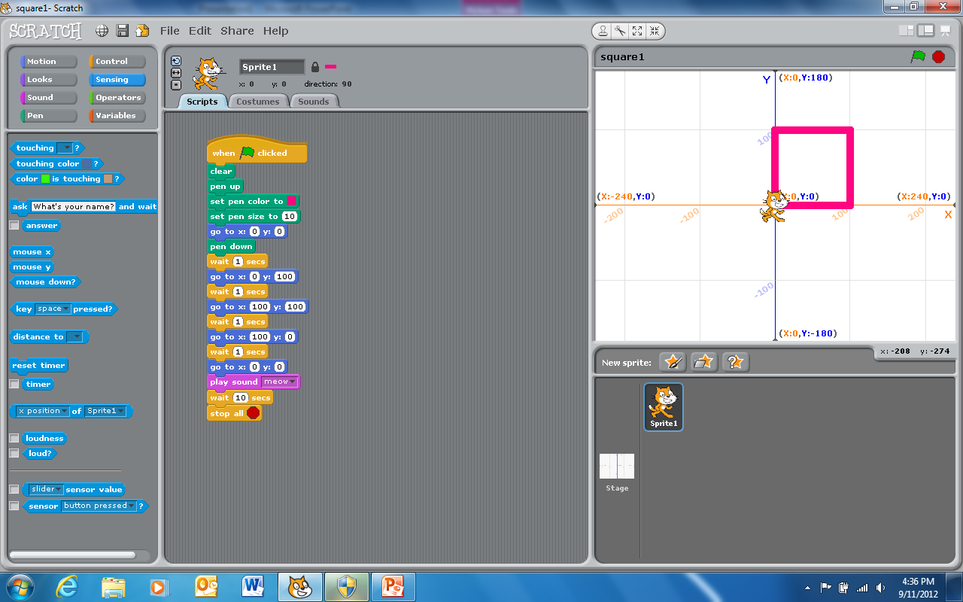
This was our first Scratch program.
We cleared the stage; raised the pen; set the pen color and pen size; and went to point (0,0) before we put the pen down.
We then drew the four sides using absolute coordinates.
We then meowed before stopping.

Slide 2
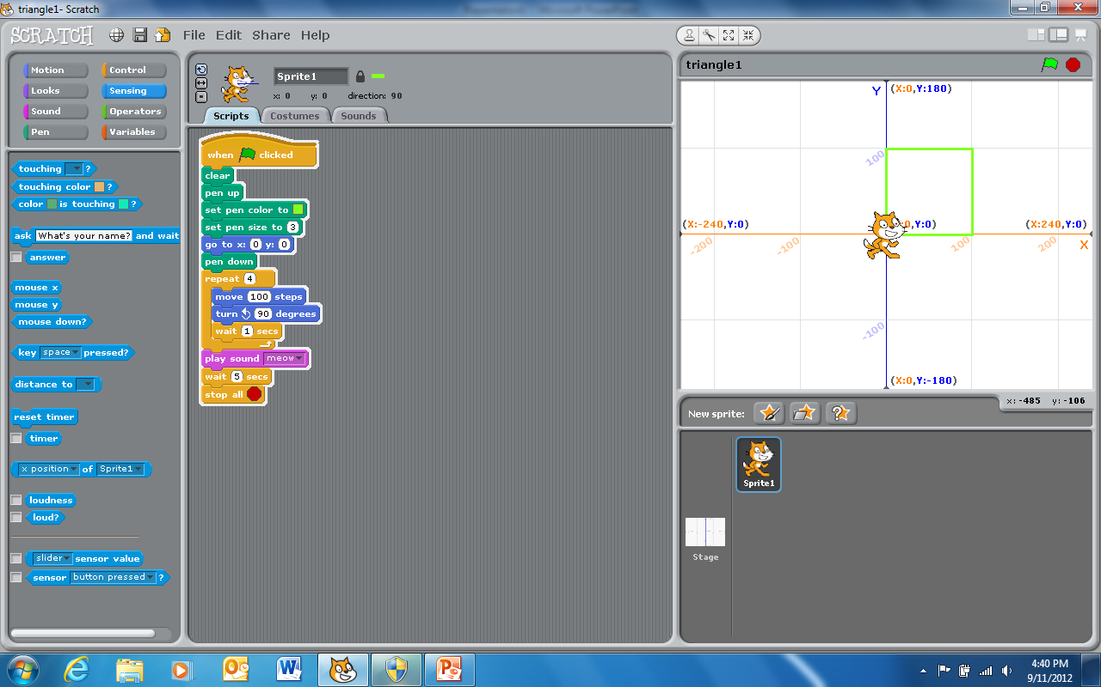
This is similar to our first Scratch program.
We cleared the stage; raised the pen; set the pen color and pen size; and went to point (0,0) before we put the pen down.
This time we used a “loop” that we repeated 4 times. We drew sides using a combination of relative moves and 90 degree turns.

Slide 3
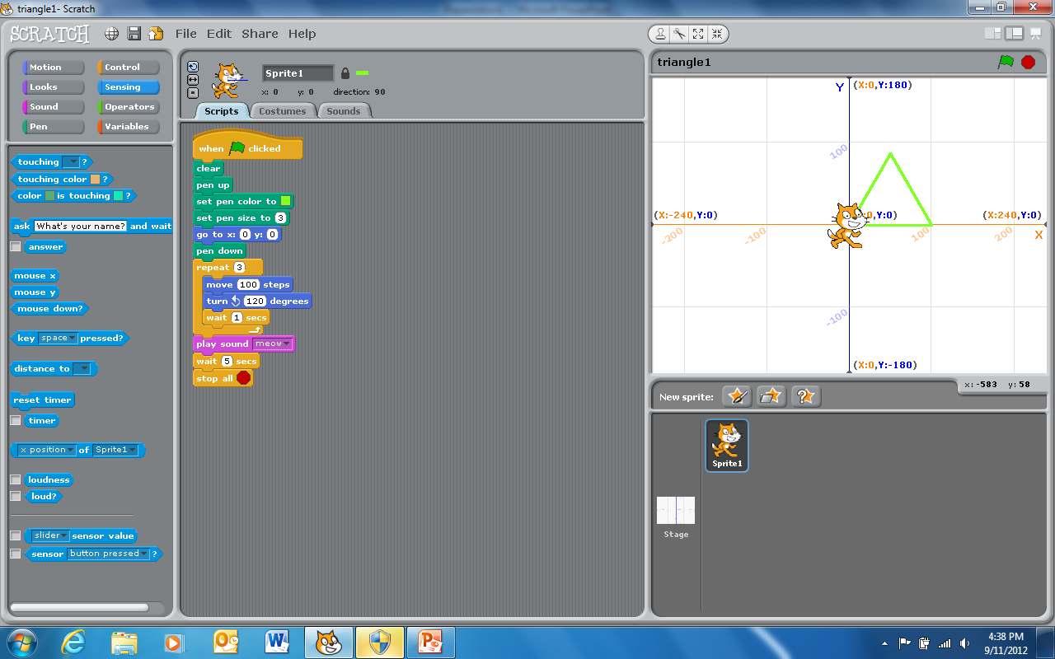
This is a modification of the second square plotting program. It draws an equilateral triangle
We cleared the stage; raised the pen; set the pen color and pen size; and went to point (0,0) before we put the pen down.
Our “loop” is repeated 3 times. We drew the three sides using a combination of relative moves and 120 degree turns.

Slide 4
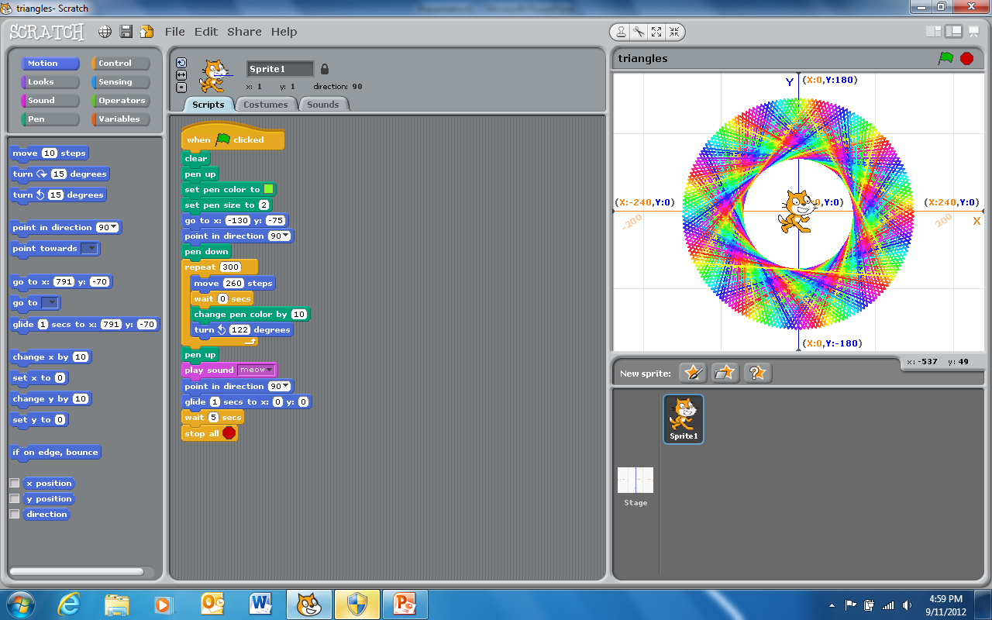
This is a modification of the triangle program.
Instead of drawing three sides and turning 120 degrees each time we drew 300 sides and turned a little more (or less) than 120 degrees. We also added color changes inside the loop.
This results in an spiral pattern that would be hard to do by hand. The cat also “glides” back to the center at the end.

Slide 5
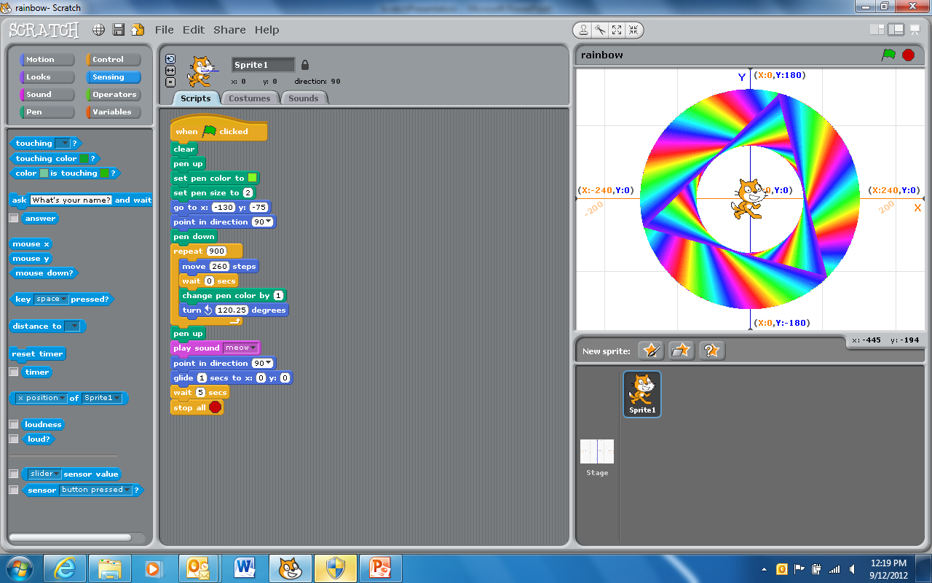
This is the same as the previous program except that I played with: (1) the number of times through the loop; (2) the amount of pen color change; and (3) the number of degrees turned.
The result is a more continuous rainbow effect in the drawing.

Slide 6
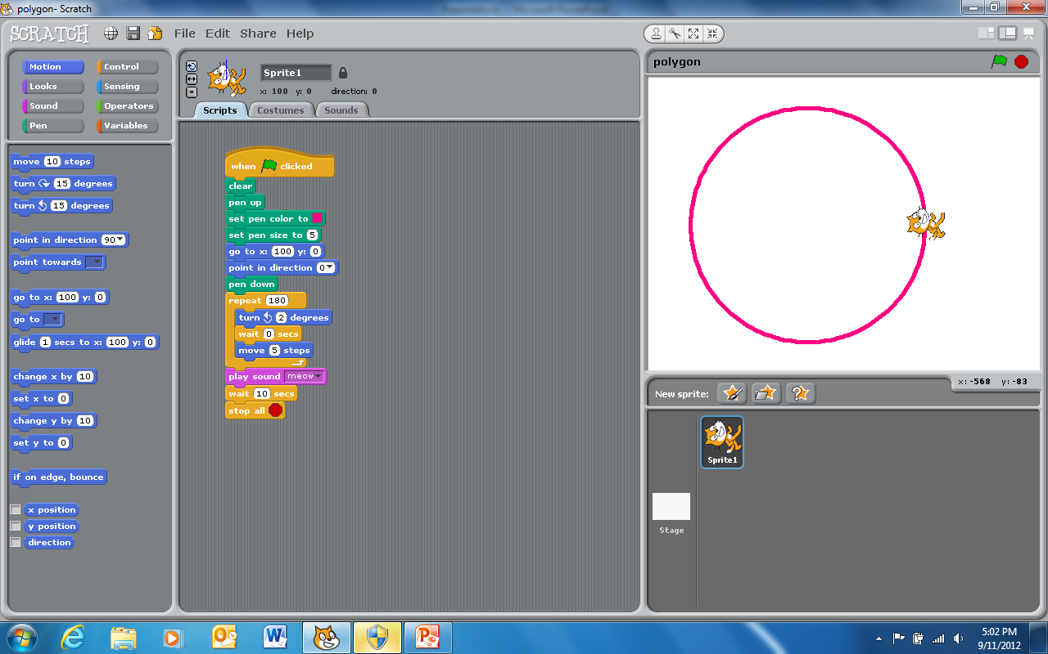
This is one way to draw a circle (actually it is a polygon with 180 sides).
We cleared the stage; raised the pen; set the pen color and pen size; and went to point (100,0) before we put the pen down.
In a loop we turned 2 degrees and walked 5 steps. We did this 180 times to complete the circle (polygon).

Slide 7
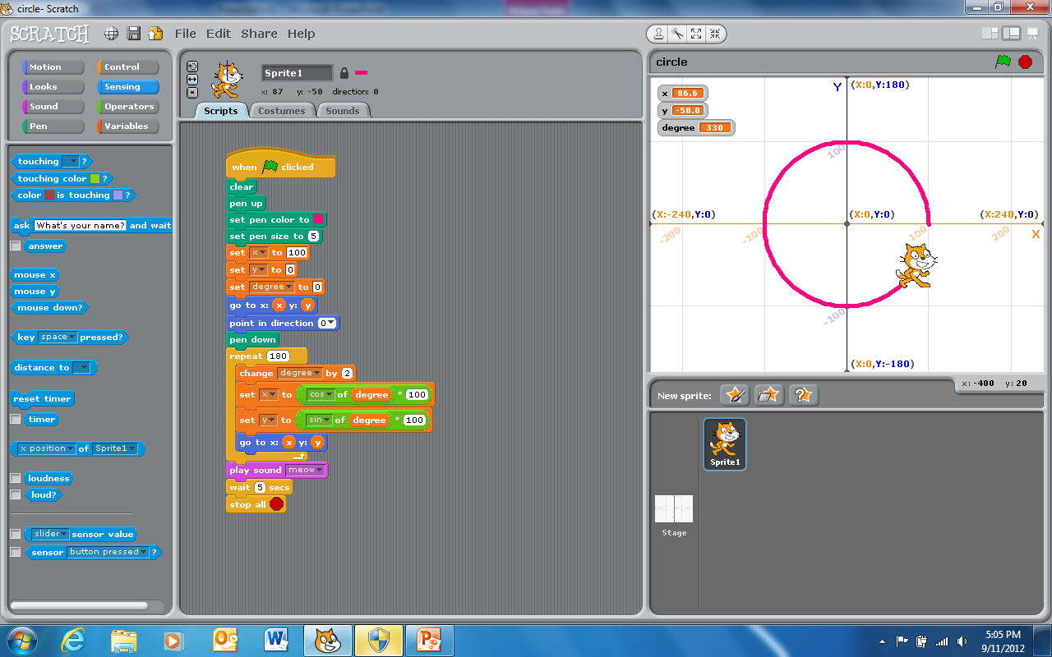
This is an alternative program for a circle.
We cleared the stage; raised the pen; set the pen color and pen size; and then set variable “x” to 100 and both variables ”y” and “degree” to 0 and then we went to point (x,y) before we put the pen down.
In a loop we used the sin() and cos() built-in functions to find the x and y for every second degree from 0 to 360.

Slide 8
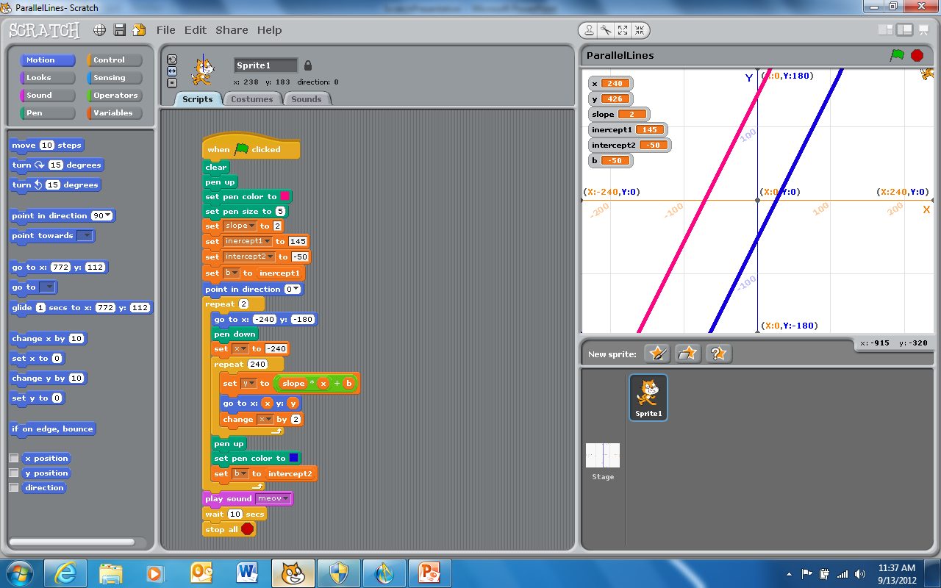
This is a program to draw two parallel lines.
We cleared the stage; raised the pen; set the pen color and pen size; and then set variable “slope” for both lines and the variables “intercept1” and “intercept2” for the y intercept of the lines.
In two nested loops we draw the two lines. We changed the intercept used and the drawing color between drawing each line.

