Slide 1
Materials Presentation
By: Blaire Miran, Molly Baker, and Lexi Cohen

Slide 2
Materials Preliminary Testing:
Material | Drop Test Score | Water Test Score | Shake Test | Marketing Test | Weight Test | Heat Test | Throw Test
Newspaper | 3 | 2 | 3 | NA | 3 | 3 | 3
Cardboard | 3 | 2 | 3 | NA | 3 | 3 | 3
Plastic baggies | 3 | 3 | 3 | NA | 3 | 3 | 3
Plastic wrap | 3 | 3 | 3 | NA | 2 | 3 | 3
Foil | 3 | 3 | 3 | NA | 2 | 2 | 3
Wax paper | 3 | 2 | 3 | NA | 3 | 3 | 3
Important Notes:
Score (3 = no damage, 2=little damage, 1=damaged)
Scores are an average of 3 trials

Slide 3
Results from the Table
Newspaper, wax paper and cardboard do not do well in water
Plastic baggies got a 3 in all categories – not easily damaged
Both plastic wrap and foil are not very weight bearing
The foil was slightly damaged from the heat

Slide 4
Materials We are Using:
Plastic Baggie
Cardboard
Duct Tape

Slide 5
Why These Materials?
Plastic baggie: waterproof and more sturdy than plastic wrap so it can hold the suntan lotion better
Also using plastic baggie on outside of package to make it waterproof
Plastic baggies have good seals
Cardboard: sturdy and when peeled, easy to bend and shape accordingly to suntan lotion
Duct tape: less expensive than glue, sturdy, and easy to bend and maneuver according to shape of package

Slide 6
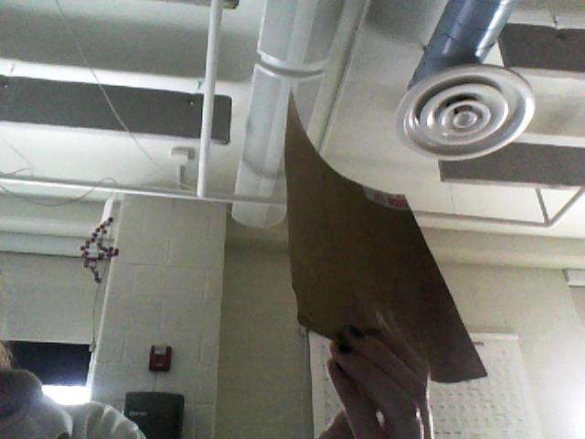
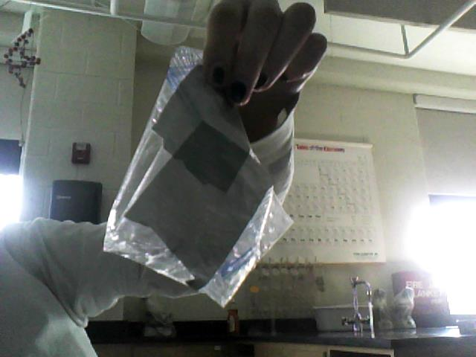
Our Package
Take the two sides off of the cardboard
Why? To make it more bendable and thin
2. Cut two of the same size triangles out of the cardboard paper
- size: 15 cm by 15 cm by 15 cm
3. Create plastic bag that will hold sunscreen by taping it in a rectangular shape and place inside of two cardboard triangles
4. Secure the two long sides of each triangle together with duct tape
5. At the bottom point of the triangle, we left a small opening in order to release the sunscreen

Slide 7
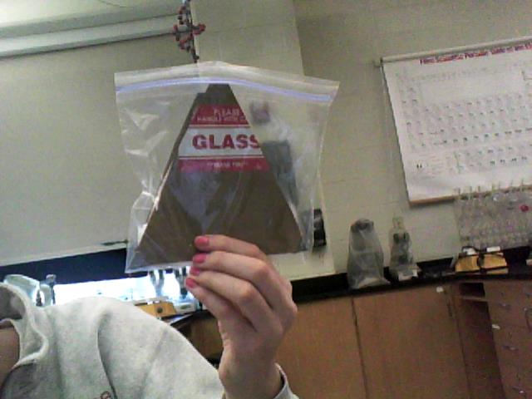
Our Package Continued:
7. The opening of the baggie should match the opening of the cardboard container (one vortex)
8. Surround the whole package with a plastic bag
9. Create a slip in order to secure the package using duct tape (show)
9. Sunscreen can be put in the container through the small opening at the bottom and it can be released from there too

Slide 8
The Package

Slide 9
Testing Our package
Test | Score (3 = no damage, 2=little damage, 1=damaged)
Drop Test | 3
Throw Test | 3
Shake Test | 3
Water Test | 1.5
Weight Test | 2 (there was a whole in the bag or too much air)
Important Notes:
The numbers in the table are an average of 3 trials for each test

Slide 10
Cost Analysis
1 square of cardboard – $1.00
2 Plastic baggie - $0.50
Duct tape – (2 inches)- $1.00
$1 + $0.50 + $1 = $2.50
Cost of our package: $2.50
Budget: $4.00

Slide 11
Plans For the Future:
The water test damaged the package
Need to find a way to keep the water out (possibly 2 plastic bags)
Weight test damage:
Need to ensure there is no air in plastic bag (holding sunscreen) and no wholes

