Slide 1
Optical Illusions: Seeing is Not Believing!
By Regan Gore, Lexi Cohen, and Julia Potter

Slide 2
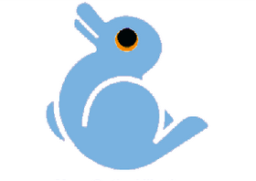
Definition
Illusion:
Latin root of illusion: illudere
Illudere: “to mock” in Greek
Definition
Something with deceptive appearance: deceives the senses or mind
A perception as of visual stimuli (optical illusion) that represents what is perceived in a way different from the way it is in reality
Seeing is Not Believing!
16
Notes:
The definition. The Latin root of illusions is illudere and illudure means to mock in Greek. This is funny b/c it relates exactly to what an optical illusion is and does. Also, a more direct definition is something with deceptive appearance and deceives the senses or mind. This topic I will go into more detail later in the following slide. Also, illusion can be defined as a perception as of visual stimuli which is the optical illusion that represents what is perceived in a way different from what it is in reality….. Seeing is Not Believing!

Slide 3
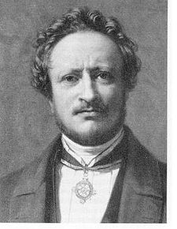
History
450 B.C.E.
Epicharmus: blamed the senses
Protagoras: blamed the environment
350 B.C.E.
Aristotle: E.+ P. are both right and wrong
300 B.C.E
Plato: 5 senses + mind are a team
1826
Johannes Mueller: psychologist + 2 books
Created + explained illusions
Johannes Mueller (17)
Notes:
In 450 B.C.E Epicharmus and Protagorus were the first scientists to start talking about optical illusions and what was the source that caused this. Epicharmus believed that the 5 senses were failing us. He believed that they are not paying attention and messing up. A direct quote of his that explained his believe for the cause of optical illusions is, “the mind sees and the mind hears. The rest is blind and deaf.” On the other hand, Protagorus thought that our senses and body were working perfectly fine and rather the enviroment was messing up. To directly quote him he said, “Man is nothing but a bundle of sensations. In 350 B..C.E Aristole said that both of the men above are right and wrong. He also said that we can trust our senses but they are can be easily fooled. Then in 300 B.C.E. Plato stated that the senses and the mind work together to help us interpret what we see. This statement is what we believe about optical illusions today. Many years later in 1826 a phsychologist named Johannes Mueller started discussing oi again however this topic was not widely known about.

Slide 4
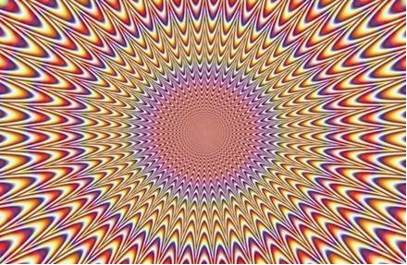
Creating Optical Illusions
15

Slide 5
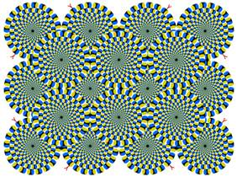
How to Create Optical Illusions
Use color, light, patterns to make images that deceive the brain
Trick our brains into seeing things which might not be real
13

Slide 6
How Optical Illusions Work
The brain processes the image and creates a perception that does not match the picture
The brain is responsible for illusions more than the optic eye
Brain makes sense of what we see
It receives stimuli from the eye (SIGHT) and adds MEMORY AND INTERPRETATION
Differences between perception and the image seen by eye = visual illusion

Slide 7
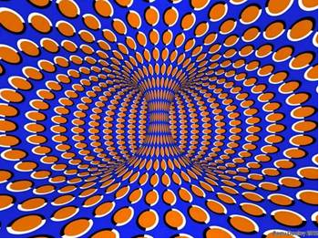
Important Question Being Studied Today
Is the illusion of movement in a stationary picture caused by the eye or the brain, or both?
14

Slide 8
Research
Relationship/direct correlation between illusory motion and microsaccades
This means people’s eyes involuntarily move several times per second while looking at a visual, causing someone to see movement.
Tests:
Used video – based eye movement monitor to track subject’s eyes
Subjects release button when they see movement and press button when they see no movement (no illusion)
Results:
Microsaccade rates increased before subjects saw fast movement
Microsaccades are related to the perception of illusory motion – may cause optical illusions

Slide 9
Different Types of Optical Illusions
Physiological Illusions and Cognitive Illusions

Slide 10
Physiological Illusions
Caused by excessive stimulation
Hermann grid
Mach bands
2
1
Notes:
Physiological illusions are optical illusions that are created by excessive stimulation on the eyes and brain. This could include color, brightness, and movement. In the picture on the right, the Hermann grid, the black boxes with the white lines between them cause the eyes to see gray dots on each corner that are not really there. In the Mach band illusion on the left, the excessive color stimulation causes the brain to believe the rectangle in the middle is a mix of colors like the background, but it is really the same shade of gray throughout.

Slide 11
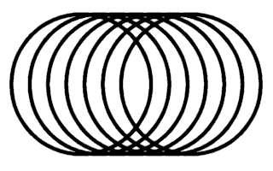
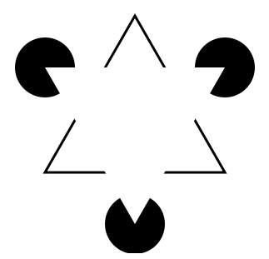
Cognitive Illusions
Ambiguous illusions
Distorting/geometrical illusions
Paradox illusions
4
5
3
Notes:
There are three types of cognitive illusions – ambiguous illusions, distorting or geometrical illusions, and paradox illusions.

Slide 12
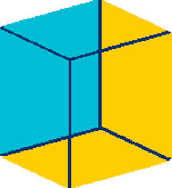
Ambiguous illusions
The brain switches between images
Necker Cube
Rubin Vase
6
7
Notes:
Ambiguous illusions are formed by two images that the brain switches between. In the example on the right, which is very well-known, the two images are a vase in the middle and the two profile faces on the sides. On the left, the brain is switching between seeing the blue square as one of the front faces of the square and seeing it as one of the back faces of the square.

Slide 13
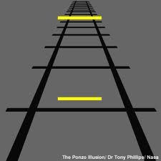
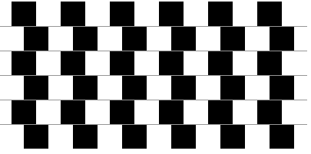
Distorting/geometrical Illusions
Size, length, position, curvature, etc. is distorted
Muller-Lyer
Café Wall
Ponzo
8
9
Notes:
Distorting illusions use different shapes and distances to make the size, length, or position appear distorted. In the picture on the right, the yellow line at the top of the picture seems longer than the one on the bottom, but they are actually the same length. In the picture on the left, the gray lines in between the rows of boxes are actually parallel, but the seem to be angled.

Slide 14
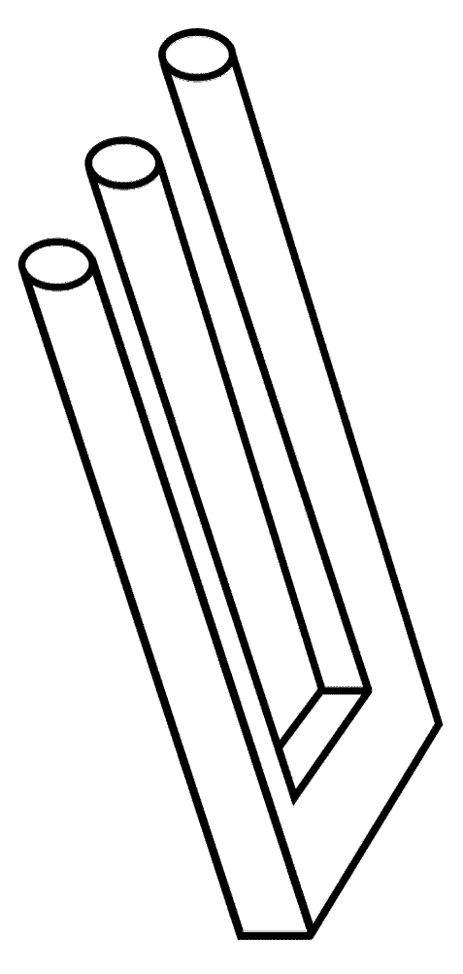
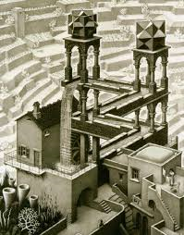
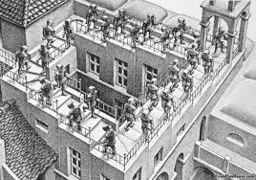
Paradox Illusions
Impossible to create in reality
Escher’s work
Blivet
11
12
10
Notes:
Finally, paradox illusions are pictures that are impossible to create in reality. Escher’s work is a well-known example of this, since his artwork appears to be logical but does not actually work in real life. The Blivet, which is the picture on the right, also seems to work, but there are three cylinders and only two sides of the object.

Slide 15
Bibliography
http://www.princeton.edu/~achaney/tmve/wiki100k/docs/Optical_illusion.html
In depth explanations of different types of illusions
http://en.wikipedia.org/wiki/Optical_illusion#Physiological_illusions
More in depth explanations of different types of illusions
http://staff.pausd.org/~cbly/1web_design/08_09/marcus/homepage.html
Background on optical illusions with various examples
http://library.thinkquest.org/J0110336/types.htm
More background on optical illusions with examples

Slide 16
Bibliography (cont.)
http://www.optics4kids.org/home/content/illusions/
This site explains what optical illusions are in an understandable way. It talks a lot about how the brain is involved with optical illusions.
http://phys.org/news145621013.html
This site is the site where we found information about research and tests on optical illusions today and how they work.
http://www.newopticalillusions.com/history/
This website gave information about the history of illusions and gave information about certain people who contributed to the knowledge of optical allusions.
http://library.thinkquest.org/J0110336/history.htm
This website gave information on the history of illusions concerning the different phases of knowledge known about optical illusions over different time periods.
http://dictionary.reference.com/browse/illusion
This website gave definitions and defined/explained what are illusions.

Slide 17
Bibliography of Pictures
http://michaelbach.de/ot/lum_herGrid/ (2)
http://lookmind.com/illusions.php?id=211&cat=9 (6)
http://www.wiskit.com/marilyn/noanswer.html (7)
http://www.psy.ritsumei.ac.jp/~akitaoka/cafewalle.html (9)
http://news.bbc.co.uk/2/shared/spl/hi/pop_ups/05/magazine_the_moon_illusion/html/1.stm (8)
http://en.wikipedia.org/wiki/Waterfall_(M._C._Escher) (11)
http://visualfunhouse.com/esher_inspired/eschers-ascending-and-descending-stairs.html (10)
http://en.wikipedia.org/wiki/Optical_illusion (3)
http://www.world-mysteries.com/illusions/sci_illusions3.htm (4)
http://www.archimedes-lab.org/what_is_illusion.html (5)
http://staff.pausd.org/~cbly/1web_design/08_09/marcus/Physiological.html (1, 12)
http://www.ritsumei.ac.jp/~akitaoka/rotsnake.gif (13)
http://www.bubblews.com/assets/images/news/1431958694_1373050204.jpg (14)
http://static.ddmcdn.com/gif/0-optical-illusions-pulsing-burst-670.jpg (15)
http://www.bing.com/images/search?q=famous+optical+illusions&qs=n&form=QBIR&pq=famous+optical+illusions&sc=0-18&sp=-1&sk=#view=detail&id=50F2A7EBD4A7BE1E4E1CBF9E548853BD5A8E2990&selectedIndex=1 (16)
http://www.bing.com/images/search?q=johannes+mueller+&qs=n&form=QBIR&pq=johannes+mueller+&sc=8-17&sp=-1&sk=#view=detail&id=E871B9200AFC8ACED33DCA81358729E5BB906141&selectedIndex=0 (17)

