Slide 1
Recycling a Skinny Pop Bag
Steffi Altman and Meredith Kuser

Slide 2
Problem
How to recycle a chip bag

Slide 3
Research
Found plastic and aluminum can be recycled
Through heating the chip bag, it will shrink.
We thought that the plastic and aluminum would separate too.

Slide 4
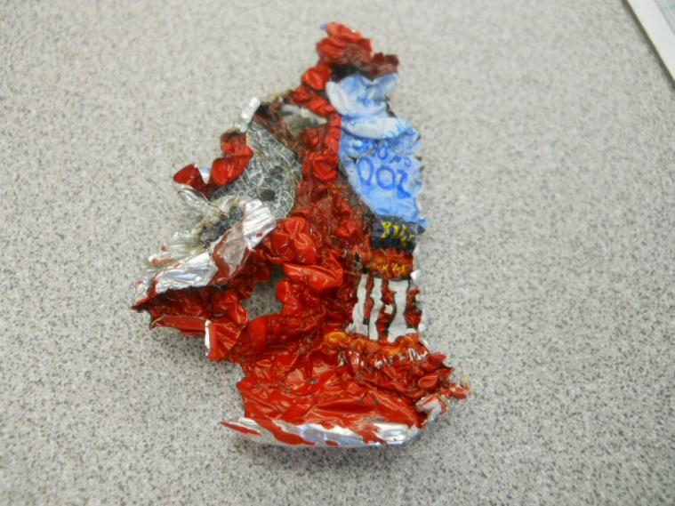
First Procedure
Microwave
5 seconds on high
There was a spark and sizzled
It shrunk and the plastic and aluminum did not separate but became harder
Shrunk by 75% of the original size
Cheez-it bag after microwaved

Slide 5
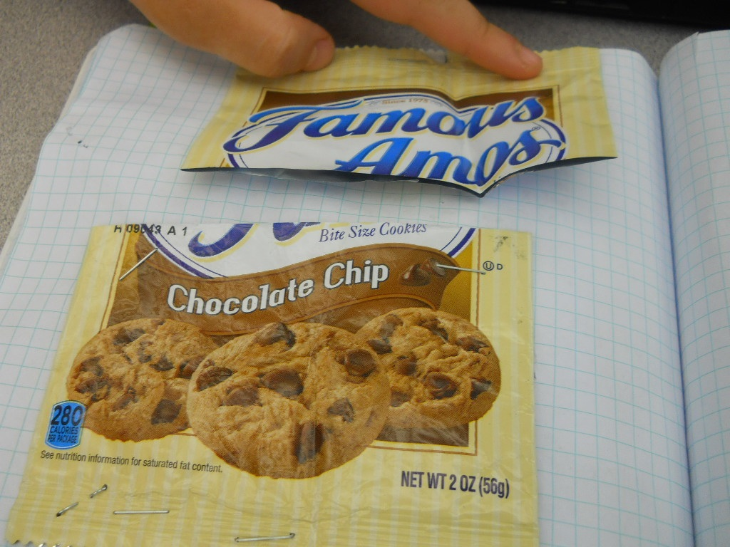
Second Procedure
Boiled half of a Famous Amos bag
No reaction after 8.17 minutes

Slide 6
Final Procedure
Baked part of a skinny pop bag in the oven for a range of 300°-350°

Slide 7
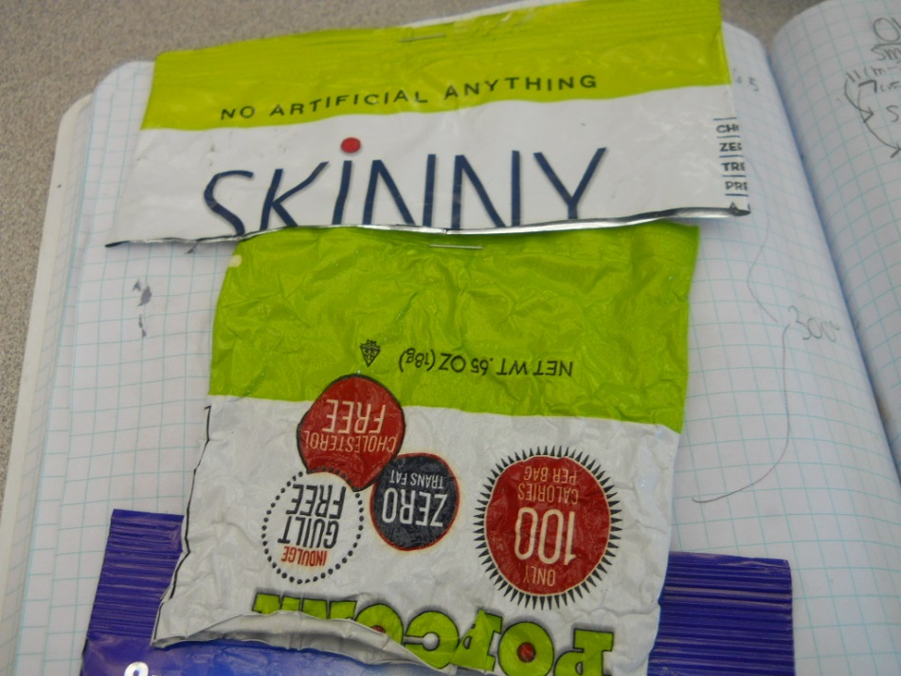
300°
Only shrunk 1.3cmx6cm
Did not separate
51% of oringal
Notes:
.72 and .71

Slide 8
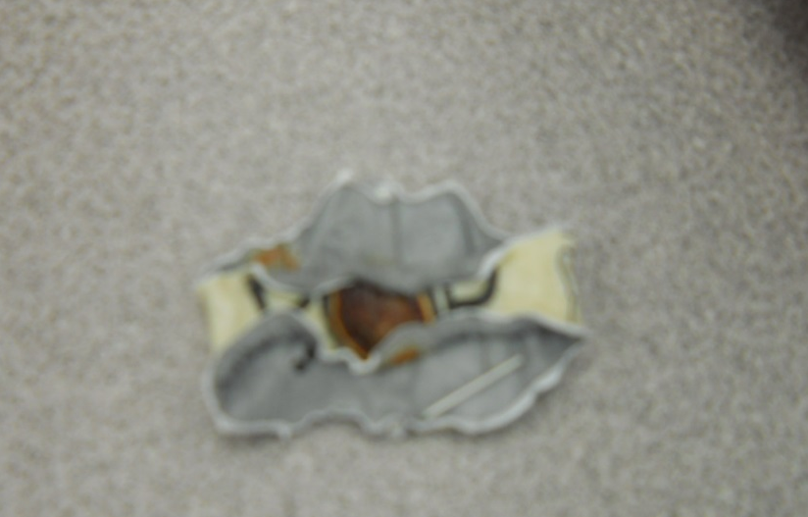
350°
Shrunk 4.2cm x 10 cm
Aluminum and Plastic melted together
11% of original
Notes:
.57 and .2

Slide 9
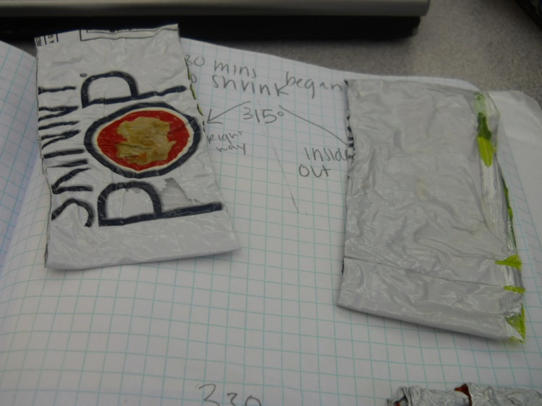
315°
Shrunk .75cm x 4cm
Not hot enough
57% of original
Notes:
.81 and .71

Slide 10
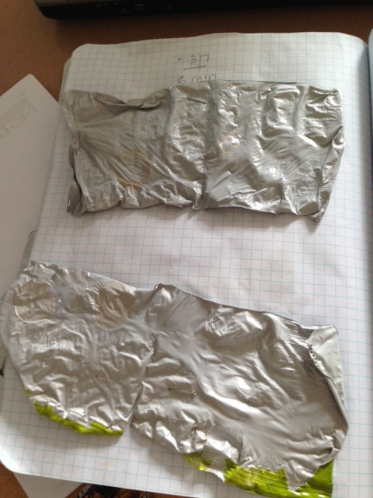
317°
Shrunk 3cmx5cm
44.8% of original
Notes:
70 and 64

Slide 11
Cost Analysis
Oven
350°-
$.32 per minute
300°-
$.26 per minute
315°-
$.28 per minute
317°
$.30 per minute
7 minutes- $2.24
15 minutes- $3.91
5 minutes- $2.23

Slide 12
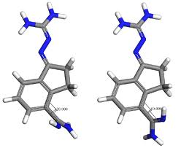
Polymers
Connect the aluminum and plastic together
Plastic polymers are stretched out
when heated, the polymers shrink

