Slide 1
Sunblock
By: Steffi Altman, Meredith Kuser, Mary Bryan Owen, Kristin Polk, Julia Potter

Slide 2
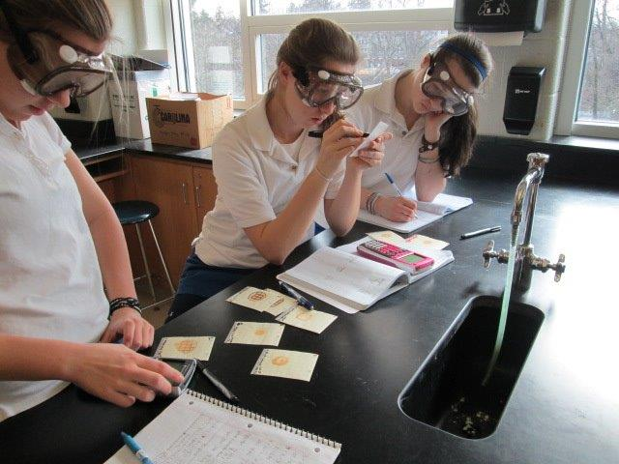
LD50 Testing
Notes:
What is LD50 testing?- a standard measurement of acute toxicity that represents the individual dose required to kill 50% of a population of test organism
How we did LD50 testing– we used percentages from the cost analysis graph that were the best fit and we tested it on ecoli (our organism) and after 24 hours we counted the colonies of bacteria on the petri plates along with the squares to find the y value which we then put into fathom to find the equation to find the max amount of the chemical we can use and to find the r squared value which tells you how reliable the information is

Slide 3
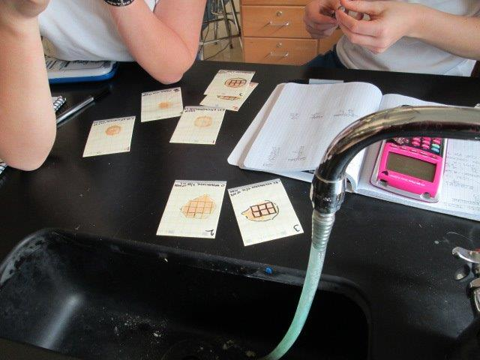
Our results
The most appropriate chemical amounts for Oxybenzone and OM-Cinnamate
Notes:
Our finally results were that we could safely use .27% of Om-Cinnamate and 1.5% of Oxybenzone.
Contradicted our hypothesis because we though we would use more OM-cinnamate than Oxybenzone but we instead found that using more Oxybenzone was better.

Slide 4
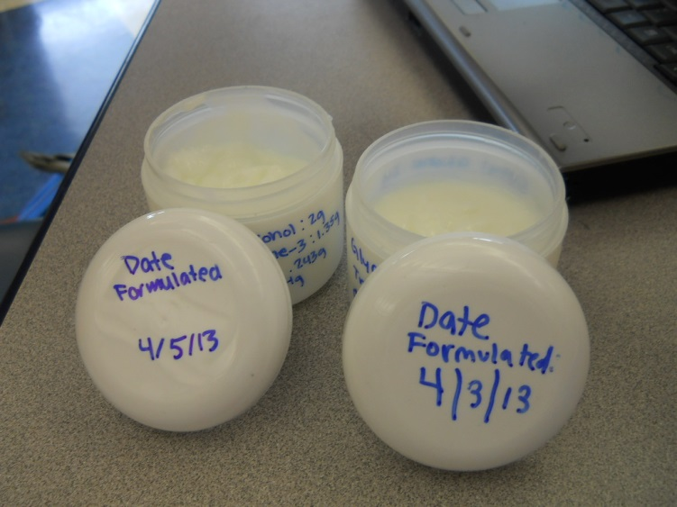
Formula for Sunblock
Ingredient | Amount (g)
Oxybenzone | 1.35
Om-Cinnamate | .243
Cetyl alcohol | 2
Steric Acid | 4
Glycerin | 2
Triethanol amine | 1
Water | 78
Notes:
- We found the formula by using .27% of Om-cinnamate and .15% of Oxybenzone out of a 90 gram total

Slide 5
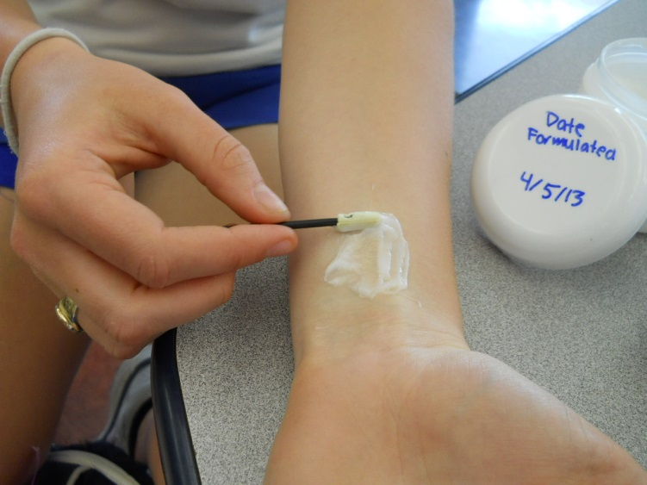
Alternative for the Sunblock formula
Hand or face Lotion
SPF value of 2.5
Notes:
- Initially thought that it was going to be a sunblock, but because it has such a low SPF (2.5) we decided that it would be better use for hand or face lotion in the winter because it has such a low amount of SPF. The texture of the sunblock is thin so it would be easily used on face and hands.

