Slide 1
The Perfect Package
Alanna Aboulafia, Kendra Foster, and Meredith Kuser

Slide 2
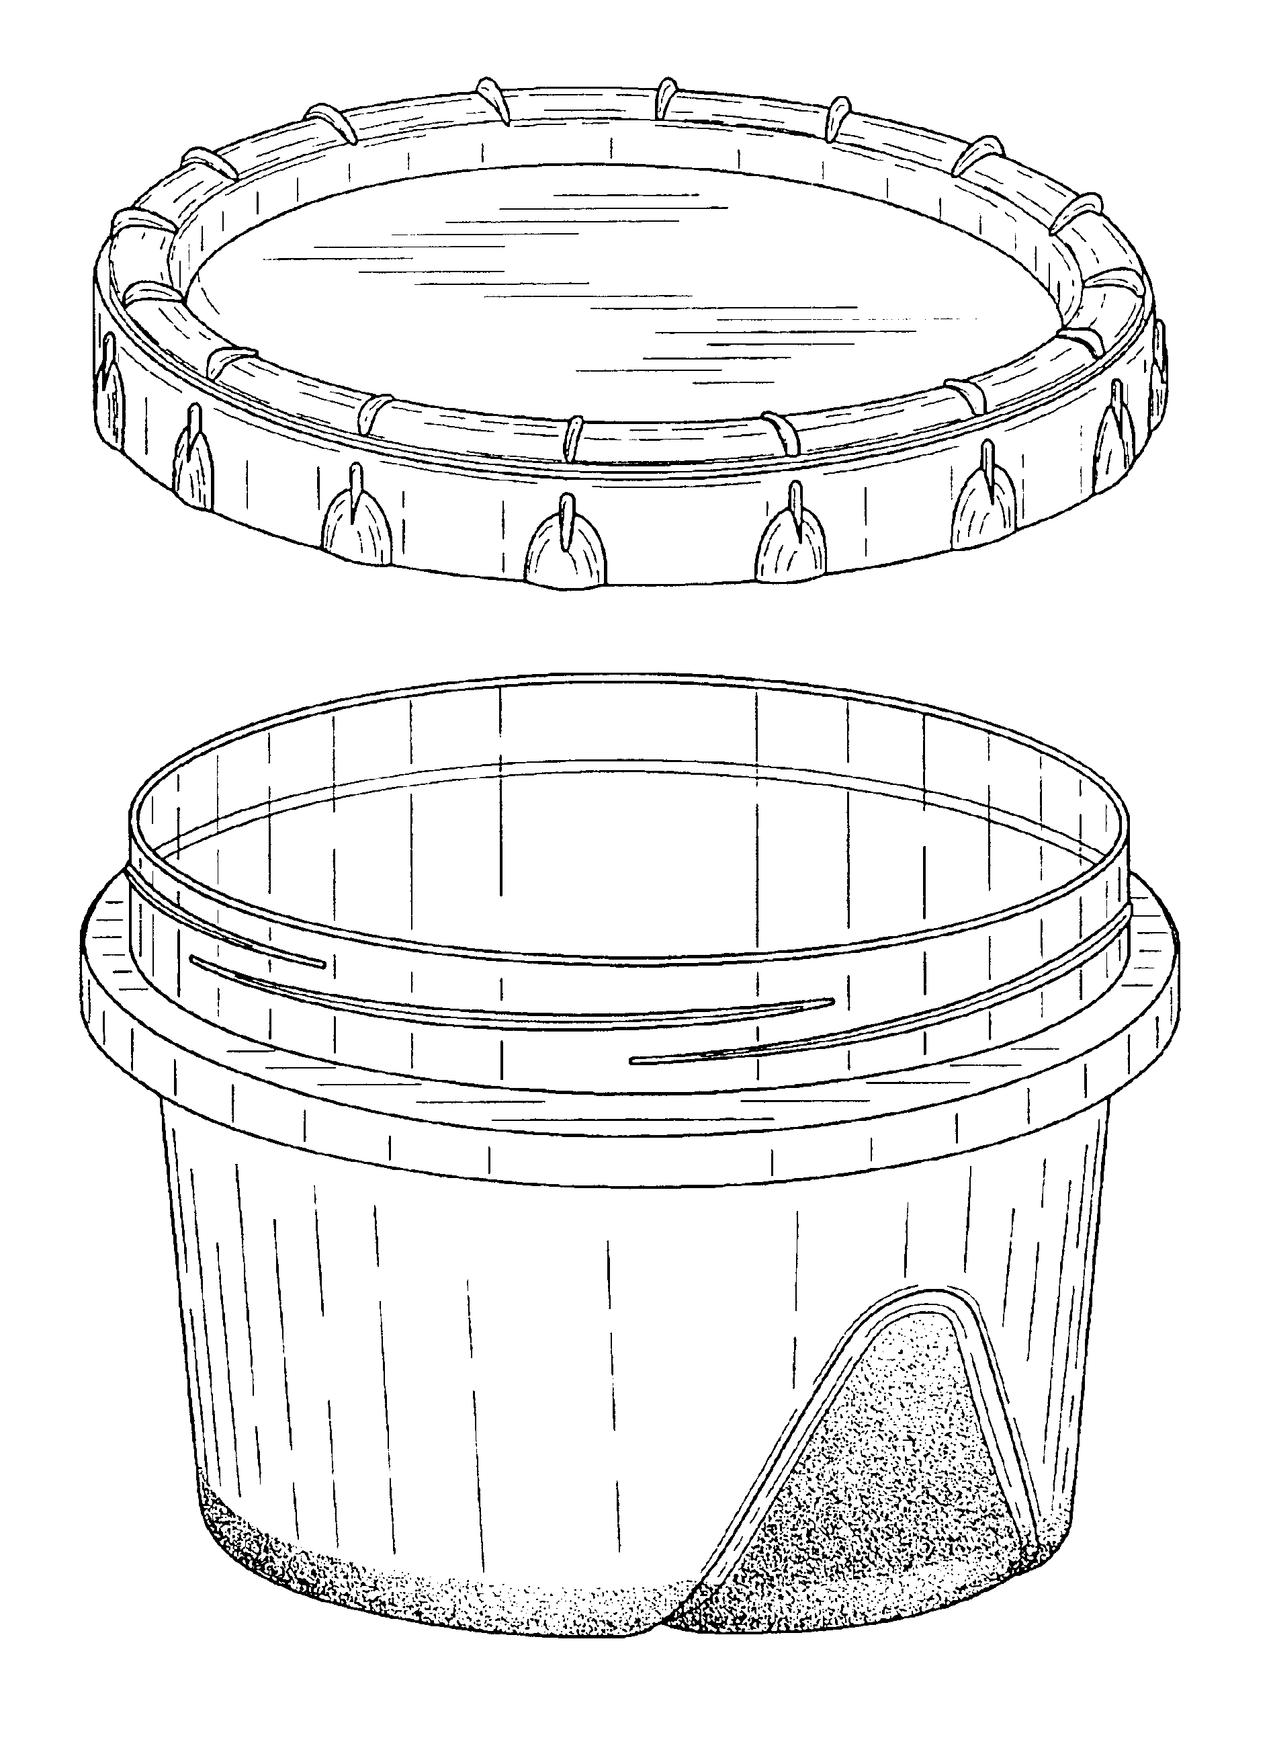
Package Shape
For our package we chose a cylinder shape with a screw on lid.
This shape is hollow and can be filled with our clay mask, but the width is wide enough so the consumer can stick their finger inside and easily get the product.

Slide 3
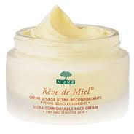
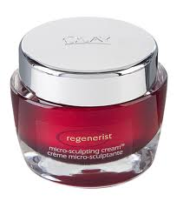
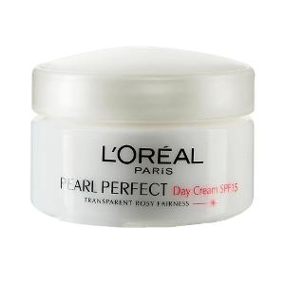
Potential Materials
Hard plastic is a good potential material because it is sturdy but safe at the same time. When handling and shipping the product it is safer and will ensure less breakage.

Slide 4
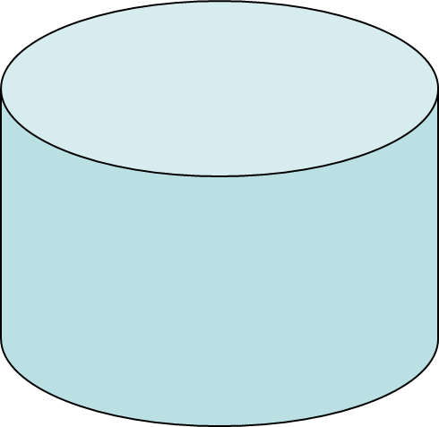
Mathematics
Radius
height

