Slide 1
Oxybenzone State-Gate Review 1
By: Regan Gore, Sarah Shmerler, and Najah Soudan

Slide 2
Goal
To find the amount of Oxybenzone and OM Cinnimate that is the safest for our sunscreen while fitting into the project constraints

Slide 3
Constraints
Maximum LD50 value
Maximum SPF value – up to the legal limit of 6% Oxybenzone
Minimum final cost per unit
Minimum of 1.5% of total mass for each of the two chemicals
Minimum of 6% of total mass for both chemicals combined
Maximum of the USA maximums for each of the chemicals

Slide 4
What is THE IDEA OF A LD50 Test?
“An LD50 is a standard measurement of acute(severe) toxicity that is stated in milligrams of chemical per kilogram of body weight”
Tests the toxicity level of the chemicals are by showing what percentage of the bacteria remains alive when exposed to a substance (Oxybenzone).
Has to be 50% or higher to be safe!

Slide 5
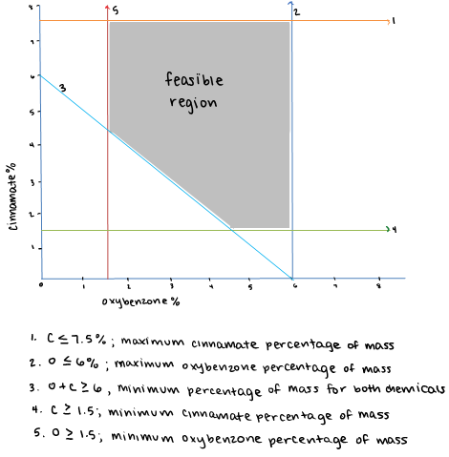
Feasible Region

Slide 6
Feasible Religion Cost Analysis
Cost = 8.05*oxybenzone+6.67*cinnimate
(4.5g,1.5g) → 46.23 cents
(6g,1.5g) → 58.31 cents
(6g,7.5g) → 98.33 cents
(1.5g,7.5g) → 62.10 cents
(1.5g,4.5g) → 42.09 cents → optimal combination for lowest cost
*cents/gram

Slide 7
Amount Chosen
CONTROL: 0 grams
LOW: 0.2 grams
HIGH: 0.351 grams

Slide 8
Amount chosen (cont.)
Originally, we were going to test the vertices of the feasible region
We tested smaller amounts (.2g and .351g) because we didn’t think the amount in the feasible region would be small enough

Slide 9
How to Analyze an LD50
Place ecoli in a tube and mix it with a given amount of solution (Oxybenzone)
Shake tube and put a drop of solution onto a plate
Put plates in an incubator over night
Analyze each plate for number of squares the entire solution covers and then the number of red squares to see how much was not killed

Slide 10
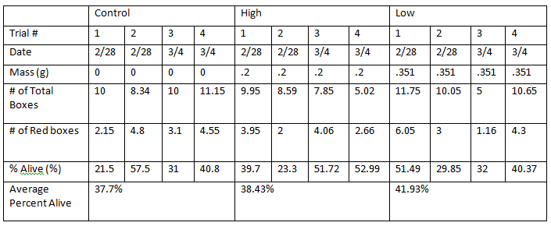
Rough Data

Slide 11
Graph of Data

Slide 12
Data Analysis
Trend:
As amount of Oxybenzone is increasing, the percent survived is also increasing

Slide 13
Next Steps
Data shows no clear “next direction”
More trials with less Oxybenzone because our data shows that killing a lot more than 50%
Control: 0 g
Low: 0.1 g
High: 0.2 g

Slide 14
Recommendations
No clear recommendation right now
The maximum amount of oxybenzone tested (.351g) caused more bacteria to survive → 51.72% and 52.99%
The minimum amount of oxybenzone tested (.2g) caused less bacteria to survive → 32% and 40.37%

Slide 15
Recommendations (cont.)
More oxybenzone should kill more bacteria
Only 50% or fewer bacteria can be killed for the sunscreen to be safe
Our results show that more oxybenzone has killed less bacteria
More tests should make the results more clear

