Slide 1
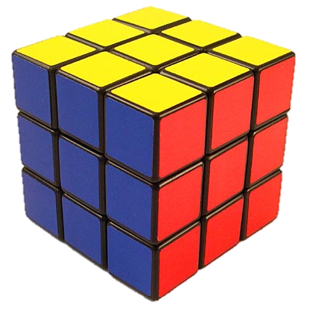
Rubik’s Cube
By: Blaire Miran and Najah Soudan

Slide 2
Who? Erno Rubik
Born July 13, 1944 in Budapest Hungry
His mother was a poet and father was a glider-manufacturer
He studied sculptor at the Technical University in Budapest and at the architecture academy of Applied Arts and Design
He loves building geometric models

Slide 3
What? Rubik’s cube
It is a 3-D object that is very artsy-like through it’s many transformations

Slide 4
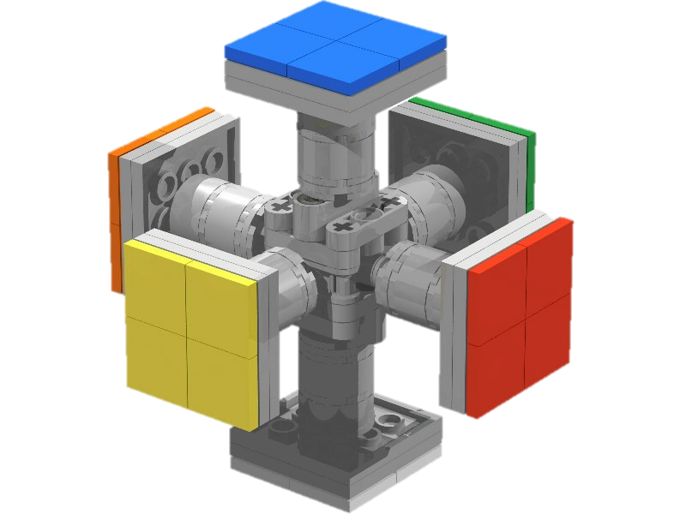
How?
It started off with wooden blocks and rubber bands
The interior has a cylinder shape
There are six distinct colors and each one was on one different face of the cube

Slide 5
When did it become popular?
He invented the rubix cube in 1974
By 1977, it first appeared in Budapest toy shops
By 1978 many children were using the cube
In September 1979, the cube went west
In February 1979, he bought the cube to Nuremberg toy fair

Slide 6
Why?
It was help for teaching algebraic group theory
He taught design to his students
he wanted to challenge his students
He noticed patterns as he challenged his students

Slide 7
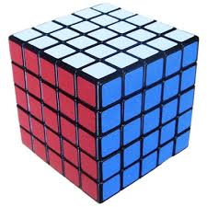
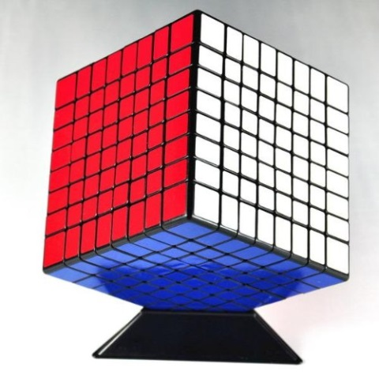
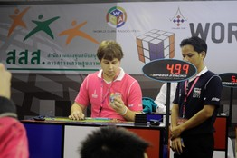
Fun facts about speed cubes
Speed cubes have less friction than normal rubik cubes
In some competitions people solve five- by- five and eight-by-eight speed cubes
Some people do it blindfolded
A teenager in Thailand lined up six colors on all six sides of the cube in 8.65 seconds

Slide 8
Solving the Rubiks cube

Slide 9
Step 1
Jumble the cube

Slide 10
Step 2
Solve the white cross of the cube
Notes:
You know when the white cross is solved correctly when each of the two pieces lines up correctly

Slide 11
Step 3
Solve the corners of the white face
Notes:
Also, when the white corners are solved there is a T of each color on its correct side

Slide 12
Step 4
Solve the middle layer of the cube with the white layer on the bottom.

Slide 13
Step 5
Solve the yellow face opposite the white face.

Slide 14
Step 6
Solve all the sides of each corner.

Slide 15
Step 7
Finally, solve the remaining edge pieces.

Slide 16
Sources
Wallstreet journal from 12/14/11
People compete using speed cubes
http://www.britannica.com/EBchecked/topic/511991/Erno-Rubik
The rubix cube started off made from wooden blocks and rubber bands
http://www.rubikszauberwuerfel.de/english/home.html?geschichte.html
The first toy shop the rubix cube appeared in was The Budapest Toy Shop
http://www.cnn.com/2012/10/10/tech/rubiks-cube-inventor/
From this source, I learned about how the first cube was made and who it originally helped.
Pictures
http://users.skynet.be/maarten.steurbaut/Pictures/Rubik_Cube_small.jpg
http://a.tgcdn.net/images/products/zoom/rubix_cube.jpg
http://www.rubiks.com/i/world/history/Erno_Rubik2.jpg
http://www.geekalerts.com/speed-cube-puzzle/
http://www.puzl.co.uk/competition-standard-5x5x5-speed-cube-p-482.html

