Slide 1
The Effect of Music Volume on Short Term Memory
Taylor Brewer & Grace Laria

Slide 2
Current Understanding of Short Term Memory (STM)
STM involves limited information storage (7-10 digits)
Known negative influences include:
Multitasking
Type of input
Types of Background Noise
Notes:
Inconclusive data of weather the distractor has an impact of the types of reiteration (verbal vs. visual)
-began to wonder about the volume

Slide 3
Our Research Question
Does the volume of classical music affect the ability to remember a sequence of digits?
Our Hypothesis
As the volume of classical music increases, the capacity to remember a sequence of digits correctly will decrease.

Slide 4
Methods
31 adolescent girls, ages 13-17
Each subject shown a sequence of varying numerical digits for 7 seconds
After each sequence, subjects wrote down how may digits recalled
Subjects were shown a 3, 6, and 12 digit sequence for each music volume (silent, low, and high)
Notes:
Modeled off a online version of a short term memory test n the Washington Inivertity’s websites.

Slide 6
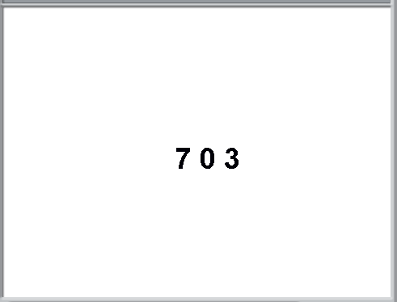

Slide 8
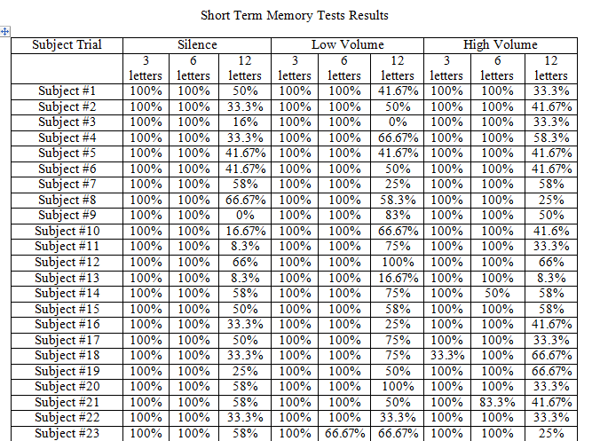
Preliminary Analysis
Notes:
We counted up each subject’s responses and calculated how many digits each subject got correct
Then calculated the percentage

Slide 9
Findings
Figure 1 – Control Condition
Figure 2 – Low Volume Condition
Percentage Recall
Percentage Recall
Figures 1 & 2 show expected negative correlation between STM and increased number of digits per sequence

Slide 10
Figure 3 – High Volume Condition
Expected negative correlation between STM and digits per sequence is repeated in Figure 3
Percentage Recall

Slide 11
Figure 4 – Percentage of Digits Remembered vs. Digits/Sequence
Expected negative correlation between increase in digits/sequence and percentage of digits remembered correctly in 3 and 6 digit sequences
Low volume background music caused increase of 14% in percentage of digits remembered in 12 digit sequence → positive effect
Notes:
P-value is 0.013

Slide 12
Conclusion
Low volume background music has a positive impact on STM – why?
Why the 12 digit sequence?
Expected negative correlation in 3 and 6 digit sequences + distractor
12 digit sequence + low volume background music showed improved performance
Why low volume background music?
The “Middle” Environment – Evolutionary Hypothesis
High volume noise immediately distracts organisms as a natural “fight or flight” response
Low volume noise heightens general awareness and mental focus without fully distracting the test subject
Notes:
3 and 6 digit sequences did not consist of enough digits for the test subjects to accurately engage their STM

Slide 13
Further Research
New experiments consisting of:
Use of white noise instead of background music
Sudden spikes of high or low white noise
Larger and more diverse testing population to prove universal impact
Greater variety of digit sequence

