Slide 1
The History of Topology
By: Taylor Brewer and Alanna Aboulafia

Slide 2
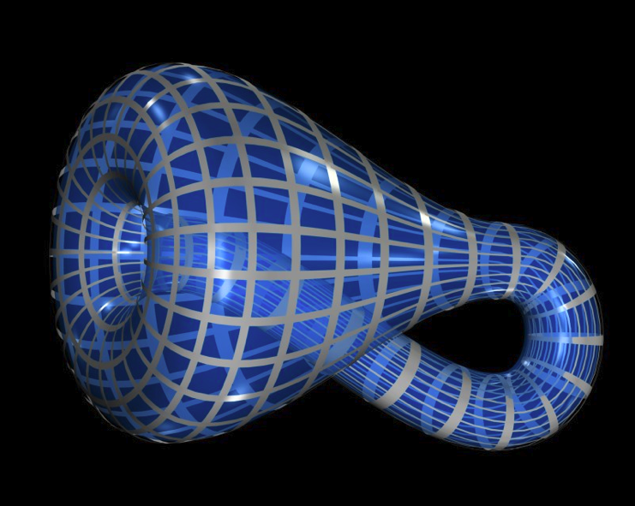
What is Topology?
Being able to change one shape into another without breaking it or gluing it together.
Klein Bottle:
Topological Shape created by Felix Klein in 1882

Slide 3

History
Expressed as early as the 1736
Toward the 19th century the ideas were concrete and were known as geometria situs or analysis situs
Euler first considered topology
In 1736, Euler’s book discussing geometry was published, this hinted at topology

Slide 4
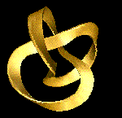
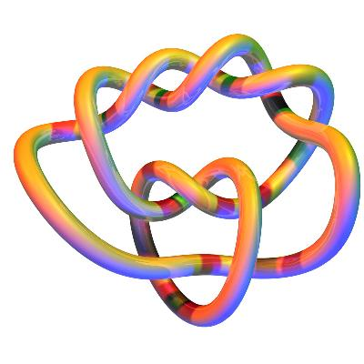
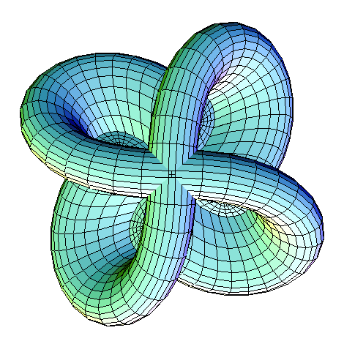
Different Types
Algebraic topology
Set topology
Differential topology

Slide 5
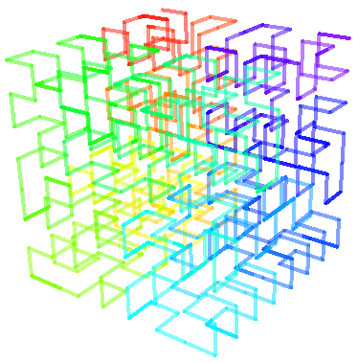
History of Algebraic Topology
What introduced topology first?
  The Rise of Abstraction by Hilbert and his coworkers
    Space filling Curves
  Centers of Activity, or “schools”

Slide 6

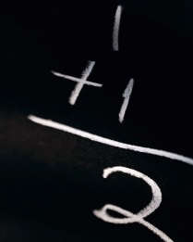
Brouwer
a strong and well noted leader of topology development
worked in topology from 1909-1912
continued to encouraged others to keep investigating
a cooperating editor of Mathematische Annalen (a famous math journal)
Hilbert wanted to decrease Brouwer’s power because it was a threat to his leadership
Brouwer lost the fight and withdrew from the Annalen,
Brouwer then founded a new journal, Compositio Mathematicea
This journal further led to topology

Slide 7

Poincaré
In a series of memoirs investigating the mathematics of curves, he introduced some topology notations based on Euler’s characteristic
He investigated the relationship between the sphere and how the air moves around it
  “The only closed compact orientable surface that has a singularity-free flow is the torus”
  All hairs on a ball cannot lay flat, this is called the hairy ball theorem, derived from Euler’s characteristic

Slide 8

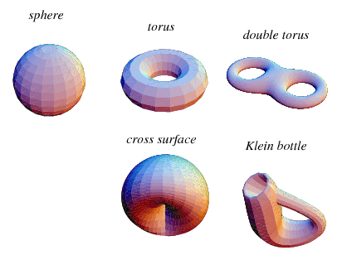
Manifolds
Poincaré started the study of manifolds
So he indirectly studied more about topology
This manifold idea spread and scientists compared them to triangle and tried to see if they were homeomorphic (being able to change surfaces while retaining their topological characteristics)

Slide 9
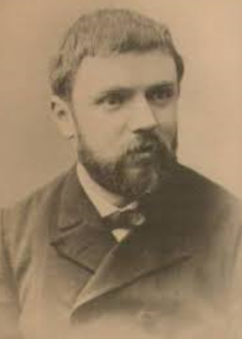
Brouwer
Worked on Hilbert’s fifth problem (on continuous groups of transformations of manifolds)
  indirectly worked in topology
Worked on topology of plane
Brouwer and Poincare worked together on manifolds
Brouwer made a proof that one cannot change the dimensionality of an object

Slide 10
Brouwer Continued
Brouwer also worked on mapping degrees and the concepts of “somplical approximation” and the relationship between maps
  Key developments to topology
Because his findings were so difficult to understand, people didn’t really expand on them

Slide 11
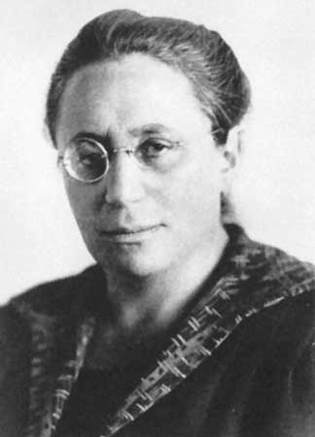
Emmy Noether
1882-1935
Visited Brouwer
She introduced grouping tolopogy
Vietoris and Heinz Hopf later published a paper on the groupings

Slide 12
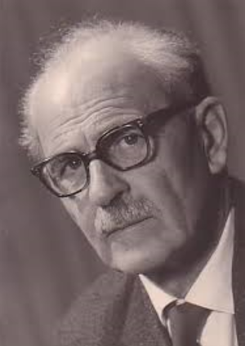
Vietoris
Expanded on Poincaré
He applied the groupings
  Groups allow people to see similarities between very diverse examples
Added new groups
Discovered more aspects of topology
Hopf then used Veitoris’s work to expand the homology theory

Slide 13

Homotopy
Being able to change an object into another with a continuous motion while keeping its location the same
  Difference, Homotopy deals with points on a map
Similar to topology
Formulated by Poincaré
This is the closest thing to topology at first
This then developed into topology

Slide 14
Time to PLAY with CLAY!
Please carefully construct a topologic shape… do this WITHOUT of course:
1. Breaking your clay.
2. Gluing/sticking your clay together
Your shape must be a number.
Once you have made a number out of clay, make a list of 5 other numbers you could make that are topologically equivalent.
**Keep in mind the two rules above always apply.

Slide 15
Bibliography
http://www.princeton.edu/~achaney/tmve/wiki100k/docs/Topology.html
http://www-history.mcs.st-and.ac.uk/HistTopics/Topology_in_mathematics.html
http://en.wikipedia.org/wiki/File:Hilbert3d-step3.png
http://mathworld.wolfram.com/Homotopy.html
http://www.hausdermathematik.at/images/vietoris70.jpg

