Slide 1
Extracting Aluminum from a Sandwich Wrapper
By: Taylor Brewer and Blaire Miran

Slide 2
Our Goal
Our problem was to extract the aluminum from a sandwich wrapper using a mechanical method (without chemicals)

Slide 3
Importance
The wrapper cannot be recycled when it is intact
The wrapper includes other items
When the aluminum is separated from the paper, the aluminum can be recycled and made into another object, such as a beverage can

Slide 4
Potential Effect
V=L*W*H
Height is the unknown variable
Length=14 inches (35.56 cm)
Width-16 inches (40.64 cm)
Need to find the volume to find the height
Constant: 2.699g aluminum/ cubic cm
found: 1.95 g of aluminum for each wrapper
1.95g/2.699 (gm/cubic cm)= 0.722 cubic centimeter
Of a cubic centimeter: l=1cm, w=1cm, H=0.722cm
0.722 cm³=35.56cm*40.64cm*H
H=0.0004999 cm
A sheet of an aluminum from one wrapper is one 2000th of a cm (~1/5000 of an inch)

Slide 5
How We Tested
Four types of tests
Pulling apart when its dry
Soaking in water then separating
Sanding the paper off with sand paper
Heating in the oven then separating

Slide 6
Dry Testing
1. Cut a sheet of sandwich wrapper in half and only test half
2. Take a corner of the cut sheet and attempt to peel the aluminum sheet off of the paper sheet slowly (try to remain a constant speed)

Slide 7
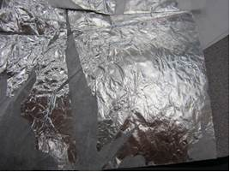
Results- Dry peeling (one trial)
Observations after pealing | Photo of results
Ripped off in small pieces There was a residue of glue on the aluminum foil Not very successful

Slide 8
Modifications
We decided this was not an efficient way to extract the aluminum as it took a while to peel and there was glue residue left
Decided to try and find ways to make the paper come off easier (water)
We recognized that we needed to pull off at a slow, constant speed

Slide 9
Water Test
Obtain three 200ml beakers and fill each with 100ml of water
Heat one up to 55 degrees Celsius
Leave room temperature water in one
Put 15 degrees Celsius water in the third (used controlled cold water from the sink)
Place a piece of wrapper in each of the three beakers and let each soak for 3 minutes
Take out each piece of wrapper and try to peel from each corner

Slide 10
Results- Water
Temperature of Water | Overall observations after pealing
55°C | Paper rips off easiest, the paper rips into pieces
25°C | Middle level of difficulty, paper didn’t rip much
15°C | Peels the hardest, paper ripped sometimes from trying to peel

Slide 11
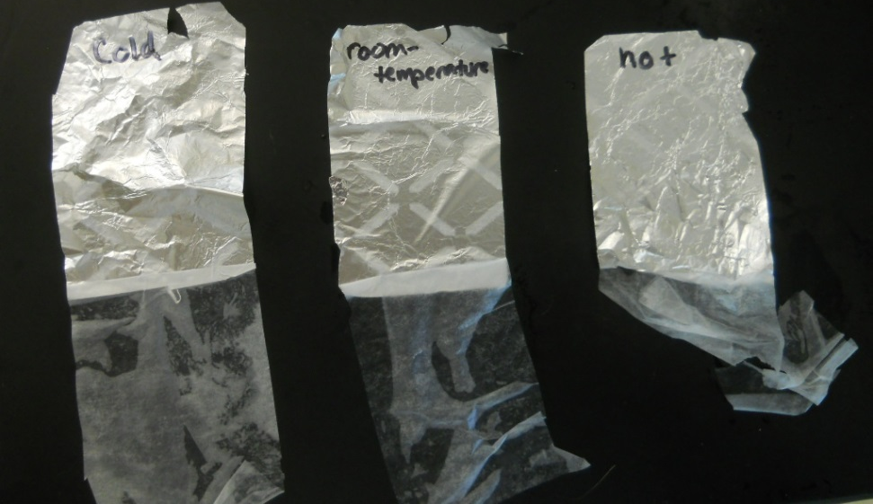
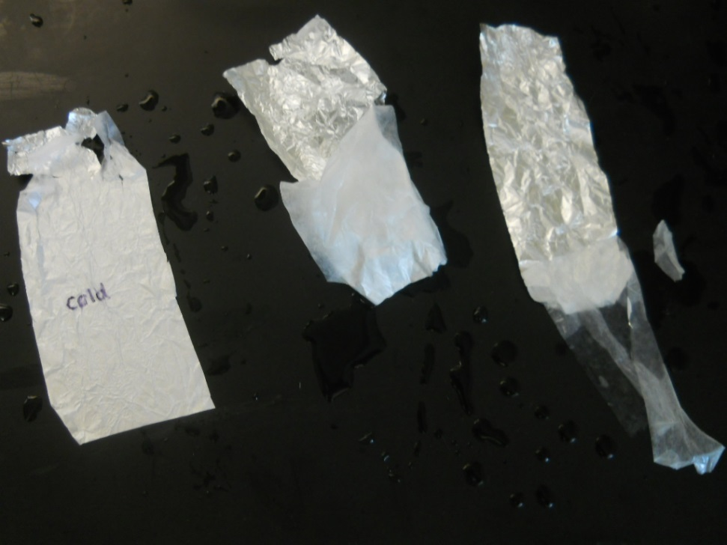
Trial 1
Trial 2

Slide 12
Observations
Started soaking the foil for 1 minute, but realized this was not enough time to make a difference on the wrapper
The cold actually had the opposite affect than what the water was predicted to do

Slide 13
Heat Testing
Preheat oven to 320°F
Cut one small 2” by 2” piece of wrapper
Place wrapper piece on a baking pan and place in the oven.
Keep in the oven for 10 minutes
Record any changes to the wrapper

Slide 14
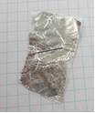
Results- heating
Temperature of Oven | Time in the Oven | Observations after Heating | Observations after peeling | Photo of results
320 degrees F | 12 minutes | No visible changes | Same as when dry

Slide 15
Modifications
If we had had more time, we would have tried different oven temperatures to try and change the wrapper in some way

Slide 16
Sand Paper Test
1. Cut three 2” by 2” pieces of the sandwich wrapper
2. With a medium force, manually rub in a circular motion one piece of the wrapper on the 60 grade sand paper
3. Repeat step 2 twice more with separate pieces of the wrapper, once on a 100 grade and 220 grade sand paper

Slide 17
Results- sanding
Grade of sandpaper | Observations after sanding | Photo of results
60 | Ripped completely in second swipe
100 | Ripped completely in 5th swipe
220 | Ripped completely in 10th swipe
*The higher the grade, the softer the sand paper

Slide 18
Modifications During Testing
After the first round on the 60 grade sand paper, the wrapper ripped immediately, so we rubbed with less force for the following trials

Slide 19
Recommendation
The warm water test was the most successful

Slide 20
Future Work
In the future, we want to look further into how the water temperature affects the ripping process
Also, we could try and keep the heat in the foil for longer so we have a longer amount of time to peel the paper off

