Slide 1
3D Object Capture
Ariel Egbunine

Slide 2
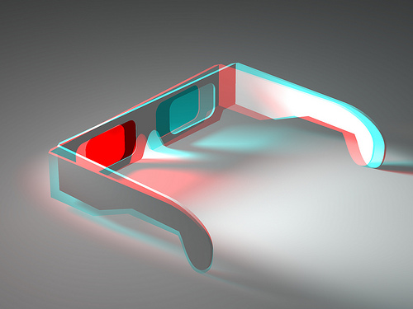
What is 3D?
3D is the shortened version of Three-Dimensional
Definition: An object that has or seems to have height, width and depth
Examples:
The human body
The earth
A Rubik's cube

Slide 3
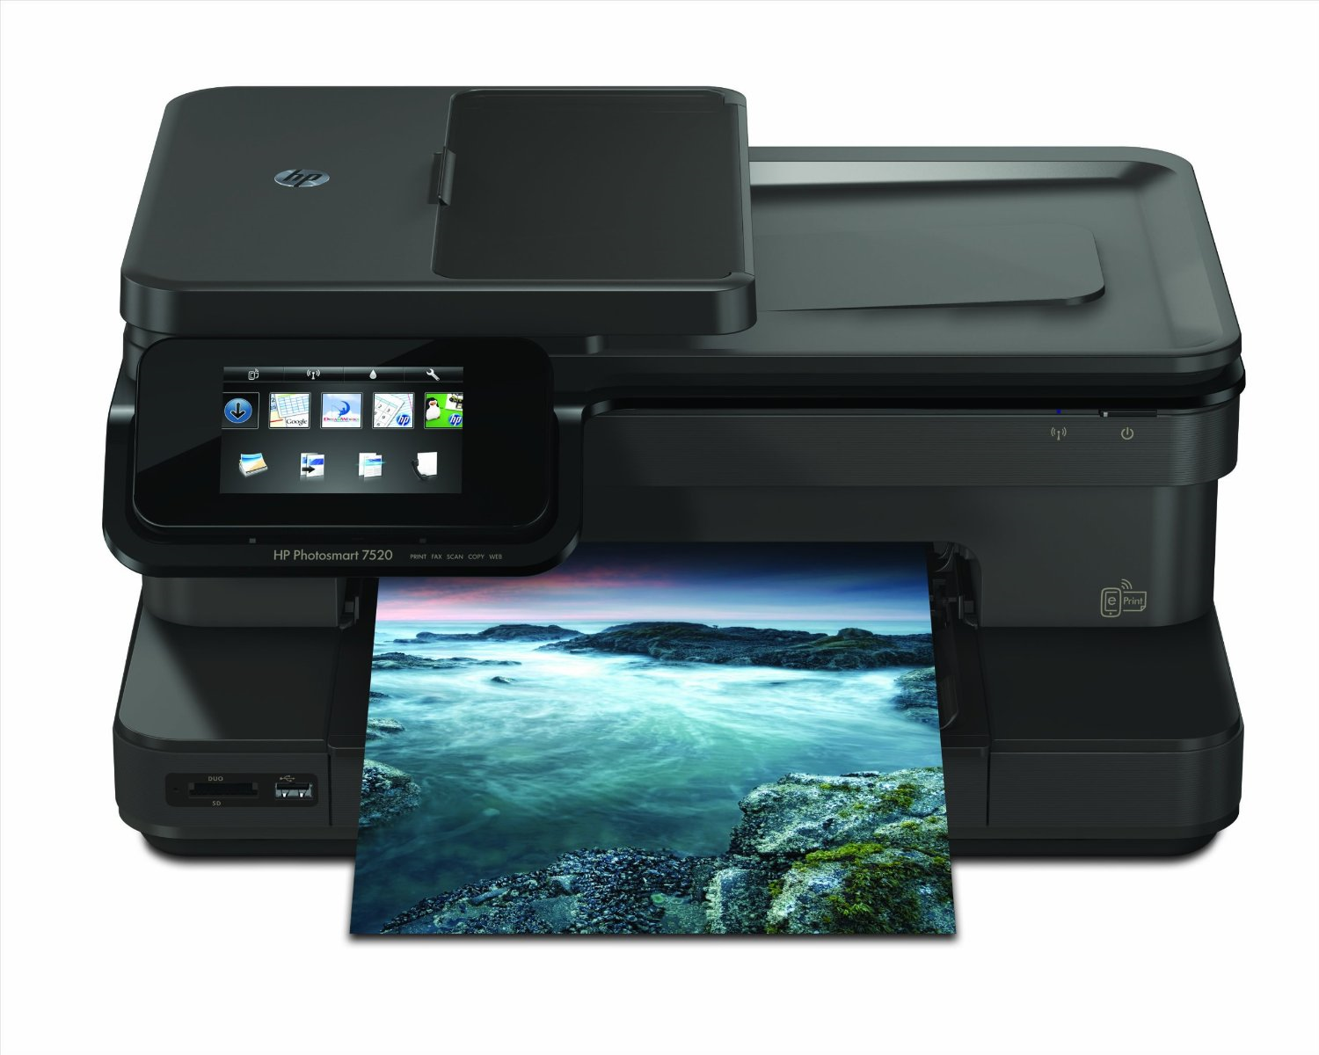
What is a Printer?
Definition: a machine that produces “prints” a paper copy of digital text and/or images, usually sent from a computer
Examples:
LaserJet
Inkjet
Oki

Slide 4
Combining the two
(3D & Printer)

Slide 5
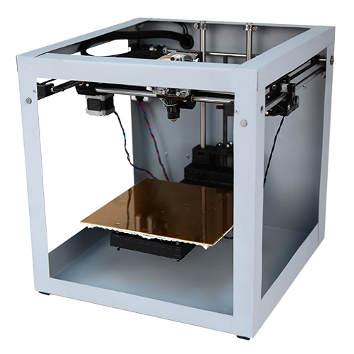
What is a 3D Printer?
Also known as Three-Dimensional Printer
Definition: A machine used to create a Three-Dimensional object from a digital screen, usually a computer.
Examples:
MakerBot Replicator
Replicator Mini Compact
CEL Robox

Slide 6
How does a 3D Printer work?

Slide 7
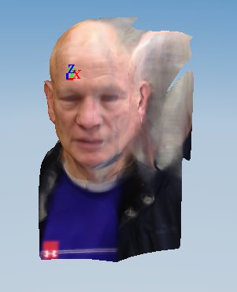
What did I print?
I printed a 3D model of Mr. Tiplady’s head.
BEFORE
AFTER

Slide 8
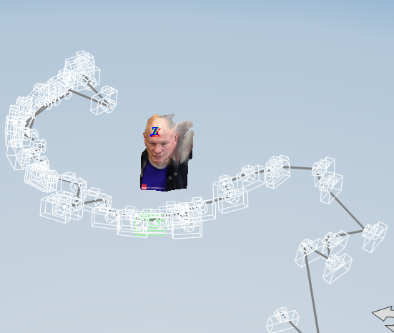
What did I use to print Mr. Tiplady’s head?
I used an application (app) that you can download on your computer called…
123D Catch

Slide 9
How 123D Catch Works
123D Catch
Take multiple pictures, 70 or less, of your object circling it.
Download the pictures onto your laptop
Open 123D Catch
Click the “Create a New Capture” button
Upload the photos of your object that you want to use
Click the “Create Capture” button
Wait for it to “Upload Photos”, “Create Capture”, and “Download Capture”
Wait a little bit for the capture to load
Edit your capture
Export your Capture to MakerBot Desktop
Edit your capture to fit the printer
Save your capture
Print capture like you would print any downloaded item

Slide 10
Better Explanation

Slide 11
Questions?!?

Slide 12
Thank you!!!

Slide 13
Bibliography
Used to find what 3D is/means.
http://www.mathsisfun.com/definitions/three-dimensional.html
http://dictionary.reference.com/browse/three-dimensional?s=t
Used to find what a Printer is.
https://www.google.com/?gws_rd=ssl#q=printer+definition
http://dictionary.reference.com/browse/printer?s=t
Used to find what a 3D Printer is.
http://dictionary.reference.com/browse/3D%20printer?s=t
https://www.google.com/?gws_rd=ssl#q=3d+printer+definition
Used to find how a 3D Printer works.
https://www.youtube.com/watch?v=Vx0Z6LplaMU
http://www.clipconverter.cc/download/T5Qo-fcl/100054736/

