Slide 1
The automatic dimmer Switch
Saving Energy One Lightbulb at a Time
By Juliette Knapp, Ariel Egbunine, Valerie Hinkle, and Erin Waire

Slide 2
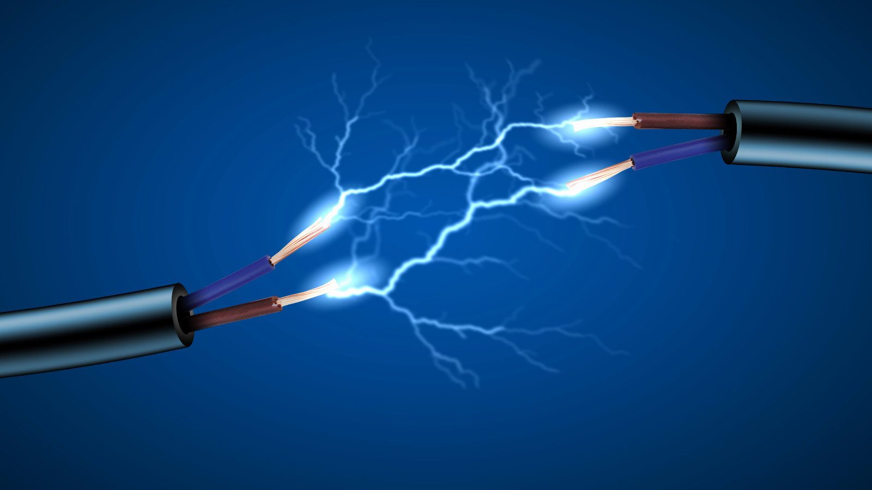
The system
The dimmer switch will move up or down depending the amount of natural light
A robot program will sense the amount of natural light in the room and change the artificial light output accordingly
For example:
If there is more natural light, the artificial light output would be less – dimmer switch moves down
If there is less natural light, the artificial light output would be more – dimmer switch moves up
The amount of artificial light will be enough to light up the room depending on the natural light
Notes:
Erin

Slide 3
Goals
Designing a light system that eliminates excess artificial light by measuring the amount of natural light
Producing the minimum amount of artificial light to fully light a room
Which is saving energy by utilizing natural light
Notes:
Ariel

Slide 4
Constraints
Make the system both cost and energy efficient
Less than $40
Using less energy then a normal light system
Materials
We were limited to the robot pieces and the initial material list
Size of the system
Must fit into wall where light switch used to be
Location
Depending on where a person lives, the dimmer switch will be more or less efficient
Where the switch is located changes the amount of light it can sense
Notes:
Erin
We think that $40 is a reasonable price for our product because:
If our product is too expensive no one will buy it
$40 – in the long run the product will ideally save more money then it costs

Slide 5
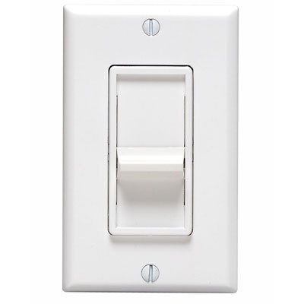
Dimmer switch
A dimmer switch allows one to change the amount of artificial light output, manually
Our goal is to create a system that will change the light output automatically based off the natural light in the room
Notes:
Juliette

Slide 6
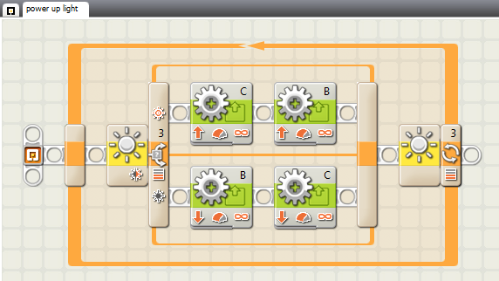
Robot and Integrated Program
This program is used to move the robot’s motor which will in turn, move the dimmer switch to dim the light. I robot will move according to the amount of light coming into the room. Using the NXT light sensor, we created a program that will sense the light and turn the motors forwards to dim the light and backwards to brighten it. This will save power and because by dimming the lights, less energy is being used to light the room and there is a good balance between natural light and electric light.
Notes:
Valerie

Slide 7
Materials List
Dimmer Switch
Standard lightbulb
Insulated Wire
Light sensor
Electrical tape
Lego Robot

Slide 8
Our Cost Analysis
Materials | Cost | Source
LED Light Bulb | $0.88 | https://www.1000bulbs.com/product/110817/SYLVANIA-11180.html?utm_source=SmartFeedGoogleBase&utm_medium=Shopping&utm_term=SYLVANIA-11180&utm_content=60+Watt+Incandescent+Light+Bulbs&utm_campaign=SmartFeedGoogleBaseShopping&gclid=CjwKEAjwpYeqBRDOwq2DrLCB-UcSJAASIYLjr_i6aCiKrvByyx9fnnneKp5-_1hLSHkPKKGLeoyy7xoCcXLw_wcB
Insulted Wire | $1.20 | http://www.oemheaters.com/p-6038-high-temperature-insulated-wire.aspx?gclid=CIL7p6GI4MUCFVUSHwodraQAPA
Electrical Tape | $0.91 | http://www.mscdirect.com/product/details/77653996?src=pla&cid=PLA-Google-PLA+-+Test&CS_003=7867724&CS_010=77653996
Light Build Holder | $2.50 | https://www.bulbamerica.com/products/sunlite-e197-porcelain-lamp-holder-with-wire-leads?CAWELAID=120150920000394014&CAGPSPN=pla&catargetid=120150920000775919&cadevice=c&gclid=COet7eqI4MUCFZYWHwodZjUAgA
Dimmer Switch | $9.97 | http://www.homedepot.com/p/Leviton-SureSlide-600-Watt-Dimmer-White-R70-06631-1LW/202051149?N=5yc1vZc34i
Light Sensor | $10.37 | http://clickserve.dartsearch.net/link/click?lid=92700007029089763&ds_s_kwgid=58700000495006985&ds_e_adid=53886259562&ds_e_product_group_id=72507151305&ds_e_product_id=204223994&ds_e_product_merchant_id=8740&ds_e_product_country=US&ds_e_product_language=en&ds_e_product_channel=online&ds_e_product_store_id=&ds_e_ad_type=pla&ds_s_inventory_feed_id=97700000000001001&ds_url_v=2&ds_dest_url=http://www.homedepot.com/p/Defiant-1-800-Watt-Postmount-Button-Photocell-EZ-346A/204223994&cm_mmc=Shopping|VF&gclid=CMnC45eK4MUCFYaRHwodODkA1Q
Battery | $1.50 | https://www.1000bulbs.com/product/117339/DURACELL-MN1300R4Z.html?utm_source=SmartFeedPriceGrabber&utm_medium=Shopping&utm_term=DURACELLMN1300R4Z&utm_content=BatteriesDBatteries&utm_campaign=SmartFeedPriceGrabber&thissku=DURACELL777dash777MN1300R4Z&site=pricegrabber.com
Lego Robot | $350.00 | http://www.ebay.com/itm/like/281697938064?lpid=82&chn=ps
Notes:
Erin

Slide 9
Ideal Cost analysis
Materials | Cost | Source
LED Light Bulb | $0.88 | https://www.1000bulbs.com/product/110817/SYLVANIA-11180.html?utm_source=SmartFeedGoogleBase&utm_medium=Shopping&utm_term=SYLVANIA-11180&utm_content=60+Watt+Incandescent+Light+Bulbs&utm_campaign=SmartFeedGoogleBaseShopping&gclid=CjwKEAjwpYeqBRDOwq2DrLCB-UcSJAASIYLjr_i6aCiKrvByyx9fnnneKp5-_1hLSHkPKKGLeoyy7xoCcXLw_wcB
Insulted Wire | $1.20 | http://www.oemheaters.com/p-6038-high-temperature-insulated-wire.aspx?gclid=CIL7p6GI4MUCFVUSHwodraQAPA
Electrical Tape | $0.91 | http://www.mscdirect.com/product/details/77653996?src=pla&cid=PLA-Google-PLA+-+Test&CS_003=7867724&CS_010=77653996
Light Build Holder | $2.50 | https://www.bulbamerica.com/products/sunlite-e197-porcelain-lamp-holder-with-wire-leads?CAWELAID=120150920000394014&CAGPSPN=pla&catargetid=120150920000775919&cadevice=c&gclid=COet7eqI4MUCFZYWHwodZjUAgA
Dimmer Switch | $9.97 | http://www.homedepot.com/p/Leviton-SureSlide-600-Watt-Dimmer-White-R70-06631-1LW/202051149?N=5yc1vZc34i
Light Sensor | $10.37 | http://clickserve.dartsearch.net/link/click?lid=92700007029089763&ds_s_kwgid=58700000495006985&ds_e_adid=53886259562&ds_e_product_group_id=72507151305&ds_e_product_id=204223994&ds_e_product_merchant_id=8740&ds_e_product_country=US&ds_e_product_language=en&ds_e_product_channel=online&ds_e_product_store_id=&ds_e_ad_type=pla&ds_s_inventory_feed_id=97700000000001001&ds_url_v=2&ds_dest_url=http://www.homedepot.com/p/Defiant-1-800-Watt-Postmount-Button-Photocell-EZ-346A/204223994&cm_mmc=Shopping|VF&gclid=CMnC45eK4MUCFYaRHwodODkA1Q
Microchip | $9.12 | http://www.newark.com/microchip/mrf24j40ma-i-rm/rf-module-transceiver-txrx-zigbee/dp/07P9585?ost=07P9585&mckv=sXRQGQ5mk%7Cpcrid%7C66379572381%7Cplid%7C&CMP=KNC-GUSA-GEN-SHOPPING-MICROCHIP&CAGPSPN=pla&gclid=CNGr892K4MUCFQoSHwodFWAA9g&CAWELAID=120185550001000747
Notes:
Erin

Slide 10
Description of testing
Our first tests were on the dimmer switch and the lightbulb. It took us a few tries but we finally got a circuit going. After the circuit and attaching the small lightbulb, we drew diagrams so that we knew what worked for the circuit.
Next, we put the big lightbulb on the circuit but it didn’t light up. We knew that the circuit was working because we tested it with the small lightbulb. So, we inferred that the battery we were using wasn’t strong enough. We then added another battery, and it was still not enough to power the lightbulb. Finally, we added two more lightbulbs and put them all into parallel circuit battery holders ot add more power, but it still didn’t work.
We then tested whether the dimmer switch was working or not by using the smaller lightbulb, only to find out that with all the battery power we were putting into the dimmer switch, we might have shorted the dimmer because the circuit was still working but the light didn’t dim.
Notes:
Valerie

Slide 11
Justification of testing
By testing using the smaller lightbulb, we were trying to test if the circuit worked so that we could test with the bigger lightbulb.
We tested the dimmer switch to see if it would dim and when it didn’t work on the big or small lightbulbs, we knew something was wrong with the dimmer.
Notes:
Juliette

Slide 12
Final Product
Notes:
Everyone

Slide 13
Future
In the future, we will create a more elaborate and accurate program that causes the Lego robot to:
move forewords (turning on the dimmer) when there is either minimal sunlight or no sunlight at all.
move backwards (turning off the dimmer) when there is either more sunlight or total sunlight at all.
Also, we will make our product more cost effective by eliminating some of our materials.
Although we never got the light bulb to operate using the dimmer, we also want to be successful in this task with a small light bulb, as well as a larger light bulb.
Notes:
Ariel

Slide 14
Bibliography
http://www.decorateokc.net/wp-content/uploads/2010/04/dimmer20switch20slide.jpg
https://buncombecounty4h.files.wordpress.com/2011/11/legonxt.jpg
http://www.foxforag.com/view/issues/campaign-finance-transparency/attachment/lightbulb/
http://www.decorateokc.net/tag/dimmer-switch/
http://globe-views.com/dreams/electricity.html
http://www3.cs.stonybrook.edu/~minhhoai/cse525/
http://www.understandingrelationships.com/goal-setting-that-works/1031
http://hapcoweb.com/wordpress/tag/casting-methods/
http://www.exponent.com/cost_and_damages/
http://ww2.kqed.org/stateofhealth/2013/09/10/how-more-expensive-health-insurance-might-actually-save-you-money-obamacare/
http://www.scientificamerican.com/article/memories-of-tomorrow/

