Slide 1
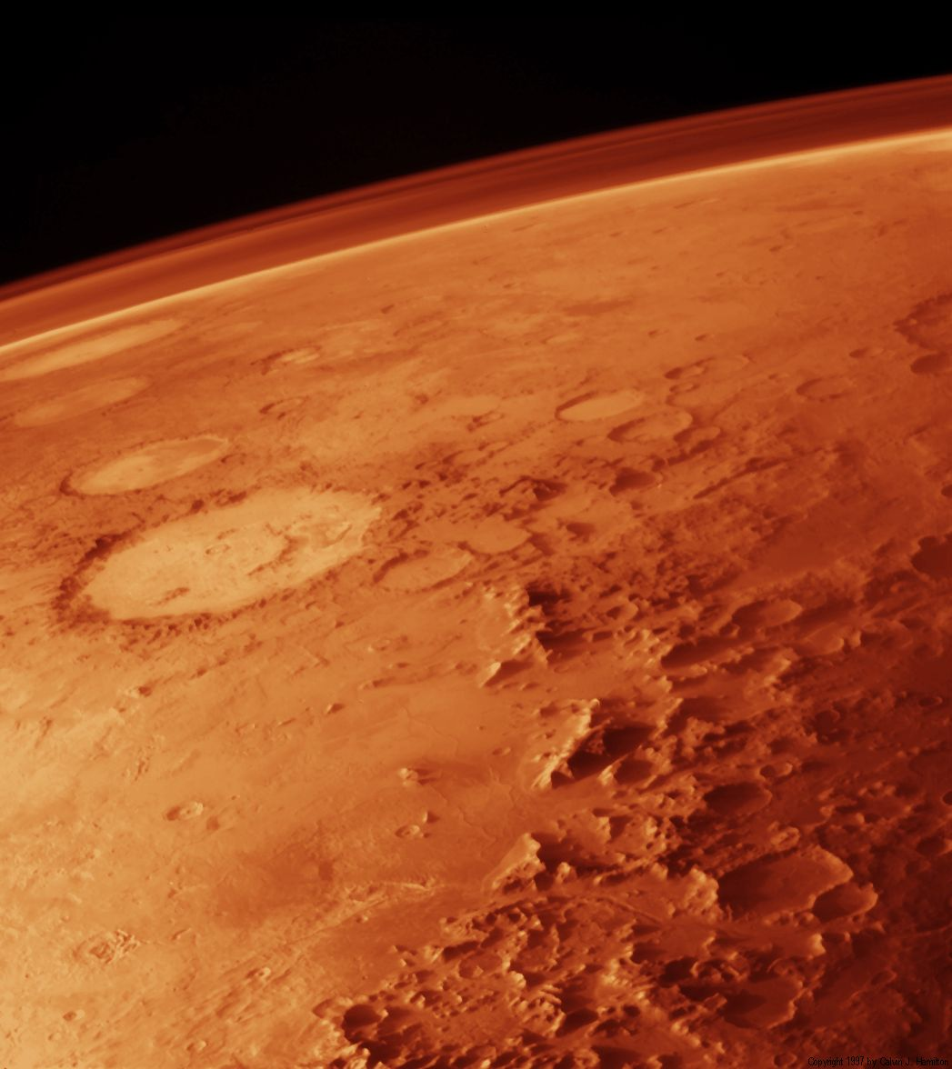
This Is A Movie That You Won’t Want To Miss

Slide 2
Here’s a Preview For Those Of You Who Can’t Wait Another Second

Slide 3
The Red Planet
By: Ariel Egbunine and Valerie Hinkle

Slide 4
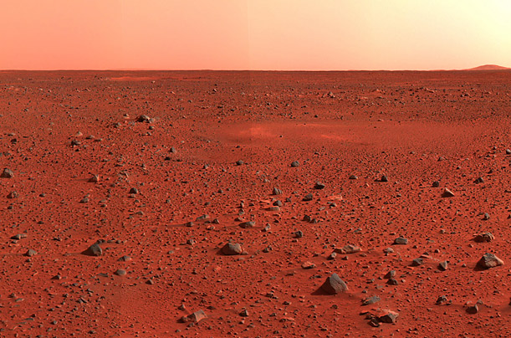
It’s a story about a robot on an Adventure…

Slide 5
To save the World

Slide 6
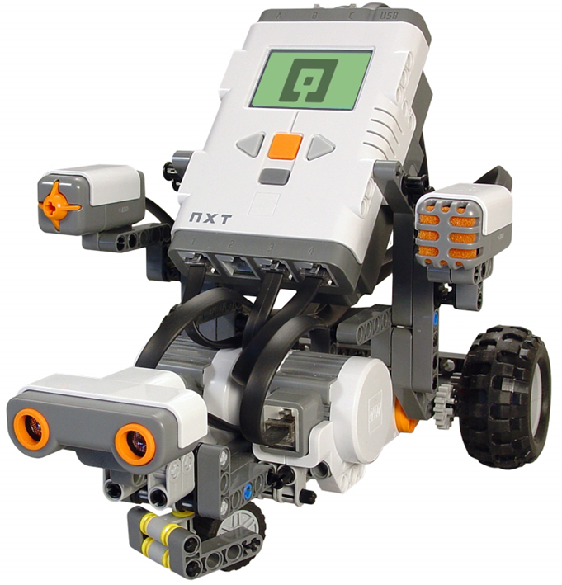
Meet The NXT Robot

Slide 7
The NXT was created just for this mission alone

Slide 8
First…

Slide 9
What the scientist (us) did to prepare for this expedition

Slide 10
We decided to use the bigger wheels so that the robot would be more stable and steady so that it would not tip over while going up inclines and going over bumps such as the rough terrain.

Slide 11
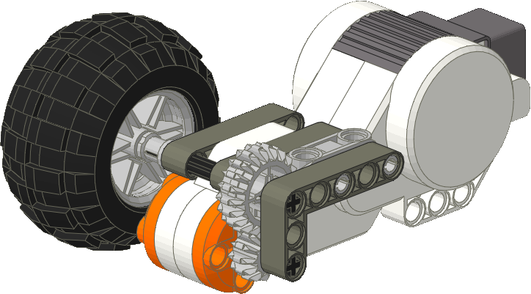
On our robot, we used 12 tooth and 20 tooth gears with the 20 tooth gear on the wheel and the 12 tooth gear on the motor. This makes the wheels move slower and the robot more careful.

Slide 12
The Programs…

Slide 13
Difficult but worth it

Slide 14
First: Moving Forward

Slide 15
We planned to make the robot go forward and backward with our “forward 3 seconds” program because, in order to make it go for longer amounts of time, all we had to do was change the amount of seconds to influence the distance the robot travels.
We also changed the program to make the robot go forward and backward according to which way we wanted it to turn. Thinking about it now, we should have copied the program and made it a separate backward program so we would have both. But at the time, switching the arrows didn’t seem too time consuming.

Slide 16
We also planned to make the robot go forward and backward with our “full speed ahead” program because, in order to make it go forward for any certain number of degrees, we needed another forward program.
We also changed the program to make the robot go forward and backward according to which way we wanted it to turn. We created a separate program called “full speed reverse” which is the same program, just in reverse. Here’s a snip of it.

Slide 17
Full Speed Reverse Program
Same program, just set on a different degrees and backwards.

Slide 18
After: Follow that Line

Slide 19
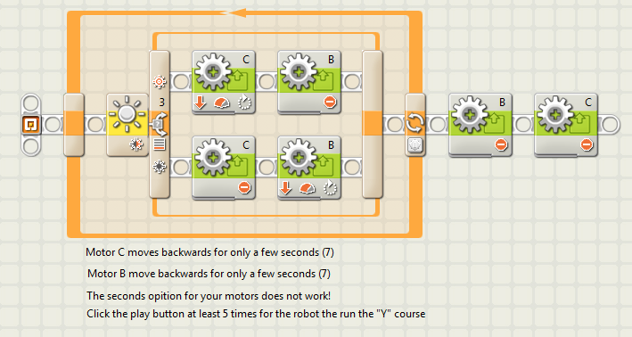
We planned to use the “line trap” program. It directs the robot to move backwards on the line, because it is easier for the robot to maneuver through the path that way.
We also created a backup program called “line trap right”. This program is the same program and was only supposed to be used if our original “line trap” program was inoperable.

Slide 20
Now: Somewhere over the rough terrain

Slide 21
We planned to traverse through rough terrain by using the “Full Speed Ahead” program, the “Full Speed Reverse” program, and the “Forward 3 Second” program. However, in lieu of only moving for 3 seconds, we will manipulate the time limit, to our personal preference for how long we want the robot to move forwards or backwards.

Slide 22
Wait
WAIT!

Slide 23
How did we know what MARS looked like???

Slide 24
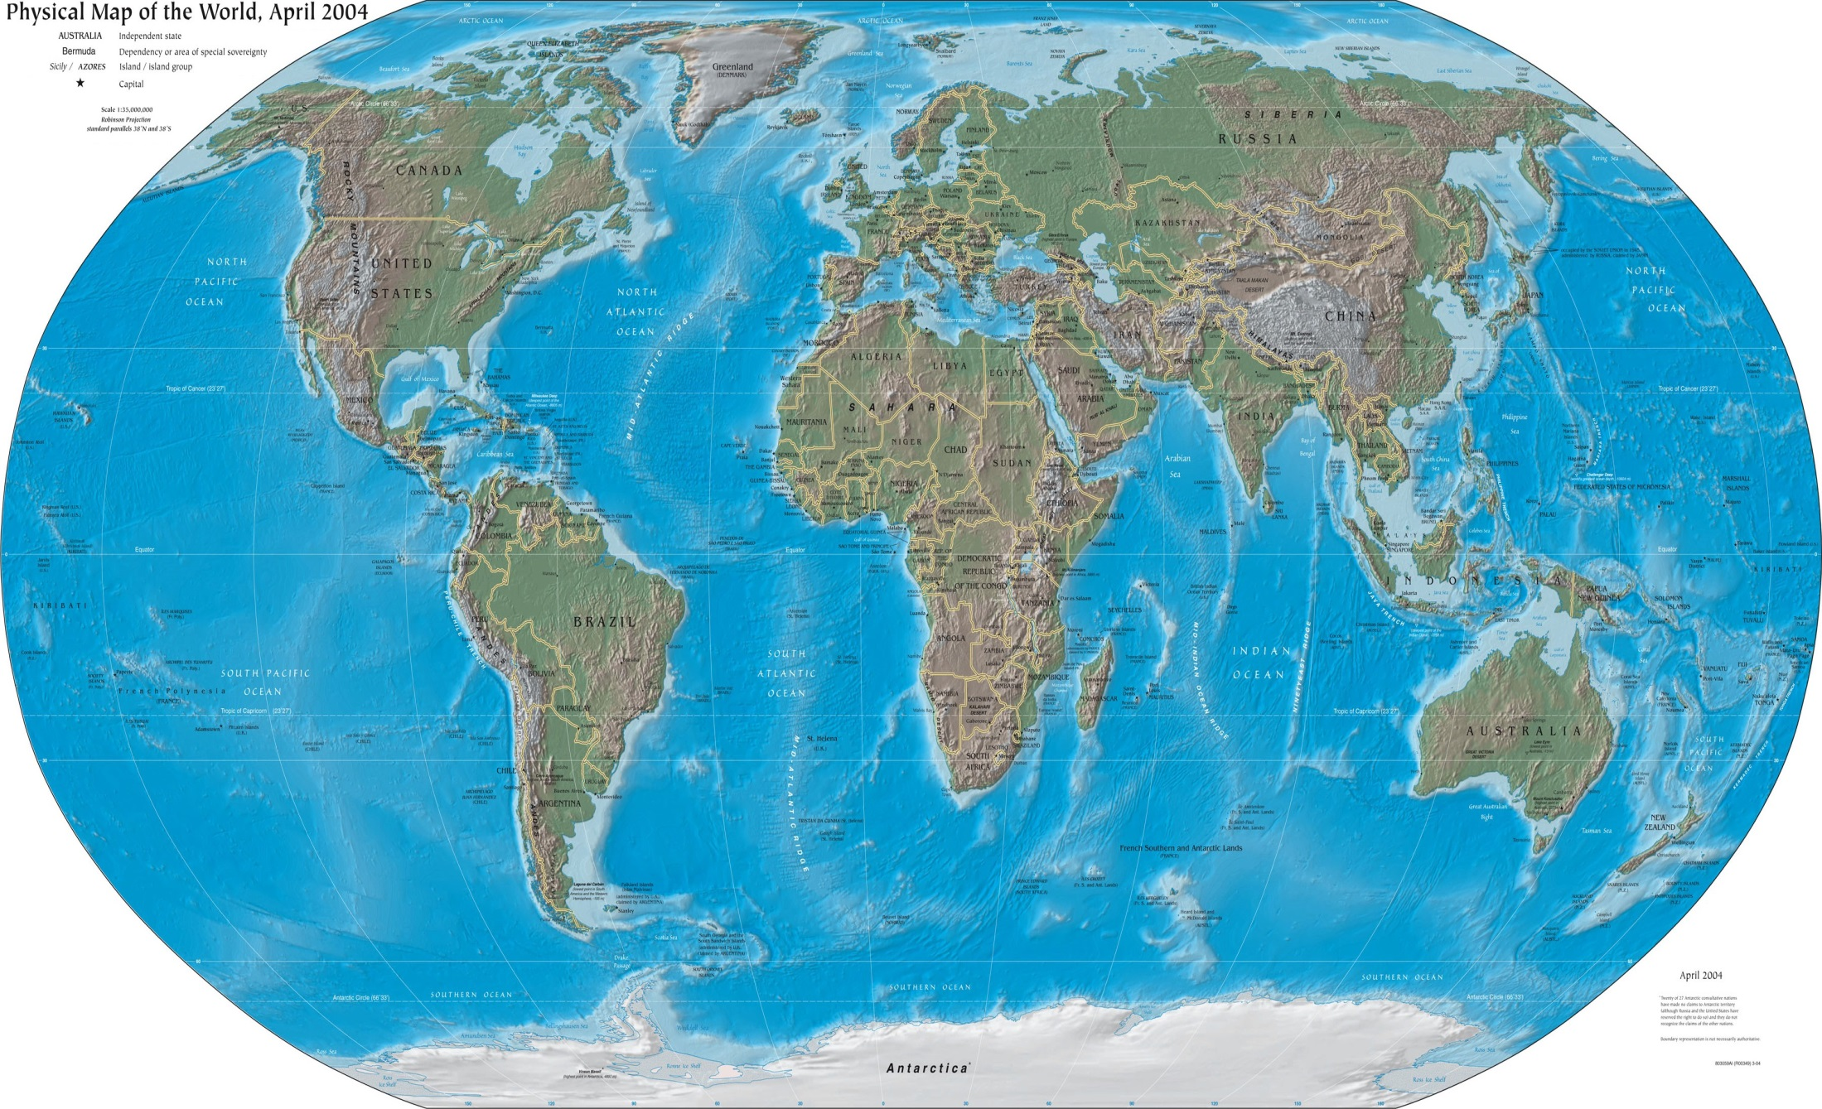
We used a MAP!
But Not This One

Slide 25
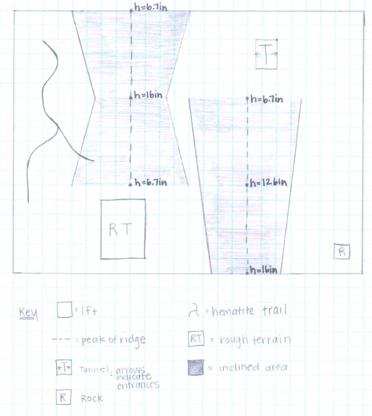
Map of Mars Landing Site

Slide 26
The Testing: The tests we performed on the robot got it ready for the mars mission

Slide 27
The Programs!
Full Speed Ahead is what we used to move forward.
Full Speed Reverse is what we used to move backwards.
Follow the Line is what we used for the hematite trail.
Sense, Back-up, and Return and is what we would have used for the rock even though we didn’t get to do that obstacle.
Swing Turn and Point Turn both were faulty programs. They would work at one point, but then stop at the next. However, after MUCH trial and error, we managed to fix the defective problem.
Stop the program that we created in case our turn programs would not work. (We found a loophole!)

Slide 28
The Red Planet
Coming Soon to a theater near you!

