Slide 1
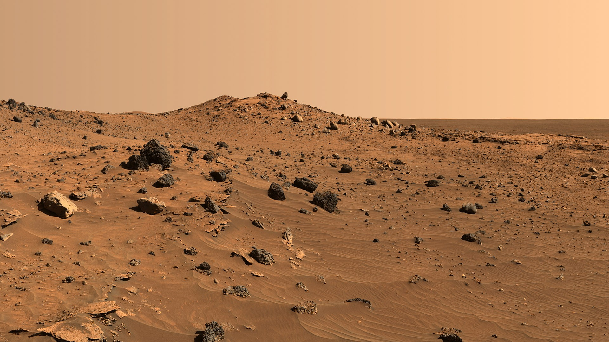
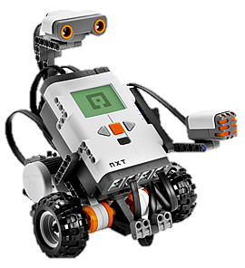
Mars Rover Expedition
By: Hailey, Julia, and Carolyn
Notes:
http://3dprint.com/2577/nasa-manned-mission-mars-3d-printing/
http://www.romansrobots.com/our-courses/

Slide 2
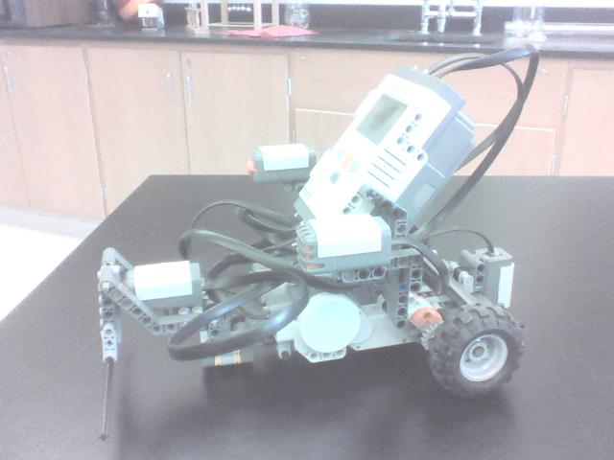
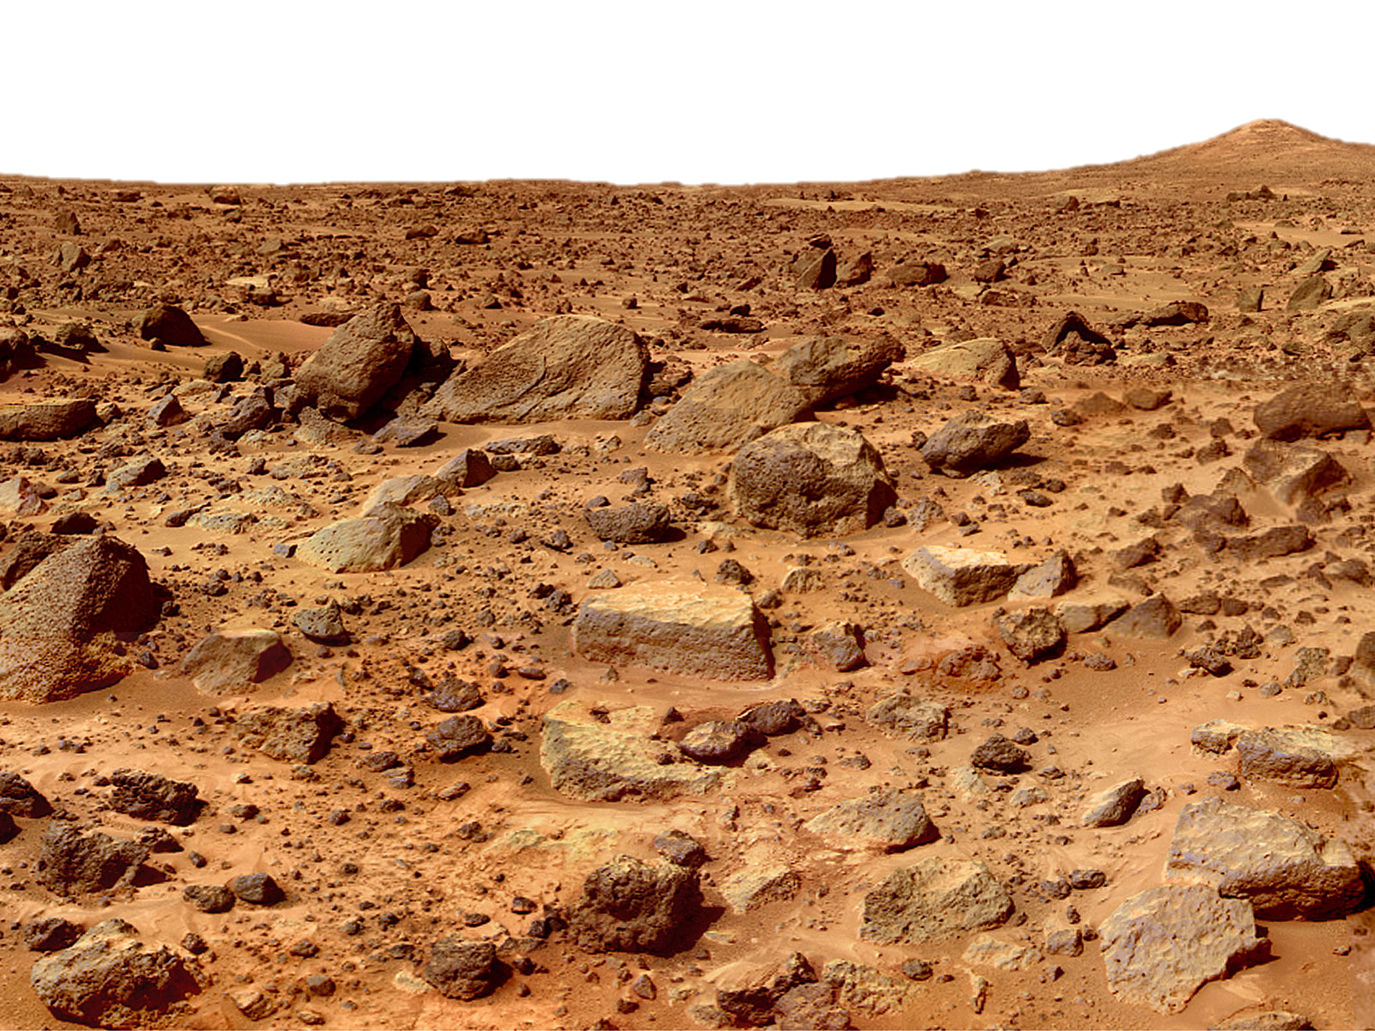
Configuration
Main battery/body of robot
Light sensor attachment
Touch sensor attachment
Regular size wheels

Slide 3
Light sensor attachment:
We chose to have the light sensor because it was an important and necessary element in our line track program. The robot needed the light sensor to track the line in order to differentiate the varying surfaces and follow the trail correctly.
Touch sensor attachment:
We chose to have the touch sensor attachment because we wanted to use this tool in our touch program (when we would examine the rock on mars). We thought it would be a good idea to have a tool that would actually touch into the rock incase the alternative option (the ultrasonic sensor) would overlook, miss, or not recognize the correct object that we would need to detect.

Slide 4
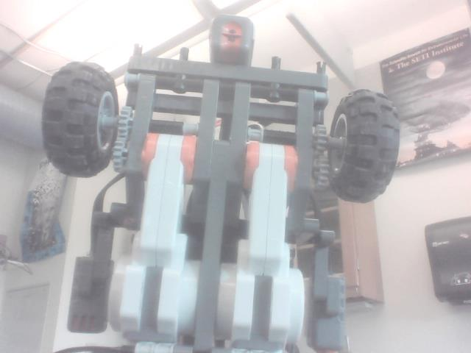
Wheels and Gears
We used regular size wheels for our robot. These wheels gave us enough speed to traverse quickly along mars and efficiently through obstacles.
We chose to use the regular or small size gears. This enabled our robot to move rapidly and move further in less time

Slide 5
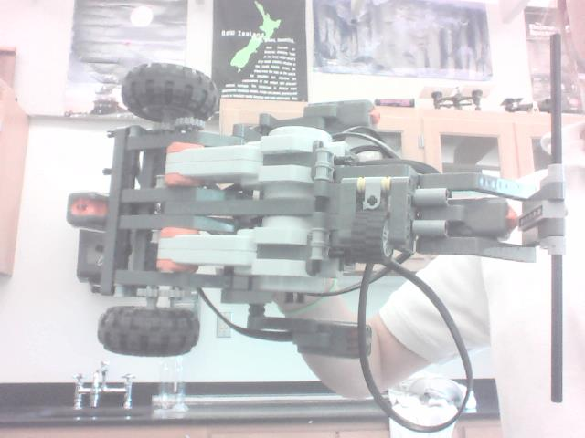
In front view
Below view (underneath)

Slide 6
Forward Program
Notes:
http://mars.jpl.nasa.gov/MPF/index1.html

Slide 7
These begin the motors for the wheels connected to port C and B. The speed of both motors is at 75 out of 100 and the wheels are moving in a forward motion.
This “wait for” block is a rotation sensor which waits for the motor connected to port C to rotate the wheel 720 degrees forward before commanding the next action.
These blocks brakes the motors for the wheels connected to port C and B. It is an immediate brake, not a coast

Slide 8
Backward Program

Slide 9
Motor block C B are programed to move the wheels connected to port C and B forward at a power level of 75 out of 100 for 720 degrees.
The “wait for” block is set on a rotation senor which is designed to make the robot wait until the wheel attached to port C is finished rotating backwards 720 degrees before conducting the next action.
The two last motor blocks C and B are designed to make the wheels connected to port C and B stop after fully rotating 720 degrees.

Slide 10
Turning Program
This program turns our robot around wheel C for a wheel rotation of 360 degrees

Slide 11
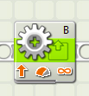
This block stops the motor for the wheels connected to port C. It is an immediate brake, not a coast.
These begin the motor for the wheel connected to port B. The speed of motor B is at 75 out of 100 and the wheel is moving in a forward motion.
This “wait for” block is a rotation sensor which waits for the motor connected to port C to rotate the wheel a 720 degrees forward before commanding the next action.
These blocks brakes the motors for the wheels connected to port C and B. It is an immediate brake, not a coast

Slide 12
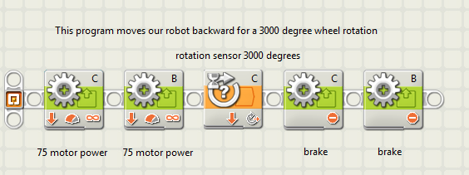
Inclined and Declined Slopes

Slide 13
**Our backwards program is designed to move our robot backwards for 3,000 degree wheel rotations because when we set up our test runs in class with the measurements of the actual slope, 3,000 degree rotations were the perfect length to get over the slope
These begin the motors for the wheels connected to port C and B. The speed of both motors is at 75 out of 100 and the wheels are moving in a backwards motion.
This “wait for” block is a rotation sensor which waits for the motor connected to port C to rotate the wheel 3000 degrees backwards before commanding the next action.
These blocks brakes the motors for the wheels connected to port C and B. It is an immediate brake, not a coast

Slide 14
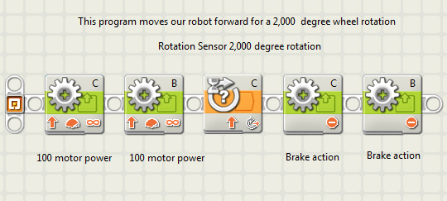
Rough Terrain Program

Slide 15
These begin the motors for the wheels connected to port C and B. The speed of both motors is at 100 out of 100 and the wheels are moving in a forward motion.
This “wait for” block is a rotation sensor which waits for the motor connected to port C to rotate the wheel a 720 degrees forward before commanding the next action.
These blocks brakes the motors for the wheels connected to port C and B. It is an immediate brake, not a coast

Slide 16
Hematite Trail Program

Slide 17
The entire line track program is on a continuous loop for 90 seconds.
Light Sensor → If the light sensor detects lights above the threshold (on our program the threshold is 50), then the switch block commands the top half of the program (top 2 motor blocks) to begin and when the light sensor detects light below the threshold, then the switch block commands the bottom half of the program (bottom 2 motor blocks) to begin.
Top 2 motor blocks → The first block stops the motor for the wheels connected to port C. It is an immediate brake, not a coast. These begin the motor for the wheel connected to port B. The speed of motor B is at 75 out of 100 and the wheel is moving in a forward motion.
Bottom 2 motor blocks → The first block stops the motor for the wheels connected to port B. It is an immediate brake, not a coast. These begin the motor for the wheel connected to port C. The speed of motor C is at 75 out of 100 and the wheel is moving in a forward motion.

Slide 18
Touch Sensor

Slide 19
Motor block C B are programed to move the wheels connected to port C and B forward at a power level of 75 out of 100 until otherwise told differently. We chose a power level of 75 because it as not to fast or to slow
This “wait for” block is a touch sensor which waits for the motor connected to port 4 to sensor any touch.
The two last motor blocks C and B are designed to make the wheels connected to port C and B stop after port 4 senses the touch.

Slide 20
Test Simulations
Rough Terrain simulation: helped us choose which speed to use to move over the rough terrain. We learned our robot would not move through the rocks if we went too slow.
Hematite Trail simulation: helped us find the correct threshold. We also figured out the time it would take to traverse the trail
Tunnel simulation: helped us have a better understand of our robot by allowing us to figure out it didn’t move forward completely straight – it turned right over time. We also learned that we could move at a fast speed through the tunnel
Touch Sensor simulation: helped us figure out how close we needed to get to the rock before we started the program (since it ran infinitely). We learned that the ultrasonic sensor would not always pick up the correct obstacle, for example thin or small objects.

Slide 21
Map of Mars

Slide 22
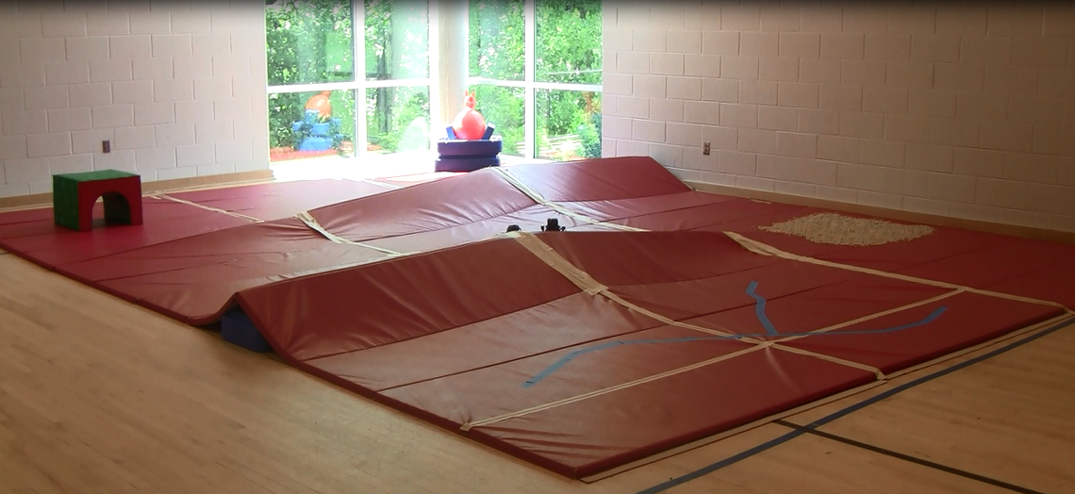
On Mars
Completed:
Rough terrain
Hematite trail

