Slide 1
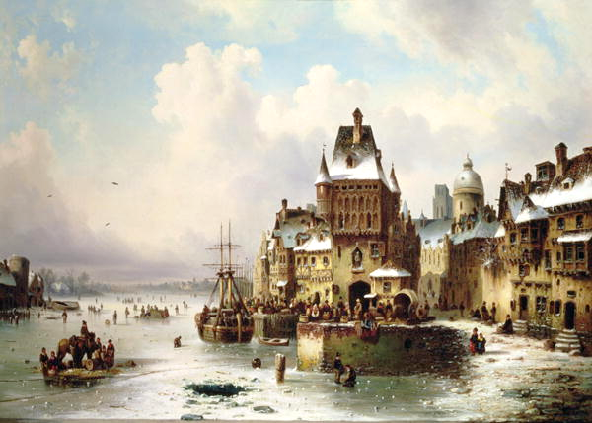
The 7 bridges of Köengsberg
By Cassidy, Carolyn and Sally

Slide 2
Can you cross each bridge once?

Slide 3
IT’S IMPOSSIBLE

Slide 4
Why doesn’t this work?
It is impossible to cross each of the bridges one time because
On each region of land there must be an even number of exits and entrances

Slide 6
Euler Theorems
Euler proved that if a network has more than two odd vertices than it doesn’t have Euler path
If a network has two or zero odd vertices than it has at least one Euler path, but it can only start at one odd vertices and end at the other odd vertices

Slide 7
Can you find the Euler paths?

Slide 10
bibliography
www.oceansbridge.com
http://spikedmath.com/541.html
en.wikipedia.org
http://mathforum.org/isaac/problems/bridges2.html
degrassi.wikia.com
www.gifwave.com
gifsoup.com
giphy.com
www.enstarz.com

