Slide 1
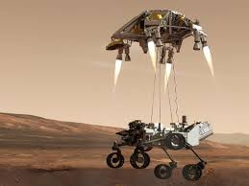
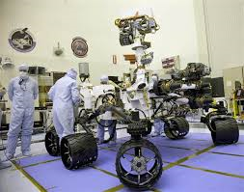
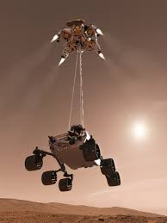
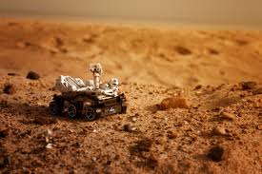
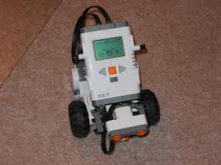
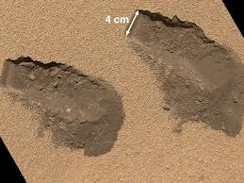
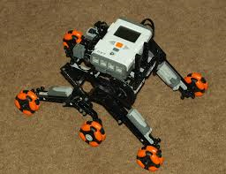
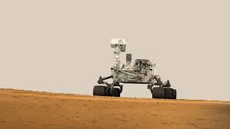
Traversing Mars
By: Cassidy Craig and Colby Yablon

Slide 2
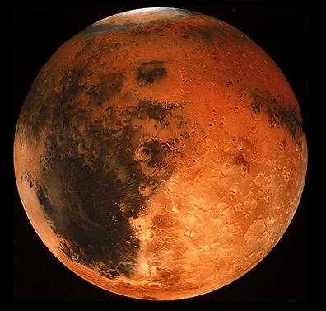
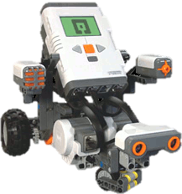
On Mars, we plan to explore…
Hematite trails
Rough terrains
Inclined terrains
Declined terrains
Tunnels
Narrow passages
Composition of rocks

Slide 3
MAP OF MARS
Hematite Trail
Inclined and Declined Slopes
Tunnel
We used the map of Mars to create test simulations during class.
Inclined Slope
Rough Terrain
The simulation help us be successful and chose the correct programs for when we actually traversed Mars.
Rock

Slide 4
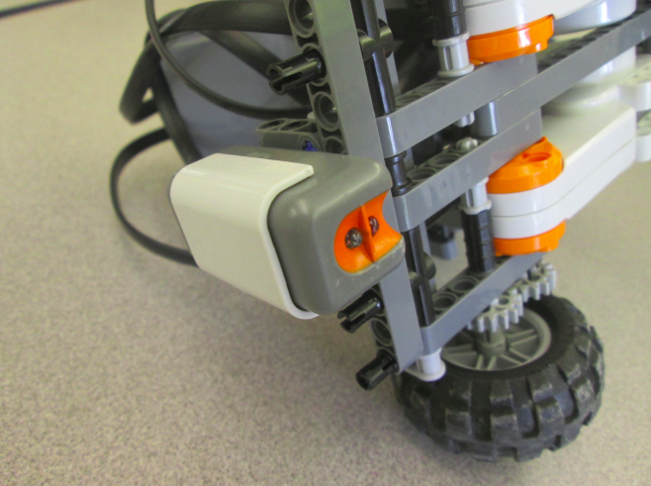
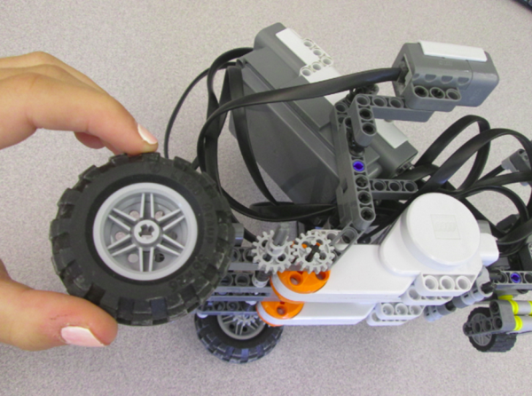
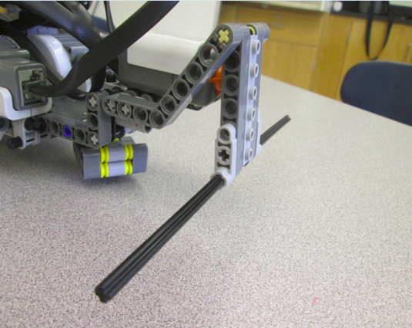
Robot Configuration
Two 16- tooth Gears
Small Wheels
Sonar Touch Sensor
Light Sensor
Notes:
We chose the wheel and gear configuration because our robot was able to complete all the programs in practice with this standard wheel configuration.

Slide 5
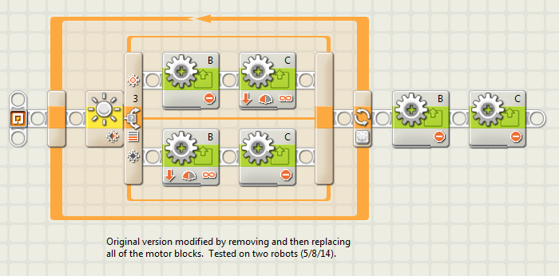
When Tracking Hematite Trials…

Slide 6
When Traversing in Rough Terrains…
2160

Slide 7
When Traveling on Inclined and Declined Terrains…

Slide 8
When Traveling through Tunnels…

Slide 9
When traveling through Narrow Passages…
Forwards
Backwards

Slide 10
Left Turn
Right Turn

Slide 11
When Detecting the Composition of a Rock…

Slide 12
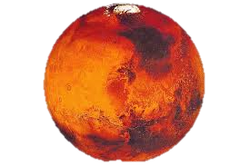
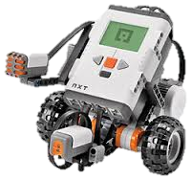
Colby and Cassidy

Slide 13
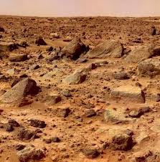
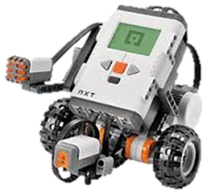
Thank you

