Slide 1
3D Transformations Using Matrices
Marsie Salvatori, Carolyn Usry, and Cassidy Craig

Slide 2
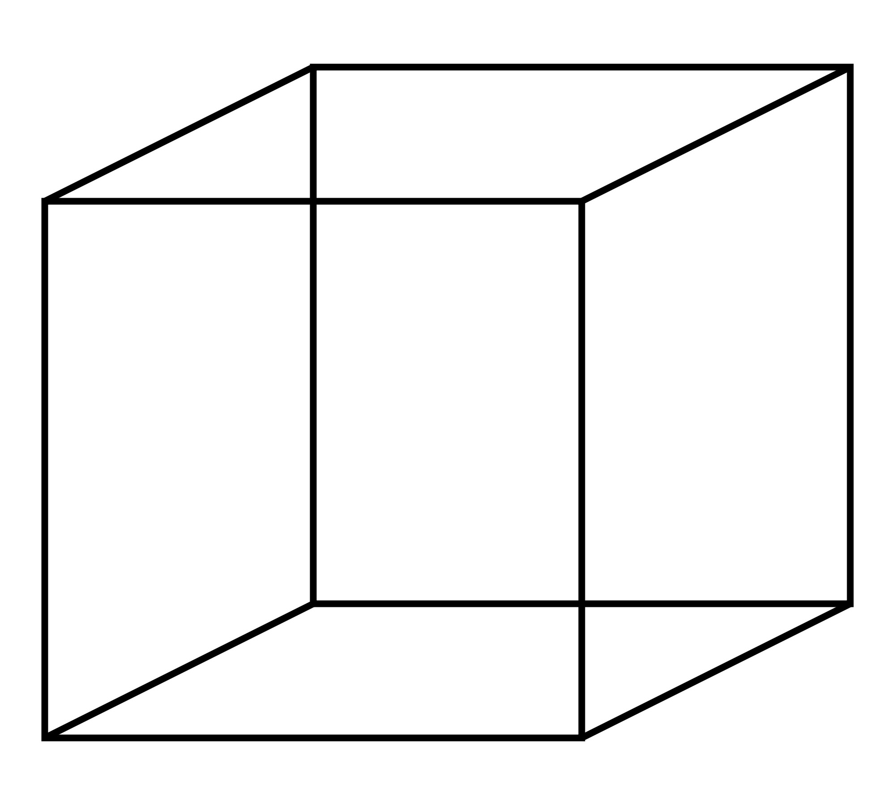
Cube
Number of Faces: 6
Number of Edges: 12
Number of Vertices: 8

Slide 3
Creating the Matrix
The number of columns in a 3D matrix is always four
- The first row represents the x values
- The second row represents the y values
- The third row represents the z values
- The last row contains only ones
The number of rows in a 3D matrix depends on the shape being graphed
- Specifically the number of vertices
Because we are graphing a cube, we will use a 4 x 8 matrix

Slide 4
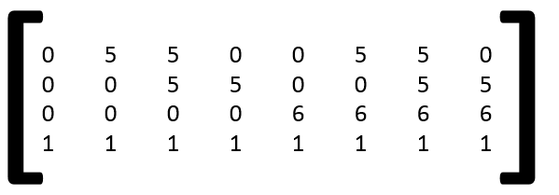
Creating the Matrix (2)
Each column number represents the x, y, and z coordinates of the respective numbered vertex of the cube

Slide 5
The FreeMat Script
cube= [0 5 5 0 0 5 5 0 ; 0 0 5 5 0 0 5 5 ;0 0 0 0 5 5 5 5 ; 1 1 1 1 1 1 1 1]
draw(cube)

Slide 6
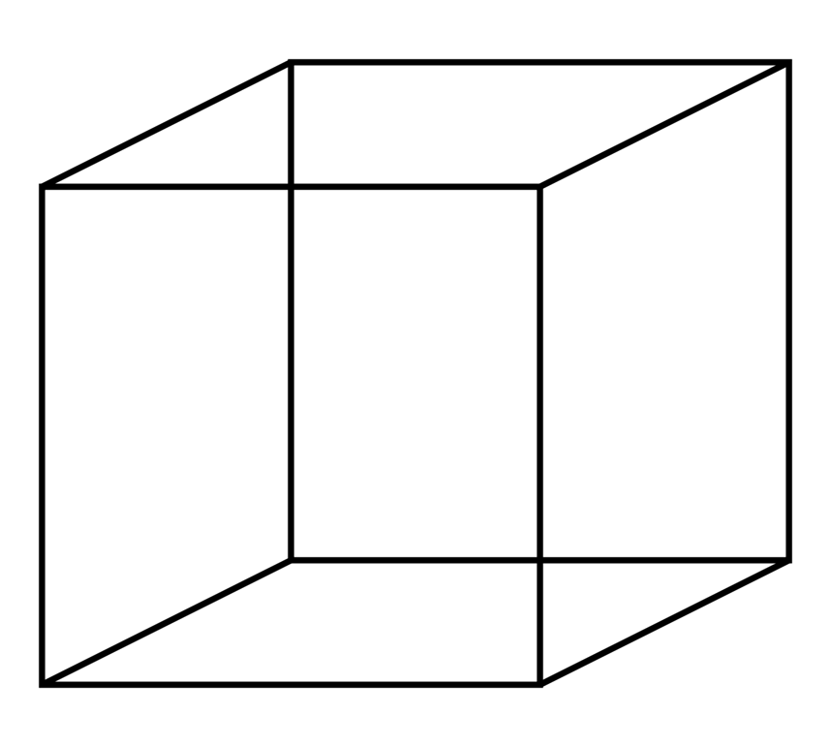
Translating the Cube
[ ]
1 0 0 6
0 1 0 7
0 0 1 5
0 0 0 1
X
Y
Z
Identity matrix
Moving the cube 6 spaces to the right, 7 spaces up, and 5 spaces forward

Slide 7
The FreeMat Script
trans= [1 0 0 6 ; 0 1 0 7 ; 0 0 1 5 ; 0 0 0 1]
trans*cube
Draw(ans)

Slide 8
Scaling the Cube
[ ]
4 0 0 0
0 4 0 0
0 0 4 0
0 0 0 1
Quadrupling the cube

Slide 9
The FreeMat Script
scale= [4 0 0 0 ; 0 4 0 0 ; 0 0 4 0 ; 0 0 0 1]
scale*cube
draw(ans)

Slide 10
Orthographic Projection
Definition: a means of representing a three-dimensional object in two dimensions
[ ]
1 0 0 0
0 1 0 0
0 0 0 0
0 0 0 1
X
Y
Z
Z = 0 not one in this identity matrix because we are technically using a 2-D graph

Slide 11
The FreeMat Script
op= [1 0 0 0 ; 0 1 0 0 ; 0 0 0 0 ; 0 0 0 1]
trans*scale*op
ans*cube
Draw(ans)

Slide 12
Rotating the Cube around the X Axis
[ ]
1 0 0 0
0 cos60 -sin60 0
0 sin60 cos60 0
0 0 0 1
Rotates the cube 60 degrees around the x axis

Slide 13
Rotating the Cube around the Y Axis
[ ]
cos60 0 sin60 0
0 1 0 0
-sin60 0 cos60 0
0 0 0 1
Rotates the cube 60 degrees around the y axis

Slide 14
Rotating the Cube around the Z Axis
[ ]
cos60 -sin60 0 0
sin60 cos60 0 0
0 0 1 0
0 0 0 1
Rotates the cube 60 degrees around the z axis

Slide 15
The FreeMat Script
sin60=sqrt(3)/2
cos60= 0.5
x= [1 0 0 0 ; 0 cos60 –sin60 0 ; 0 sin60 cos60 0 ; 0 0 0 1]
y= [cos60 0 sin60 0 ; 0 1 0 0 ; -sin60 0 cos60 0 ; 0 0 0 1]
z= [cos60 –sin60 0 0 ; sin60 cos60 0 0 ; 0 0 1 0 ; 0 0 0 1]
composite= x*y*z
total= op*trans*scale*composite
total*cube
draw(ans)

Slide 16
Bibliography
I used the dictionary to search the definition of orthographic projection.
http://www.merriam-webster.com/dictionary/orthographic%20projection
I used this website to observe the coordinates of a cube.
http://cccmz.de/~fw/howtos/isw/parts/3d/chapter_1/chapter_1_basic_3d.pdf
I also used the FreeMat packet that we received in STEM class.

