Slide 1
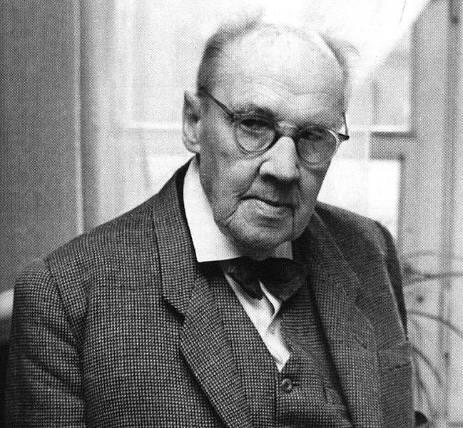
Waclaw Sierpinski

Slide 2
Who is Waclaw Sierpinski?
Born: March 14, 1882, in Warsaw, Poland
Died: October 21, 1969, in Warsaw, Poland
Education: University of Warsaw
Work:
Wrote more than 700 papers and 50 books
Areas of set theory
Point set topology
Number theory
Notes:
University of Warsaw: went for four year and was awarded a gold medal for math
Set theory: “a branch of mathematics or of symbolic logic that deals with the nature and relations of sets” – Merriam Webster
Point set topology: “a branch of topology concerned with the properties and theory of topological spaces and metric spaces developed with emphasis on set theory” – Merriam Webster
Number theory: “the study of the properties of integers” – Merriam Webster

Slide 3
What did he do?
Graduated from college in 1904
Worked as a teacher until the school was shut down
Sierpinski became a part of the Department of Mathematics and Physics at the University of Warsaw
Got his doctorate
1907 – became interested in set theory
1909 – Sierpinski gave the first lecture about set theory
Published three books: The theory of irrational numbers (in 1910), Outline of Set Theory (in 1912) and The theory of Numbers (in 1912)
1919 – became professor at University of Warsaw
Fundamenta Mathematicae – a journal which Sierpinski edited about set theories
Retired as a professor in 1960

Slide 4
Fractals
A pattern that goes on forever
Every part of the pattern is self similar
http://fractalfoundation.org/resources/what-are-fractals/
http://www.youtube.com/watch?v=TLxQOTJGt8c

Slide 5
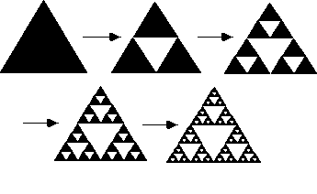
2-D Sierpinski
Sierpinski Gasket or Triangle
Start with one triangle
Mark the mid-point on each side and attach each point
Now there should be four triangles
The center triangle is removed
The process is repeated an infinite number of times
Sierpinski Carpet
Start with one square
Draw a smaller square similar to the first square in the center
Now from each vertex of the newly formed square, draw one vertical and one horizontal line to the sides of the first square
The center square is removed
The process is repeated an infinite number of times

Slide 6
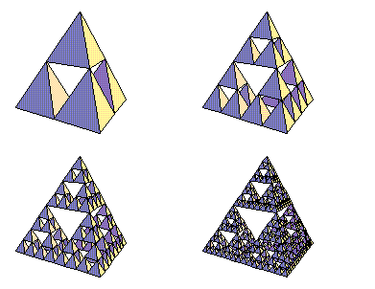
3-D Sierpinski
Sierpinski Gasket or Triangle
Similar to the 2-dimensial form of the gasket
Instead adding triangles, square based pyramids are added
Instead of removing triangles, octagons are removed
Menger Sponge
“It is created by sectioning the unit cubes by slits of width 1/3… The central piece and each cube located at the center of the faces are removed.” (http://paulbourke.net/fractals/gasket/)

Slide 7
Sierpinski and Topology
Sierpinski Space is a topologic space

Slide 8
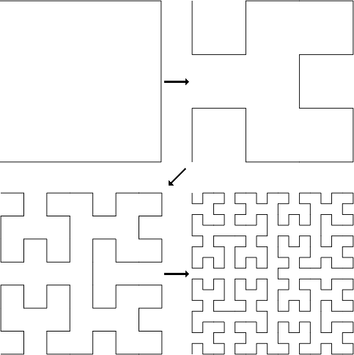
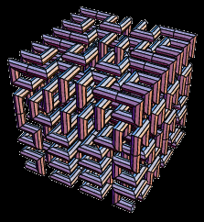
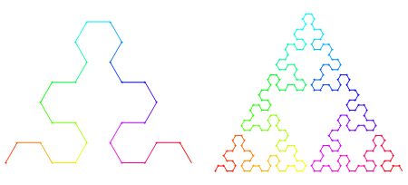
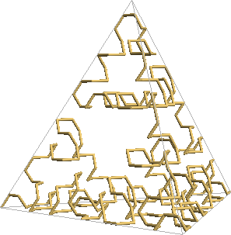
Hilbert and Sierpinski
Hilbert and Sierpinski– both are used to fill up three dimensional space
Hilbert Curve and Sierpinski Arrowhead Curve – both fractal curves that can be shown in both 2 and 3 dimensional forms

Slide 9
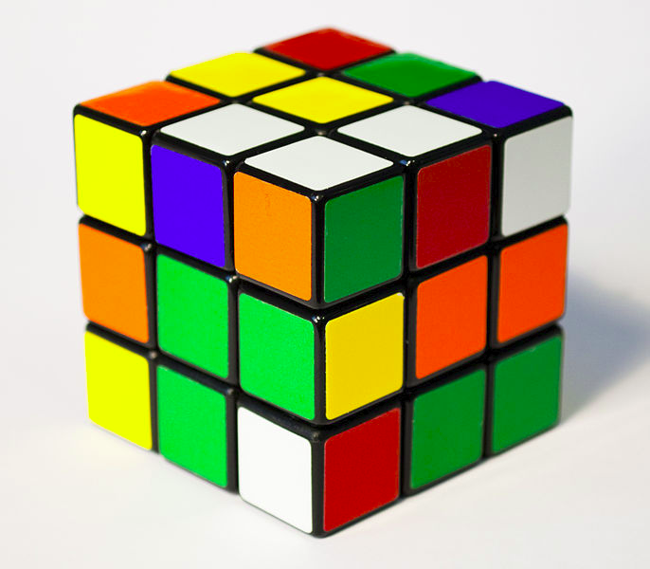
Sierpinski and Rubik
Removing the center cubes in a Rubik’s Cube can form a Menger Sponge

Slide 10
Work Cited
http://www.merriam-webster.com/dictionary/number%20theory
http://www.merriam-webster.com/dictionary/point+set+topology?show=0&t=1416158499
http://www.merriam-webster.com/dictionary/set%20theory
http://ecademy.agnesscott.edu/~lriddle/ifs/siertri/sierbio.htm
http://math.bu.edu/DYSYS/chaos-game/sierp-det.GIF
http://theiff.org/images/menger/menger1.gif
http://www.ics.uci.edu/~eppstein/junkyard/robertd/tetrarray.gif
http://fractalfoundation.org/OFC/OFC-2-2.html
http://paulbourke.net/fractals/gasket/
http://www-history.mcs.st-andrews.ac.uk/Biographies/Sierpinski.html
http://www-history.mcs.st-andrews.ac.uk/Biographies/Sierpinski.html
http://www.oxforddictionaries.com/us/definition/american_english/Sierpinski-triangle
http://en.wikipedia.org/wiki/Sierpinski_carpet#mediaviewer/File:Animated_Sierpinski_carpet.gif
http://ncatlab.org/nlab/show/Sierpinski+space#as_a_classifer_for_closed_subspaces
http://www.robertdickau.com/hilbert3d.html
http://www.robertdickau.com/sierpinskiarrow.html
http://yozh.org/wp/wp-content/uploads/2010/10/hilbert-0-3.png
http://mathworld.wolfram.com/HilbertCurve.html
http://demonstrations.wolfram.com/TheMengerSponge/
http://upload.wikimedia.org/wikipedia/commons/d/de/Menger_sponge_(Level_0-3).jpg
http://upload.wikimedia.org/wikipedia/commons/thumb/e/ee/Rubik's_Cube_cropped.jpg/686px-Rubik's_Cube_cropped.jpg
http://www.edupress.pl/gfx/edupress/pl/defaultaktualnosci/569/128/1/2061037933.jpg
http://paulbourke.net/fractals/gasket/angelo.gif

Slide 11
Work Cited Continued
http://www-history.mcs.st-andrews.ac.uk/Biographies/Hilbert.html
http://datagenetics.com/blog/march22013/c.png
http://www.robertdickau.com/mooresier6.png
http://1.bp.blogspot.com/-Yu3EUX3fGVE/Ty8ExxA42rI/AAAAAAAAAEE/VVklbL7J4UA/s1600/Screen%2BShot%2B2012-02-05%2Bat%2B22.35.32.png
http://upload.wikimedia.org/wikipedia/commons/5/52/Menger-Schwamm-farbig.png
http://pc-ua.com.ua/images/line2.JPG
https://www.vismath.eu/en/3d-models/hilbert-curve-3d-print
http://www.slideshare.net/theblackcatcomesback/david-hilbert-presentation
http://www.soc.napier.ac.uk/~cs66/hilbert.html
http://www.jasondavies.com/hilbert-curve/
http://www.britannica.com/EBchecked/topic/511991/Erno-Rubik
http://pics2.ds-static.com/prodimg/411354/300.JPG
http://www.infoplease.com/biography/var/ernorubik.html
http://thecube.guru/erno-rubik/
http://www.rubiks.com/solving-guide/3x3
http://hyderabadtalks.com/2013/07/benefits-of-solving-a-rubiks-cube/
http://www.cs.swarthmore.edu/~knerr/helps/rcube.html
http://www.rubiks.com/history
http://upload.wikimedia.org/wikipedia/commons/b/bc/Rubiks_cube_inside.JPG
https://d2t1xqejof9utc.cloudfront.net/screenshots/pics/c49c2243f52343074a1d5db09ae6f5d1/medium.JPG
http://upload.wikimedia.org/wikipedia/commons/9/9a/Rubik's_Cube_variants.jpg
http://www.puzzlesolver.com/data/29/images/head.jpg

