Slide 1
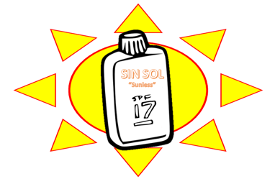
SIN SOL SUNSCREEN
Erin Waire,
Reilley Chamness,
and
Cassidy Craig

Slide 2
Summary of the task
Main goals:
- Create the most safe sunscreen with the highest SPF using benzophenone-3 and ethylhexylmethoxycinnamate
- Create the most durable package to successfully transport the sunscreen
- Optimize the lowest cost for both the ingredients used in the sunscreen and the packaging materials
The MSDS set a safety maximum for the two chemical used in our sunscreen
- Benzophenone-3: 6%
- Ethylhexylmethoxycinnamate: 7.5%
Notes:
Most safe = LD 50 tests → acute toxicity test that are conducted to see how much of a chemical is needed to kill 50% of a population
Highest SPF = varies between the different chemicals used

Slide 3
MSDS Safety Precautions
Ingredients | Common Safety Methods
Cetyl Alcohol Benzophenone-3 Ethylhexylmethoxycinnamate Steric Acid Glycerin Trethanol Amine | Slightly hazardous to hazardous in cases of skin contact, eye contact, indigestion, and inhalation Combustible at high temperature or when exposed to open flames/sparks, heat, or oxidizing materials Store in a tightly closed container in a cool, well-ventilated area Wear gloves, lab coat, splash goggles, and vapor respirator while handling
Distilled Water | Contains no chemicals Not harmful to humans

Slide 4
Cost analysis for the sunscreen ingredients
Ingredients | Amount | Price per Gram | Website
Cetyl Alcohol | 2.0 g | $0.0175 | www.alibaba.com
Benzophenone-3 | 5.22 g | $0.0027 | www.alibaba.com
Ethylhexylmethoxycinnamate | 3.26 g | $0.0147 | www.alibaba.com
Steric Acid | 4.0 g | $0.01 | www.grainger.com
Glycerin | 2.0 g | $0.035 | www.alibaba.com
Trethanol Amine | 1.0 g | $0.048 | www.amazon.com
Water, Distilled | 78.0 g | $0.0002325 | www.wallmart.com
GOAL PRICE: $0.35
TOTAL PRICE: $0.27 !!!
Notes:
All three of us searched for each ingredient needed in our sunscreen separately online
We looked to try to find the lowest price per gram
We analyzed each of our prices and in this table combined the lowest price found for each ingredient

Slide 5
What is LD50 testing?
Tests that are conducted on living things to determine the amount of a chemical is required to kill 50% of the population
- 50% survival rate insures that the specific dose will not have a harmful effect on the organism
- The safest dose of the chemical will have to highest survival rate
Tested on E. coli (bacteria) and D. pulex (sea fleas)

Slide 6
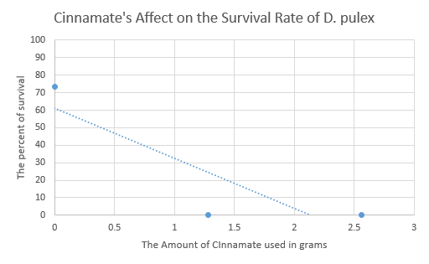
Ld50 data
Ethylhexylmethoxycinnamate E.coli Testing (Average)
Ethylhexylmethoxycinnamate D. pulex Testing (Average)
Amount | #/cm²
0.0 grams | 62.7%
0.013 grams | 65.9%
0.026 grams | 62.1%
Amount | Percent that Survived
0.0 grams | 73.3 %
1.28 grams | 0 %
1.56 grams | 0 %
BASED ON THE TRENDLINE, AMOUNTS OF CINNAMATE FROM 0 g TO 0.4 g CAN BE USED BECAUSE THE SURVIAL RATE WOULD BE ABOVE 50%

Slide 7
Conclusions from ld50 Ethylhexylmethoxycinnamate tests
As a group, we discuss the solubility of ethylhexylmethoxycinnamate
- Soluble in oil and alcohol
- Insoluble in water
In the E. coli testing, all three values had a survival rate over 50%
- E. coli is a bacteria that is stored in alcohol
- Ethylhexylmethoxycinnamate was fully and thoroughly mixed into the E. coli solution → high survival rate (all over 50%)
Notes:
E. Coli was in an alcohol solutions when we conducted our tests

Slide 8
Conclusions from ld50 Ethylhexylmethoxycinnamate tests
In the D. pulex testing, only the control had a survival rate over 50%
- D. pulex is a organism that lives in water
- Because of its insolubility in water, ethylhexylmethoxycinnamate was not able to dissolve into the D. pulex solution → high concentration = no survival rate (all 0%)
Major effect on our testing
No other complex organisms that are safely stored or mixed with alcohol to test
WE CHOSE TO USE THE 50% VAULE OF THE ETHYLHEXYLMETHOXYCINNAMATE BECAUSE OF INSOLUBILITY IN WATER→ 3.26 g
Notes:
EXPLAIN HOW 3.26 G WAS FOUND → 7.5% OF THE SUNSCREEN

Slide 9
Recommendations for the formula mix and total cost
Benzophenone-3 E.coli Testing (Average)
Benzophenone-3 D. pulex Testing (Average)
Amount | #/cm²
0.0 grams | 67.8%
0.0043 grams | 67.6%
0.0107 grams | 57.6%
Amount | Percent that Survived
0.0 grams | 95%
0.43 grams | 0%
0.85 grams | 0%
Amount | Percent that Survived
0.0 grams | 100%
0.1075 grams | 0%
0.215 grams | 0%
Amount | Percent that Survived
0.0 grams | 100%
0.01 grams | 40%
0.05 grams | 0%

Slide 10
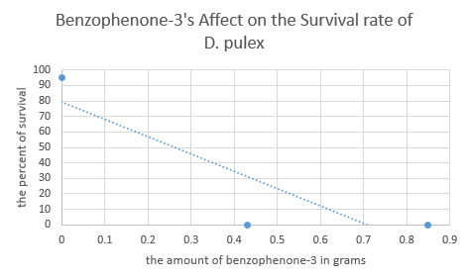
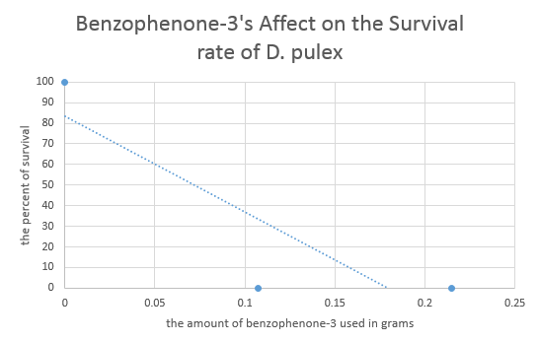
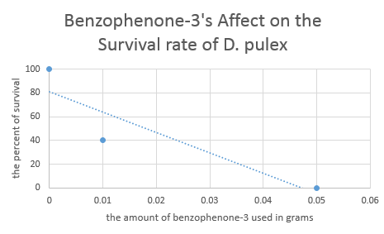
Continued…
GRAPH 1:
THE TRENDLINE SUGGESTS THAT AMOUNTS FROM 0 g TO 0.26 g CAN BE USED BECAUSE THE SURVIAL RATE IS ABOVE 50%
GRAPH 2:
THE TRENDLINE SUGGESTS THAT AMOUNTS FROM 0 g TO 0.075 g CAN BE USED BECAUSE THE SURVIAL RATE IS ABOVE 50%
GRAPH 3:
THE TRENDLINE SUGGESTS THAT AMOUNTS FROM 0 g TO 0.018 g CAN BE USED BECAUSE THE SURVIAL RATE IS ABOVE 50%
Notes:
50 percent survival rate = (0.016,5)

Slide 11
Conclusions from ld50 Benzophenone-3 tests
As a group, we discuss the solubility of benzophenone-3
- Soluble in oil and alcohol
- Insoluble in water
In the E. coli testing, all three values had a survival rate over 50%
- E. coli is a bacteria that is stored in alcohol
- Benzophenone-3 was fully and thoroughly mixed into the E. coli solution → high survival rate (all over 50%)
Notes:
E. Coli was in an alcohol solutions when we conducted our tests

Slide 12
Conclusions from ld50 Benzophenone-3 tests
In the D. pulex testing, only the control had a survival rate over 50%
- D. pulex is a organism that lives in water
- Because of its insolubility in water, the benzophenone-3 was not able to dissolve into the D. pulex solution → high concentration = no survival rate (all 0%)
Major effect on our testing
No other complex organisms that are safely stored or mixed with alcohol to test
WE CHOSE TO USE THE 100% VAULE OF THE BENZOPHENONE-3 BECAUSE OF THE INSOLUBILITY OF WATER→ 5.22 g
Notes:
Decided to conduct more tests on the Benzophenone → longer survival rate (time) → could see the sea fleas dying almost as soon as they entered the Cinnamate
→ Before we found the major flaw in our experiment that would have saved a lot of time

Slide 13
Recommendation for the sunscreen formula
PRODUCT | AMOUNT
Cetyl Alcohol | 2.0 g
Benzophenone-3 | 5.22 g
Ethylhexylmethoxycinnamate | 3.26 g
Steric Acid | 4.0 g
Glycerin | 2.0 g
Trethanol Amine | 1.0 g
Water, Distilled | 78.0 g

Slide 14
SPF (Sun protection factor)
The SPF depends on the amount of specific chemicals used in the sunscreen
Ethylhexylmethoxycinnamate: 1% corresponds to an SPF of 2
Benzophenone-3: 1% corresponds to an SPF of 1.5
We used 3.75% Ethylhexylmethoxycinnamate and 6% Benzophenone-3
- Ethylhexylmethoxycinnamate: 3.75% × 2 = 7.5 SPF
- Benzophenone-3: 5.44% × 1.5 = 8.16 SPF
TOTAL SPF: 16

Slide 15
Visual Representation of Initial Material Findings
 | Drop Test | Shake Test | Weight Test | Throw Test | Water Test | Heat Test | Total
Recyclable Newspaper | 3 | 3 | 3 | 3 | 0 | 3 | 15
Plastic Baggies | 3 | 0 | 3 | 3 | 3 | 3 | 15
Masking Tape | 3 | 2 | 3 | 3 | 0 | 3 | 14
Wax Paper | 3 | 3 | 3 | 3 | 3 | 2.5 | 17.5
Cardboard Square | 3 | 0 | 3 | 2 | 2 | 3 | 13
Plastic Wrap | 2 | 2 | 2 | 2 | 3 | 3 | 14
Tin Foil | 2 | 2 | 3 | 0 | 3 | 3 | 13
Duct Tape | 3 | 2 | 3 | 3 | 3 | 3 | 17
KEY:
No Damage: 3
Little Damage: 2
Lots of Damage: 0
TOTAL AMOUNT OF POINTS IN EACH SECTION: 18

Slide 16
Justification of Materials Selected for Package Construction
 | Drop Test | Shake Test | Weight Test | Throw Test | Water Test | Heat Test | Total
Recyclable Newspaper | 3 | 3 | 3 | 3 | 0 | 3 | 15
Plastic Baggies | 3 | 0 | 3 | 3 | 3 | 3 | 15
Masking Tape | 3 | 2 | 3 | 3 | 0 | 3 | 14
Wax Paper | 3 | 3 | 3 | 3 | 3 | 2.5 | 17.5
Cardboard Square | 3 | 0 | 3 | 2 | 2 | 3 | 13
Plastic Wrap | 2 | 2 | 2 | 2 | 3 | 3 | 14
Tin Foil | 2 | 2 | 3 | 0 | 3 | 3 | 13
Duct Tape | 3 | 2 | 3 | 3 | 3 | 3 | 17
Notes:
Explain verbally why you chose the materials that we did and how we are using the other materials to improve the score of our materials

Slide 17
Cost analysis of the package
Maximum budget (using glue) - $3.00
Maximum budget (without glue) - $4.00
Our materials:
- 1 cardboard square - $1.00
- 2 plastic bag - $1.00 ($0.50 each)
- 1 wax paper - $0.50
- Glue
TOTAL COST: $2.50 !!!

Slide 18
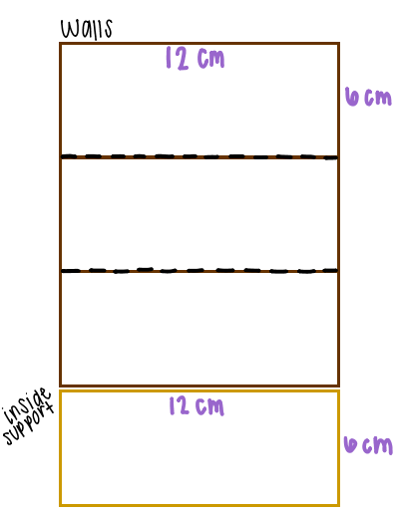
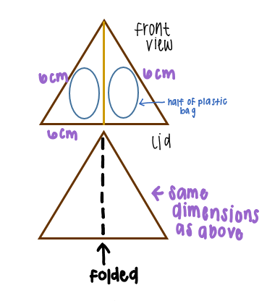
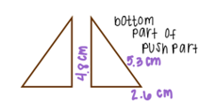
Package Design

Slide 19
Product Testing Results
Type of Test | Drop Test | Shake Test | Weight Test | Throw Test | Water Test | Heat Test | Total point value out of 18:
Score 3- no damage 2- little damage 1- lots of damage | 3 | 3 | 3 | 3 | 3 | 3 | 18

