Slide 1
Optical Illusions
By Hailey and Sally

Slide 2
Our Investigation
What are we trying to investigate?
What optical illusions are
How optical illusions work
What types of optical illusions there are
Research different types of optical illusions and show examples
3D print an optical illusion

Slide 3
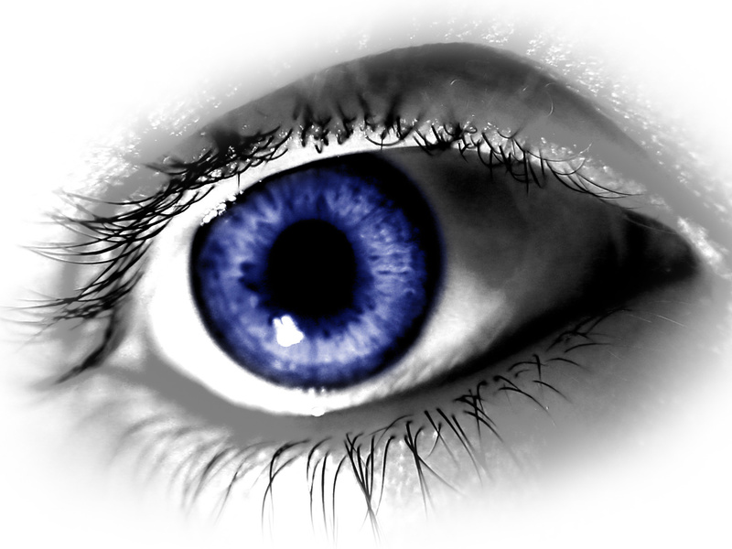
WHAT IS AN OPTICAL ILLUSION?
an experience of seeing something that is not there or does not appear as it truly exists
something that deceives the eye by visually perceiving something that is not realistic

Slide 4
3 MAIN TYPES:
A cognitive illusion is when the eye is tricked because the brain makes unconscious interferences.
A literal optical illusion is when an images different from the objects that make it up.
A physiological optical illusion is one that effects the eyes and brain because of excessive stimulation such as brightness, tilt, color, movement

Slide 5
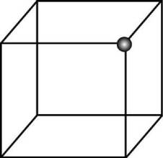
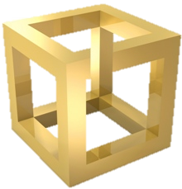
COGNITIVE ILLUSIONS
Necker Cube is one of the most common examples
The box if shifted based on the viewer’s vision:
Can be perceived from a downward position or an upward position
An example of the human eye’s ability to see a 2D object in a 3D manner
Other cognitive illusion = impossible cube
Could seem to be possible at first, however it has missing sides and can never be fully drawn as a cube
The missing sections allow for us to perceive and misinterpret the image we are actually looking act

Slide 6
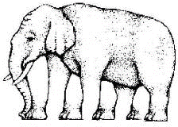
LITERAL OPTICAL ILLUSIONS
Caused by one or more objects interacting with each other
Includes the weird ability of the human eye to assume details and fill in images when they do not truly exist
The brain will chose certain details and insert them into the image
Common example = elephant with more than 4 feet

Slide 7
PHYSIOLOGICAL OPTICAL ILLUSIONS
Due to the over occurrence of an image and the over stimulation of bright light
Common example = The Herman Grid
“the contrast between the two images causes the human eye to see gray blibs in the center unless an specific intersection is focused on”
First found by Ludimar Hermann

Slide 8
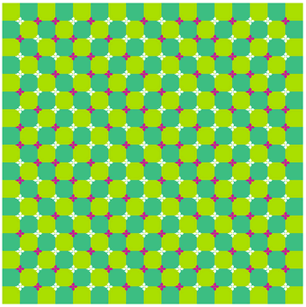
Another example of a physiological optical illusion: is the picture really moving?

Slide 9
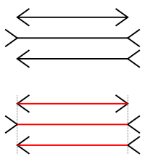
TIED TO PREVIOUS WORK
Müiller-Lyer Illusion
An optical illusion that consists of straight line segments of equal length, the different arrows on each line segment cause the line segments to seem unequal
The fins, which are on the end of the line segments, can point inwards or outwards making the shaft seem longer or shorter

Slide 10
After Images

Slide 11
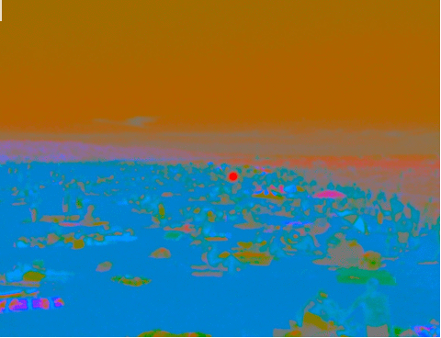
Notes:
30 seconds

Slide 12
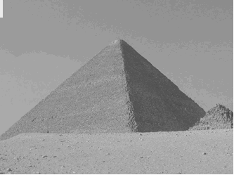
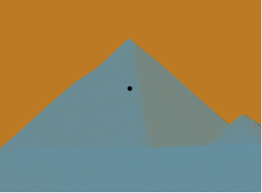

Slide 13
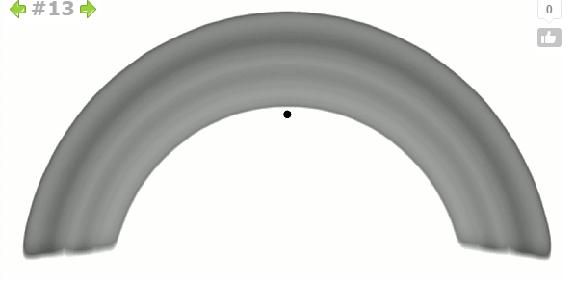
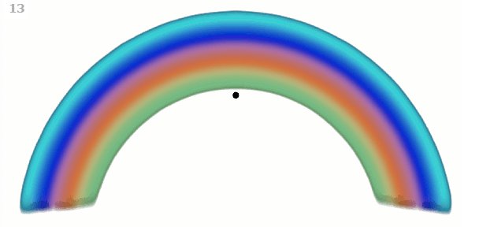

Slide 14
FOCUSING ON PHYSIOLOGICAL OPTICAL ILLUSIONS…
Afterimages and other physiological illusions work as they do because of the theory that stimuli have single dedicated neural paths in the beginning stages of processing images in the eye, and the repetition of stimulation of a single or a few channels causes physiological imbalance that alters perception.
IN OTHER WORDS…
After looking at an image for an extended period of time the bright hues will tire out the eye rods and cones

Slide 15
Our Investigation
We tried to analyze certain optical illusions and figure out which types of illusions they are
For example: face changing optical illusion + “triangle” optical illusion that we printed on the 3D printer
We concluded the different types of optical illusions and how each type works. We found out that the eyes and brain have a lot to do with optical illusions, and illusions can be perceived different on different people

Slide 16
Sources
http://izismile.com/2011/11/11/mind_blowing_afterimages_optical_illusions_3_pics_11_gifs.html
http://www.unisaustralia.com/university-quizzes-problems-brain-teasers-and-experiments/psychological-illusions-and-puzzles/psychological-optical-illusions/
http://www.worqx.com/color/after_image2.htm etheric.com
http://eyediologyopticians.co.uk/pages/Optical-illusions.html

Slide 17
Annotated Bibliography
"Mind Blowing Afterimages Optical Illusions." Izismile.com. N.p., 2011. Web. 08 Jan. 2015. http://izismile.com/2011/11/11/mind_blowing_afterimages_optical_illusions_3_pics_11_gifs.html
This website gave me examples of after images that are used in the PowerPoint. The examples were different types of afterimages, dealing with different colors and different results
"Optical Illusions - Your Eyes Playing Tricks." Eyediology Opticians. N.p., 2015. Web. 07 Jan. 2015. http://eyediologyopticians.co.uk/pages/Optical-illusions.html
This website gave me specific information on each of the 3 types of optical illusions: cognitive, literal, and physiological. There were images to go along with the information and I used the definitions and explanations of the images to describe each type of optical illusion.

Slide 18
"Insane Optical Illusions." Vial Nova. N.p., 30 May 2014. Web. 08 Jan. 2015. <http://www.viralnova.com/instant-optical-illusions/>.
This website was used to find an example of a physiological illusion in motion.
"Physiological Illusions." Psychological Illusions, Cognitive Illusions, Visual and Optical Illusions. Australia University News and Information Service, n.d. Web. 08 Jan. 2015. <http://www.unisaustralia.com/university-quizzes-problems-brain-teasers-and-experiments/psychological-illusions-and-puzzles/psychological-optical-illusions/>.
This website was used to provide an example of a physiological optical illusion that was not moving.
"After Images." Worqx. N.p., n.d. Web. 08 Jan. 2015. <http://www.worqx.com/color/after_image2.htm>.
This website was used to learn about after images and their effects on the eyes.
"Interesting Facts." Optical Illusions. N.p., n.d. Web. 08 Jan. 2015. http://opticalillusionsirisandemily.weebly.com/interesting-facts.html
This website gave me the fun facts about optical illusions.

