Slide 1
Sustainable Snow Salts
By: Marsie Salvatori, Hailey Morris, and Cassidy Craig

Slide 2
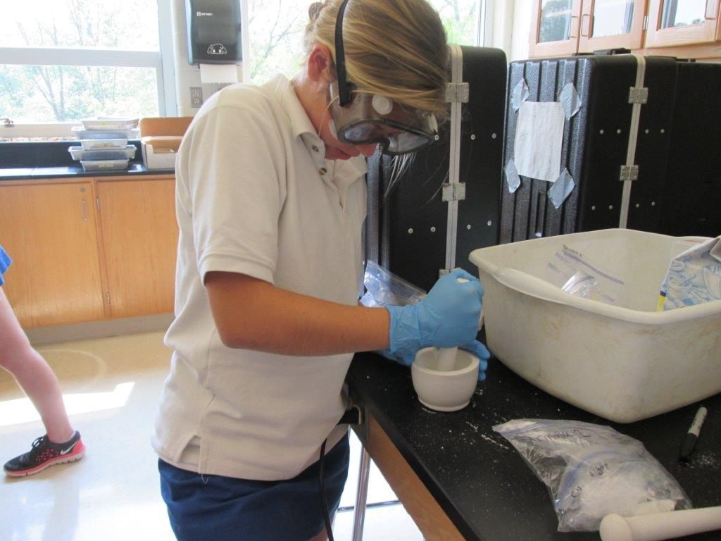
Summary of Project Constraints
Using engineering to help RPCS and the surrounding communities live more sustainable lifestyles
Our goal is:
- To create the most cost efficient alternative to snow salt
Personal constraint: no more than $0.30/ m²
In Maryland, 15 grams of formula is used per meter of land
- To create the most effective alternative to snow salt that has the least harmful effect on the environment
Formula that melts the most ice in a specific amount of time
Formula that has the least harmful visible affect on a plot of grass

Slide 3
How and Why We Chose Our Project Topic?
Brainstormed environmentally harmful substances and habits that take place around the world
Narrowed down our lists of ideas to the substances and habits that specifically effect our RPCS community
After examining a list of many harmful practices, we chose one that we all felt the strongest about
Considering that the past two winters in Baltimore have been very cold and snowy, this project can help the people in our community fight the harsh winters without harming the environment

Slide 4
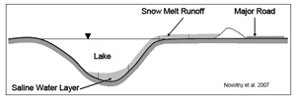
Environmental Effects
1. Water Quality
- High water density
- Deprived of Oxygen
2. Human Health
- High concentration of sodium → harmful to people with high blood pressure
3. Pet Health
- Ingestion leads to numerous symptoms ranging from drooling to death
- Irritation, inflammation, and cracking of foot pads
4. Wildlife Health
- Animals think the snow salts are pelts of food → dehydration, confusion, and weakness
5. Soil and Vegetation
- Dehydration, change in chemistry, depletion of soil, impermeability, and infertility
6. Infrastructure
- Corrosion, deterioration of concrete, car parts (brakes and frame), loss of electricity (corrosion of insulator)

Slide 5
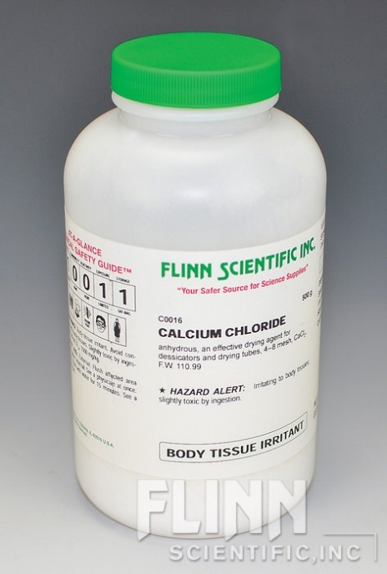
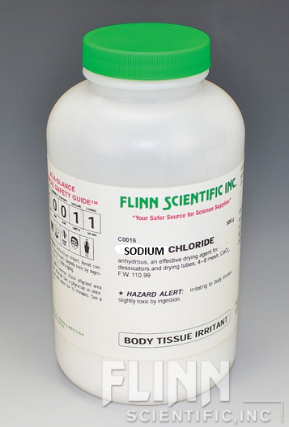
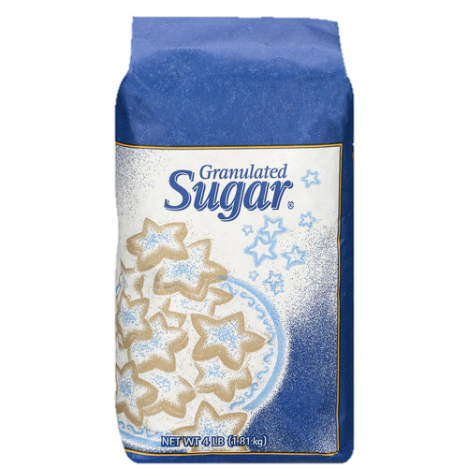
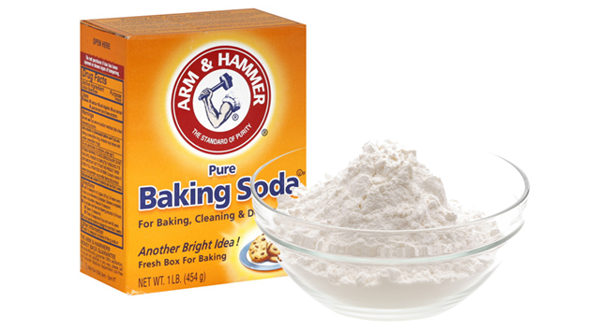
Common Ingredients Used in Snow Salts
Sodium Chloride
Calcium Chloride
Baking Soda
Sugar

Slide 6
Cost Analysis
Note: each formula has its own cost, so there is no overall cost for all of the formulas
Total Lowest Cost
Ingredient | Total cost and amount | Cost per gram | Source
Sodium Chloride | $8.95 for 500 g | $0.0179 | http://www.sciencecompany.com/Sodium-Chloride-500g-P6374.aspx
Calcium Chloride | $18.97 for 50 lbs | $0.000836 | http://www.lowes.com/pd_151998-10611-50B-HEAT_0__?productId=3540820
Sugar | $13.49 for 25 lbs | $0.0011896 | http://www.webstaurantstore.com/granulated-sugar-25-lb/104SUGAR25.html?utm_source=Google&utm_medium=cpc&utm_campaign=GoogleShopping&gclid=CNyQrKjErsUCFYgXHwodxRgAPg
Baking Soda | $1.49 for 5 lb | $0.000657 | www.acehardware.com

Slide 7
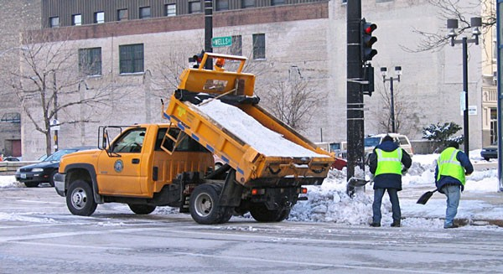
Standard Snow Salt Formula
80% sodium chloride
20% calcium chloride

Slide 8
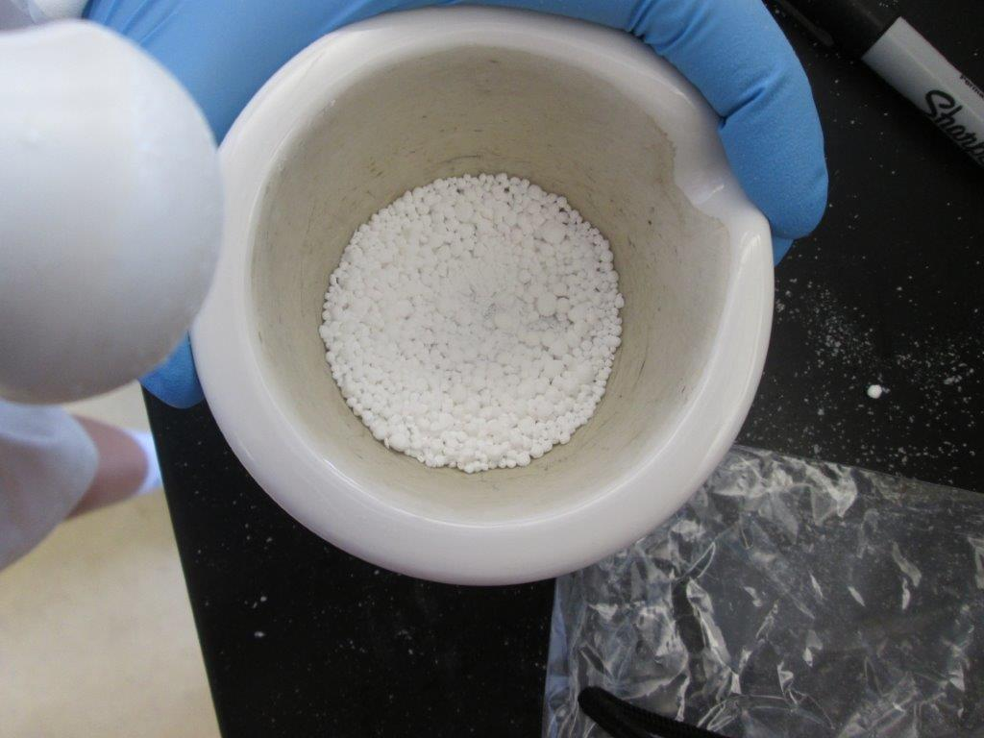
Sustainable Formulas
Formula 7
Formula 4
Formula 6
Formula 2
Formula 5
Formula 1
Formula 3
Formula 8
80% sodium chloride
15% calcium chloride
5% sugar
80% sodium chloride
10% calcium chloride
10% sugar
80% Sodium chloride
5% calcium chloride
15% sugar
80% sodium chloride
20% sugar
80% Sodium Chloride
20% Sugar
60% Sodium Chloride
20% Baking Soda
20% Calcium
40% Sodium Chloride
40% Baking Soda
20% Calcium Chloride
20% Sodium Chloride
60% Baking Soda
20% Calcium Chloride
Formula 9
Formula 12
Formula 10
Formula 11
Formula 13
80% Baking Soda
20% Calcium Chloride
60% Sodium Chloride
15% Calcium Chloride
20% Baking Soda
5% Sugar
40% Sodium Chloride
10% Calcium Chloride
40% Baking Soda
10% Sugar
20% Sodium Chloride
5% Calcium Chloride
60% Baking Soda
15% Sugar
80% Baking Soda
20% Sugar

Slide 9
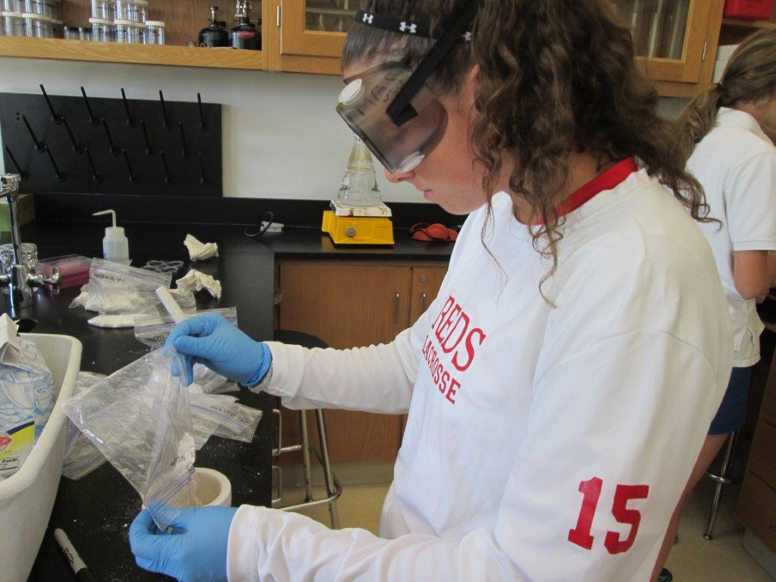
Replacing Sodium Chloride with Baking Soda
Baking soda chemical formula = NaHCO3
Sodium Chloride chemical formula = NaCl
Baking soda breaks down into water, carbon dioxide, and sodium
Sodium chloride breaks down into sodium and chlorine
Chlorine is much more harmful/toxic to plant life -- for example chlorine is used to clean pools
We chose to replace sodium chloride with a substance that does not contain chlorine

Slide 10
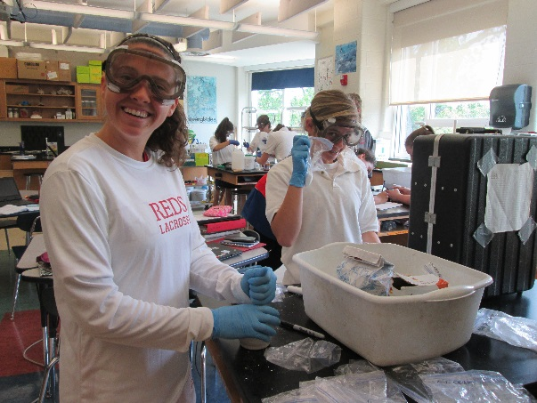
Replacing Calcium Chloride with Sugar
Sugar chemical formula = C₁₂H₂₂O₁₁
Calcium Chloride chemical formula = CaCl₂
Sugar interferes with the crystalline bonds (formed when water freezes), which occur between the water molecules and are maintained by hydrogen bonding
Calcium chloride breaks down into calcium and chlorine
Chlorine is much more harmful/toxic to plant life -- for example chlorine is used to clean pools
We chose to replace calcium chloride with a substance that does not contain chlorine

Slide 11
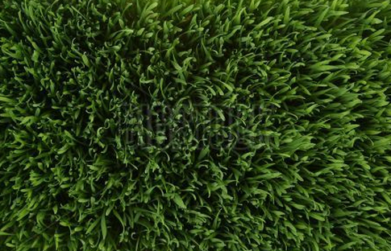
Environmental Testing Details
0.2 by 0.2 meter plots outside
Square plots marked with flags
Places on front lawn, in sunlight
7.31 grams of each formula poured evenly onto plot
- Reason: we looked up the Maryland snow salt use on roads in 2014-2015 and made a proportion to find the total number of grams per 0.2 by 0.2 meter plots
Waited 2 full days to take “after” photos and analyze condition of plots
- Large storm and sunny weather for each day respectively

Slide 12
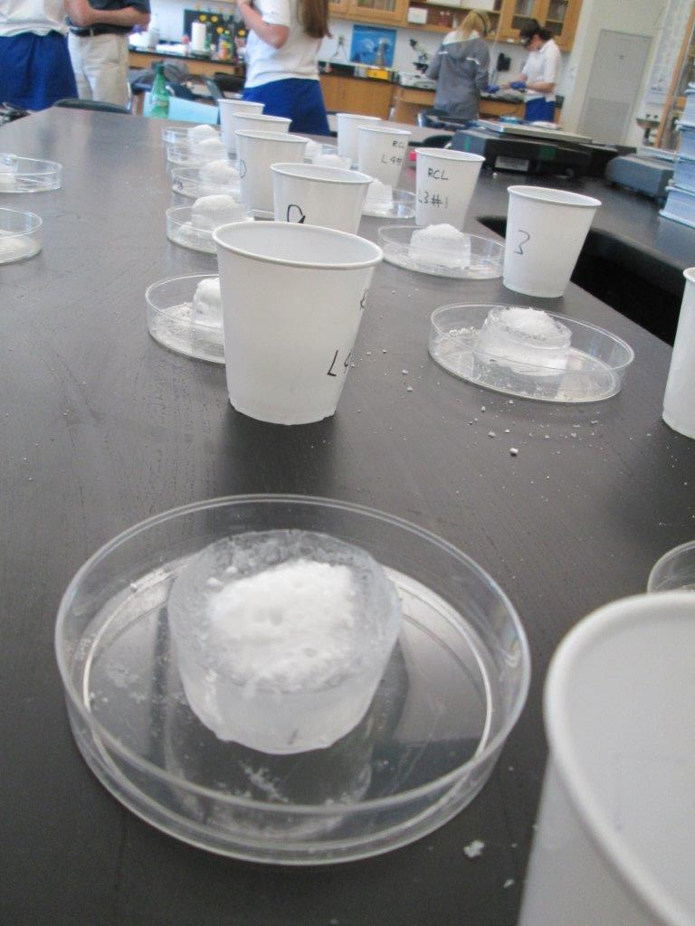
Ice-Melt Testing Details
20 ml of tap water frozen into ice cubes over 24 hour time period
Ice cubes made from Dixie cups to control surface area and shape
3 grams of formula poured onto ice cube
Wait time = 10.00 minutes

Slide 13
Ice Melt Data-averages
3 most efficient formulas
Number of Solution | Amount of Ice Melted (out of 23 grams) | Percent of Ice Melted
1 | 7.35 g | 31.96%
2 | 7.5 g | 32.61%
3 | 6.7 g | 29.13%
4 | 4.5 g | 19.57%
5 | 7.15 g | 31.09%
6 | 9.75 g | 42.39%
7 | 6.85 g | 29.78%
8 | 8.9 g | 38.70%
9 | 6.5 g | 28.26%
10 | 7.05 g | 30.65%
11 | 6.15 g | 26.74%
12 | 6.9 g | 30.00%
13 | 4.9 g | 21.30%
14 | 6.5 g | 28.26%

Slide 14
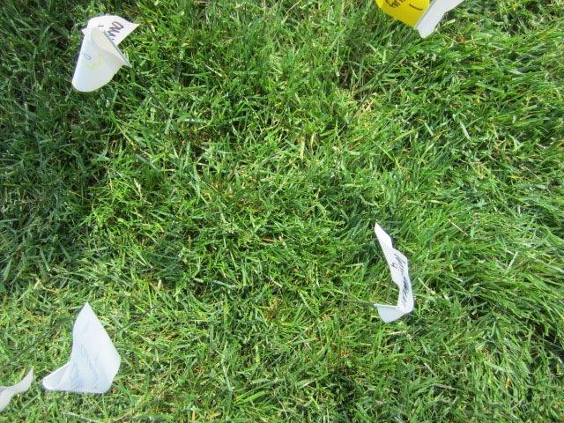
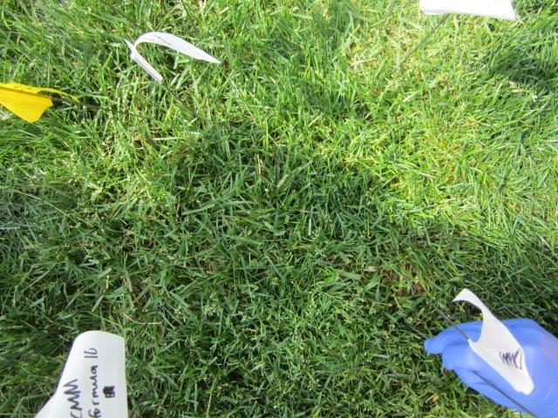
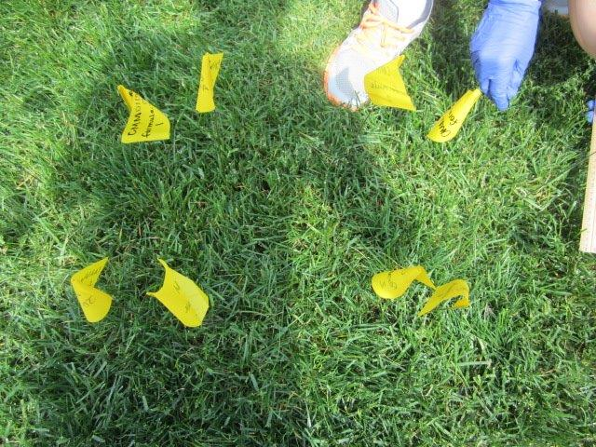
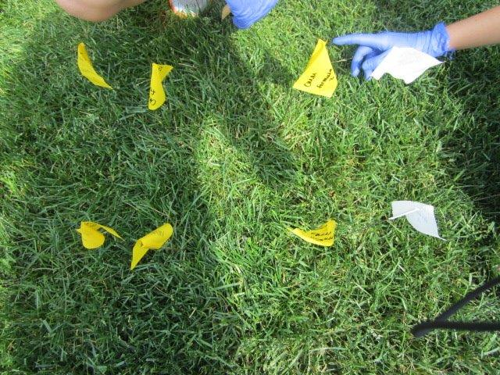
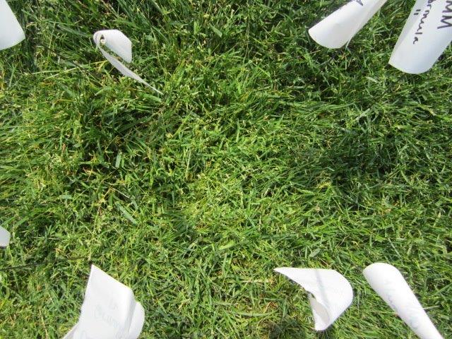
Environmental Affects—Before and After
6-before
2-before
2-after
8-before
8-after
6-after

Slide 15
Environmental effects-analysis
We concluded that formula 6, formula 8, and formula 2 were respectively the most efficient at melting ice. Due to the solutions clear lack of negative effects on the grass plots, we concluded that all three of these solutions are environmentally friendly and no one solution has more of a negative environmental effect on the soil and grass. This allows us to only consider cost and efficiency when choosing the best formula for our solution.

Slide 16
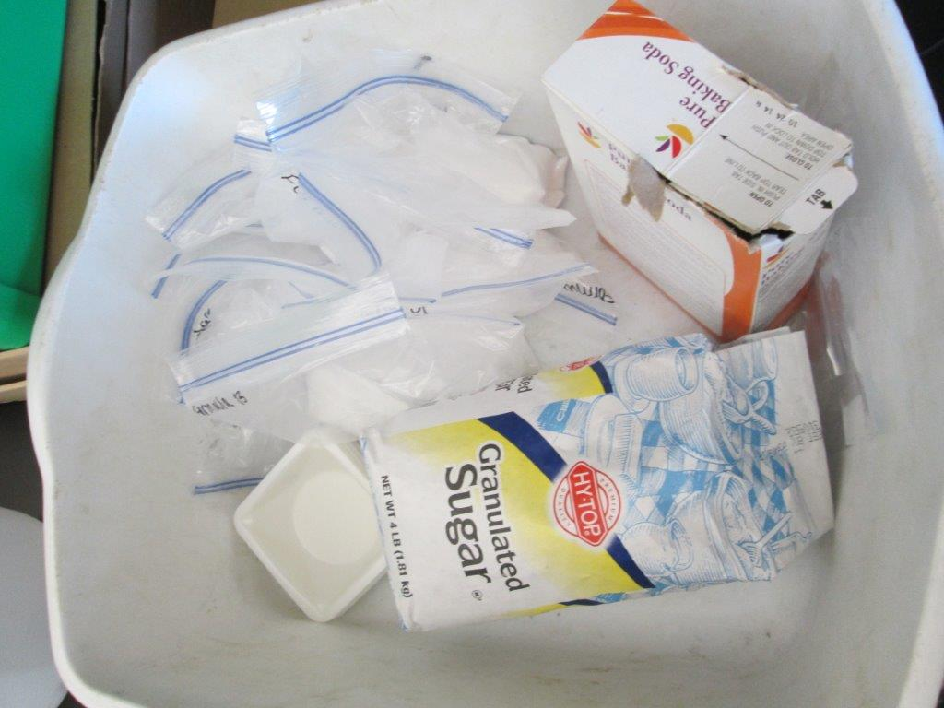
Cost Analysis for top 3 formulas
Formula 8
20% sodium chloride = $0.0537
60% baking soda = $0.005913
20% calcium chloride = $0.002508
Total: $0.06
Formula 2
80% sodium chloride = $0.2148
10% calcium chloride = $0.001254
10% sugar = $0.0017844
Total: $0.22
Formula 6
60% sodium chloride = $0.1611
20% baking soda = $0.001971
20% calcium = $0.002508
Total: $0.17

Slide 17
Final Decision
We decided to eliminate formula 2 from the running to be the final product
Had the lowest melting percent out of top 3
Was the most expensive at $0.22
While formula 6 melted the fastest, it was $0.11/m² more than formula 8 – adds up to a lot!
The final formula is… FORMULA 8!
The most cost efficient at only $0.06!
Second highest melting rate while still being environmentally friendly
Will melt ice in record timing!

Slide 18
Works Cited
http://www.flinnsci.com/store/catalogPhotos/C0016cat.jpg
http://a3145z1.americdn.com/wp-content/uploads/2014/11/how-to-fight-colds-and-the-flu-with-baking-soda1.jpg
http://i.walmartimages.com/i/p/00/78/59/21/81/0078592181482_500X500.jpg
http://www.sciencelab.com/msds.php?msdsId=9927593
http://www.sciencelab.com/msds.php?msdsId=9923251
http://www.sciencelab.com/msds.php?msdsId=9927258
http://www.erocksalt.com/wp-content/themes/vulcan/timthumb.php?src=http://www.erocksalt.com/imatges/road-salt-for-snow-melting.jpg&w=600&zc=1
http://www.scotwoodindustries.com/brands/1/products/5
http://webdmamrl.er.usgs.gov/g1/ggranato/WRIR99-4077.pdf
http://www.greenlivingonline.com/article/alternatives-rock-salt

