Slide 1
Tinkercad
By: Lexi Orlinsky

Slide 2
What is Tinkercad?
Tinkercad is an online program that uses simple geometric shapes and symbols, as well as a few other easy to use tools in order to facilitate 3D printing
It allows you to build your own design to then 3D print

Slide 3
Simple How to Use Tinkercad
In order to create a 3D object in Tinkercad, you can…
Create an account
Click “Create New Project”
Drag shapes, letters and symbols onto the platform
Click and drag the objects around the platform
Drag the black and white dots around the object to change the size and scale the object
Insert photos or textures onto rectangular 3D prisms using the tools under the “Shape Generators—Tinkercad” tab
Group objects together using the “Group” button

Slide 4
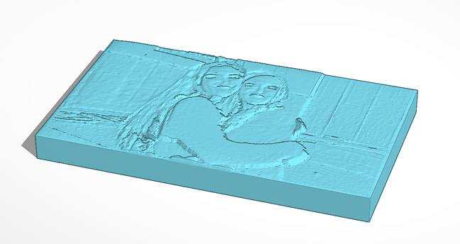
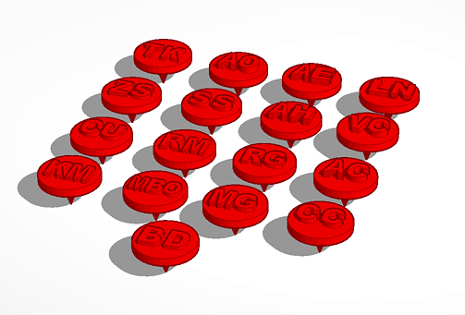
Objects I created And printed With Tinkercad
Embossed photograph:
Golf Ball Markers with Initials for the RPCS Golf team:

Slide 5
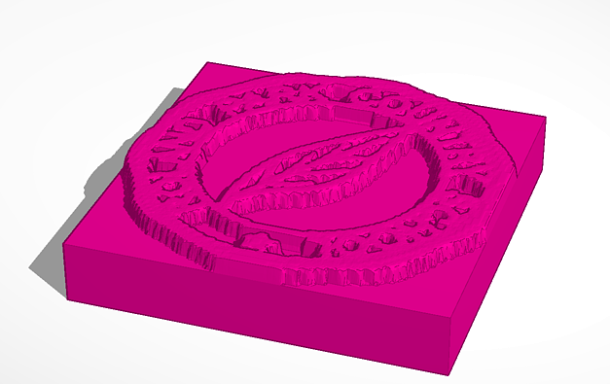
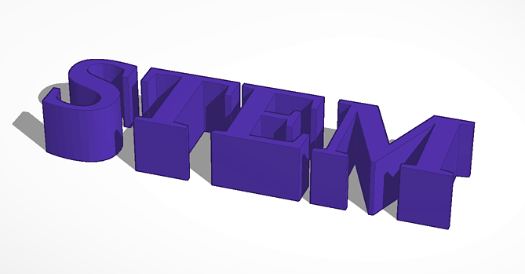
Objects I created And printed With Tinkercad
Embossed Roland Park Laurel Leaf:
STEM Word:

Slide 6
Annotated Bibliography
To begin with tinkercad, go to https://www.tinkercad.com/ and create an account. This website can be used to create 3D print schematics using the provided tools and shapes. There are tutorials located within the website which can be used to learn your way around the program.

