Slide 1
HEXAFLEXAGONS.
Olivia Carroll, Ariel Egbunine, Lexi Orlinsky

Slide 2
COOL WEBSITE! (from class)
http://prezi.com/kpmsbhk5nm4z/topology/ (47 of 47)

Slide 3
How do Hexaflexagons Relate to Classwork?
Like Mobius strips→ odd “sides” that appear to be different than they are
Hexaflexagon work in class

Slide 4
The Basics.
Hexaflexagons have a very straightforward name–
hexaflex, meaning six faces
gon, the suffix used for polygons (meaning many angles with Greek origins)

Slide 5
More of the Basics.
There are two different types of flexagons:
Hexaflexagons, which have six different faces (sides) and form a hexagon
Tetraflexagons, which form rectangles
Each division of flexagons have subcategories:
A trihexaflexagon which has three different faces
A tetrahexaflexagon, which has four different faces
Most common hexaflexagon is made from equilateral triangles on a strip of paper
Simplest of these are made up of 10 triangles, which fold into three different faces (more complex is made up of 19 triangles which fold into 6 different faces)

Slide 6
How/Why They Work.
“By pressing the edges together, the center of the hexaflexagon opens and reveals on the hidden faces.”

Slide 7
Arthur H. Stone
Accidentally discovered flexagons in 1939
He happened to come upon hexaflexas because when he went to school in England, his American paper was too big for his English binder
So what did he do? He did what we all would have done…he trimmed it to size!
And he fooled around in class with the strips– folding, and pinching, and twirling, and flexing.
His end result? A FLEXAGON!!

Slide 8
Visual Aid

Slide 9
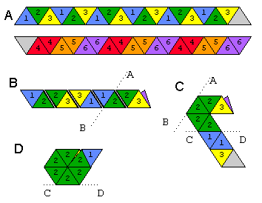

Slide 10
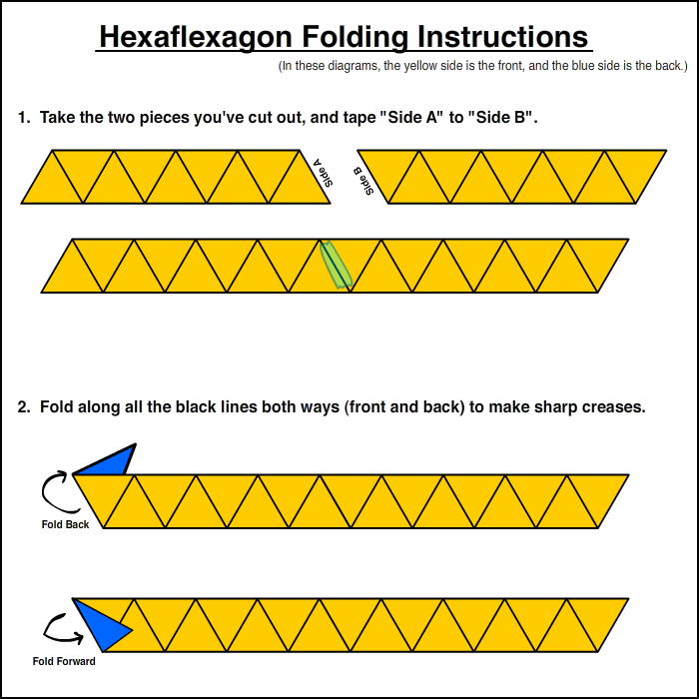

Slide 11
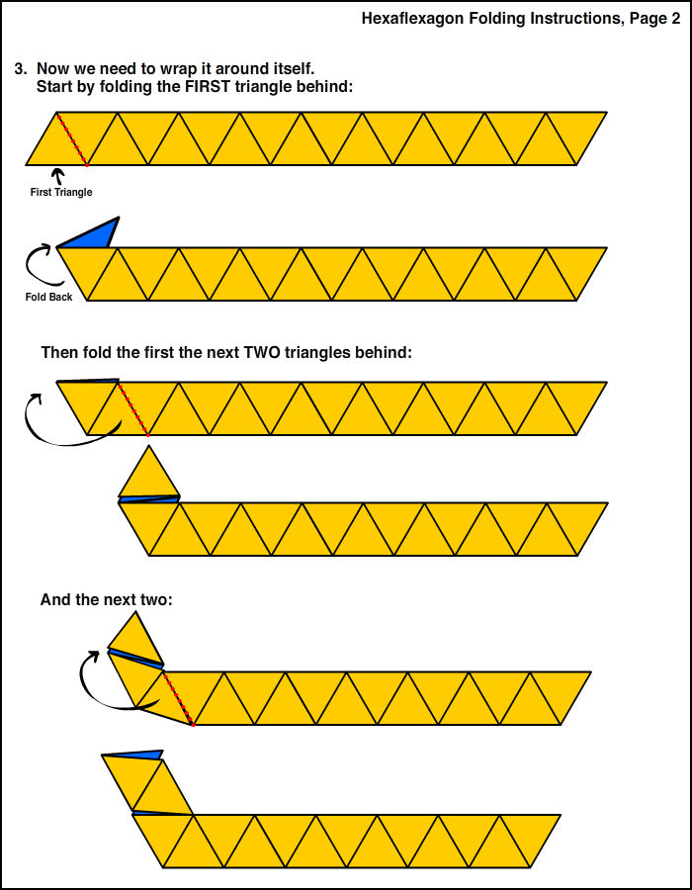

Slide 12
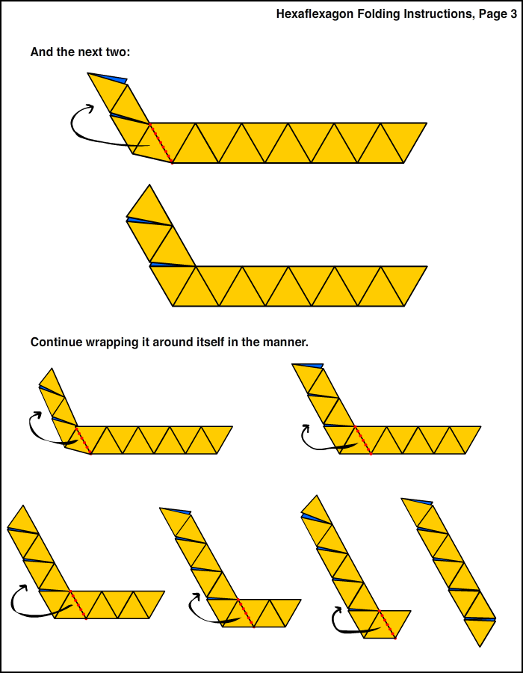

Slide 13
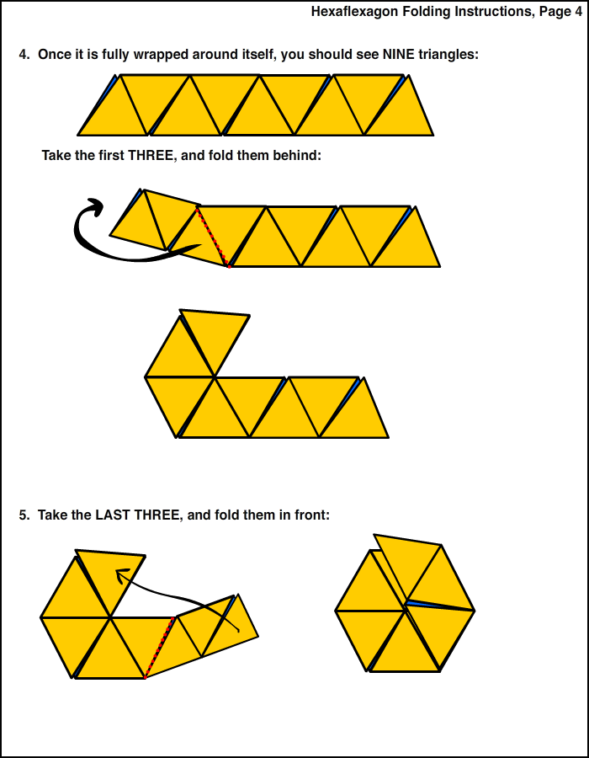

Slide 14
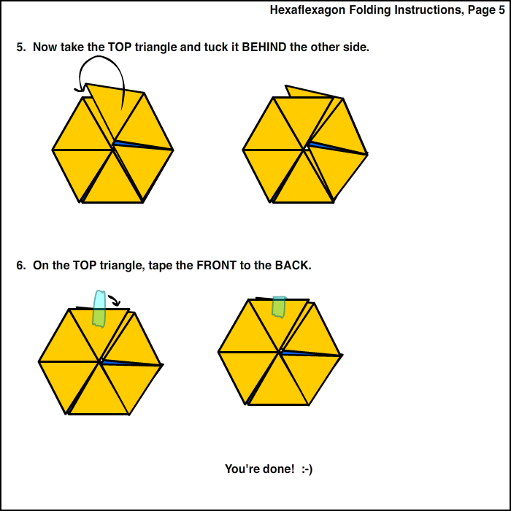

Slide 15
now it’s time…..
TO PLAY WITH YOUR VERY OWN HEXAFLEXAGON!!!

Slide 16
HAPPY FLEXIN’ ☺

Slide 17
6 Faced Hexaflexagon Color Chart
From | To
Red | Purple, Pink, Blue, Green
Purple | Pink, Blue, Orange, Red
Blue | Red, Purple, Green
Pink | Purple
Green | Blue, Red
Orange | Blue

Slide 18
Bibliography!
http://prezi.com/kpmsbhk5nm4z/topology/
http://graceavery.com/hexaflexagon/
http://britton.disted.camosun.bc.ca/hexahexa/hexa1.gif
https://www.google.com/#q=what+does+the+suffix+'gon'+mean
https://www.google.com/#q=what+is+a+hexaflexagon
https://www.google.com/#q=what+is+the+purpose+of+a+hexaflexagon
http://www.wou.edu/~burtonl/courses/math394/projects/FlexagonsPaper.pdf

