Slide 1
Solar System Scratch Program
By: Lexi Orlinsky

Slide 2
Goal:
Using the scratch program, draw a picture illustrating a specific Euclidean shape

Slide 3
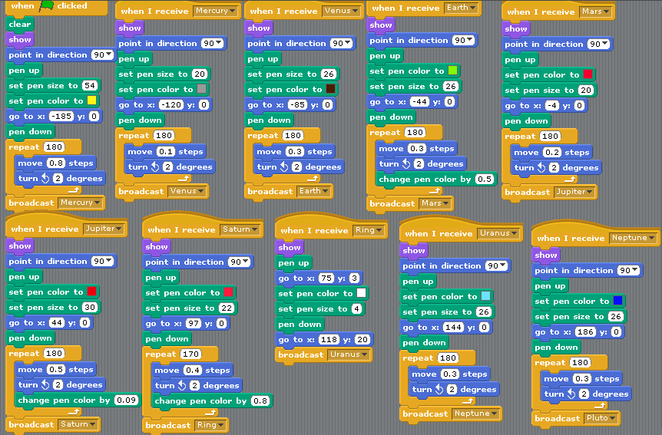
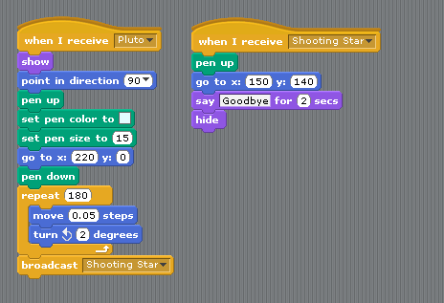
Behind the Scenes: The Programming commands

Slide 4
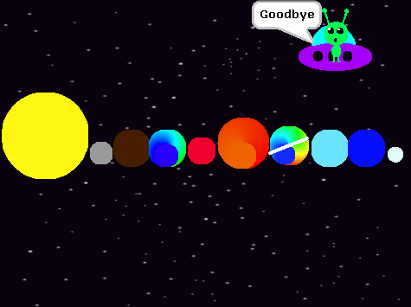
The Final Product

