Slide 1
SUSTAINABLE BATTERIES
BY REBECCA, LEXI, AND SALLY

Slide 2
Why Did We Choose this Topic?
We wanted to engineer a battery that could be assembled using local coins and fruits (in a chosen region) that are inexpensive, acidic, and easy to find in order to help underdeveloped nations. A little light could go a long way.
Notes:
Sally

Slide 3
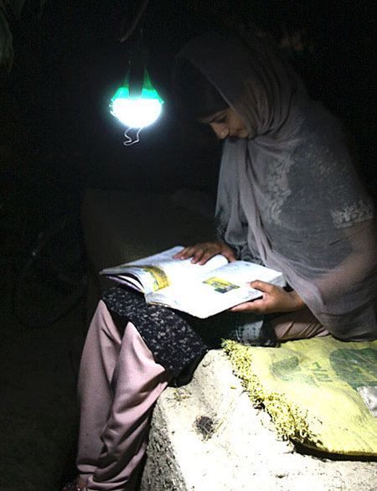
As a team of engineers, our mission is to…
Create the most efficient and sustainable battery using coins and various acidic drinks
Design a kit for an unassembled battery that can be shipped to a region where electricity is not easily accessible
Reduce the hazardous waste created by batteries
Notes:
Rebecca

Slide 4
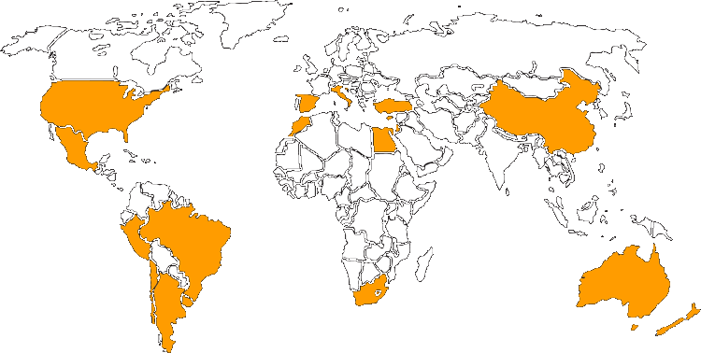
Potential Regions to Send the Kits
Notes:
Sally

Slide 5
Product Constraints:
Create a project having to do with increasing the sustainability of energy usage
Various acidic solutions mixed with salt must be used to make a battery and power a small light bulb
The battery must be able to light the light bulb for 15 minutes
An easy to access kit must be made to hold the battery
The battery kit should be as cost efficient as possible
Notes:
Lexi

Slide 6
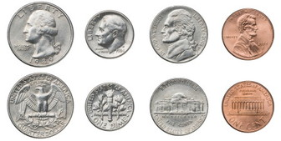
How will this battery work?
Acid Salt Solution: Contains electrolytes (ions) which have positive and negative charges
Metals: conductors of electricity that allow the ions to flow through them
Notes:
Lexi

Slide 7
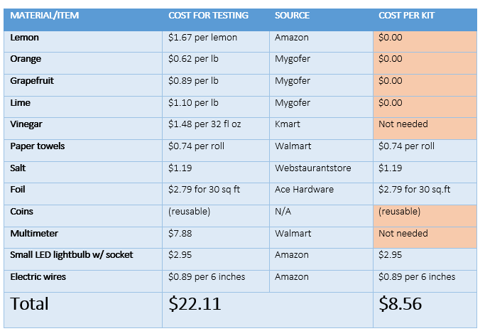
Cost Analysis:
Notes:
Rebecca

Slide 8
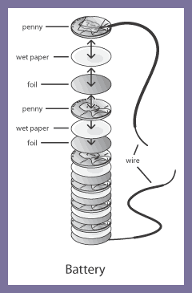
Procedure:
Pour 10 milliliters of the acidic solution
Add 1.3 grams of salt
Cut paper towel and foil (if needed) into size of coins
Soak the paper towel into the solution
Compile the foil, paper, and then coin
Record measurements
Notes:
Sally

Slide 9
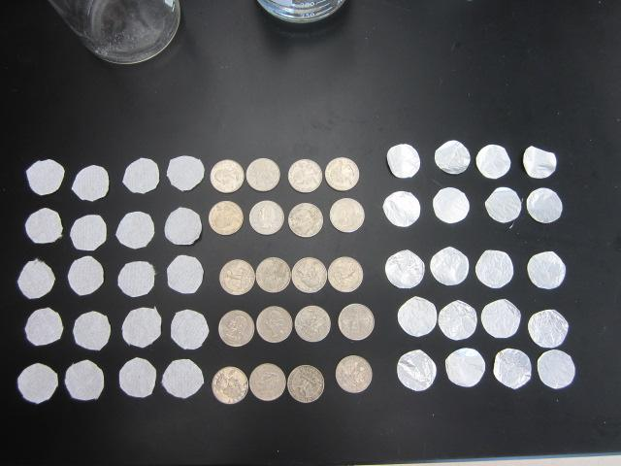
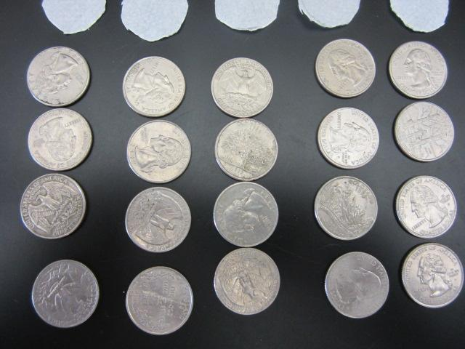
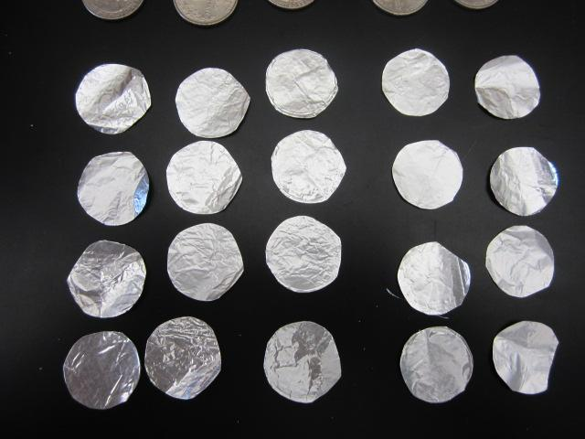
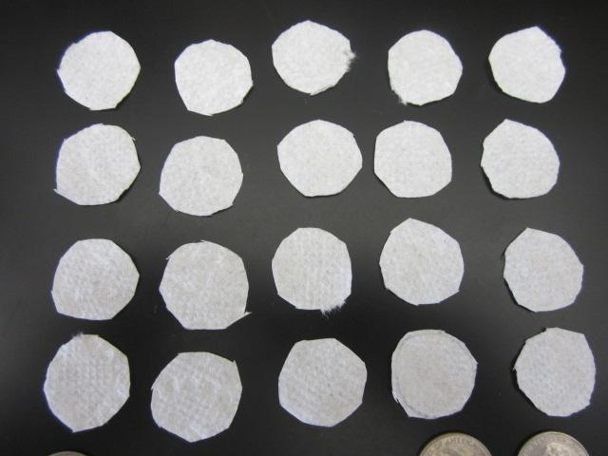
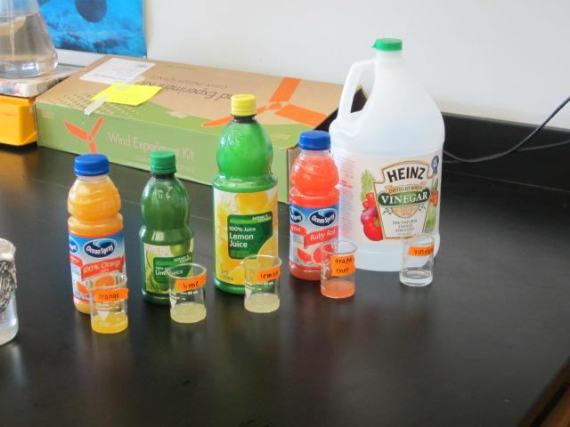
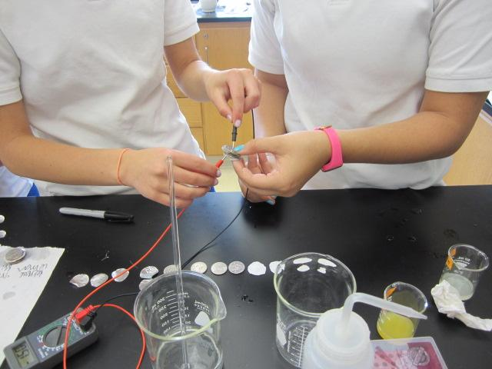
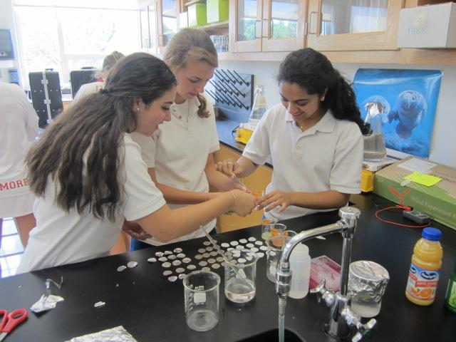
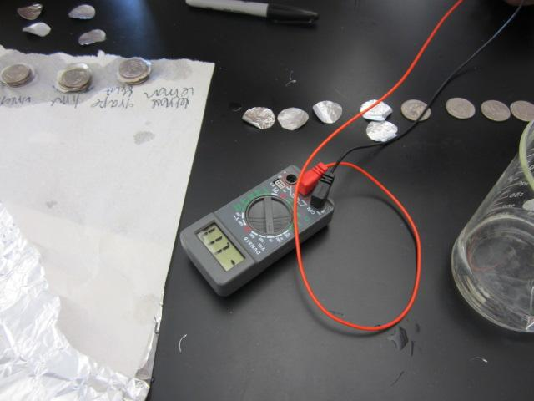
EXPERIMENT IN ACTION
Notes:
Rebecca

Slide 10
Testing and Data

Slide 11
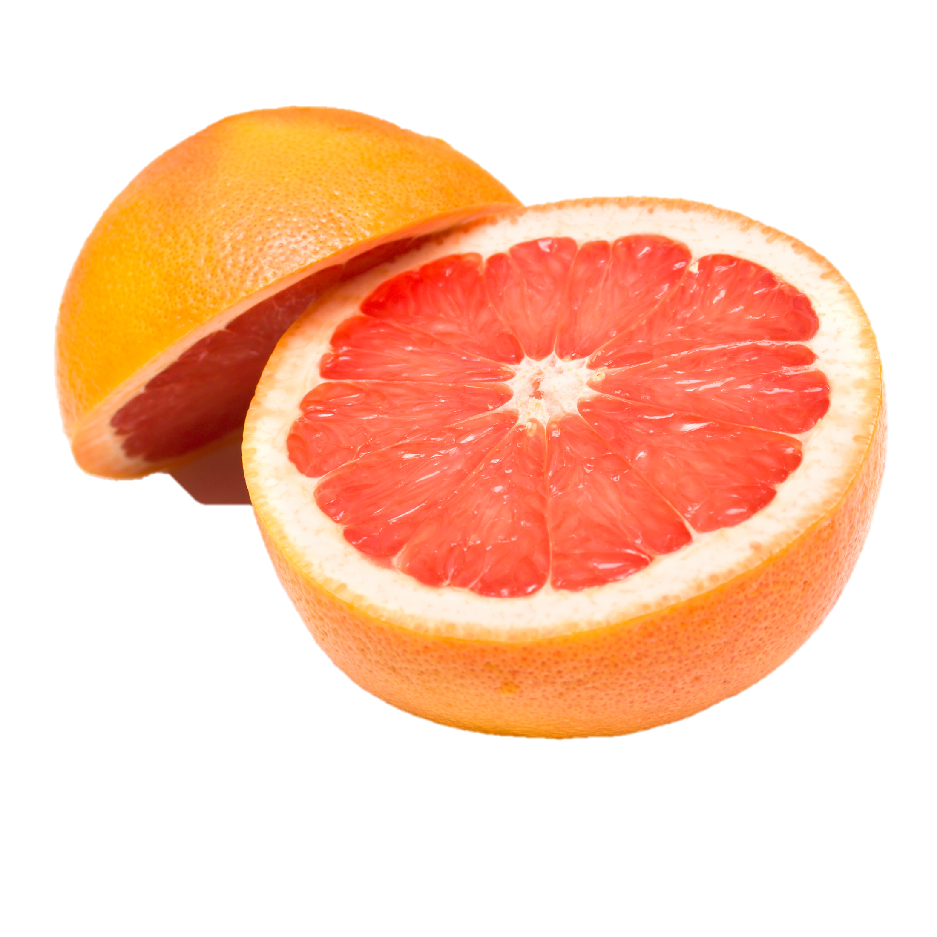
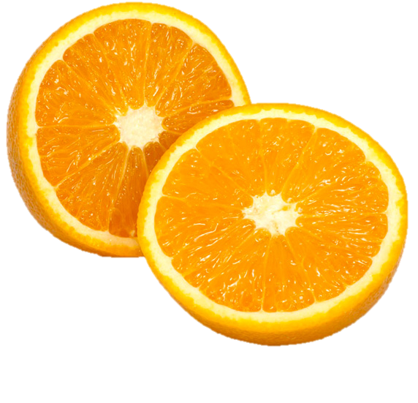
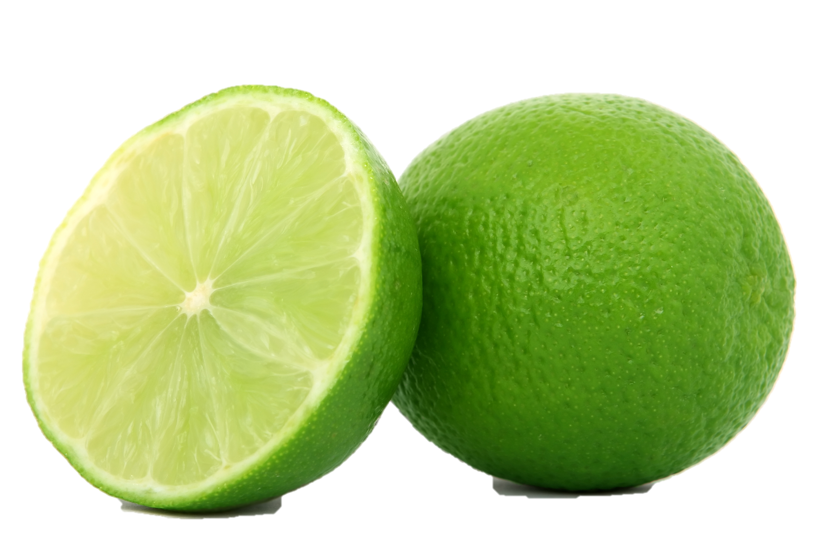
Test 1: Ranges of Energy Produced by Different Combinations of Coins and Acids (V)
Highest Voltages Produced:
Grapefruit Juice and US Quarters: 1.00-2.5V Lemon Juice with US Quarters: 1.15-1.6V
Lowest Voltages Produced:
Orange Juice and Dime/ Lemon Juice and Penny
Most Consistent Over Time (does not lose energy fast): Lime Juice with all coins
Notes:
Sally

Slide 12
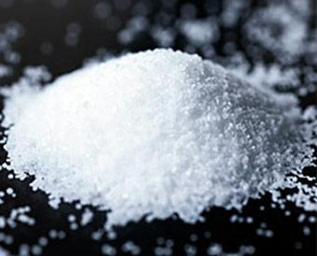
Test 2: Voltage Produced from Four Quarters and Various Acids with Higher Salt Concentrations (V)
Increased the salt concentration since they would not light the light bulb
Voltage remained the same/similar to previous trials (no significant differences)
Rayovac D battery lights light bulb (has a voltage of 1.5V)
Notes:
Rebecca

Slide 13
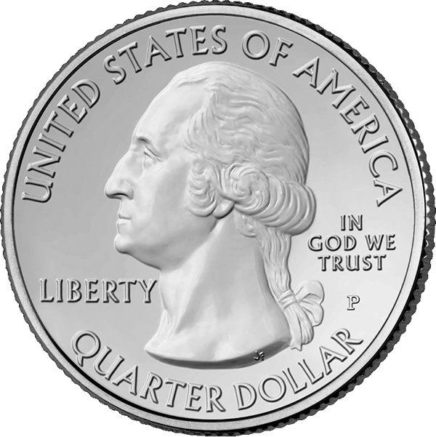
Test 3: Resistance of Battery
Rayovac D Battery Resistance: 246Ω
Our battery (grapefruit and four quarters): 264Ω
Rayovac D Battery had a current→ ours did not due to its higher resistance→ tried to decrease resistance by varying number of coins from one to ten
Optimum Voltage and Low Resistance:
Four Quarters: 70-100Ω and 1.58V (theoretically enough voltage and low enough resistance to light the light bulb)
Nothing lit the light bulb→ need to increase current some other way
Notes:
Lexi

Slide 14
Test 4: Nickels and Pennies
Researched that nickels and pennies will light the light
bulb
Replaced tinfoil with pennies and replaced quarters with nickels
Trying to increase the current by switching the metals
Only used pennies from 1983 to present due to change of composition in 1982
Used four pennies and four nickels with all five solutions
No batteries had a high enough voltage→ best result was vinegar solution with 220Ω and 0.94 V (this cannot power the battery)
Notes:
Lexi

Slide 15
Observations:
Coins rusted over time when left in plastic bag with wet paper towels
Resistance decreased when the battery was squeezed
Voltage decreased when battery was squeezed
Holes appeared in tinfoil after testing battery (salt?)
Measurement of resistance on the multimeter was very inconsistent
Without the foil the structure of the battery was less stable, could potentially be resolved with package
Notes:
Sally

Slide 16
What we have accomplished…
Reached voltage threshold
Surpassed resistance threshold
Discovered the optimum combination of coin and acidic solution for voltage using more sustainable materials
In the future we can…
Research compositions of various batteries to discover what our battery is lacking
Research ways to increase current
Compile a complete kit
Create a potential casing for the battery
Notes:
Lexi and Rebecca

Slide 17
Works Cited
Where Friends & Family Gather for Fun & Fitness. (2015, January 1). Retrieved April 13, 2015, from
“Build up a Battery + Recharge what you have” (2015). Retrieved May 10,2105, from http://bundlr.com/b/build-up-a-battery-recharge-what-
you-have
“Nokero: The Solar Light bulb for Developing Countries” (2015). Retrieved May 10, 2015, from http://www.igreenspot.com/nokero-the-solar-light-bulb-for-developing-countries/
“Replanting for Madagascar’s Future” (2015). Retrieved May 10, 2015, from https://www.arborday.org/programs/rainforest/madagascar/
“File:United States dime, reverse.jpg” (December 6, 2014). Retrieved May 10, 2015, from
http://commons.wikimedia.org/wiki/File:United_States_dime,_reverse.jpg
“Washington quarter” (May 11, 2015). Retrieved May 11, 2015, from
http://en.wikipedia.org/wiki/Washington_quarter
“Metals and Materials are Used in US Coins and Banknotes?” (2015). Retrieved May 10, 2015, from
http://www.azom.com/article.aspx?ArticleID=8088#5
“26 fruits” (2015). Retrieved May 7, 2015, from http://www.26fruits.co.uk/orange.php
“Hug it foward” (2015) Retrieved May 26, 2015, from http://hugitforward.org/
“MMUK Citrus” (2015) Retreived May 26, 2015http://www.mmuk.co.uk/citrus

