Slide 1
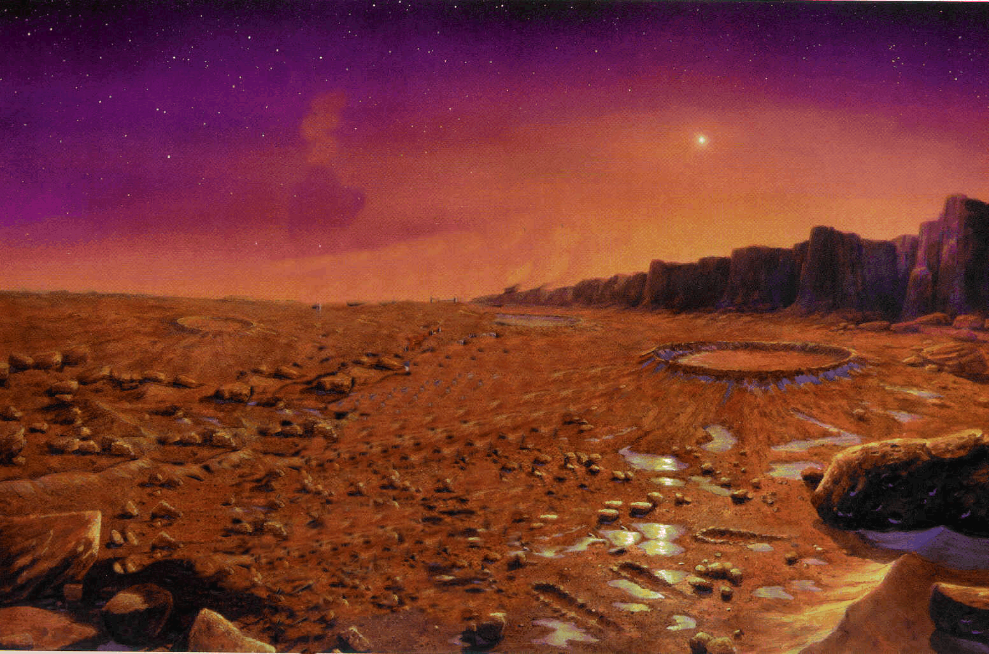
Traversing Mars
By: Hannah Song and Lexi Orlinsky

Slide 2
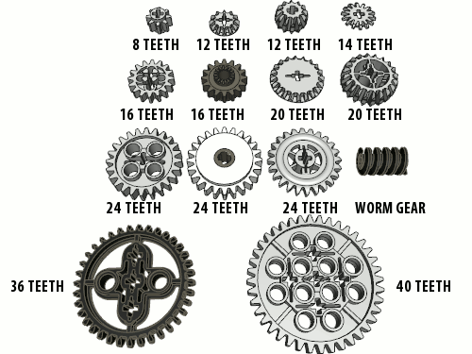
Robot Configuration

Slide 3
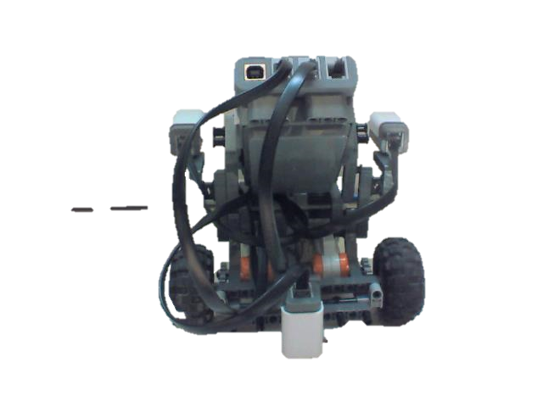
Robot Configuration

Slide 4
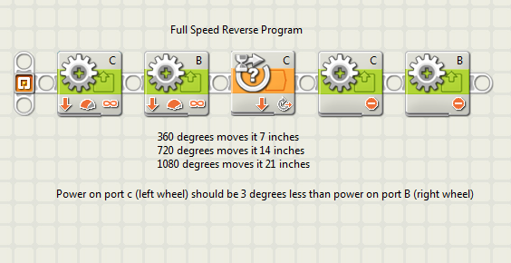
Full Speed Reverse

Slide 5
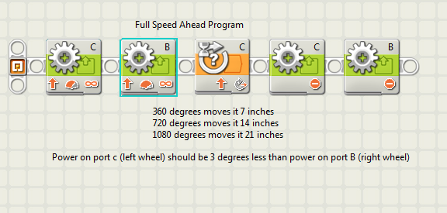
Full Speed Ahead

Slide 6
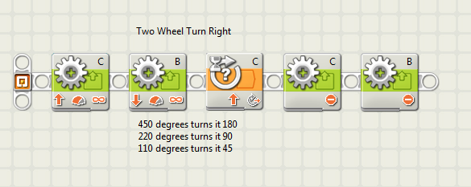
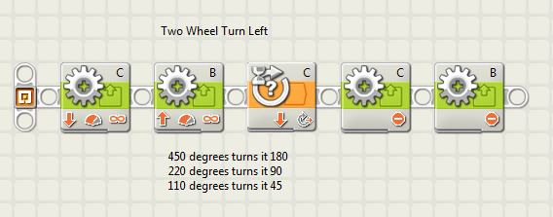
Turning

Slide 7
Inclines and Declines

Slide 8
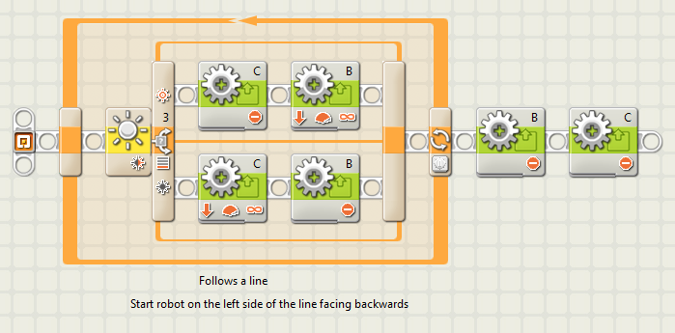
Following the Hematite Trail

Slide 9
Rough Terrain

Slide 10
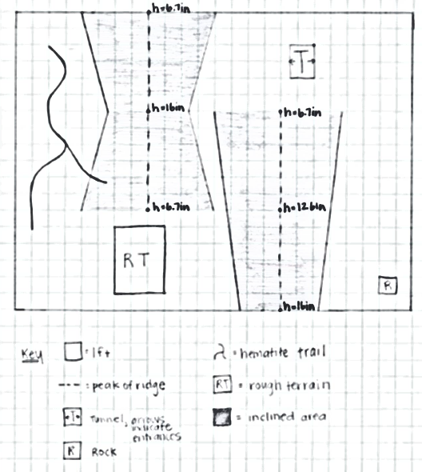
Map of Mars Landing Site

Slide 11
Test Simulations

Slide 12
Bibliography
http://science.ksc.nasa.gov/biomed/marsdome/MARS2.gif

