Slide 1
123D Design
By Rebecca Mathew

Slide 2
http://www.123dapp.com/design
I used this website to download the software.
https://www.youtube.com/watch?v=ZVGXcqVHCaw
I used this video to get familiar with the basics of the software.

Slide 18
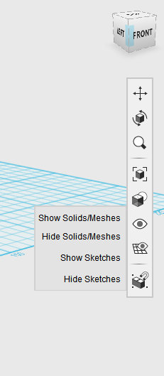

Slide 19
Finished product!

Slide 20
Finished product!

Slide 21
If you want to customize…

Slide 23
Finished product!

Slide 24
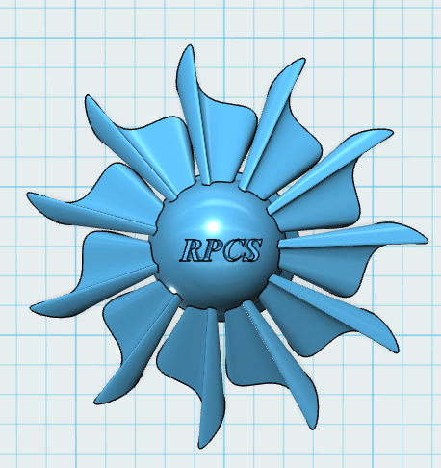
Finished product!

