Slide 1
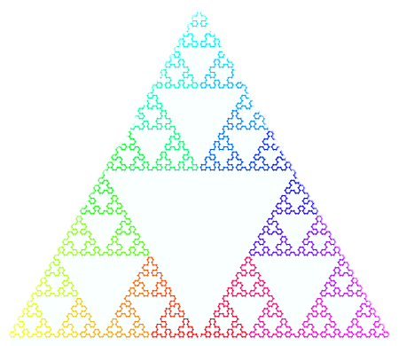
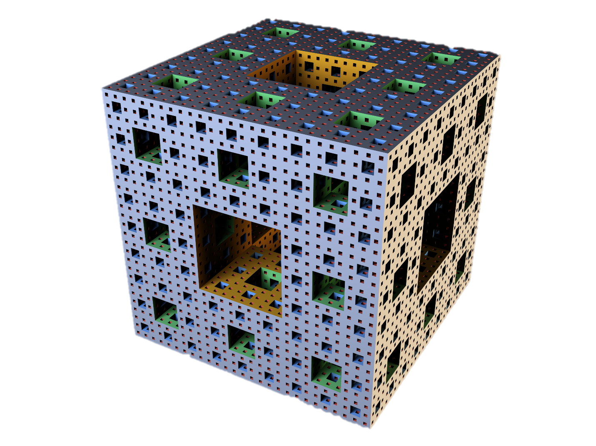
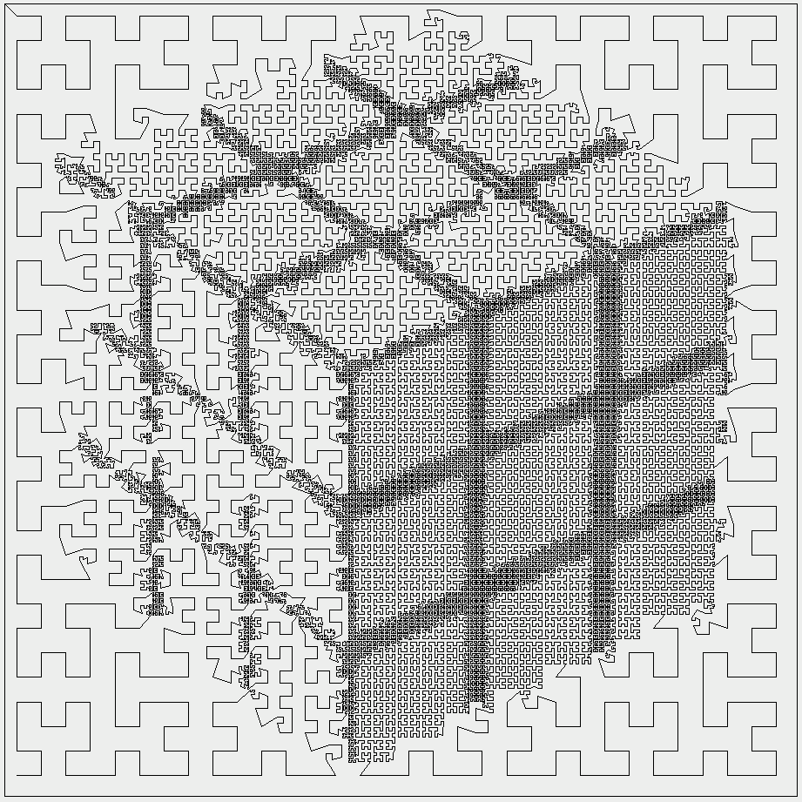
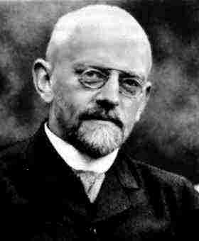
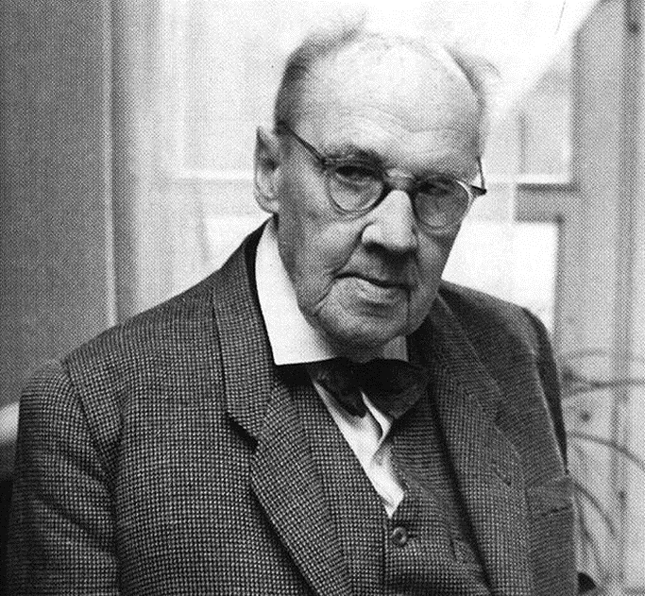
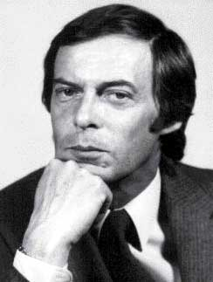
Hilbert, Sierpinski, Rubik
By Rebecca, Erin, Valerie

Slide 2
David Hilbert

Slide 3
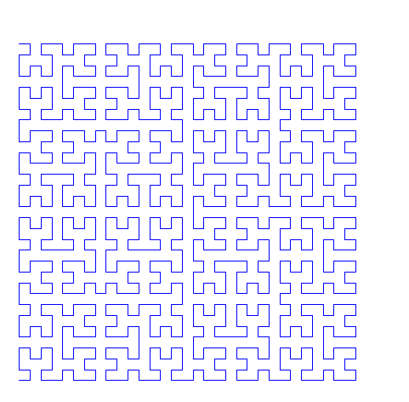
Who is Hilbert?
Born: January 23, 1862 in Konigsberg, Germany
Died: February 14, 1943, Gottingen, Germany
Books: Geometry and the Imagination, Principles Of Mathematical Logic, Mathematical Problems, etc.
Education: University of Konigsberg (1880–1885)
“We must know. We will know.”

Slide 4
What did he do?
Hilbert theory 90 (Galois cohomology), Basis Theorem
Converse of a shape that forms the content of theorem
Had greatest influence after Euclid
Systematic study of axioms of Euclidean geometry-> propose 21 axioms
Made contributions to math, physics, philosophy
Wanted to create laws true for physics
Challenged 23 Paris problems

Slide 5
Sample of his work
23 Problems:
1) Is there a number, which is larger than any finite number, between that of a countable set of numbers and the numbers of the continuum? [To think of a continuum, think of a number line - and ALL the numbers on it - without any gaps.] - This problem has been answered by Gödel.
2) Can it be proven that the axioms of logic are consistent? Gödel also answered this problem with his incompletness theorem which states that all consistent axiomatic formulations include some undecidable propositions. See the short history of Euclidean and non-Eucliden geometry to find more.
3) Give two tetrahedra that cannont be decomposed into congruent tetrahedra directly or by adjoining congruent tetrahedra. Dehn showed this could be done, but had to invent his own invariants (something that does not change under a set of transformations).
4) Find other geometries (with specific directions) which are close to Euclidean geometry. This has been solved by G. Hamel.
Hilbert contributed to many branches of mathematics, including invariants, algebraic number fields, functional analysis, integral equations, mathematical physics, and the calculus of variations.

Slide 6
2-D
Starts with a “cup”
4 orientations of cup
Three segments connect
4 cups
4 orientations of new shape
Three segments connect 4 of new shape
4 orientations of new shape
Three segments connect 4 of new shape
Notes:
Used for data base softwares

Slide 7
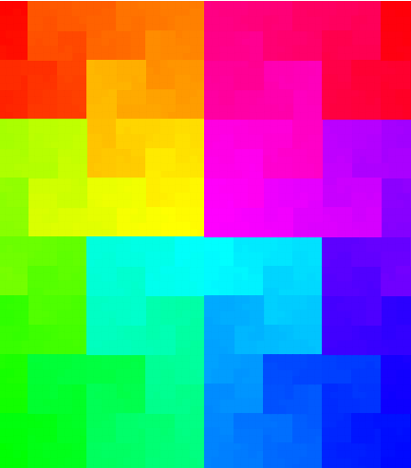
Notes:
points near each other in terms of distance along the curve will also be near each other on the 2D plane. For example, colours of the rainbow can be plotted such that similar colours are always near each other

Slide 8
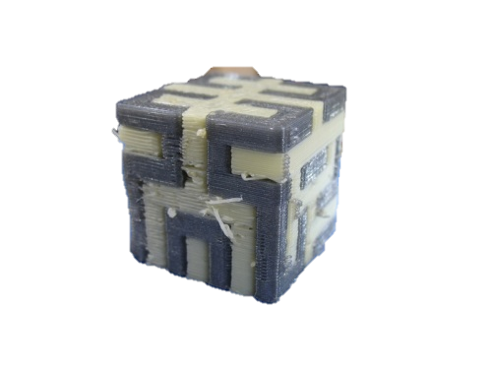
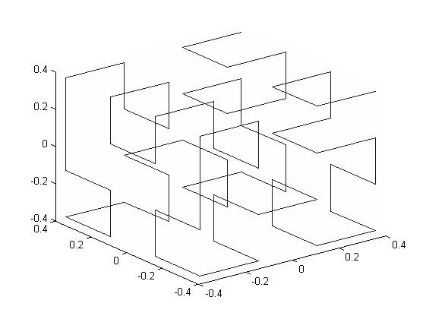
3-D
cubic Hilbert curve:
can transform into many other forms
made up from one connected line

Slide 9
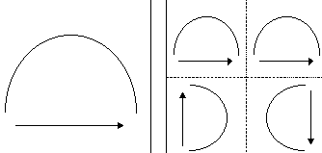
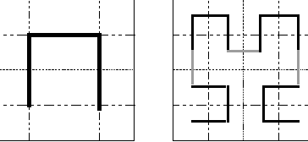
ties
Euclid Geometry
Mobius strip
Sierpinski
Jordan curve theorem
Notes:
~ from the two-dimensional Euclidean plane and three-dimensional space to spaces with any finite or infinite number of dimensions. A Hilbert space is an abstract vector space possessing the structure of an inner product (length of a vector or the angle between two vectors) that allows length and angle to be measured.
~ a closed curve which does not cross itself will divide the plane into two regions, the inside and the outside. The Hilbert curve may be closed fairly easily and appears not to cross itself, neverthless it has no inside.

Slide 10
Waclaw Sierpinski

Slide 11
Who is Waclaw Sierpinski?
Born: March 14, 1882, in Warsaw, Poland
Died: October 21, 1969, in Warsaw, Poland
Education: University of Warsaw
Work:
Wrote more than 700 papers and 50 books
Areas of set theory
Point set topology
Number theory
Notes:
University of Warsaw: went for four year and was awarded a gold medal for math
Set theory: “a branch of mathematics or of symbolic logic that deals with the nature and relations of sets” – Merriam Webster
Point set topology: “a branch of topology concerned with the properties and theory of topological spaces and metric spaces developed with emphasis on set theory” – Merriam Webster
Number theory: “the study of the properties of integers” – Merriam Webster

Slide 12
What did he do?
Graduated from college in 1904
Worked as a teacher until the school was shut down
Sierpinski became a part of the Department of Mathematics and Physics at the University of Warsaw
Got his doctorate
1907 – became interested in set theory
1909 – Sierpinski gave the first lecture about set theory
Published three books: The theory of irrational numbers (in 1910), Outline of Set Theory (in 1912) and The theory of Numbers (in 1912)
1919 – became professor at University of Warsaw
Fundamenta Mathematicae – a journal which Sierpinski edited about set theories
Retired as a professor in 1960

Slide 13
Fractals
A pattern that goes on forever
Every part of the pattern is self similar
http://fractalfoundation.org/resources/what-are-fractals/
http://www.youtube.com/watch?v=TLxQOTJGt8c

Slide 14
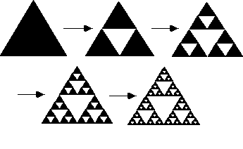
2-D Sierpinski
Sierpinski Gasket or Triangle
Start with one triangle
Mark the mid-point on each side and attach each point
Now there should be four triangles
The center triangle is removed
The process is repeated an infinite number of times
Sierpinski Carpet
Start with one square
Draw a smaller square similar to the first square in the center
Now from each vertex of the newly formed square, draw one vertical and one horizontal line to the sides of the first square
The center square is removed
The process is repeated an infinite number of times

Slide 15
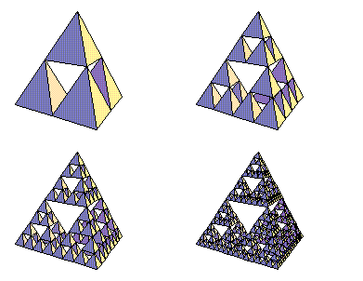
3-D Sierpinski
Sierpinski Gasket or Triangle
Similar to the 2-dimensial form of the gasket
Instead adding triangles, square based pyramids are added
Instead of removing triangles, octagons are removed
Menger Sponge
“It is created by sectioning the unit cubes by slits of width 1/3… The central piece and each cube located at the center of the faces are removed.” (http://paulbourke.net/fractals/gasket/)

Slide 16
Sierpinski and Topology
Sierpinski Space is a topologic space

Slide 17
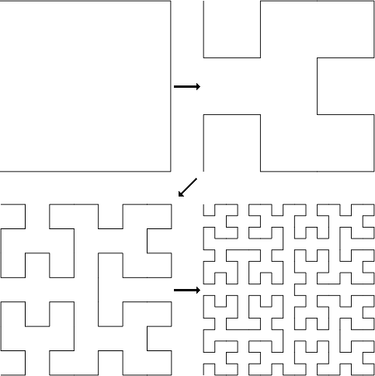
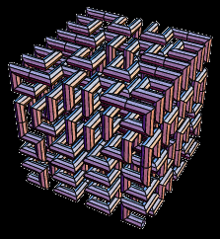
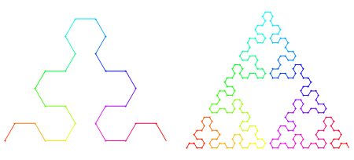
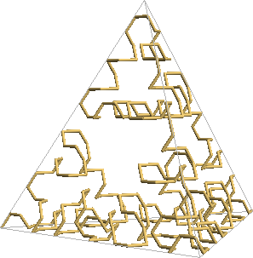
Hilbert and Sierpinski
Hilbert and Sierpinski– both are used to fill up three dimensional space
Hilbert Curve and Sierpinski Arrowhead Curve – both fractal curves that can be shown in both 2 and 3 dimensional forms

Slide 18
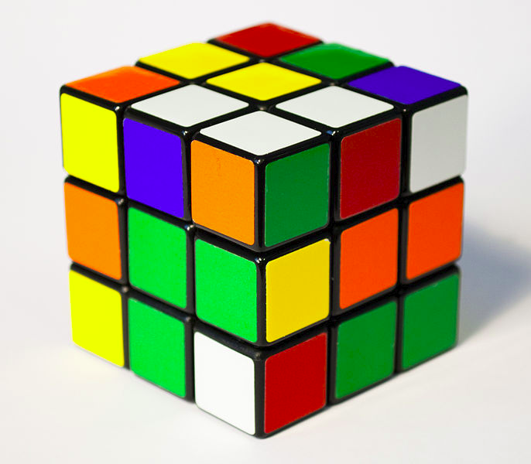
Sierpinski and Rubik
Removing the center cubes in a Rubik’s Cube can form a Menger Sponge

Slide 19
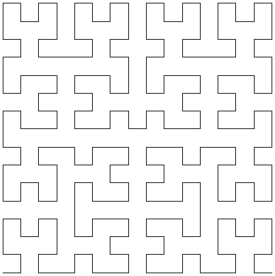
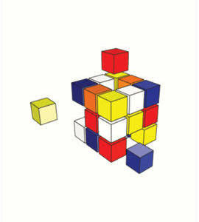
Hilbert and Rubik
Cube
Many of same pattern making one whole

Slide 20
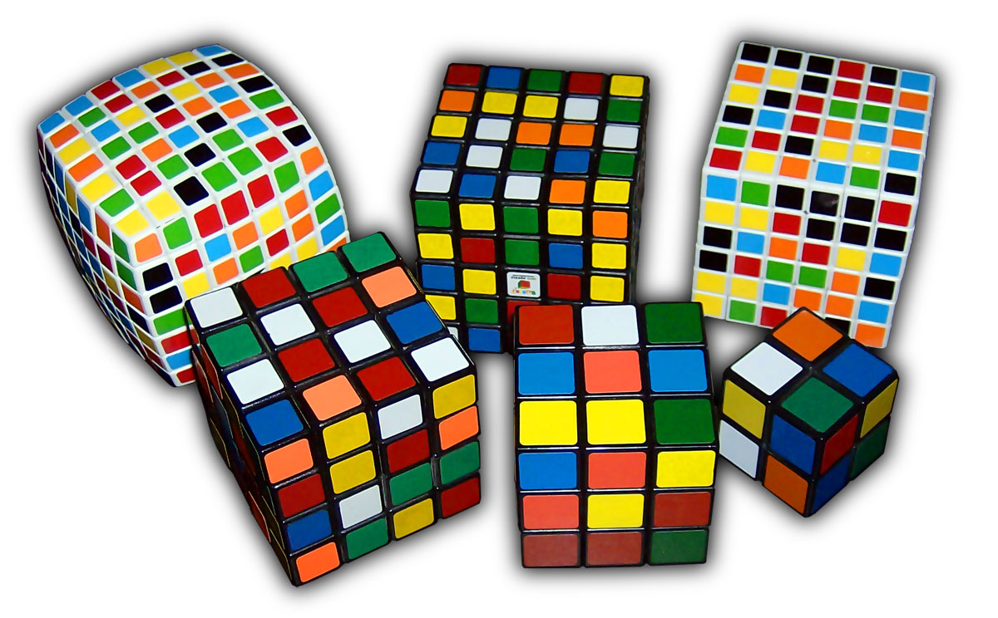
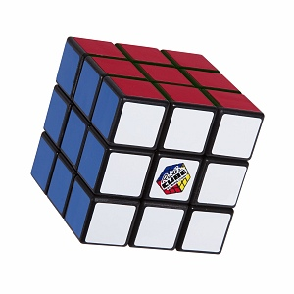
Rubik’s Cubes
By: Valerie Hinkle

Slide 21
Who is Erno Rubik?
Erno Rubik, the creator of the Rubik’s Cube, was born on July 13th, 1944 in Budapest, Hungary
He studied sculpture at Technical University in Budapest and studied architecture at the Academy of Applies Arts and Design in Budapest
He taught design and architecture in Budapest

Slide 22
What did he do?
He created the first working prototype of the Rubik’s cube in 1974
He spent months trying to solve it and finally came up with an algorithm
He patented the cube in 1975
The cubes were being manufactured in Hungary in 1977
He introduced the cube to the U.S. in 1980
Solving the Rubik’s cube became a competitive event around 1982

Slide 23
Benefits of the Rubik’s Cube
It is engaging and strengthens brain cells
It helps to increase concentration for figuring out the algorithms
It improves your hand-eye coordination
It strengthens your patience to figure things out
It increases you mental reflexes because you have to be aware of all the pieces
It strengthens short-term memory

Slide 24
An algorithm
On every side the middle piece color is the color that side is
There is only one solution out of about 43 quintillion possible combinations to make out of that cube
Erno Rubik spent months figuring it out and came up with these algorithms for different situations:
Notation:
F = front side or the side facing you
U = top side
L = left side
R = right side
D = down side
B = bottom side
Algorithm Notation:
F = front side clockwise 90º
F’ (prime) = front side counterclockwise 90º
2F = front side clockwise 180º
And so on
There are so many algorithms to solve the cube and other algorithms to solve parts of the cube
http://www.cs.swarthmore.edu/~knerr/helps/rcube.html

Slide 25
A 3x3 cube has 26 min-cubes in it, each with different turn systems
Each middle piece is the color of that side – there are 6 of those
The corner pieces can be switched around so that they are on the right sides but they can’t be moved from the corners – there are 8 corners
The middle pieces can be moved and switched around with other middle pieces – there are 12 of those
They all have specific turning patterns

Slide 26
How does this relate to what we have learned in STEM class?
A Rubik’s cube is a platonic solid
A Rubik’s cube is made of 24 smaller cubes, each with a certain move notation
Cubes can be topologically manipulated to become any shape that is one simple lump
A cube is a shape prominent to Euclidean Geometry

Slide 27
Video
Guy solves Rubik’s cube in 6 seconds
https://www.youtube.com/watch?v=wIvHw17vuGU
How to solve a Rubik's Cube (beginners method)
https://www.youtube.com/watch?v=tYmtdFM1Zwk

Slide 28
Work Cited
http://www.merriam-webster.com/dictionary/number%20theory
http://www.merriam-webster.com/dictionary/point+set+topology?show=0&t=1416158499
http://www.merriam-webster.com/dictionary/set%20theory
http://ecademy.agnesscott.edu/~lriddle/ifs/siertri/sierbio.htm
http://math.bu.edu/DYSYS/chaos-game/sierp-det.GIF
http://theiff.org/images/menger/menger1.gif
http://www.ics.uci.edu/~eppstein/junkyard/robertd/tetrarray.gif
http://fractalfoundation.org/OFC/OFC-2-2.html
http://paulbourke.net/fractals/gasket/
http://www-history.mcs.st-andrews.ac.uk/Biographies/Sierpinski.html
http://www-history.mcs.st-andrews.ac.uk/Biographies/Sierpinski.html
http://www.oxforddictionaries.com/us/definition/american_english/Sierpinski-triangle
http://en.wikipedia.org/wiki/Sierpinski_carpet#mediaviewer/File:Animated_Sierpinski_carpet.gif
http://ncatlab.org/nlab/show/Sierpinski+space#as_a_classifer_for_closed_subspaces
http://www.robertdickau.com/hilbert3d.html
http://www.robertdickau.com/sierpinskiarrow.html
http://yozh.org/wp/wp-content/uploads/2010/10/hilbert-0-3.png
http://mathworld.wolfram.com/HilbertCurve.html
http://demonstrations.wolfram.com/TheMengerSponge/
http://upload.wikimedia.org/wikipedia/commons/d/de/Menger_sponge_(Level_0-3).jpg
http://upload.wikimedia.org/wikipedia/commons/thumb/e/ee/Rubik's_Cube_cropped.jpg/686px-Rubik's_Cube_cropped.jpg
http://www.edupress.pl/gfx/edupress/pl/defaultaktualnosci/569/128/1/2061037933.jpg
http://paulbourke.net/fractals/gasket/angelo.gif

Slide 29
Work Cited Continued
http://www-history.mcs.st-andrews.ac.uk/Biographies/Hilbert.html
http://datagenetics.com/blog/march22013/c.png
http://www.robertdickau.com/mooresier6.png
http://1.bp.blogspot.com/-Yu3EUX3fGVE/Ty8ExxA42rI/AAAAAAAAAEE/VVklbL7J4UA/s1600/Screen%2BShot%2B2012-02-05%2Bat%2B22.35.32.png
http://upload.wikimedia.org/wikipedia/commons/5/52/Menger-Schwamm-farbig.png
http://pc-ua.com.ua/images/line2.JPG
https://www.vismath.eu/en/3d-models/hilbert-curve-3d-print
http://www.slideshare.net/theblackcatcomesback/david-hilbert-presentation
http://www.soc.napier.ac.uk/~cs66/hilbert.html
http://www.jasondavies.com/hilbert-curve/
http://www.britannica.com/EBchecked/topic/511991/Erno-Rubik
http://pics2.ds-static.com/prodimg/411354/300.JPG
http://www.infoplease.com/biography/var/ernorubik.html
http://thecube.guru/erno-rubik/
http://www.rubiks.com/solving-guide/3x3
http://hyderabadtalks.com/2013/07/benefits-of-solving-a-rubiks-cube/
http://www.cs.swarthmore.edu/~knerr/helps/rcube.html
http://www.rubiks.com/history
http://upload.wikimedia.org/wikipedia/commons/b/bc/Rubiks_cube_inside.JPG
https://d2t1xqejof9utc.cloudfront.net/screenshots/pics/c49c2243f52343074a1d5db09ae6f5d1/medium.JPG
http://upload.wikimedia.org/wikipedia/commons/9/9a/Rubik's_Cube_variants.jpg
http://www.puzzlesolver.com/data/29/images/head.jpg

