Slide 1
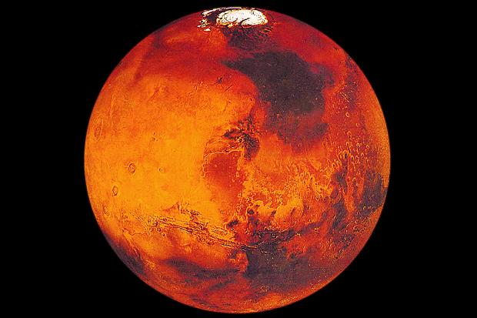
Mars Rover Project– Robbie on mars
By: Rebecca Mathew and Berit Ginsberg

Slide 2
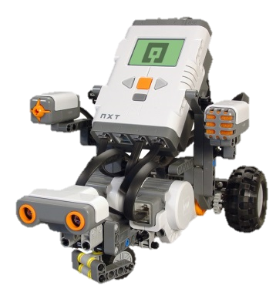
Meet Robbie
HELLO

Slide 3
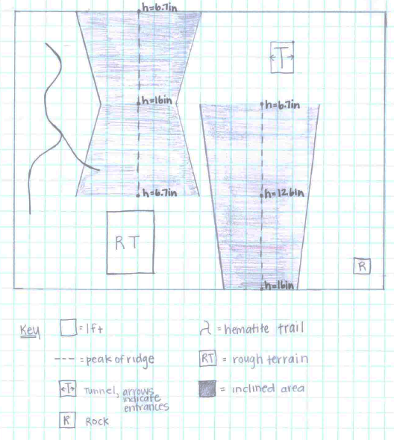
Map (model) of Mars
Notes:
This is a map of the Mars Rover landing site. It showed us the various obstacles Robbie would face on Mars. Therefore we knew what programs to create and furthermore the simulations to test.

Slide 4
Robot Configuration

Slide 5
Moving Forward
The second block commands the robot to move the wheel connected to port C forward
The fifth block commands the robot to stop moving the wheel connected to port C
The fifth block commands the robot to stop moving the wheel connected to port C
The first block commands the robot to move the wheel connected to port B forward
The third block commands the robot to move for 5 seconds

Slide 6
Moving Backward
The second block commands the robot to move the wheel connected to port C backwards
The fourth block commands the robot to stop moving the wheel connected to port B
The first block commands the robot to move the wheel connected to port B backwards
The fifth block commands the robot to stop moving the wheel connected to port C
The third block commands the robot to move for 5 seconds

Slide 7
Left Point Turn
The second block commands the robot to not move the wheel connected to Port B
The fourth block commands the robot to stop moving the wheel connected to Port C
The first block commands the robot to move the wheel connected to Port C forward
The fifth block commands the robot to not move the wheel connected to Port B
The third block commands the robot to turn the Port C wheel a specified number of degrees

Slide 8
Right Point Turn
The second block commands the robot to move the wheel connected to Port B backwards
The fourth block commands the robot to not move the wheel connected to Port C
The first block commands the robot to stop the wheel connected to Port C
The third block commands the robot to turn the Port C wheel a specified number of degrees
The fifth block commands the robot to stop the wheel connected to Port B

Slide 9
Follow the Hematite
The third block commands the robot to move the wheel connected to Port C backwards
The fourth block commands the robot to not move the wheel connected to Port B
The eighth block commands the robot to not move the wheel connected to Port C
The first block commands the robot to repeat all the programs that are within the box that the block makes
The second block commands the robot to use its light sensor in order to follow the Hematite
The seventh block commands the robot to not move the wheel connected to Port B
The fifth block commands the robot to not move the wheel connected to Port C
The sixth block commands the robot to move the wheel connected to Port B backwards

Slide 10
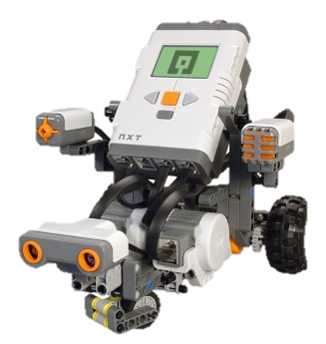
Incline and Decline Slope

Slide 11
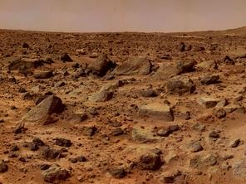
Rough Terrain
This is a picture of Robbie on the Rough Terrain in Mars

Slide 12
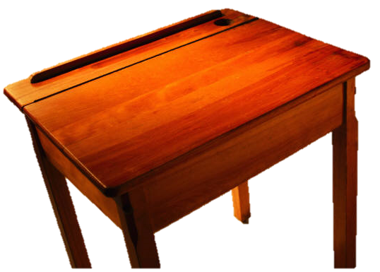
Simulations

Slide 13
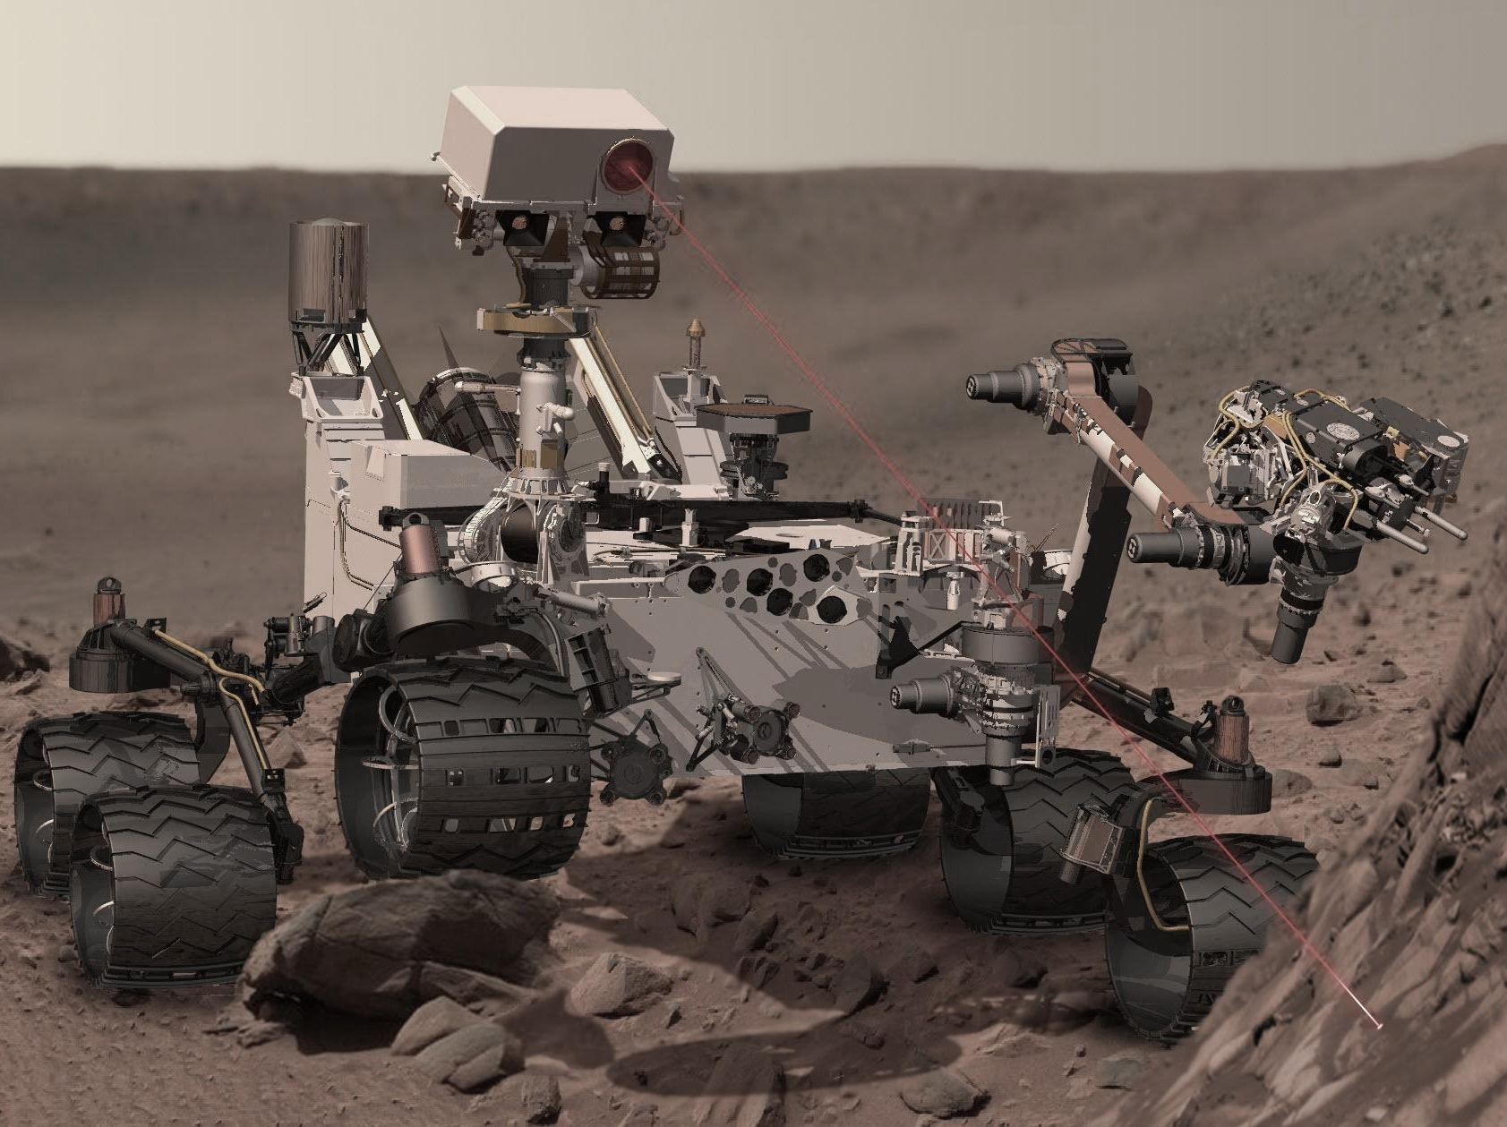
Performance

Slide 14
Video Robbie on mars

Slide 15
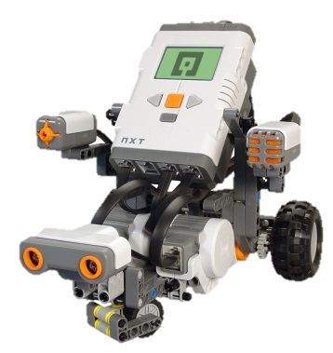
Thank You

Slide 16
Citations
http://upload.wikimedia.org/wikipedia/commons/f/fa/Martian_rover_Curiosity_using_ChemCam_Msl20111115_PIA14760_MSL_PIcture-3-br2.jpg
http://www.nasa.gov/images/content/229535main_PIA02406_516-387.jpg
http://www.thetimes.co.uk/tto/multimedia/archive/00115/mars2_115916c.jpg
http://teachingphysics.files.wordpress.com/2010/01/taskbot.jpg
http://teachingphysics.files.wordpress.com/2010/01/taskbot.jpg
Clip Art

