Slide 1
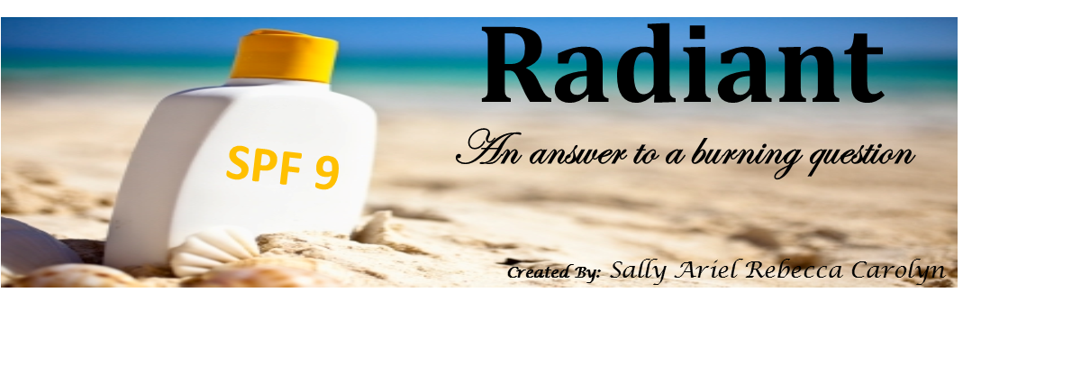

Slide 2
As Engineers, our task was…
To create a sunscreen mixture and package to market
To create 88 ml of sunscreen using specifics of a formula
To efficiently create a package using provided materials under a limited budget
Notes:
Through research, testing, and analyzing
by completing LD50 tests for 2 chemicals when interacted with daphnia and E-Coli

Slide 3
Why you should buy Radiant
Affordable
costs $0.24 per 88 ml
Package for the sunscreen costs only $3.63
2. Sensitive
Within the regulations of the FDA
Blocks UV rays
3. Portable
Can hold 88 ml of sunscreen and withstand several durability tests

Slide 4
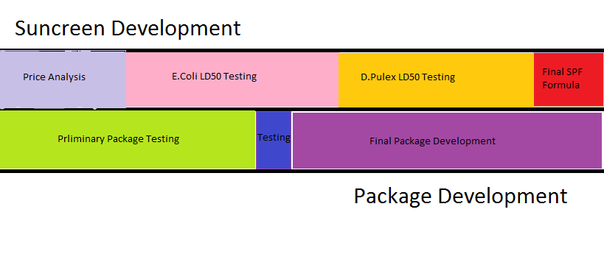
Sunscreen Development Timeline
Preliminary package testing

Slide 5
Ethylhexylmethoxycinnimate and Benzophenone
We used the MSDS, Material Safety Data Sheet, for the safety information
Always wear gloves and goggles when in the presence of these SPF Materials
Cinnamate:
Avoid contact with eyes skin, mouth, and nose
May be explosive when encounter upon high temperatures, static discharge, mechanical impact, or flames
Benzophenone:
Avoid contact with eyes, skin, ingestion, and inhalation
May be explosive when encountered upon heat, static discharge, sparks, and mechanical impact

Slide 6
RESEARCH

Slide 7
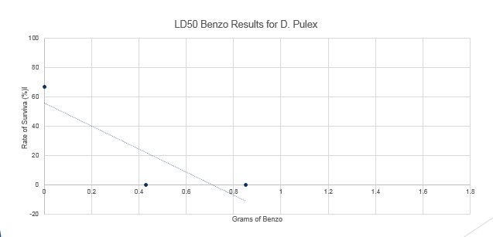
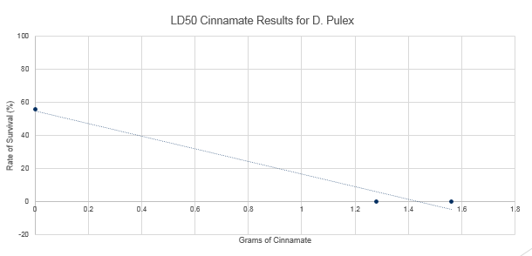
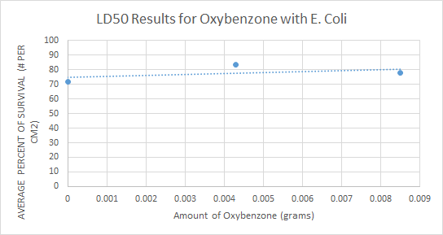
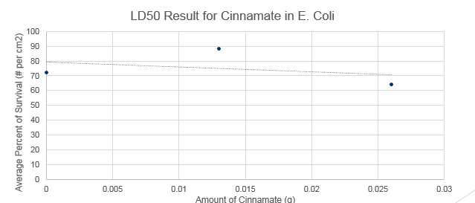
LD50 Testing Summary
We used LD50 testing to compare the toxicity of Benzophonone and Ethylhexylmethoxycinnimate. The LD50 testing was performed on E.coli (simple cell structure) and on D.pulex (more similar to complex structure of humans)
BENZONEPHENONE
ETHYLHEXYLMETHOXYCINNIMATE

Slide 8
Recommendation for Formula
These different forms of alcohol help increase the solubility of the oxybenzone.
Ingredient | Amount
Water | 78 grams
Trethanol Amine | 1 gram
Glycerin | 2 grams
Steric Acid | 4 grams
Benzonphenone | 5.6 grams
Cetyl Alcohol | 2 grams
Total: 92.6 grams

Slide 9
Chemicals Used to Block UV Rays
The team decided to use 6% Benzophenone after the LD50 toxicity tests showed Ethylhexylmethoxycinnimate to be much more harmful to organisms than Benzophenone. This precaution enables the sunscreen to be used by all consumers, especially those with sensitive skin.

Slide 10
Portability & Durability

Slide 11
Materials in Isolation
 | (Name of Test)
 |  | Drop Test | Weight Test | Shake Test | Throw Test | Heat Test | Water Test | Total
(Name of Material) | Cardboard | 3 | 3 | 3 | 3 | 3 | 1 | 16
 | Wax paper | 3 | 2 | 3 | 2 | 3 | 3 | 16
 | Plastic Baggy | 3 | 3 | 3 | 3 | 3 | 3 | 18
 | Plastic Wrap | 2 | 2 | 2 | 2 | 3 | 3 | 14
 | Foil | 2 | 3 | 2 | 1 | 3 | 3 | 14
 | Newspaper | 2 | 3 | 3 | 2 | 3 | 1 | 14
 | Masking Tape | 3 | 3 | 2 | 2 | 3 | 1 | 14
 | Duct Tape | 3 | 3 | 2 | 2 | 3 | 1 | 14
Key:
No Damage= 3
Little Damage= 2
Lot of Damage= 1

Slide 12
Package Testing
Key:
No Damage= 3
Little Damage= 2
Lot of Damage= 1
Preliminary Package
Test | Score
 | Vertical | Horizontal
Weight Test | 3 | 3
Drop Test | 3 | 3
Throw Test | 2 | 2
Shake Test | 3 | 3
Water Test | 2 | 3
Heat Test | 3 | 3
Total: | 16 | 17
Final Package
Test | Score
 | Vertical | Horizontal
Weight Test | 3 | 3
Drop Test | 3 | 3
Throw Test | 3 | 3
Shake Test | 3 | 3
Water Test | 3 | 3
Heat Test | 3 | 3
Total: | 18 | 18

Slide 13
Final Package Design Dimensions
18cm
18cm
4.9cm
SUNSCREEN
8.2cm
3.1cm
17.2cm

Slide 14
Final Package Design Explanation
Cardboard wrapped with wax paper for water resistance
interior cardboard provides support
Exterior cardboard, wax paper, and interior cardboard ends connected with hot glue
SUNSCREEN
Plastic Bag
Cardboard
Cardboard
Plastic Bag cut in half and ends melted together to save money and space

Slide 15
Affordability

Slide 16
Total Cost of Sunscreen
Material | Amount in Sunscreen | Total Cost | Source
Cetyl Alcohol | 2.0 grams | $0.035 | Alibaba
Benzophenone- 3 | 1.5 grams | $0.025 | Alibaba
Cinnimate | 4.5 grams | $0.066 | Green Chem
Steric Acid | 4 grams | $0.004 | Alibaba
Glycerin | 2 grams | $0.07 | CVS pharmacy
Trethanol Amine | 1 gram | $0.02 | Lotion Crafter
Distilled Water | 78 grams | $0.02 | Walmart
Total: $0.24

Slide 17
Total Cost of Packaging
Material | Cost per unit | Quantity | total cost
Cardboard | $1.00 | 2 | $2.00
Wax Paper | $0.25 | 2 | $0.50
Plastic Baggy | $0.25 | .5 | $0.13
Glue | $1.00 | 1 | $1.00
 |  |  | $3.63

Slide 18
DON’T FORGET!
Radiant is…
Affordable
Child Friendly
Durable
Protective

Slide 19
Thank you & we hope we have answered your burning question

Slide 20
Works Cited
Where Friends & Family Gather for Fun & Fitness. (2015, January 1). Retrieved April 13, 2015, from
http://www.sigsgym.com/programs.html
"Scientists Working in a Laboratory." Depositphotos. Wave Break Media, n.d. Web. 15 Apr. 2015.
<http://depositphotos.com/10314804/stock-photo-scientists-working-in-a-laboratory.html>.
Clip Art

