Slide 1
Final Stage Gate
By: Julia Sturtz, Julia Garber, Carolyn Usry, and Reilley Chamness

Slide 2
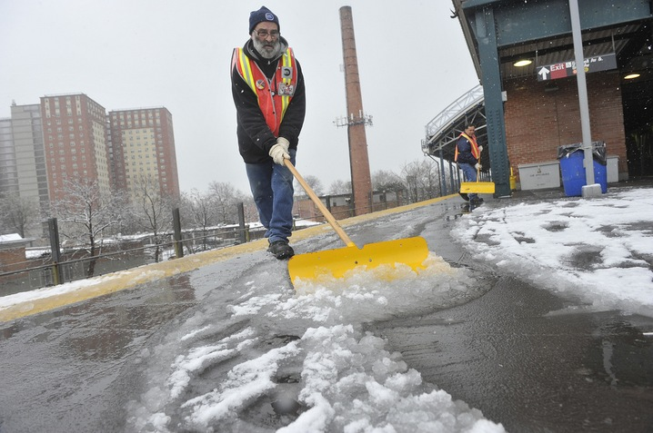
Current Road salt
1. Dissolves
2. Turns into sodium and chloride ions
3. Runoff (into bodies of water)
Notes:
Usry

Slide 3
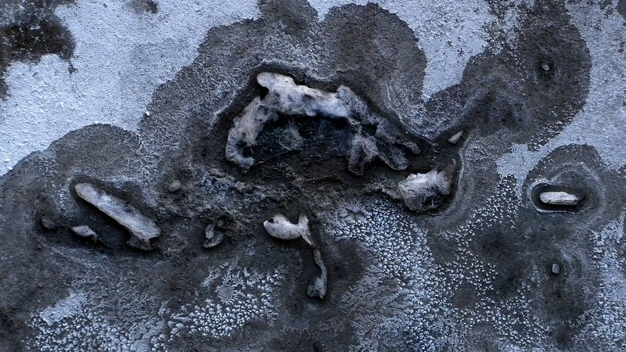
Where does the salt go?
The salt contaminates our
Lakes
Streams
Wetland
Groundwater
Plant life
“It takes only one teaspoon of road salt to permanently pollute 5 gallons of water.”
There is no way to extract the water from these bodies of water which in turn causes:
The survival rate of organisms living in these waters to decrease
A decrease in the amount of water being circulated (lack of oxygen at the bottom of the water sources)
The salt also kills plant life near the roadway due to dehydration. The salt makes it harder for the plants to obtain the amount of water needed in order for them to survive.
Notes:
Chamness

Slide 4
Project Constraints
Money
each county/city sets a particular budget
Baltimore County: $6 million
The use of certain chemicals is either prohibited or restricted
The Snow Melt Mixture must be:
Durable : last more than three snow storms → Reduce usage by 1/3
Ecofriendly (no run-off)
Efficient (melt snow faster or as fast as traditional snow salt)
Notes:
Reasoning:
The average snow salt lasts one snow storm and turns into run off. By having snow salt last three snow storms, the use of chemicals will be reduced by 1/3. Snow Paint would be most effective in southern and western states with minimal snow fall.

Slide 5
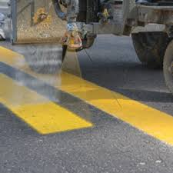
Our Plan
Make a solution that can be mixed into traffic paint.
Our solution should be long-lasting and only need to be painted on the roads once a year.
The solution dissolves snow, just like road salt, without chemical run off.
Notes:
Garber

Slide 6
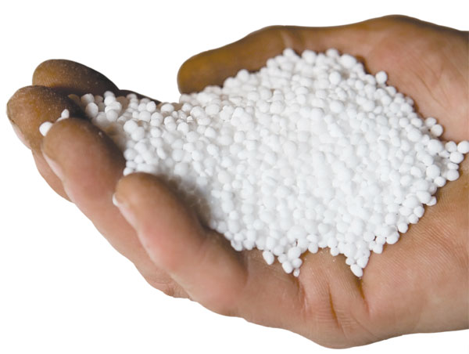
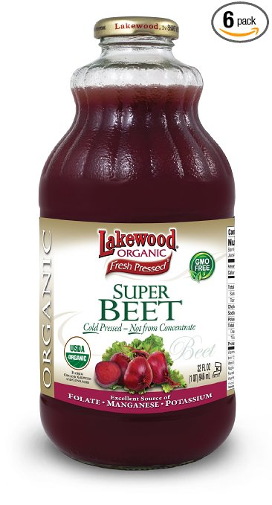
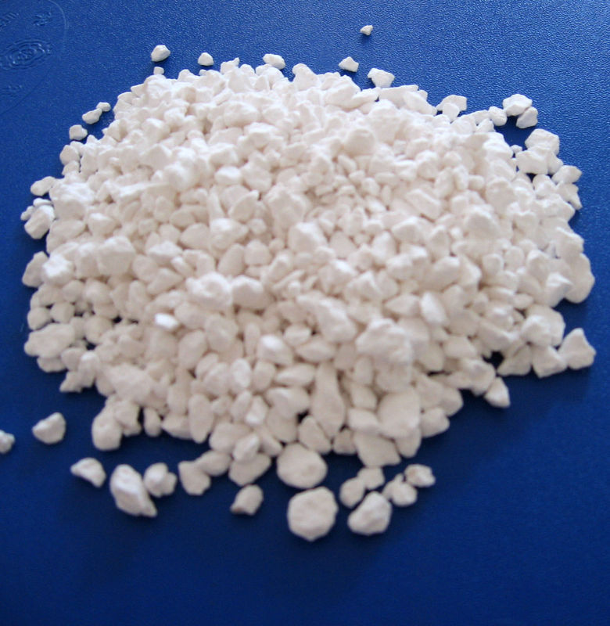
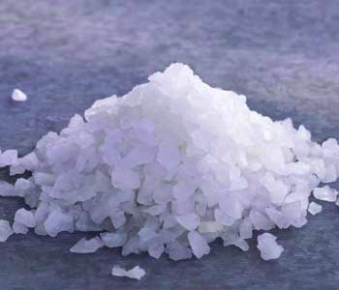
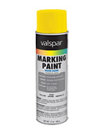
Ingredients List and Cost Analysis
Urea - $0.34 for 10 grams (sciencecompany.com)
Beet Juice - $11.44 for 1 gallon (eders.com)
Calcium Chloride - $0.89 for 1 pound (officedepot.com)
Sodium Chloride - $13.49 for 1 GM (amazon.com)
Zone Marking Paint - $39.03 for 1 gallon (amazon.com)
Notes:
Chamness

Slide 7
Formulas
Formula #1
Chemical | Amount
Calcium Chloride | 10 g
Sodium Chloride | 10 g
Urea | 10 g
Alcohol | 30 ml
Water | 15 ml
Formula #2
Chemical | Amount
Beat Juice | 30 g
Alcohol | 30 ml
Water | 15 ml

Slide 8
Formulas
Formula #3
Chemical | Amount
Calcium Chloride | 10 g
Sodium Chloride | 10 g
Urea | 10 g
Beat Juice | 30 g
Alcohol | 30 ml
Water | 15 ml
Formula #4
Chemical | Amount
Calcium Chloride | 10 g
Sodium Chloride | 10 g
Urea | 10 g
Beat Juice | 30 g
Alcohol | 60 ml
Water | 45 ml

Slide 9
Formulas
Formula #5
Chemical | Amount
Calcium Chloride | 10 g
Sodium Chloride | 10 g
Urea | 10 g
Alcohol | 60 ml
Water | 45 ml
Formula #6
Chemical | Amount
Calcium Chloride | 10 g
Sodium Chloride | 10 g
Beat Juice | 30 g
Alcohol | 60 ml
Water | 45 ml

Slide 10
Formulas
Formula #7
Chemical | Amount
Sodium Chloride | 10 g
Urea | 10 g
Beat Juice | 30 g
Alcohol | 60 ml
Water | 45 ml
Formula #8
Chemical | Amount
Calcium Chloride | 10 g
Urea | 10 g
Beat Juice | 30 g
Alcohol | 60 ml
Water | 45 ml

Slide 11
Testing Results: Data Kew
Numerical Value | Meaning
0 | Frozen: H20 remains in original solid state
1 | Ice cube reduced in size, but still solid
2 | Pool of liquid surrounding the remaining ice and shape has changes
3 | Completely Melted: H20 is in liquid form

Slide 12
Future Work
Complete more testing:
Using the same blocks of concrete to see if the paint stays and the formulas that were effective continue to be so
Testing after the painted blocks experience real life circumstances such as pressure and heat

Slide 13
Resources
http://www.baltimoresun.com/news/weather/weather-blog/bs-md-snow-costs-20150303-story.html

