Slide 1
Poppy 3D
By: Reilley Chamness and Julia Garber

Slide 2
What does Poppy do?
Poppy lets you capture your own high-quality photos and videos in 3D using the camera of your iPhone 4 or 5.
Looking through Poppy looks like you are looking into another world!
You can record 3D videos and photos with Poppy.
Find cool Poppy 3D photos on flicker and twitter using the hashtag #poppy3d.
There are 1000’s of 3D movies and trailers available for Poppy on YouTube.

Slide 3
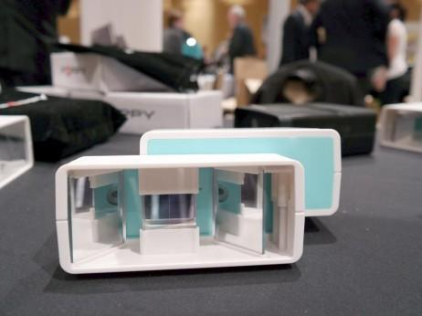
How does Poppy work?
Poppy uses mirrors to capture two sterographic pictures
one picture is a left eye view and the other picture is the right eye view
The app downloaded on the iphone combines the two images into a single 3D Picture

Slide 4
How do you use Poppy?
View your own photos/videos:
Take a 3D photo/video:
Open the file you wish to see on your phone
Place your phone in the tray and place the tray in the Poppy imager
Twist the mirror assembly so it is vertical
Look through Poppy and view your image in 3D!
Download and open the Poppy 3D app
Place your phone into the tray and place the tray in the Poppy imager
Use the holes at the bottom of Poppy and your thumbs to control the app
View your new photos and videos right on the app!

Slide 5
How does Poppy relate to STEM class?
Poppy utilizes 3D imaging using two view points as we have seen before
Linked to 3D printing
Pictures can be developed into optical illusions

Slide 6
Bibliography
http://www.pcpro.co.uk/blogs/2014/01/08/how-to-create-and-view-3d-photos-with-your-iphone-meet-poppy
http://www.poppy3d.com/

Slide 7
Thank You!

