Slide 1
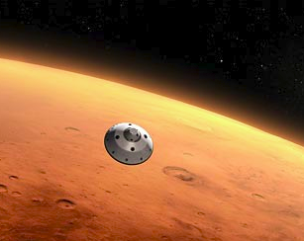
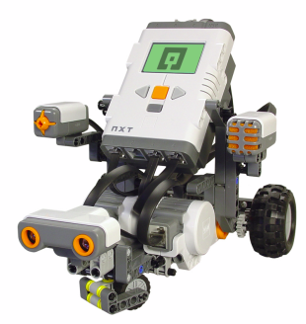
Mars Rover Expedition
By: Scarlett and Sally

Slide 2
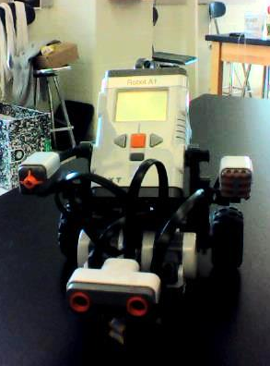
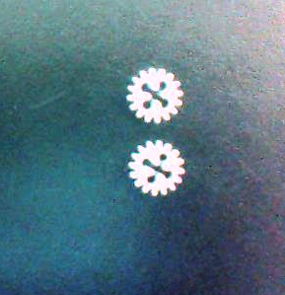
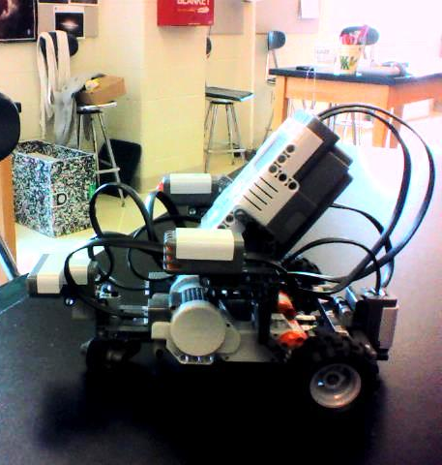
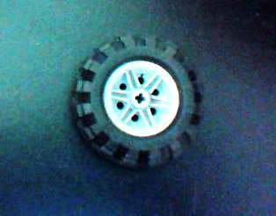

Robot Configuration
Notes:
Robot A1 has 16 tooth gear on the motor and 16 tooth gear on the axel. The gears are the same size so the robot does not have too much speed and not enough power and vice versa. The gears we have are an average between the three options and enable us to have an appropriate amount of speed and power. We used the medium sized wheels because they were thicker than the big ones. We choose the sonar detector instead of the touch sensor because it is a safer way to determine objects. When the robot uses the touch sensor sometimes the robot can get damaged when it runs into the objects.

Slide 3
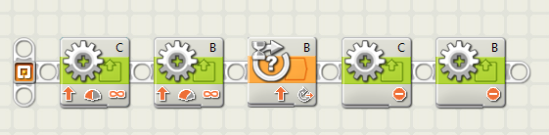
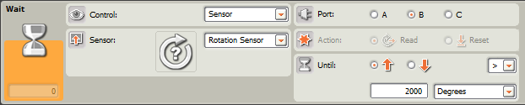
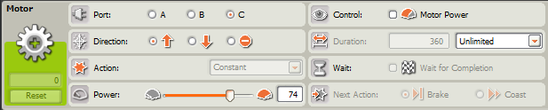
Explanation for Forward Program

Slide 4
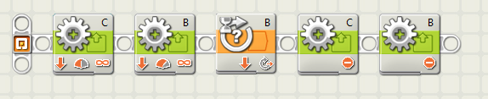
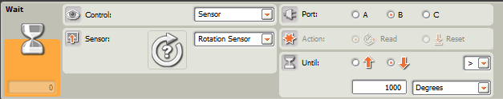
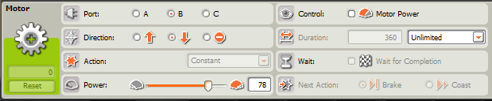
Explanation for Backward Program

Slide 5
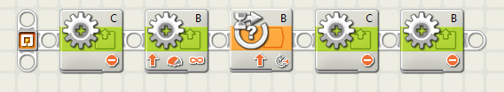
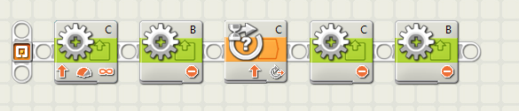
Explanation for Turning Program
Left turn
Right Turn

Slide 6
Movement Plan for Inclined and Declined Slope
Notes:
To move on an inclined and declined slope we plan on use the same program to go forward on a flat surface.

Slide 7
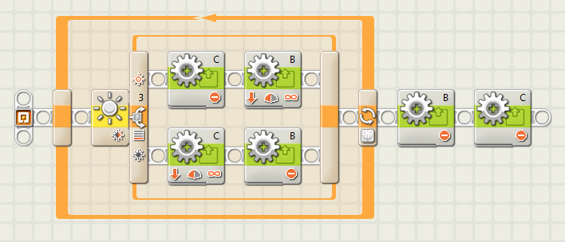
Explanation for Tracking a Curve
Notes:
The yellow block in the beginning reads the value picked up from the light sensor and interprets it. If the value from the light sensor is less than 42% is tells wheel C to rotate backwards and wheel B to stay in place. When the light sensor detects a value higher than 42% is tells wheel C to stay in place and for wheel B to rotate backwards. The orange arrow that encompasses the entire program tells the blocks to repeat this pattern for a specific amount of seconds. The wheels rotate backwards because, historically, the light sensor picks up the color values better when going backwards. In the simulation my partner and I will determine the amount of seconds we want the program to repeat, but for practice is set on 40 seconds. This program will find the Hecate trail and allow the robot to follow it by determining the color values of the surface below it.

Slide 8
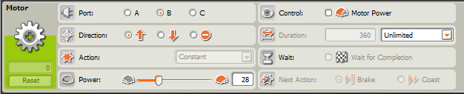
Explanation for How to Traverse Rough Terrain
Notes:
The first block signals the motor B to move forward at the power level of 25. The second block signals wheel C to move forward at the power level of 28. Motor C is at a higher power level to compensate for the turn wheel B makes, because it goes faster. Both the motors are at such a low power level because when we tested the robot on rough terrain it traversed easier when it was going at slower rate viruses a faster rate. The third block waits for wheel B to rotate 3000 degrees, which is about 3 feet. When the rotation sensor senses 3000 degrees of rotation in wheel B, it signals both wheels to stop.

Slide 9
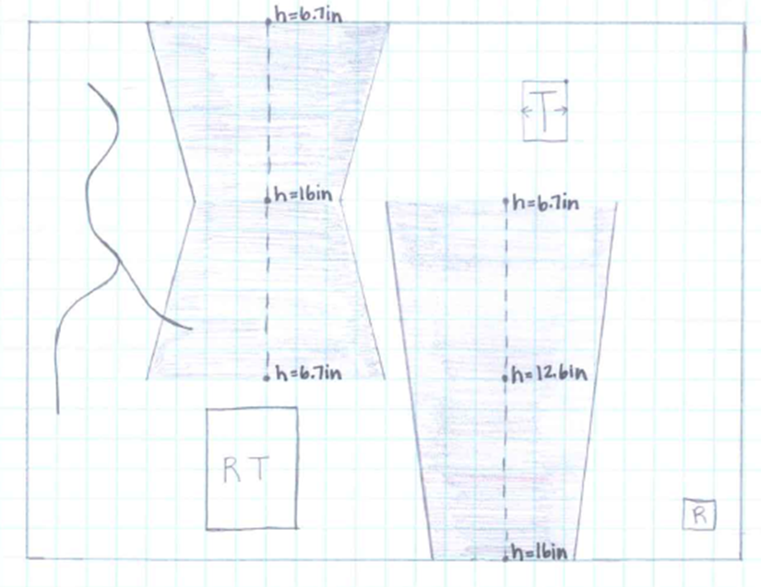
Reference to Map of Mars Landing Site
Notes:
At first when we saw the map we created a path for the robot to travel (indicated in red). Then we decided that since where we start the simulation will be random, we should create individual programs we can change depending on where the robot is positioned. We also used the measurements of the map to simulate inclined and declined slopes

Slide 10
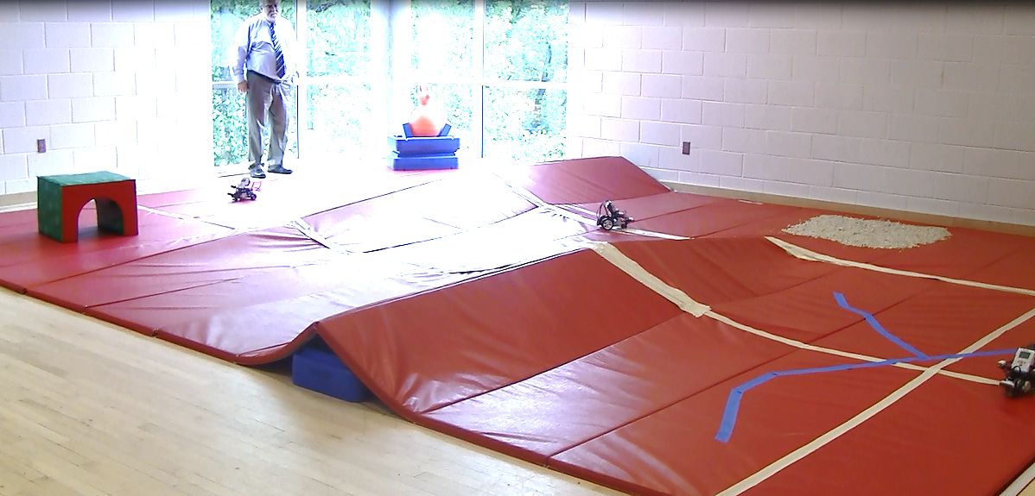
The Real Mars Simulation

Slide 11
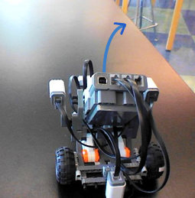
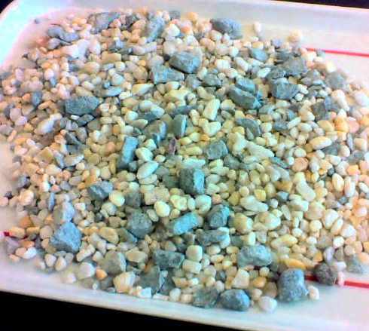
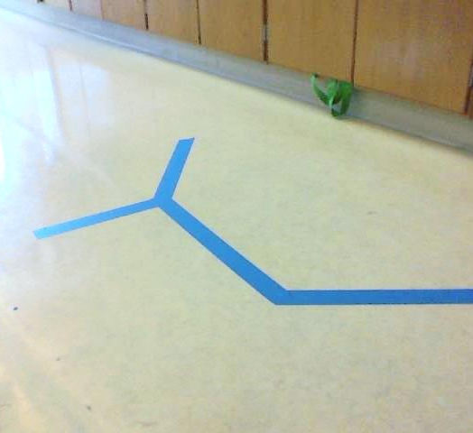
How Test Simulations Guided Programming

Slide 12
Citations
http://news.nationalgeographic.com/news/2012/08/pictures/120804-mars-science-laboratory-nasa-space-rover-landing/
http://www.cs.cmu.edu/~staszel/stuff/robothalloffame2007/Lego_Mindstorm/

