Slide 1
Sustainable Batteries
By Rebecca, Lexi, and Sally

Slide 2
Why Did We Chose this Topic?
We wanted to engineer a battery which can be assembled using local coins and fruits (in a chosen region) that are inexpensive, acidic, and easy to find in order to help underdeveloped nations. A little light could go a long way.

Slide 3
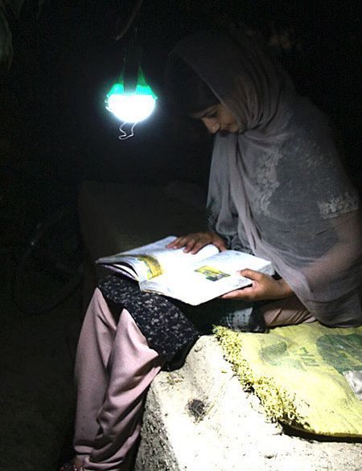
As a team of engineers, our mission is to…
create the most efficient and sustainable battery using coins and various acidic drinks
design a kit for an unassembled battery that can be shipped to a region where electricity is not easily accessible
reduce the hazardous waste created by batteries

Slide 4
Product Constraints
Create a project having to do with inscreasing the sustainability of energy usage
Acidic fruits mixed with salt must be used to make a battery and power a small light bulb
The battery must be able to light the light bulb for 15 minutes
An accessible, cost efficient package must be made to hold the battery
The battery should be as cost efficient as possible

Slide 5
Cost Analysis
MATERIAL/ITEM | COST PER UNIT | SOURCE
Lemon | $1.67 per lemon | Amazon
Orange | $0.62 per lb | Mygofer
Grapefruit | $0.80 per lb | Mygofer
Lime | $1.10 per lb | Mygofer
Vinegar | $1.48 per 32 fl oz | Kmart
Paper towels | $0.74 per roll | Walmart
Salt | $1.19 | Webstaurantstore
Foil | $2.79 for 30 sq ft | Ace Hardware
Coins | (reusable) | N/A
Multimeter | $7.88 | Walmart
Total | $18.27 | N/A
Note: Cost per battery when completed will differ when a kit is finalized; however, if one were to use all of these materials, this is the cost

Slide 6
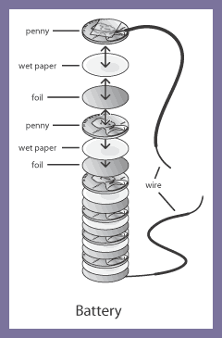
How do you make a sustainable battery?
You can make a battery by soaking a paper towel into a acidic solution mixed with salt. You will then layer tinfoil, paper towel, and a coin in that order until you have reached your desired amount of layers.

Slide 7
Procedure
cut 20 pieces of foil and paper towel to shape quarter
gather 20 quarters made with same composition of metals
create acid solutions by mixing 0.2g of salt with 10 ml of each fruit juice, place salt and juice in a 50 ml glass beaker
stir each solution using a glass stir rod until salt dissolves (make sure glass stir rod is wiped before stirring each solution)
place 1 piece of cut paper towel into beaker of vinegar solution
extract paper towel piece using tweezers after it is fully soaked in the solution
place soaked paper towel piece on top of 1 cut foil piece
place 1 coin on top of soaked paper towel piece
repeat steps 5-8 until 4 of paper towel pieces , foil pieces, and coins are used
use voltage monitor to read the voltage of battery by placing 1 wire on one side of battery, and 1 wire on other side of battery
record voltage under 20m in data table
repeat steps 5-11 testing the lime solution, lemon solution, grapefruit solution, and orange solution with 4 quarters each
repeat steps 1-12 using pennies, dimes, and other coins instead of quarters

Slide 8
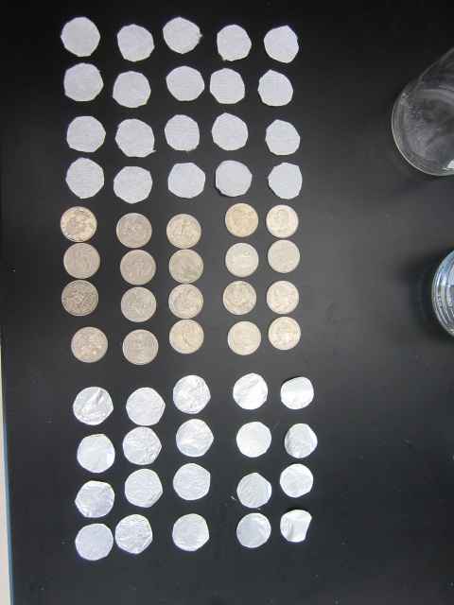
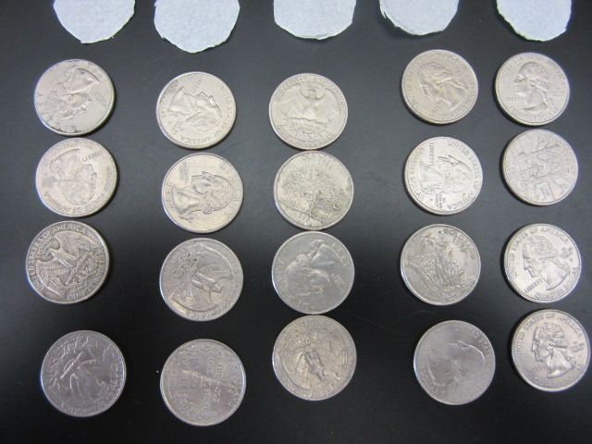
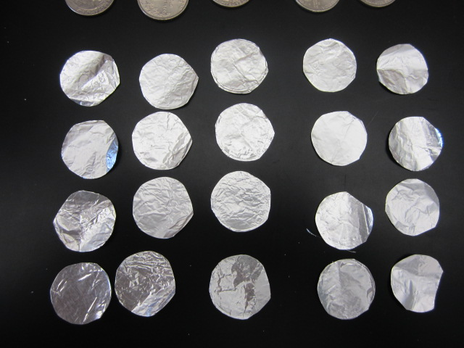
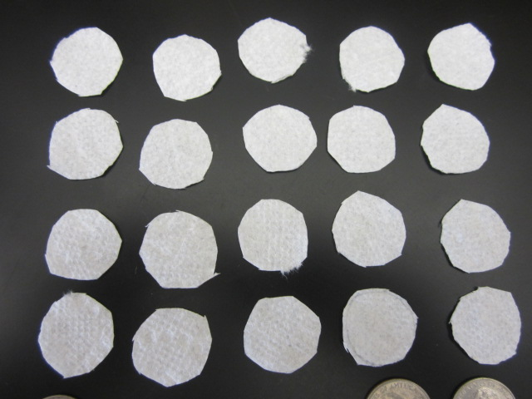
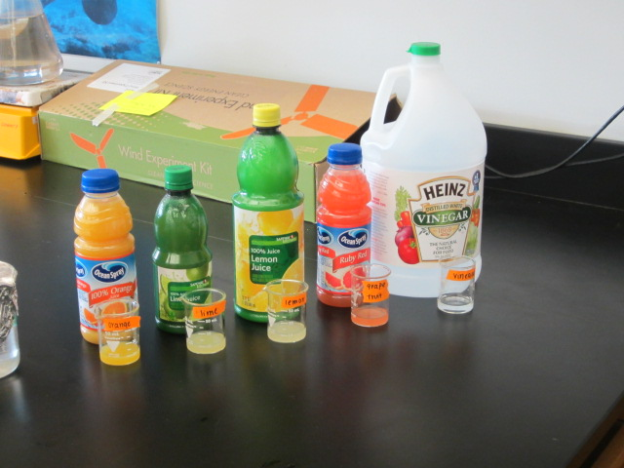
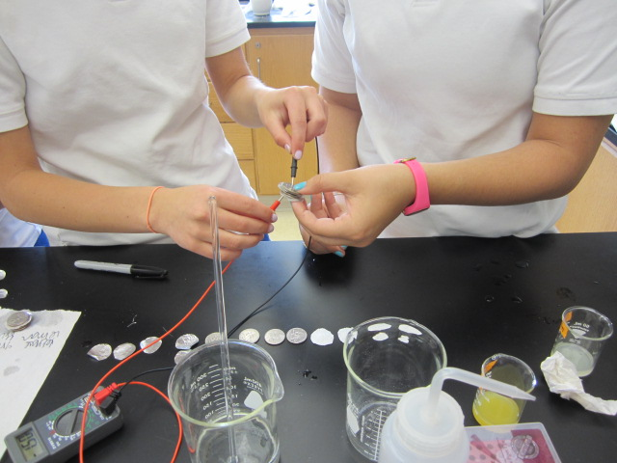
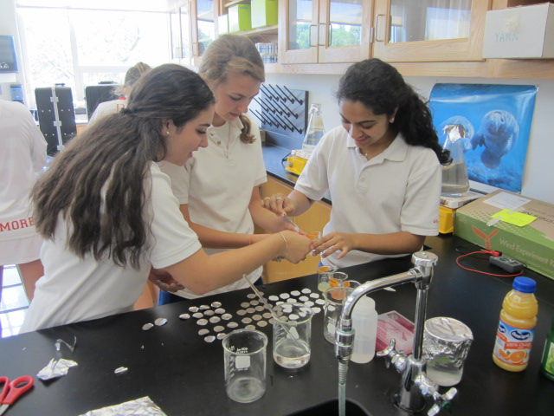
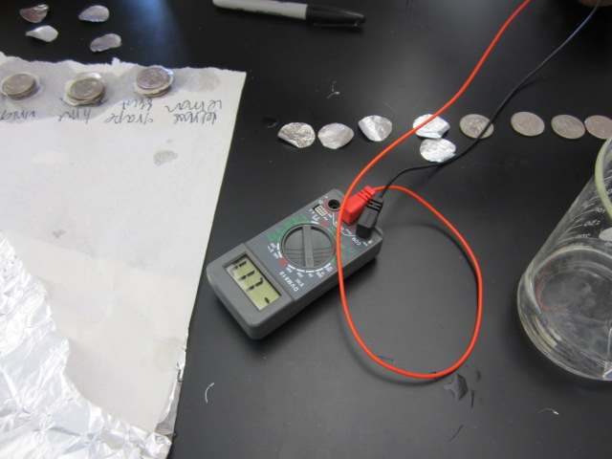
Experiment in Action

Slide 9
Ranges of Energy Produced by Different Combinations of Coins and Acids (V)
Type of Coin | Vinegar | Lime Juice | Lemon Juice | Orange Juice | Grapefruit Juice
US Quarter | 1.08 V | 0.88-0.61 V | 1.60-1.15 V | 0.90-0.84 V | 2.50-1.00 V
US Penny | 1.00-0.38 V | 1.14-1.11 V | 0.03-0.01 V | 1.40-1.02 V | 0.88-0.54 V
US Dime | 0.12-.10 V | 0.69 V | 0.46-0.19 V | 0.05-0.00 V | 0.29-0.17 V
(The ranges are written from largest to smallest since the voltage decreased over time)

Slide 10
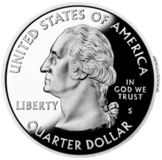
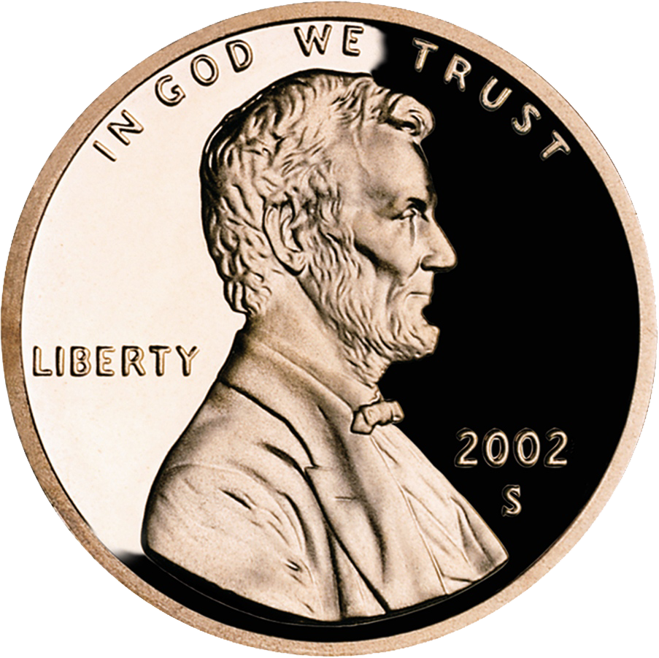
Visual Representations of Data

Slide 11
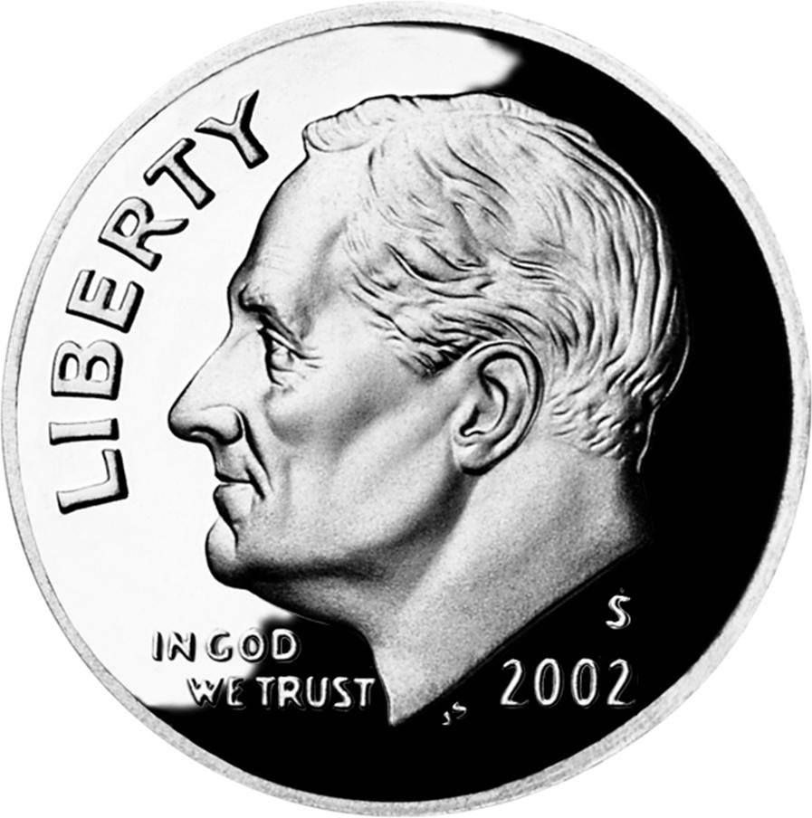
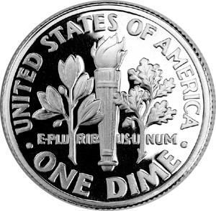
Visual Representations Continued

Slide 12
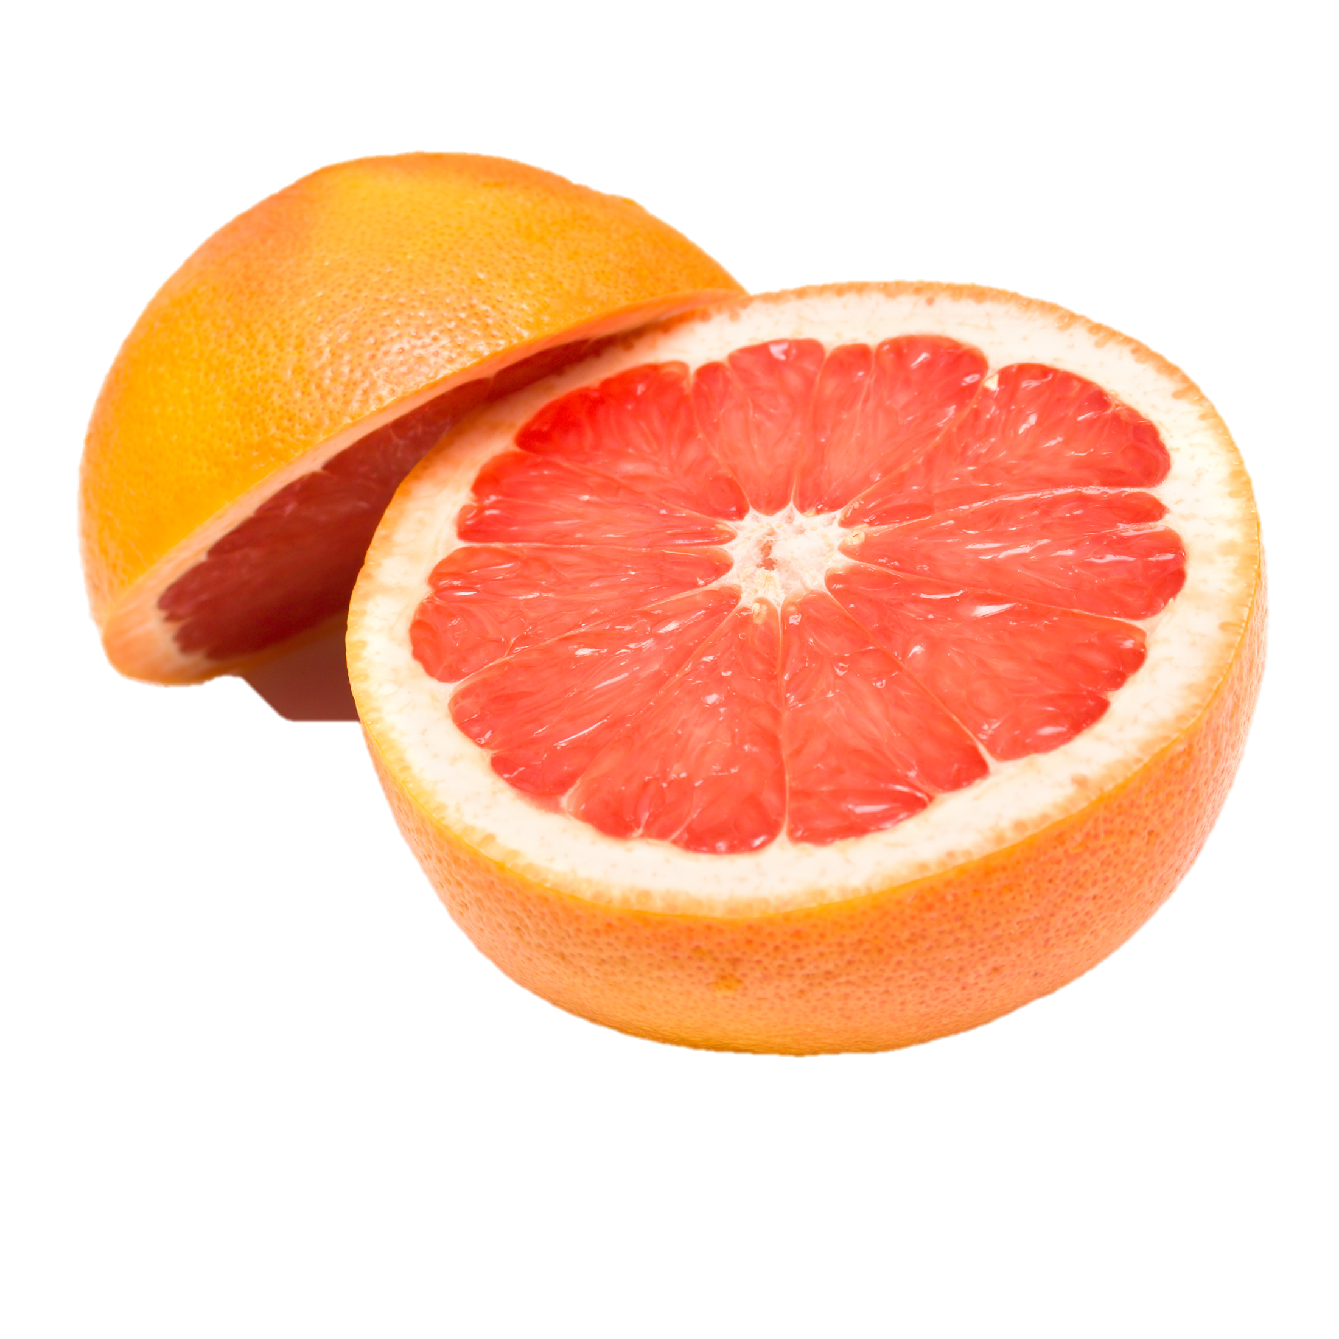
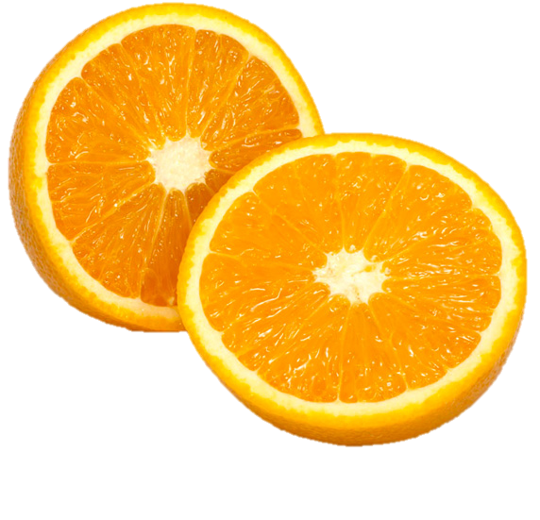
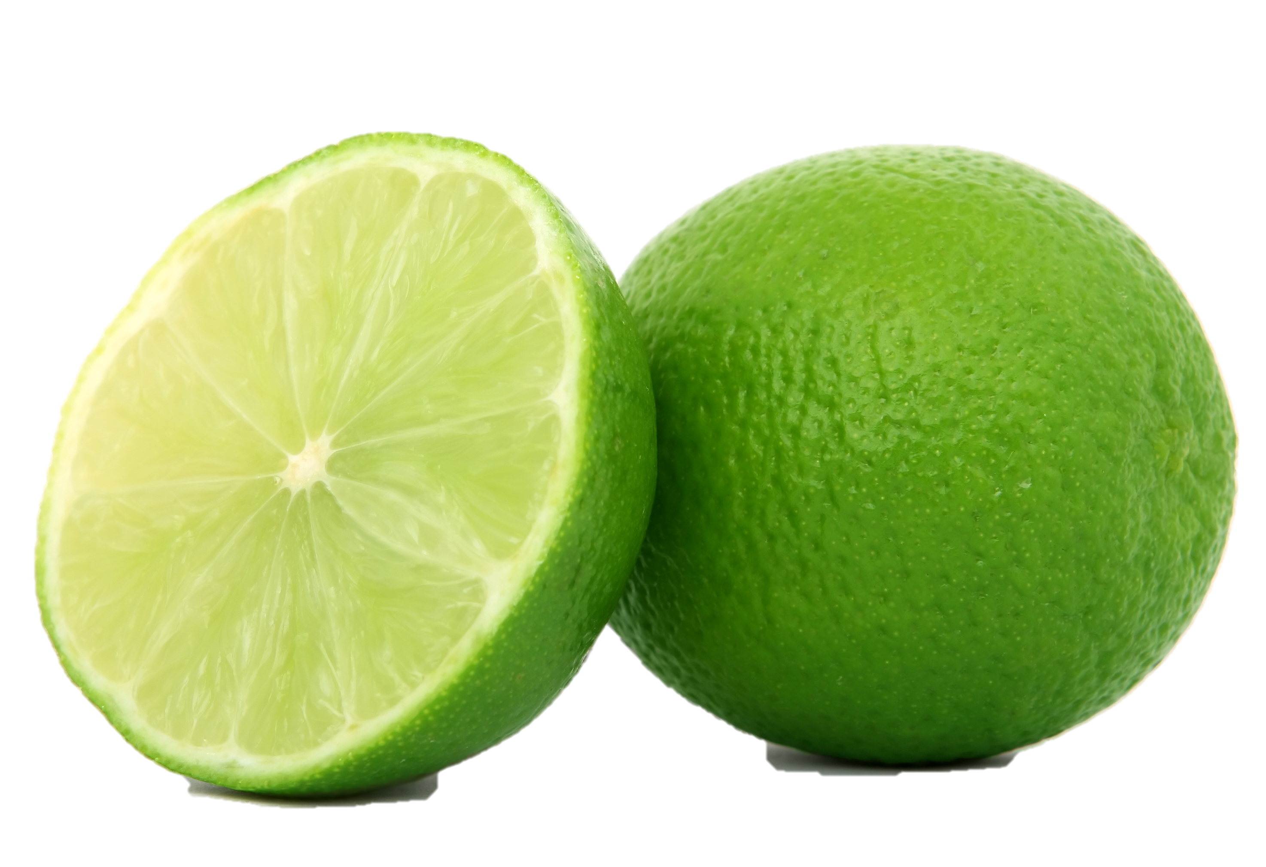
Observations from Data
Highest Voltage Produced: Grapefruit Juice with US Quarters
Lowest Voltage Produced: Orange Juice and Dime/ Lemon Juice and Penny
Most Consistent Over Time (does not lose energy fast): Lime Juice

Slide 13
Final Observations
Tried using quarters with the vinegar solution to light a small LED light bulb→ did not light

Slide 14
In the future we will…
Research compositions of coins in other developing countries that match those of the USA
Try to optimize the amount of voltage by altering the...
concentration of salt and acidic fruit juice
amount of coins used

Slide 15
Works Cited
http://bundlr.com/b/build-up-a-battery-recharge-what-you-have
http://www.igreenspot.com/nokero-the-solar-light-bulb-for-developing-countries/
https://www.arborday.org/programs/rainforest/madagascar/
http://commons.wikimedia.org/wiki/File:United_States_dime,_reverse.jpg
http://en.wikipedia.org/wiki/Washington_quarter
http://www.azom.com/article.aspx?ArticleID=8088#5
http://www.clipartpanda.com/categories/lightbulb-clipart
http://www.26fruits.co.uk/orange.php

