Slide 1
Hilbert Curves
By: Alex Rubin & Isabelle Alfriend

Slide 2
Investigation Question:
Who is Hilbert and what are his contributions to geometry?

Slide 3
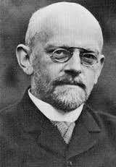
David Hilbert
January 23 1862 - February 14 1943
German Mathematician
he is known as one of the most influential mathematicians of the 19th and early 20th centuries
He is known as a founder of proof theory and mathematical logic
He is also one of the first people to distinguish between mathematics and metamathematics
metamathematics : “This study produces metatheories, which are mathematical theories about other mathematical theories

Slide 4
Hilbert curves
a continuous fractal and self-similar curve
If you zoom in and look closely at a section of a higher-order curve, then the pattern you see will look the same
Limit is a space-filling function which fills a square
covers every point in a square
The basic element is a U-shape

Slide 5
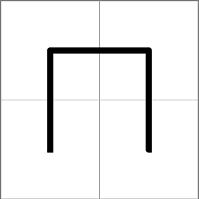
Step One
“Hilbert designed his curve as connecting the centers of 4 sub-squares, which made up a larger square. To begin, 3 segments connect the 4 centers in an upside-down U shape.”

Slide 6
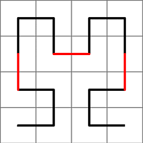
Step Two
the 4 squares have been divided into 4 more squares
U shape is shrunken to half its original size and copied into each sector of 4 squares
top left:it's just copied In
top right: it's flipped horizontally
bottom left: it's rotated 90 degrees clockwise
bottom right:it's rotated 90 degrees counter-clockwise
The 4 pieces are connected with 3 red segments
same size as the shrunken pieces of the U shape

Slide 7
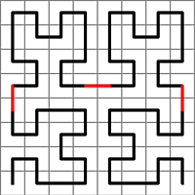
Step Three
The 16 squares from step 2 have been divided into 4 more squares each
The shape from step 2 is shrunken and copied
3 red segments are added to complete the curve

Slide 8
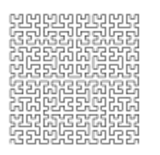
The Pattern of Hilbert Curves
The steps continue
At each step: the previous curve is shrunken to half its size & copied 4 times
In the top left it's just copied, In the upper right it is flipped, in the bottom left it is rotated 90 degrees clockwise, and in the bottom right it it rotated 90 degree counter clockwise
At each step the curve starts in the lower left corner and ends in the lower right corner, never touching or crossing itself

Slide 9
Relation to Topology
related because of the growing and shrinking of the hilbert curves
it starts out as a simple U shape which is combined to together over and over again to form a larger pattern of the same shape

Slide 10
Watch this!
https://www.youtube.com/watch?v=dkGJIIdQQI8

Slide 11
https://www.fractalus.com/kerry/tutorials/hilbert/hilbert-tutorial.html
https://en.wikipedia.org/wiki/David_Hilbert
http://mathworld.wolfram.com/HilbertCurve.html
https://en.wikipedia.org/wiki/Hilbert_curve

