Slide 1
SUSTAINABLE SOAP
By Jaden Kielty, Keziah Palmer, Alex Rubin, Grace Watts

Slide 2
Soaps today aren’t as sustainable as they claim…
Today, in some of the top soap brands, harmful chemicals (for both the environment and humans) are hidden in so called “organic” and “green” soaps.

Slide 3
Top Unsustainable Ingredients
Palm oil- removes oil and dirt from skin; grows in tropical rainforests, and when extracted, causes destruction of habitat of endangered species; Present in Dial and Dove
Sulfates- used in foaming products and can damage eyes and irritate skin; present in Method Dish Soap, Dawn Dish Soap, All Purpose Hand Soap, and Ivory Soap
Parabens- found in breast cancer tumors (methylparaben, butylparaben, ethylparaben, propylparaben); Present in Cetaphil
BHA & BHT- preservatives that can induce allergic reactions in the skin; possible human carcinogen
Petrochemicals- can be absorbed through skin and be toxic to the kidney, brain and respiratory system

Slide 4
More ingredients
DEA, MEA, & TEA- makes products creamy or sudsy and can cause carcinogenic effects and increased risk of liver and kidney cancer
Propylene glycol and polyethylene glycol- penetrates skin and weakens protein and cellular structure
Triclosan- in antibacterial and antifungal products it is suspected of causing cancer; present in Dial, Clearasil, CVS Antibacterial Soap, Ajax, Bath and Body Works Antibacterial Hand Soaps
Synthetic dyes- colors can be absorbed into skin causing depletion of oxygen in body; present in Dial and Lever 2000
Artificial fragrance- irritates skin and leads to asthma or damage to immune and nervous systems

Slide 5
Proposal
We used a vegan soap recipe from Soap Recipes 101.
We modified the recipe to fit our soap size. We also altered some of the ingredients used.
Our preliminary soap recipe included…
0.75 oz. Lye
2.375 oz. Crisco
1.5 oz. Olive oil
1.5 oz. Coconut Oil
2 oz. Distilled Water

Slide 6
What is lye?
Made from wood ash and water (preferably rain water)
Hard woods such as apple wood, hickory, chestnut, etc. are better for making lye
Soap is result of chemical reaction called saponification between lye and triglyceride (fat or oil)
Substances are chemically transformed creating soap and natural glycerin
The original ingredients are absorbed in the reaction
Lye is consumed by reaction
Glycerin= result of saponification

Slide 7
What is Crisco?
Crisco is an all- vegetable shortening often used in cooking
High in fat content
Ingredients
Soybean oil
Fully hydrogenated palm oil
Palm oil
Mono and Diglycerides
TBHQ AND Citric acids (Antioxidants)

Slide 8
What is olive oil?
Obtained from the fruit of olive trees
Olives are picked, crushed, and from the crushed olives, a paste is made
Maceration results in the creation of olive oil
Uses
Packed with anti-aging antioxidants and hydrating squalene, making it superb for hair, skin, and nails
Can be used in many beauty and health treatments for hair, lips, antibacterial balm, cuticle conditioning, eczema remedy, and skin moisturizer
Can be used in cooking as a healthy fat and oil

Slide 9
What is coconut oil?
Edible oil extracted from coconut meat
Contains fatty acids with powerful medicinal properties
Contains richest sources of saturated fat
Medical Uses
Moisturizes skin
Unlike mineral oil, there is no chance of harmful side effects for skin when applied generously
Skin care and hair care
Digestion
Immunity against infections and diseases

Slide 10
Procedure
Materials
6 bowls
Gain Dish Soap
Water
Our Vegan Soap
Olive Oil
Mineral Oil
Label the six bowls (Gain- Mineral Oil, Gain- Olive Oil, Water- Mineral Oil, Water- Olive Oil, Vegan Soap- Mineral Oil, Vegan Soap- Olive Oil).
Coat 3 bowls with olive oil and 3 bowls with natural oil until the bottom has approximately ½ cm. of oil on the bottom.
Use each product (Gain, Water, and Vegan Soap) with water to create suds on one mineral oil and one olive oil bowl.
Wait overnight and record results.

Slide 11
Test Results
 | Cost | Effectiveness | Sustainability | Marketing
Gain | $3.00 | 1 | 4 | 1
Water | NA | 4 | 1 | 4
Our Soap | $1.96 | 2 | 2 | 4
Effectiveness
1= clean and ready to use
5= covered in oil
Sustainability
1= most sustainable
5= least sustainable
Marketing
1= Beautiful
5= ugly

Slide 12
Analysis
Our soap was able to clean the oil off of the dishes. However, when the bowl dried, there was a white film on the bottom of the bowl.
The water did not clean off any of the oil. A film of oil remained when observed the next day.
Gain cleaned off all the oil and left no film or grease.

Slide 13
Our vegan soap

Slide 14
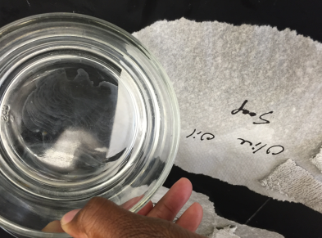

Slide 15
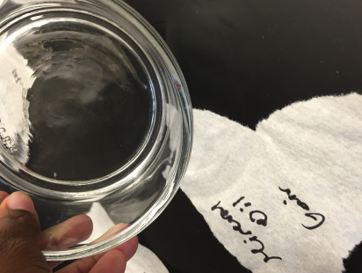
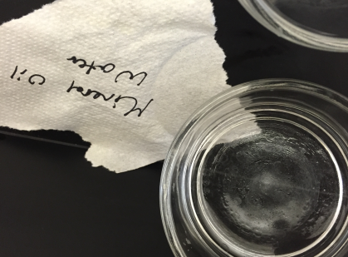

Slide 16
Second Recipe
To improve effectiveness of our sustainable soap, we tested another recipe. This recipe was from Modern Soap Making. Using the same ingredients, we modified the recipe to our mold size. The ingredients included…
•Shea Butter -.5 oz
•Table Salt - 2.167 oz
•Coconut Oil - 3.125 oz
•Olive Oil - .83 oz
•Sodium Hydroxide – 1.767 oz
•Distilled Water – 1.767 oz

Slide 17
Pareto
bar soap- 2.28oz
total soap- 5.84oz

Slide 18
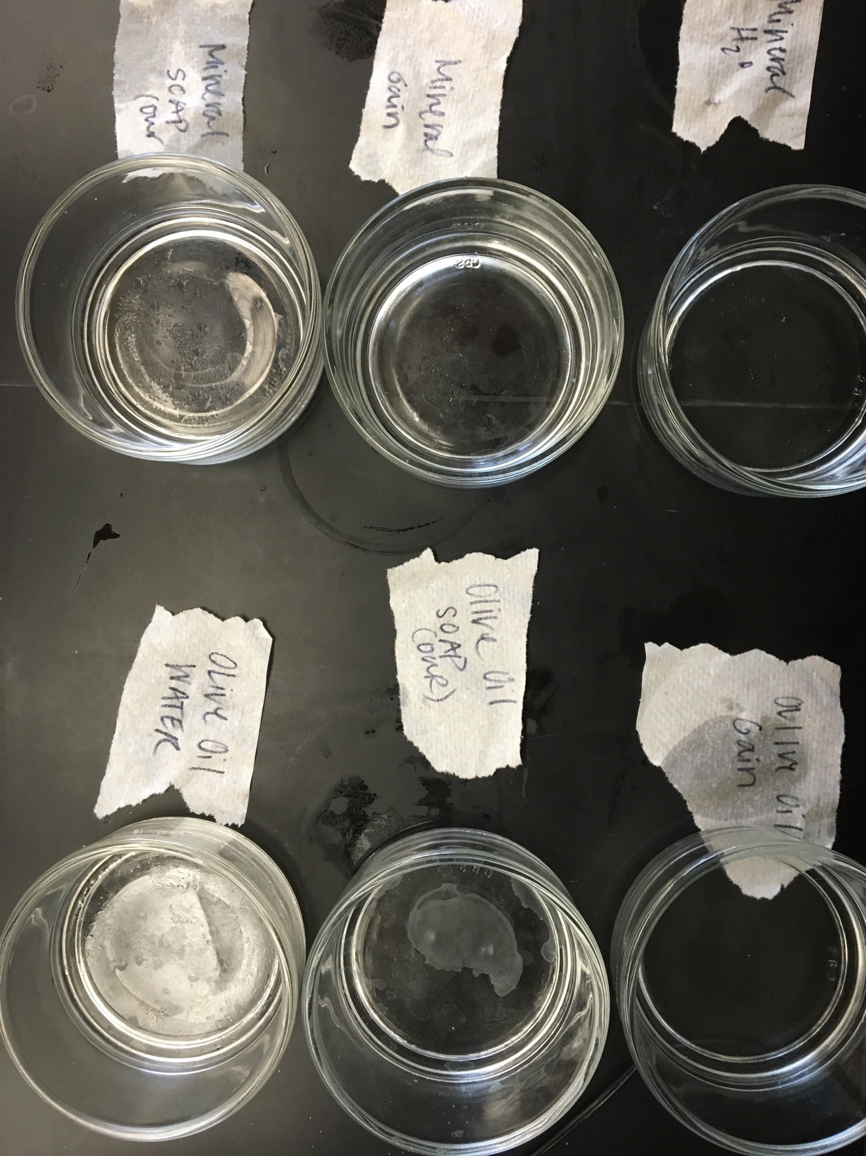

Slide 19
Analysis
Our soap was able to clean the mineral oil jar better than Gain cleaned it. Gain did not clean mineral oil as much as it did for Olive oil. It left behind a thin layer of oil as well as an all white film. However for Olive Oil our soup left behind an all white film behind. Where as gain left behind a thin layer of oil inside the jar.

Slide 20
Sustainable Packaging
Beneficial, safe, and healthy for people and communities while still meeting market criteria for performance and cost
Sourced, manufactured, transported, and recycled using renewable energy
Optimizes the use of renewable or recycled source materials
Manufactured using clean production technologies
Produced from healthy materials
Designed to optimize materials and energy

Slide 21
Sources
http://blog.freepeople.com/2013/09/staying-natural-10-ingredients-avoid-beauty-products/
http://www.worldwildlife.org/pages/which-everyday-products-contain-palm-oil
http://www.soapshed.com/Handmade-Natural-Soap/
http://www.soaprecipes101.com/homemade-soap-recipes/vegan-handmade-soap-recipe/
http://botaniesoap.com/blog/the-truth-about-lye-and-organic-soap/
http://www.allure.com/beauty-trends/blogs/daily-beauty-reporter/2014/06/diy-beauty-uses-for-olive-oil.html
http://www.sustainablepackaging.org/content/?type=5&id=definition-of-sustainable-packaging

