Slide 1
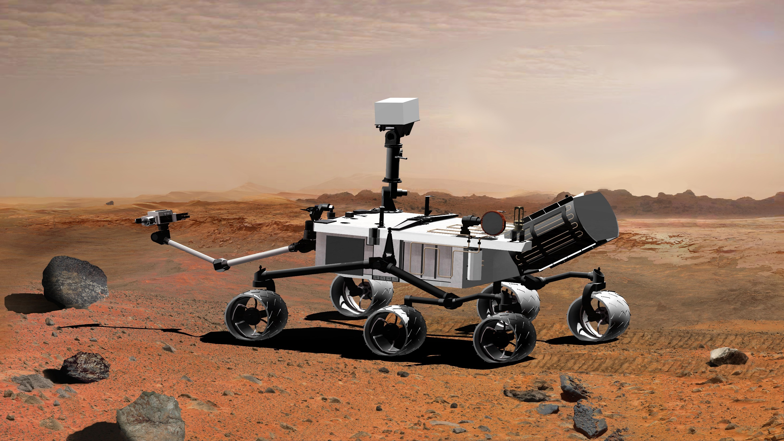
Traversing Mars
By: Payton and Alex

Slide 2
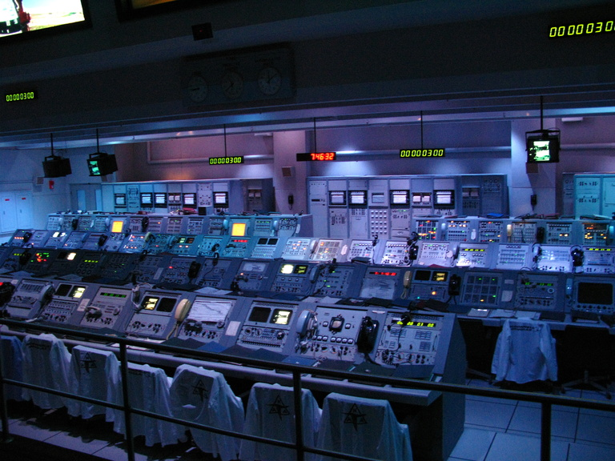
Join Payton and Alex on their journey of traversing mars with a Mars Rover!!

Slide 3
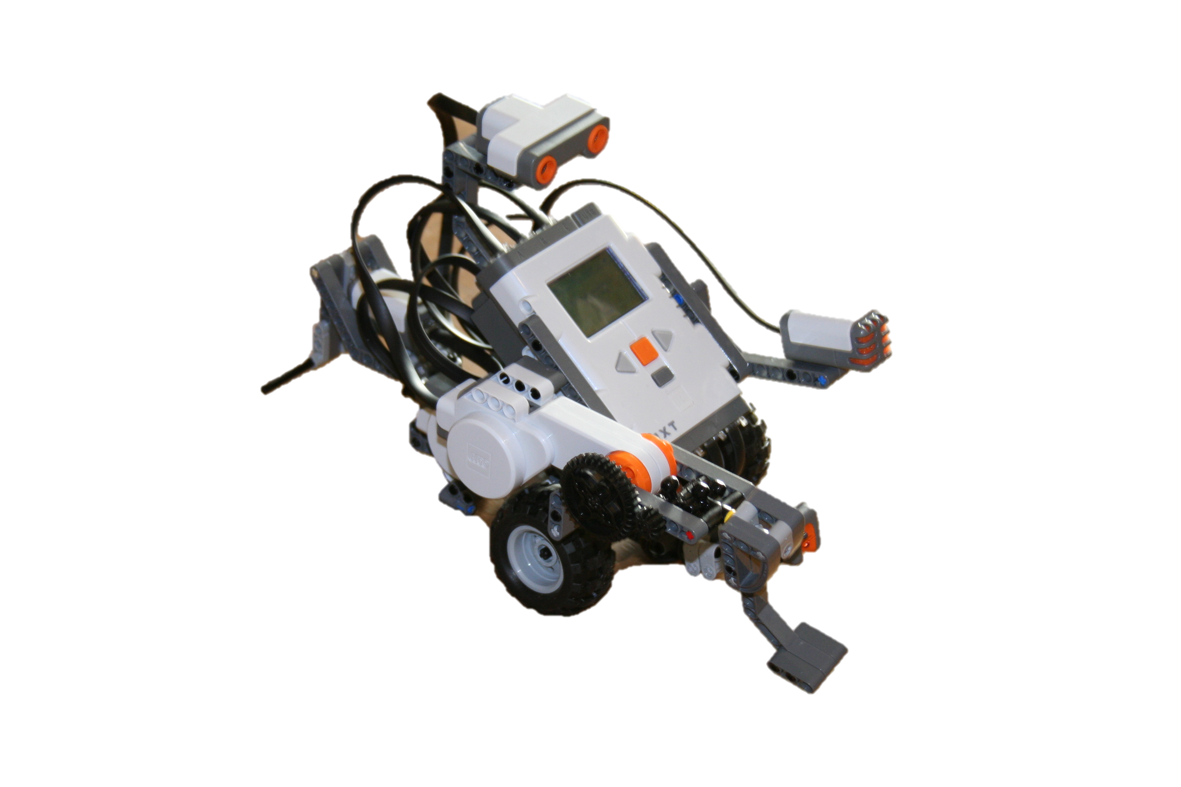
Robot Configuration
We used the standard wheels and gears!

Slide 4
Standard Programs
Forwards
Backwards
Turning

Slide 5
Moving Forward

Slide 6
Moving Backward

Slide 7
Turning
We used swing turns left and right with a 90 degree wheel rotation, along with 440, and 720 degree wheel rotations
← Program for all right turns
← Programs for all left turns

Slide 8
Traveling Through Obstacles
Inclined and declined slopes
Hematite trail
Tunnel
Rough terrain
Exploring Rock

Slide 9
Map

Slide 10
Rough Terrain

Slide 11
Map

Slide 12
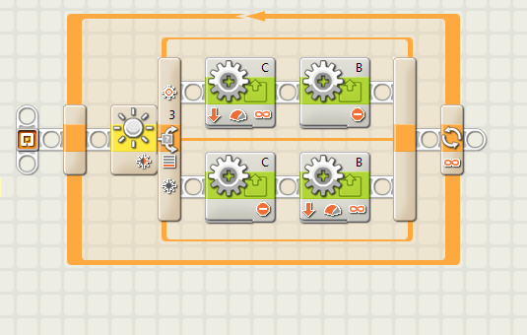
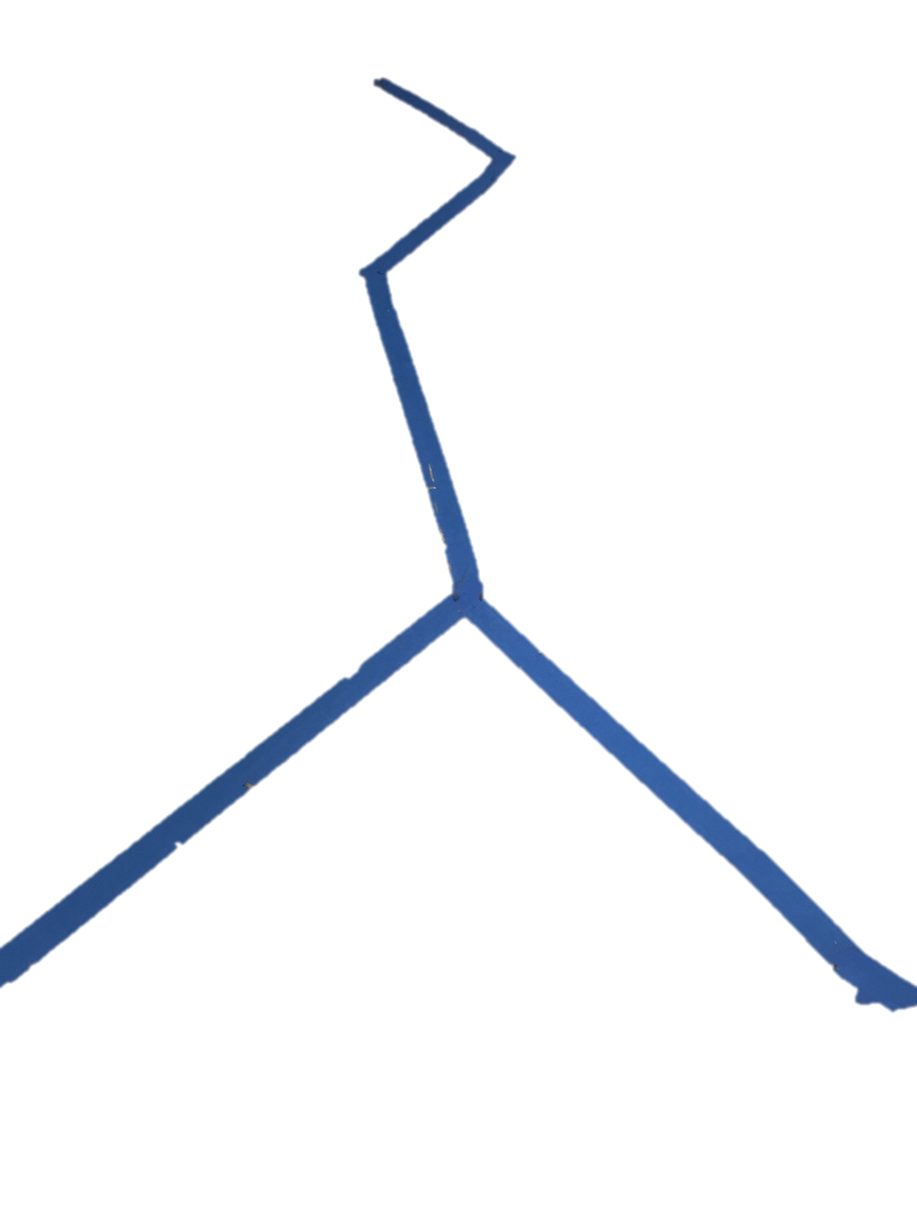
Following the Hematite Trail

Slide 13
Map

Slide 14
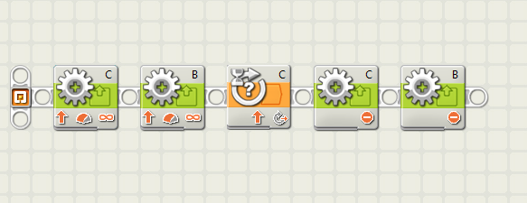
Going through the Tunnel

Slide 15
Map

Slide 16
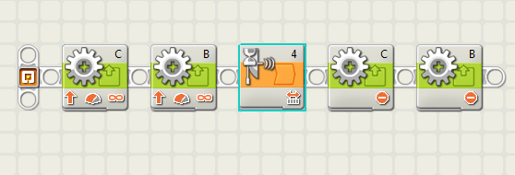
Exploring the Rock

Slide 17
Movement on Inclined and Declined slopes

Slide 18
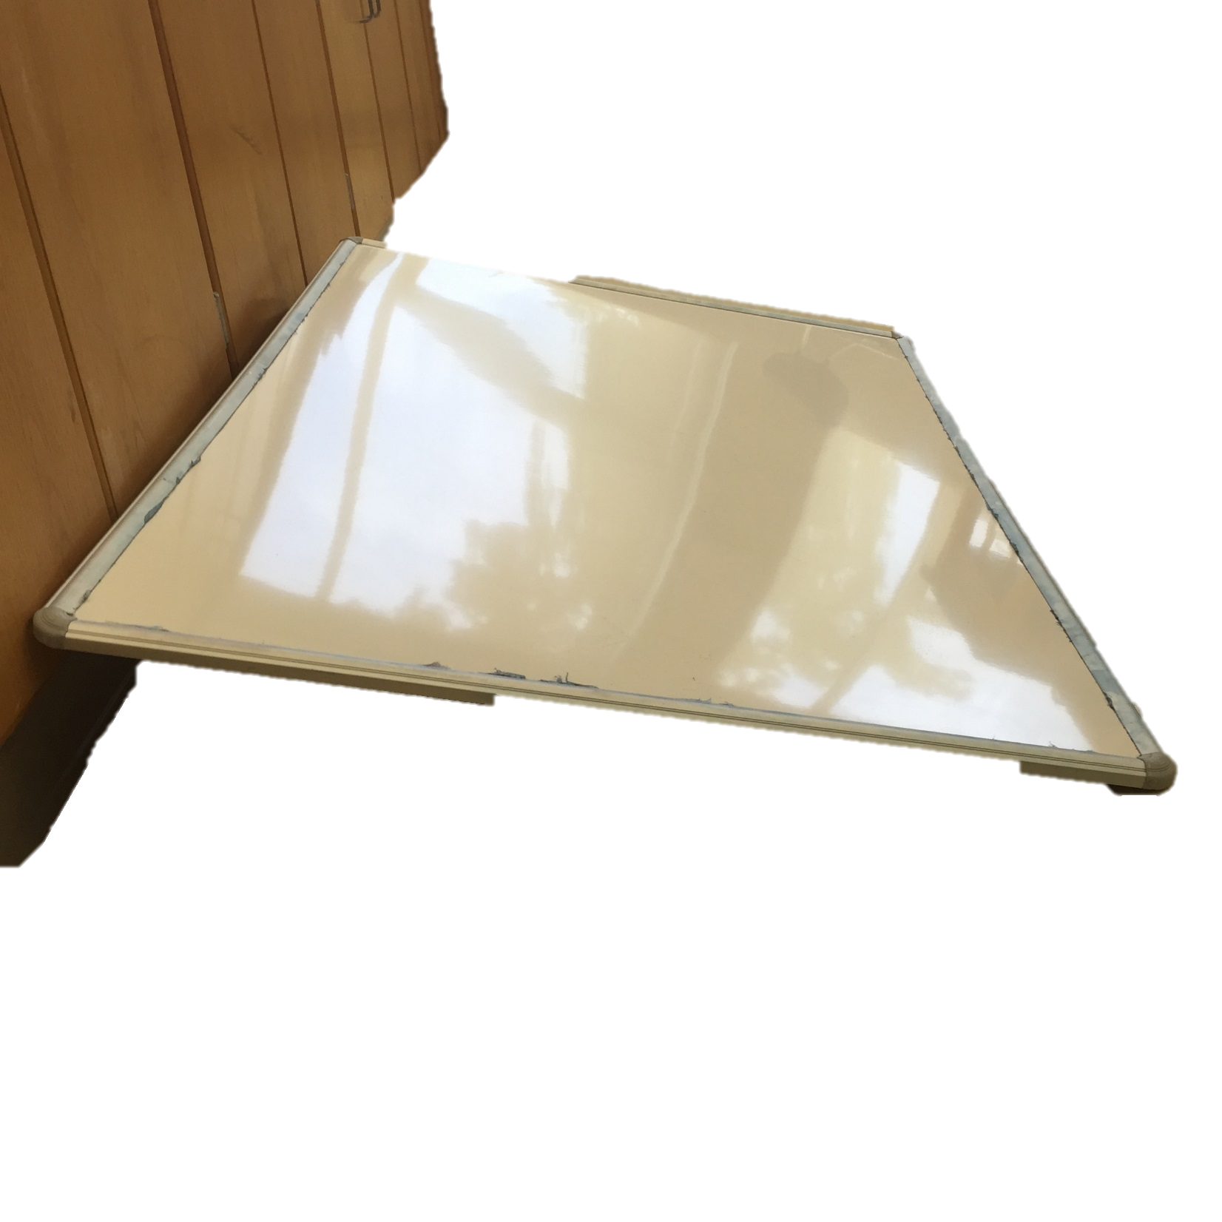
How Testing helped to make our Programs

