Slide 1
7 Bridges of Konigsberg
By Ava and Rachel

Slide 2
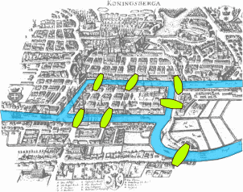
Background of the 7 bridges of konigsburg
- 7 bridges of Konigsberg was based in modern day Kaliningrad, Russia.
- The 7 bridges were built over a river that ran through the city.
- For centuries mathematicians have pondered Euler's discovery of the relationships between vertices, edges, and degrees, in the 7 bridges of Konigsberg. It is impossible to cross all the seven bridges using a Euler path.

Slide 3
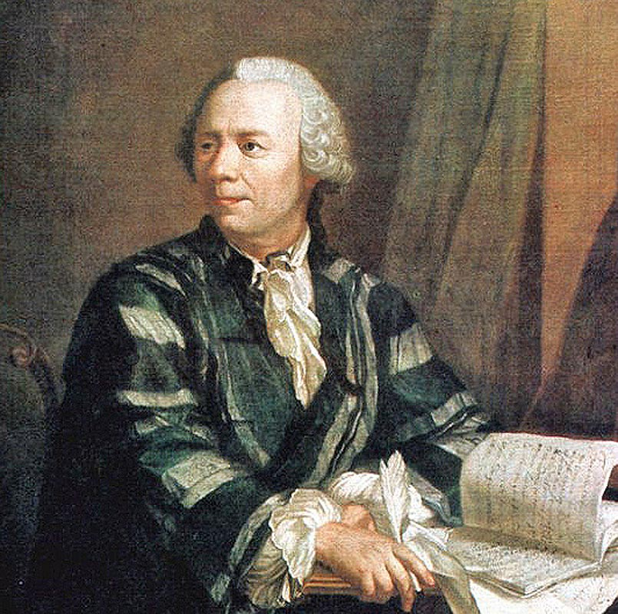
History of Leonhard Euler
- Born on April 15, 1707 in Basel, Switzerland.
- Was a physicist scholar-Worked in the fields of geometry, Trigonometry, and calculus
- Worked in St. Petersburg Academy, where he eventually lost his sight.
- He died on September 18, 1783 in Russia.

Slide 4
What is a euler path
- A Euler path is a path that covers every edge of the shape only once.
- For example, a Euler path is possible for a square with a single line through it

Slide 5
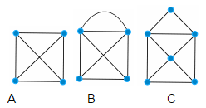
Give it a try
Now use the piece of paper given to you to find which of the following can or cannot have a Euler path. A good way to do this is to trace along the edge without removing your pencil from the paper. Start at one of the vertices or the corners.

Slide 6
Solutions to the problems
Shape A does not have a Euler path. There is no way to trace along each of the edges without retracing at least one edge.
Shapes B and C both have a Euler path. It is difficult.

Slide 7
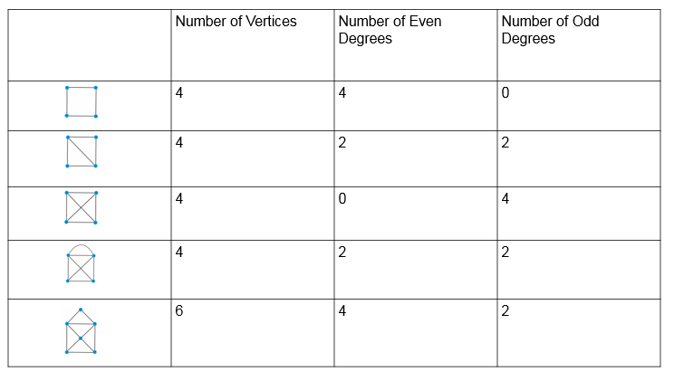
Reasoning behind the Euler path

Slide 8
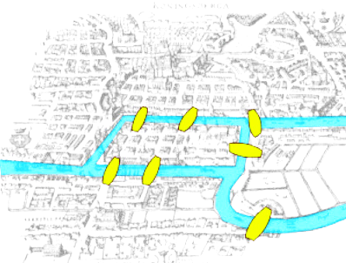
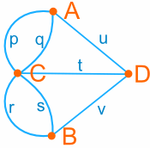
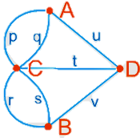
Why does this work?
A Euler path works for shapes that have 0 or 2 odd degrees ONLY
This leads back to the Bridges of Konigsberg. The map looks like this
Here is another way the bridges can be drawn

Slide 9
The impossible shown
Therefore, there is no possible way to cross each bridge once because there are 4 odd degrees in the diagram.

