Slide 1
Sunscreen Final Stage Gate
Prabhnoor Kaur, Ava Drum, Henna Fraiman, Ilana Moffet

Slide 2
Sunscreen Project Goals:
To create the optimum mixture of benzophenone and oxy cinnamate according to the FDA’s legal limits
To create the optimum protective and appealing packaging for 88 ml of sunscreen

Slide 3
Constraints
Goal is to have maximum SPF and LD50 possible
Goal is to have a minimum cost for packaging of: $4 with glue and $3without glue
Goal is to have a minimum cost for sunscreen chemicals of: less than $0.35
Goal is to use packaging materials with the highest materials testing value
Notes:
SPF: which the highest protection from sunlight
LD50: which chemicals have a survival rate above 50% which is crucial for use of sunscreen

Slide 4
Constraints on chemical values
Legal limit of Benzophenone: 6% = maximum amount used: 0.03 g and middle amount used: 0.015
Legal limit of Ethylhexylmethoxycinnamate: 7.5% = maximum amount used: 0.038 g and middle amount used: 0.0187 g
Notes:
tested to see their effect on the simplest living thing→ bacteria and their survival is crucial for application on humans which are much more complex

Slide 5
MSDS OVERVIEW FOR TESTED CHEMICALS
in case of eye or skin contact, flush eyes or skin with water for 15 minutes
in case of ingestion, seek medical attention. Do not induce vomiting unless directed by a medical professional and drink about 2-4 cups of water
in case of inhalation, seek medical attention. Remove victim to fresh air and if breathing is difficult, give oxygen.
**Do not give mouth to mouth resuscitation if victim ingested or inhaled the substance; induce artificial respiration with a pocket mask.
Notes:
PRABHNOOR

Slide 6
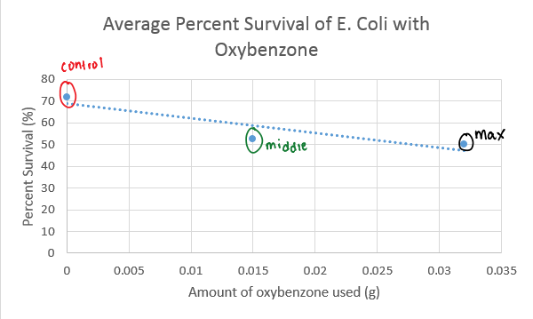
Initial Benzophenone Results- E. Coli Survival
Conclusion:
an amount between the control (0 g) and middle (0.015) values should be used in order for the greatest survival of bacteria
max. amount should not be used on humans
*Raw data available upon request
Notes:
Amount between the control 0 grams and the middle .015 grams and from our data we deicded for the next trial that an amount between these two numbers would give the greatest survival rate, max amount should not be used on humans

Slide 7
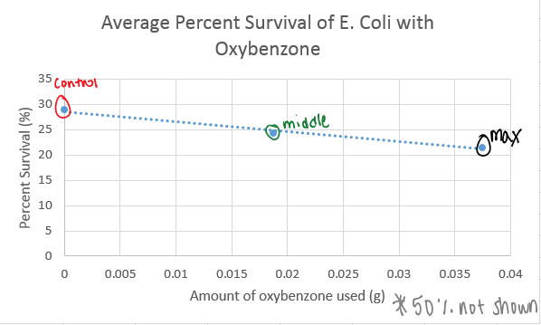
Initial Cinnamate Results- E. Coli survival
Conclusion:
cinnamate allowed less than 50% of bacteria to survive for all values of control, middle, and max.
Further tests should be conducted
*Raw data available upon request
Notes:
Based off of our data the cinnamate should not be used at all in the sunscreen because all amounts of cinnamate used had a negative

Slide 8
Sea Fleas Testing
After E. Coli, different amounts of benzophone and cinnamate based off of previous results on E. Coli were used to submerge sea fleas in to test their toxicity based off of previous results
Notes:
AVA: Sea fleas were used because they are eukaryotes and have systems similar to the human body; allowing us to test the safety of the chemicals.

Slide 9
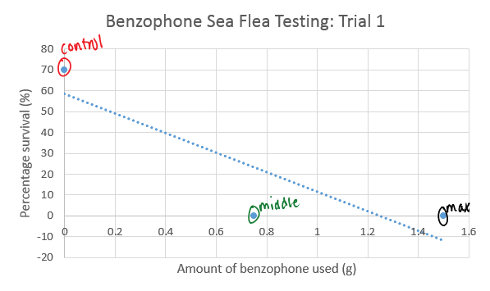
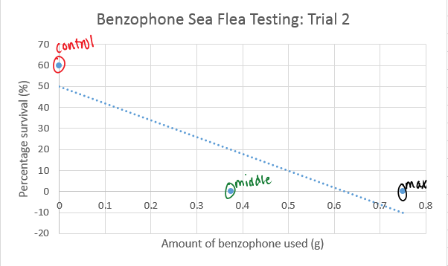
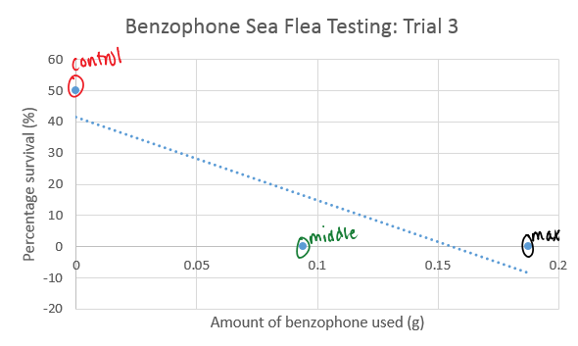
Sea Flea Benzophenone Testing
Control : 0 grams
Middle: .375 grams
Max: .75 grams
Control: 0 grams
Middle: .75 grams
Max: 1.5 grams
Control: 0 grams
Middle: .094 grams
Max: .1875 grams
Notes:
a. Because this is one of the final testing of the stages, different amounts were constantly being used for accurate results, preventing us from being able to average data together.
b. Using the results from the E. Coli survival, we decided to lower the amounts of benzophenone used in the first trial of sea fleas; so we made the found a number between the control and the max which was .0075 grams in the .5 ml tubes, and once converted to the 50 ml beakers, the new middle value was .75 ml while the max was 1.5 ml.
c. However, as seen from trial 1, there was no sea flea survival for middle and max, so each of these values was decreased by half in trial 2, with the same results as trial 1. Then these values were divided by four, with the sa

Slide 10
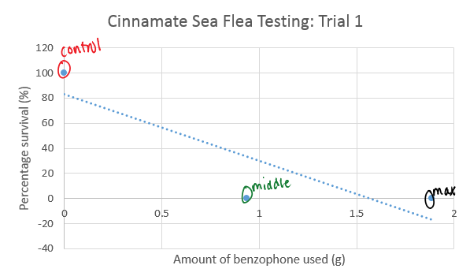
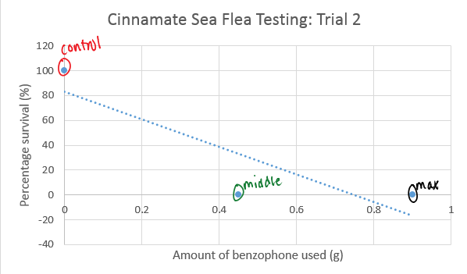
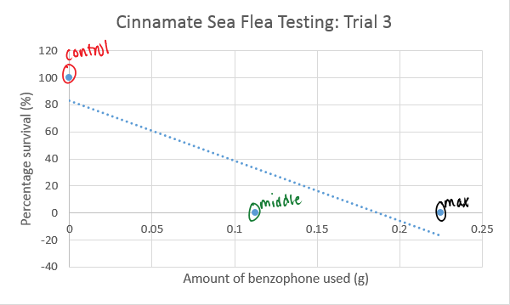
Sea Flea Cinnamate Testing
Control: 0 grams
Middle: .9375 grams
Max: 1.885 grams
control : 0 grams
Middle: .47 grams
Max: .9
grams
Control: 0 grams
Middle: .1125 grams
Max: .225 grams
Notes:
a. Because of the unfavorable data from the E. Coli testing, cinnamte was tested on sea fleas. similar to the benzophenone testing, results from the cinnamate survival showed minimal survival, so the maximum value of .018 grams was converted according to the 50 ml of the beaker, and now was used as the max value instead of the middle for sea flea testing of 1.8 with a corresponding middle value of .9375. However, with these values, there was no survival of sea fleas. Therefore, for trial 2, each of the values was divided by 2, with still no survival. So for trial 3, each of the values was divided by four, with no survival.

Slide 11
Conclusions from Testing
Cinnamate had a less than 50% survival with e. Coli and no survival with the sea fleas, so it will not be used
Benzophenone had a greater than 50% survival rate with e. Coli, but 0% with sea fleas → can’t be used in our sunscreen based on our data, but we will still use it with the support of other people’s trials:
Less than 4% should be used
Helpful in protecting self from UV rays
Absorbs and dissapates UV radiation
Comes from mother’s milk
Notes:
a. Cinnamate will not be used due to its e. Coli testing of less than 50 % survival, and no survival of sea flea testing, and damaging effects.
b. After conducting research, benzophenone will be used. In research, we found that sunscreens that contained less than 4% of benzophenone were safest. Studies have also proven that benzophenone is helpful in protecting the body from any harm that can come of UV rays and it helps absorb and dissipate UV rays transmitted by the sun. It is important that sunscreen be able to protect the body against UV rays because keeping those rays out, preserves the properties of the sunscreen that protect against the sun. Not only can benzophenone be found in sunscreen, but it is also in mother’s milk further proving that the human body can tolerate a certain amount of the chemical.

Slide 12
Cost Analysis and Formula Mix
Ingredient | Amount | Cost
Cetyl Alcohol | 2.0 g | $0.026
Bezophenone-3 | 2.64 g | $0.02475
Steric Acid | 4.0 g | $0.006
Glycerin | 2.0 g | $0.002
Trethanol Amine | 1.0 g | $0.02
Water, Distilled | 78.0 g | $0.00012
Total Cost of Materials listed above: $0.7687
Notes:
a. because cinnamate will not be used, it is not included in our cost plan. However the 3 % of the benzophenone- 2.64 grams that has been decided based off of research and data collection is included along with 2 grams of cetyl alcholhol, 4 grams of steric acid, 2 grams of glycerin, 1 gram of trethanol amine, and 78 grams of distilled water. All of these prices and amounts in the formula mix is for the according amount that will be used in 88 ml of sunscreen

Slide 13
Sources for cost of ingredients
cetyl alcohol: http://www.lotioncrafter.com/cetyl-alcohol-nf.html
steric acid: http://www.alibaba.com/product-detail/cosmetic-raw-ingredients-benzophenone-3-UV_1728118068.html?spm=a2700.7724857.29.10.UqI5qM&s=p
glycerin: http://www.alibaba.com/product-detail/glycerine-USP-Grade_60116229450.html?spm=a2700.7724857.29.10.zvcf9S&s=p
benzophenon: http://www.makingcosmetics.com/Oxybenzone_p_262.html
ethylhexylmethoxycinnamate: http://www.alibaba.com/showroom/octyl-methoxycinnamate.html
trethanol amine: http://www.lotioncrafter.com/triethanolamine.html
distilled water: tap water but still have to pay for it because it costs to have it filtered before it comes out the sink

Slide 14
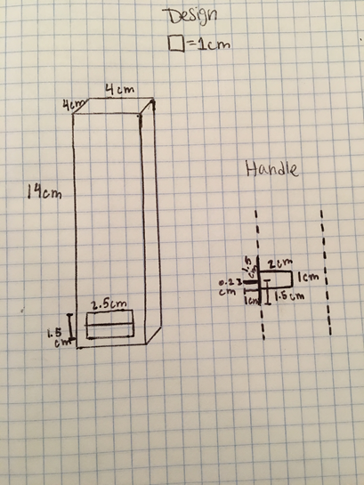
How Materials are Used
Cardboard was used for the exterior and wax paper was used for the interior of the box.
The handle is made of cardboard and covered in wax paper.
Notes:
a. HOW DID WE USE EACH THINGS: flap, sides, wax paper etc...
we used glue to connect the cardboard and wax paper to one another.
The picture to the left is a side view of the handle design. The flaps are used to prevent sunscreen leakage. We also lined the inside of the handle with wax paper to make it waterproof.

Slide 15
Average Representation of Initial Test Results
 | Drop | Shake | Throw | Weight | Water | Heat
Newspaper | 2.33 | 3 | 2.66 | 3 | 1 | 3
Cardboard | 3 | 3 | 3 | 3 | 2 | 3
Plastic wrap | 2 | 2 | 1.33 | 2 | 2 | 3
Plastic baggies | 3 | 2 | 3 | 3 | 3 | 3
foil | 2.66 | 2.66 | 1 | 3 | 2 | 3
Wax paper | 3 | 3 | 2 | 3 | 3 | 3
Duct tape | 3 | 2 | 3 | 3 | 3 | 3
Masking tape | 3 | 3 | 3 | 3 | 2 | 3

Slide 16
Why Materials Are Used:
Products used and why:
Cardboard:exterior of prototype as well as handle
.
Used because data showed that for the 5 of the 6 tests cardboard faced no damage.
2) Wax Paper: covered the cardboard in the interior
data showed that for 5 of the 6 tests, wax paper faced no damage.
Wax paper is biodegradable, waterproof, and does not absorb moisture.
3) Glue: used to connect cardboard
Used because even though the data was favorable towards the tapes, glue provides a much stronger structure for the package
Notes:
· We used cardboard because it is a strong material that is partially water proof and had a relative impressive initial testing data of 5 out of 6 tests with no damage
· We used wax paper to insulate the box, because of the 5 out of 6 tests of no damage. Also, because through our research we found that it was biodegradable and waterproof.
· Lastly, we used glue to connect the cardboard and wax paper to one another, because even though the data showed minimal damage towards the tape, glue provides a stronger structure.
· As well as the materials testing well and being durable, they were very cost savvy. Cardboard was $1 per square, which is why we only used 1, Wax Paper was $0.50 per sheet which is why we only used 1, and glue our last ingredient limited our max cost to $3.00. Although glue limited our max cost, we believed it was best to use as the binding agent because it provided a sturdy structure for the cardboard, where as tape is more flimsy and less waterproof.

Slide 17
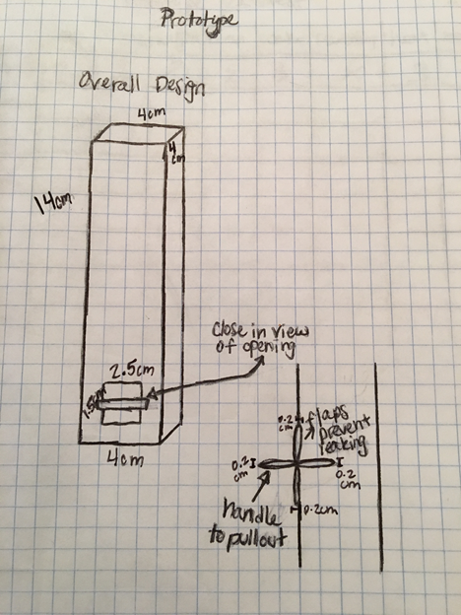
Prototype #1 Results
Test | Score
Throw (from 6ft) | 2
weight (5 books) | 3
water (1 cup) | 2
drop (from 6ft) | 2
shake (30 sec) | 3
heat (overnight @37 degrees celcius) | 3
Key:
3: No damage
2: little damage
1: very damaged
Notes:
a. “based on testing, we came up with these adjustments which are made in our final package”
b. More hot glue: because after testing, it was evident, that the package was not holding
c. Bigger hole for sunscreen because it is evident that hole is too small for the release of sunscreen
d. We also moved the hole closer to the edge so that no sunscreen would be wasted
e. Put wax paper over plug: crucial part of the design and needs to stay sturdy and within the package without getting soggy from water for prevention of leaking
f. After all these changed were made the testing scores of the package were all 3’s

Slide 18
Our Final Product, Prototype #2
Conclusion:
more hot glue between cardboard to prevent it from splitting
bigger hole for sunscreen to come out, which also means a bigger plug for the hole to further prevent leaking of the sunscreen
put hot glue and wax paper over the plug to make it waterproof
After these changes, the product had no damage (3) on all of the tests.

Slide 19
Tentative cost plan for packaging
With the current design…
Material | Quantity | Cost
Cardboard | 1 square | $1.00
Wax paper | 1 piece | $.50
Glue | X | maximum cost of product if glue is going to be used: $3.00
Total Cost of current prototype: $2
Notes:
a. cardboard: Frame for package
b. wax paper: Inner insulation and outer lining
c. glue: Constructing all of the pieces of the design together
We chose these materials because they were not just durable but also very cost savvy. Cardboard was $1 per square, which is why we only used 1, Wax Paper was $0.50 per sheet which is why we only used 1, and glue our last ingredient limited our max cost to $3.00. Although glue limited our max cost, we believed it was best to use as the binding agent because it provided a sturdy structure for the cardboard, whereas tape is more flimsy and less waterproof.

Slide 20
Alternative to Benzophenone
Benzophenone used in non-mineral sunscreens
Mineral sunscreens are an alternative which contain zinc or titanium
Notes:
a. Benzophenone is the active ingredient in non-mineral sunscreens, which are the most common sunscreens. These sunscreens have been proven to disrupt hormones and be more allergenic than mineral sunscreens. Mineral sunscreens have zinc or titanium as the most active ingredient. These two alternative chemicals have not been proven to be allergenic and do not negatively affect hormones. For these reasons, if given more time, we would like to test zinc or titanium to use instead of benz

Slide 21
Sources for External Research
https://www.truthinaging.com/ingredients/benzophenone-3
http://www.cosmeticsinfo.org/ingredient/benzophenone-1
http://www.smartskincare.com/skinprotection/sunblocks/sunblock_benzophenones-3-and-4.html
http://www.ewg.org/2015sunscreen/report/the-trouble-with-sunscreen-chemicals/
http://www.ewg.org/news/testimony-official-correspondence/cdc-americans-carry-body-burden-toxic-sunscreen-chemica
http://draxe.com/75-of-sunscreens-are-toxic-what-to-do-instead/

Slide 22
RAW DATA FOLLOWS THIS SLIDE

Slide 23
Average percent survival of E.Coli with Benzophenone
Data Collected: 2/24/16
Level | Trial 1 | Trial 2 | Trial 3 | Trial 4 | Average of Trials
Control (0g) | 100% | 28% | 76.25% | 83.35% | 71.9%
Middle (about 0.015 g) | 11.5% | 41% | 83.75% | 74.45% | 52.675%
Max (about 0.032 g) | 40.5% | 12.75% | 81% | 66.75% | 50.25%

Slide 24
Average percent survival of e. coli with OxyCinnamate
Data Collected: 2/26/16
Level | Trial 1 | Trial 2 | Trial 3 | Trial 4 | Average of trials
Control (0 ul) | 88.75% | 12% | 5.2% | 41.5% | 36.86%
Middle (.01875 ul) | 45.75% | 5.875% | 24.75% | 22.75% | 24.28%
Max (.0375 ul) | 30% | 38.75% | 4.4% | 12.4% | 21.3875%

Slide 25
Benzophenone Sea flea Testing
trial 1- mid: .75 ml and max: 1.5 ml
Test | # Fleas Alive | # Fleas Dead | % Survival
Control | 7 | 3 | 70%
Middle | 0 | 10 | 0%
Max | 0 | 10 | 0%
Notes:
JUSTIFY WHY WE CHANGED OUR AMOUNTS
After 24 hours

Slide 26
Benzophenone Sea flea Testing
trial 2- mid: .375 and max: .75 ml
Test | # Fleas Alive | # Fleas Dead | % Survival
Control | 6 | 4 | 60%
Mid | 0 | 10 | 0%
Max | 0 | 10 | 0%
Notes:
Divided previous mid and max by 2

Slide 27
Benzophenone Sea flea Testing
trial 3- mid: .094 and max: .1875
Test | # Fleas Alive | # Fleas Dead | % Survival
Control | 5 | 5 | 50%
Mid | 0 | 10 | 0%
Max | 0 | 10 | 0%
Notes:
Divided previous mid and max by 4

Slide 28
Cinnamate Testing Sea Flea Data
Trial 1- mid: .45 ml and max; .9
Test | # Fleas Alive | # Fleas Dead | % Survival
Control | 8 | 2 | 80%
Mid | 0 | 10 | 0%
Max | 0 | 10 | 0%

Slide 29
Cinnamate Testing Sea fleaData
Trial 2- mid: .1125 and max: .225
Test | # Fleas Alive | # Fleas Dead | % Survival
Control | 0 | 10 | 0%
Mid | 0 | 10 | 0%
Max | 0 | 10 | 0%
Notes:
Divided previous mid and max by 4

Slide 30
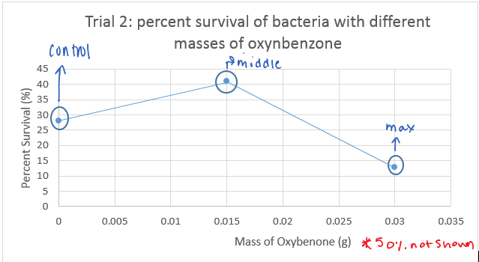
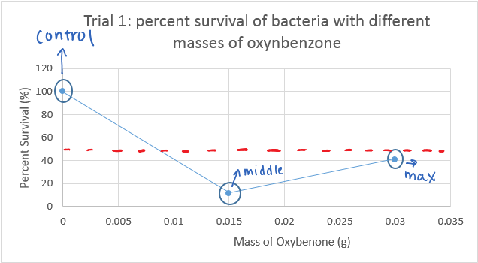
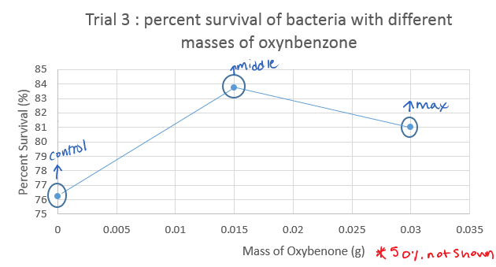
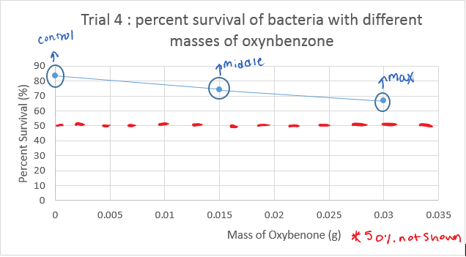
Benzophenone trials Displayed- LD50 testing (50 % survival shown by red line)

Slide 31
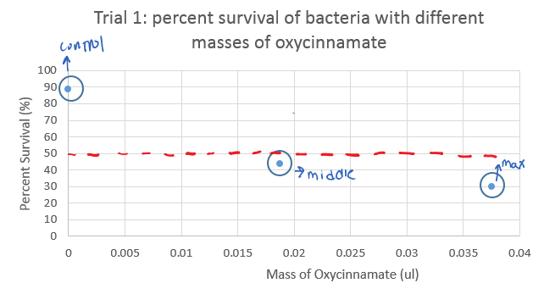
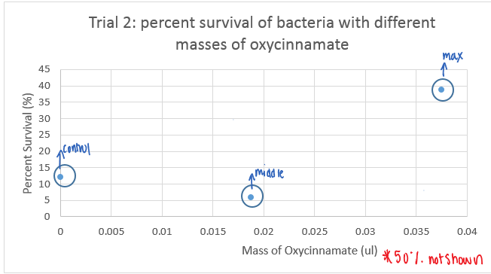
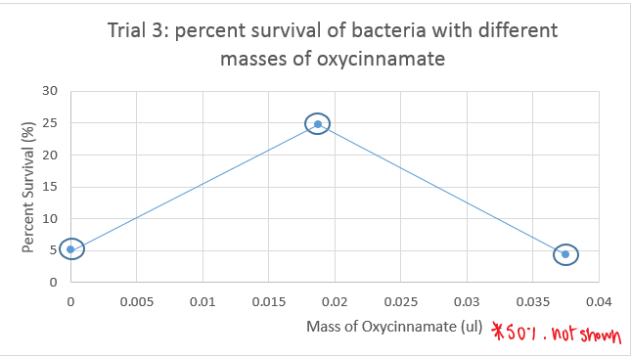
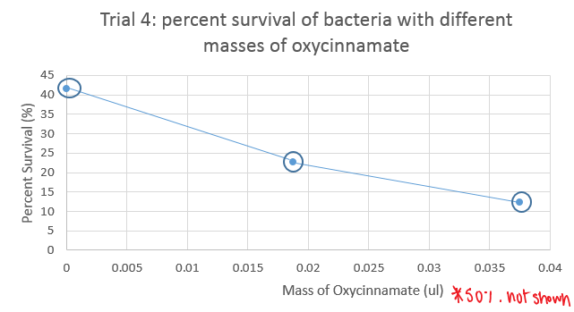
OxyCinnamate trials Displayed- LD50 testing (50 % survival shown by red) line)

