Slide 1
Stage Gate of Harbor Pollution: The Harm of Rock Salt
Rachel Clemons, Ally Osten, Lizzie Cohen, Ava Drum

Slide 2
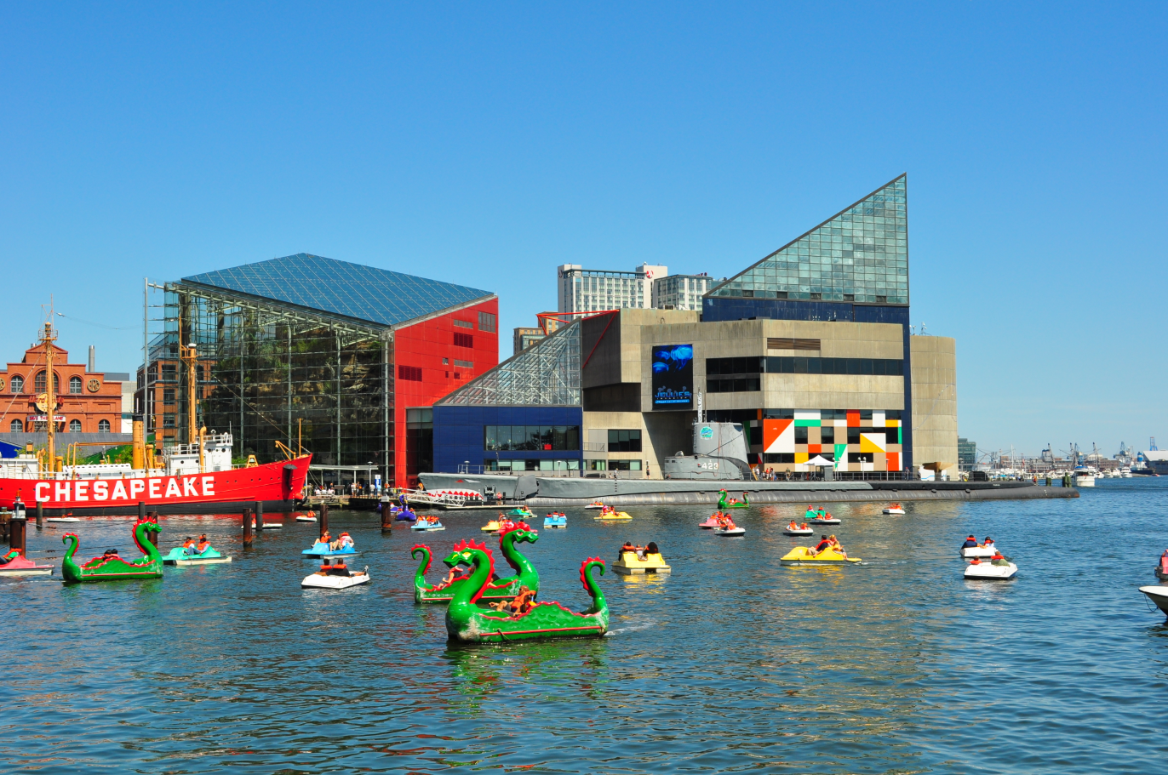
The Baltimore Harbor
Notes:
I am sure when you go to the harbor, you see this. However, there is so much you don’t see.

Slide 3
The Baltimore Harbor

Slide 4
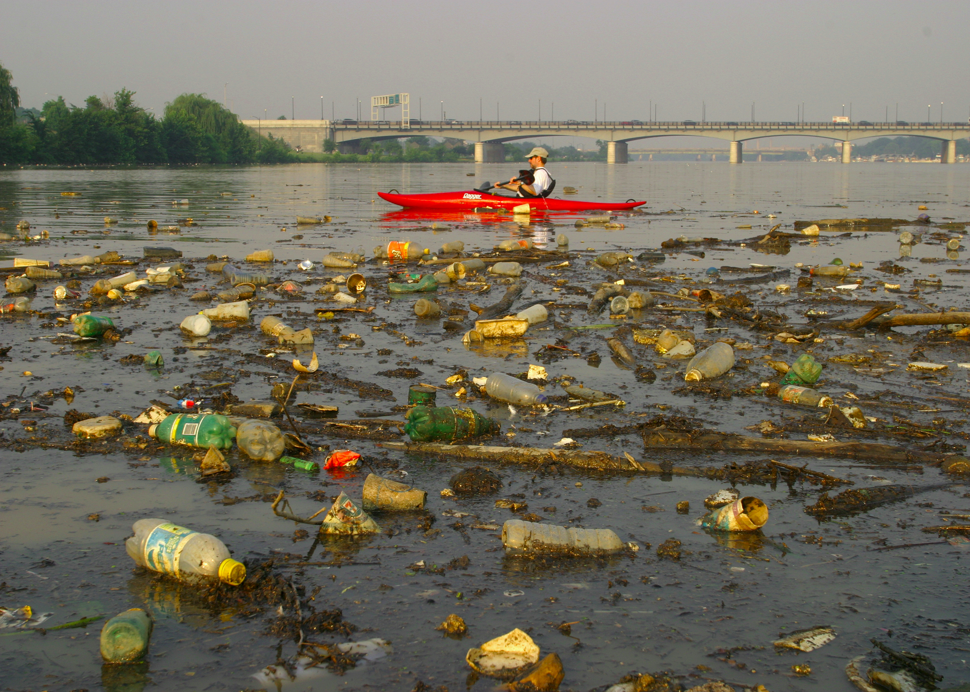
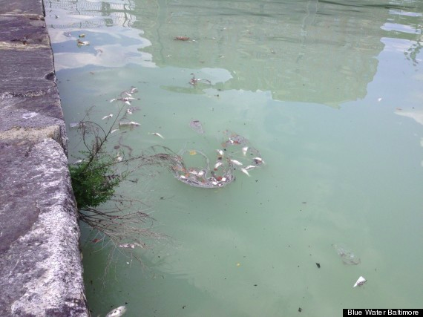
A Closer Look...
Notes:
In reality, there is a ton of trash, and chemicals entering the water especially road salt.

Slide 5
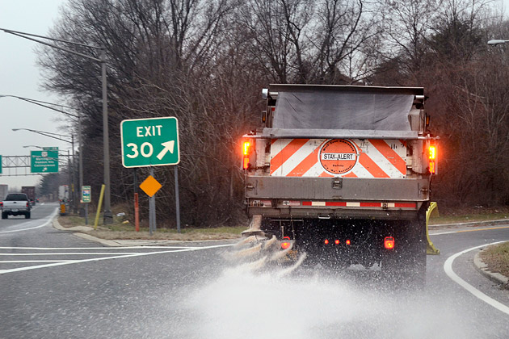
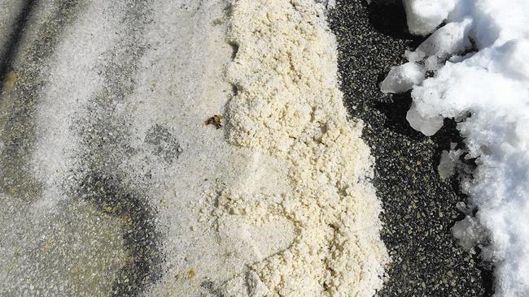
The Process of Road Salt

Slide 6
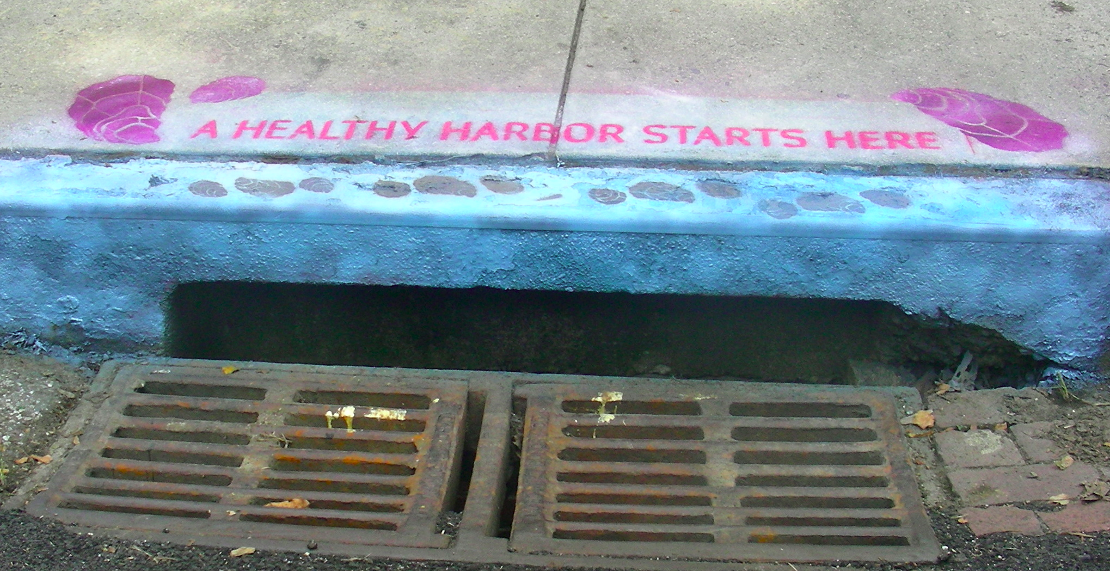
The Process of Road Salt Continued

Slide 7
Road Salt Background
Chloride is deadly to aquatic life and wildlife:
There is no natural way to break down chloride
An increase of sodium leads to changes in soil chemistry
Sodium chloride that seeps into the drains kill sea life
Once the water goes into the storm drain, it goes into the nearest stream, then the stream leads to the Bay.

Slide 8
Question:
Will our filtering system successfully lessen the amount of road salt entering the Baltimore Harbor?

Slide 9
Project Constraints
Making a device that separates solutions by density
Ex: salt water vs. clean water
The device should successfully separate the undissolved road salt
To make a device that is both cost effective and will not harm the environment

Slide 10
Cost Analysis
Item | Quantity (cm²) | Price ($) | Store
Genova Vinyl Gutter Guard | 1380 | 2.99 | Lowes
Amerax PVC Gutter Cover | 1530 | 2.81 | Lowes
New York Wire 36-in x 7-ft Charcoal Vinyl-Coated Polyester Screen Wire | 372 | .26 | Lowes
We have currently spent $6.06 on the building of this filter.
Notes:
Per unit--- this is how much to make this many centimeters etc

Slide 11
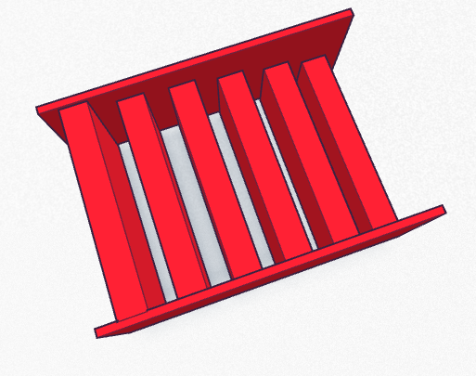
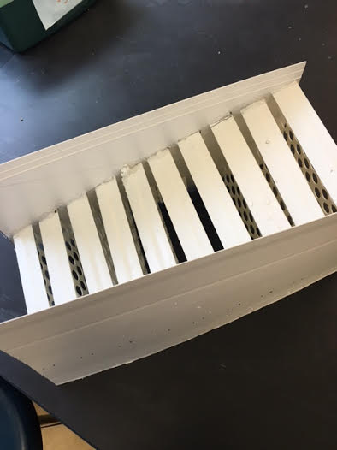
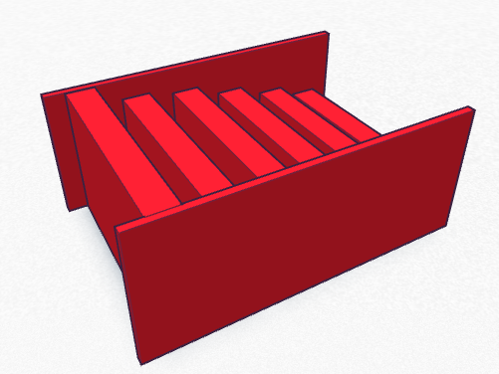
Model of the filter
2.5cm
14.5 cm
1cm

Slide 12
What Changed From Last Design...
Instead of having a ramp, we placed the filter in between the two bins. In this way, the saltier water would fall into the first bin in the first half of the filter and the cleaner water would fall into the second bin.

Slide 13
Test Prep
Measure 247 grams of rock salt in bottle
Add 950 mL of water to bottle and shake
Pour into pitcher
Measure 950 mL of regular water in second pitcher

Slide 14
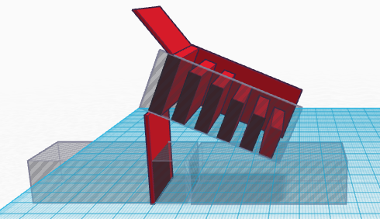
Design Model for Testing

Slide 15
Video

Slide 16
Current Results: Data From Filter Test
 | Trial 1 |  | Trial 2 |  | Trial 3 |  | Averages
 | Box 1 | Box 2 | Box 1 | Box 2 | Box 1 | Box 2 | Box 1 | Box 2
Amount of Salt Concentrate | 1.065 | 1.05 | 1.07 | 1.055 | 1.06 | 1.05 | 1.065 | 1.052
Amount of Water Trapped | 900ml | 700ml | 880ml | 1040ml | 1140ml | 1150ml | 973.333ml | 963.333ml
Amount of Salt Caught | 5.4g | 0.5g | 11g | 22.6g | 4.4g | 25.8g | 6.933g | 16.3g
Notes:
Lizzie

Slide 17
Plan for Moving Forward
To create a self cleaning filter
Future Cost:
Additional money will need be spent to modify either the existing storm drains in Maryland to put to this filter or have the drains lead to a larger drainage system where a large filter could be placed.

Slide 18
Research Sources
http://des.nh.gov/organization/divisions/water/wmb/was/salt-reduction-initiative/impacts.htm
http://blog.skillingsandsons.com/blog-1/bid/336257/How-do-I-Remove-Sodium-and-Choride-Salt-from-My-Well-water http://onlinepubs.trb.org/onlinepubs/sr/sr235/017-030.pdf

Slide 19
Picture Sources
http://www.bloomberg.com/news/articles/2014-02-20/new-jersey-is-out-of-road-salt-dot-blame-maritime-law
http://mapio.net/s/22959227/
http://cbf.typepad.com/bay_daily/2012/11/
https://www.google.com/url?sa=i&rct=j&q=&esrc=s&source=images&cd=&ved=0ahUKEwjUpKzZo8PMAhVC4D4KHZH9BrAQjhwIBQ&url=http%3A%2F%2Fbaltimore.org%2Fneighborhoods-maps-transportation%2Finner-harbor&psig=AFQjCNEOokvuctjkjWcy3BI5k7tt4SUKwQ&ust=1462549283787854
https://en.wikipedia.org/wiki/Inner_Harbor
http://www.huffingtonpost.com/2013/07/19/dead-fish-inner-harbor-baltimore-milky-water_n_3623931.html
http://www.dronestagr.am/hanover-street-bridge-baltimore/
https://www.tinkercad.com/things/aKTp0WWmA8C-copy-of-my-first-lesson-lesson-learning-the-moves/edit

