Slide 1
Illusions in Color
By: Emma Sunderland and Henna Fraiman

Slide 2
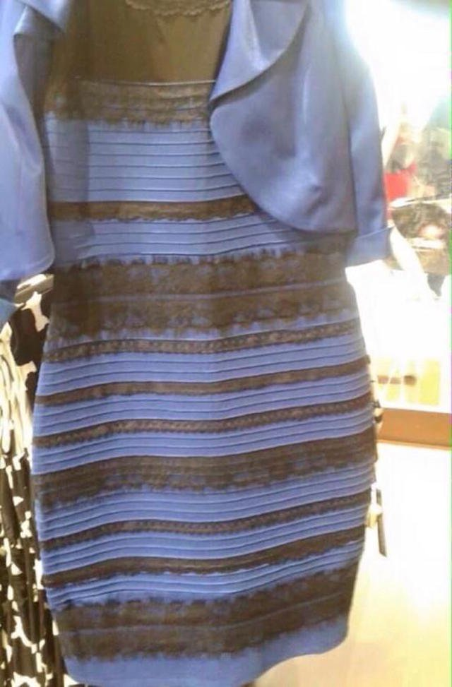
Color Illusion: Dress
What color do you see?
Color constancy: human color perception
Shadows
Type of light
The brain makes assumptions about the surroundings of the dress, which will affect the color your brain sees.

Slide 3
https://www.youtube.com/watch?v=AskAQwOBvhc
Notes:
Dress video
2 minutes

Slide 4
https://www.youtube.com/watch?v=ZflIMBxyIak
Notes:
2 minutes

Slide 5
More Examples
The left inner box appears darker than the box on the right. However, they are the same color. Both squares reflect the same amount of light, but they still appear different because of their surroundings.

Slide 6
Scintillating Grid Illusion
Do you see the black dots at the white intersection points?
Photoreceptors in the eye send information to a retinal cell in the brain. The brain cells prevent the activity in nearby cells, which creates an unequal black-white contrast.

Slide 7
Moving Stripe Illusion
Stare at the black dot in the corner. The moving stripe will eventually turn blue.
By keeping your eyes in one spot, it causes the continual stimulus of a certain color to weaken the photoreceptors.

Slide 8
Sources
http://mentalfloss.com/article/54448/5-color-illusions-and-why-they-work
http://brainden.com/color-illusions.htm#prettyPhoto
https://www.youtube.com/watch?v=ZflIMBxyIak
https://www.youtube.com/watch?v=AskAQwOBvhc

