Slide 1
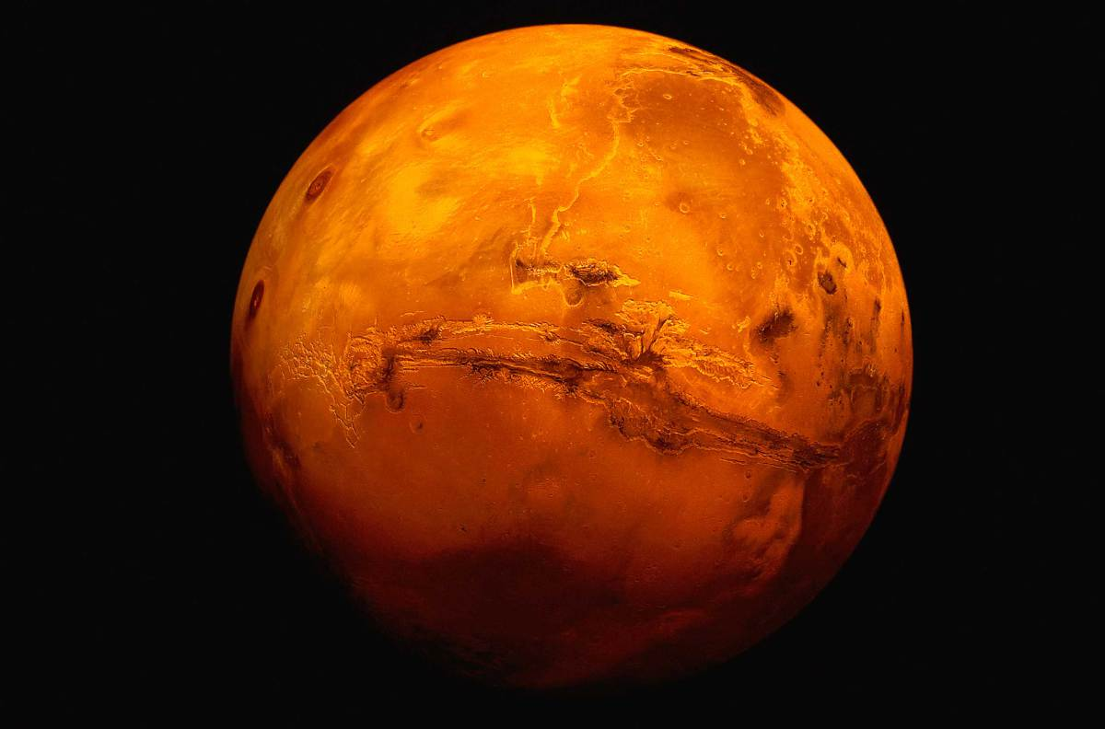
Welcome to Mars
Kennedy Manley and Hyo Shin
Robot A1

Slide 2
Gear Choice!
On the wheels, we used the big gear.
On the motor, we used the small gear.

Slide 3
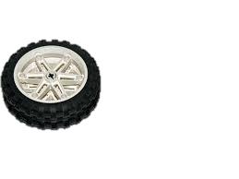
Wheel Choice!
Big Size Wheels!

Slide 4
Forward Program

Slide 5
Backwards Program

Slide 6
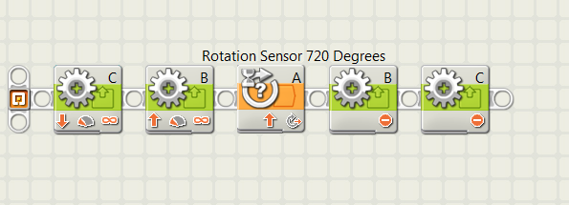
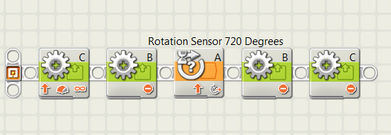
Turning
Point Turn
Swing Turn

Slide 7
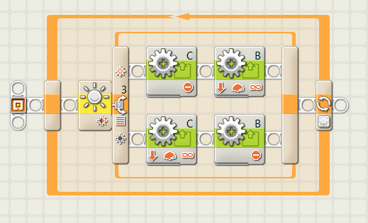
Tracking A Curve

Slide 8
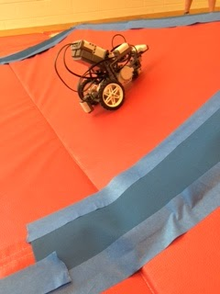
Inclined or Declined Slopes
Decline
-Speed of 50%
-Forward Program
Incline
-Full Speed of 100%
- Forward Program
Notes:
For decline, we chose the speed of 50 percent and used the forward program
for incline we chose full speed and used the forward program

Slide 9
Various Surfaces
Rocky:
-Forward Program
-Full Speed, 100% power
-Point Turn to align robot with the center of the rock
Smooth
-Forward Program
-Approximately 75% speed

Slide 10
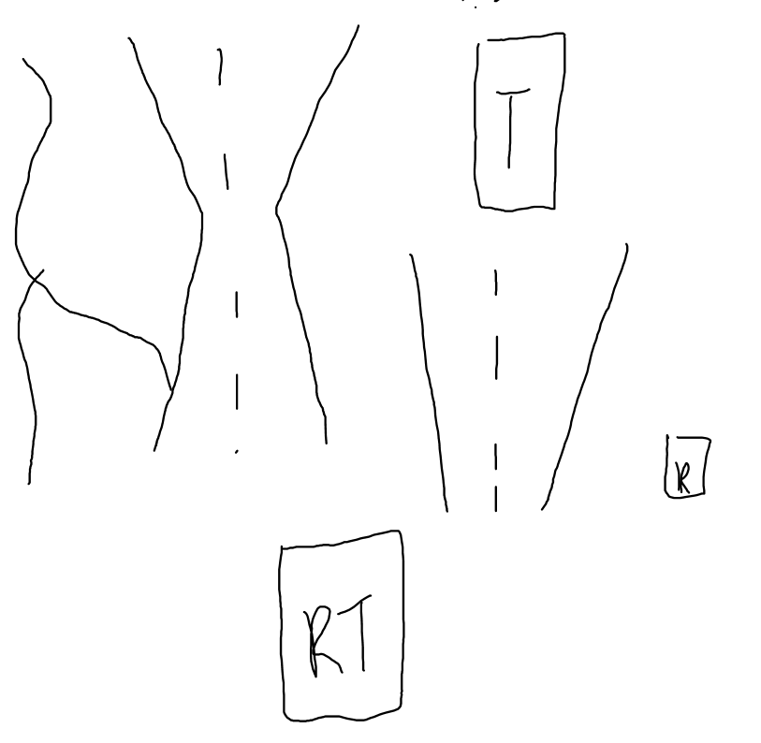
Map or Mars Landing Site

Slide 11
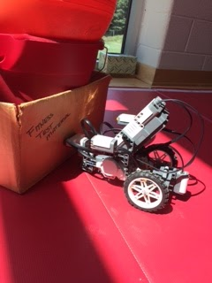
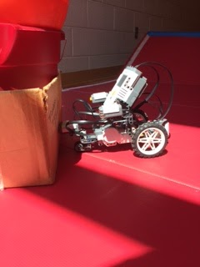
Problems while on Mars
Ran into the Rock

Slide 12
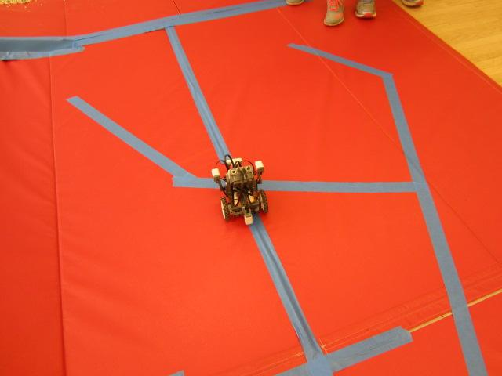
Problem while on Mars
followed the wrong blue line while on the hematite trail

Slide 13
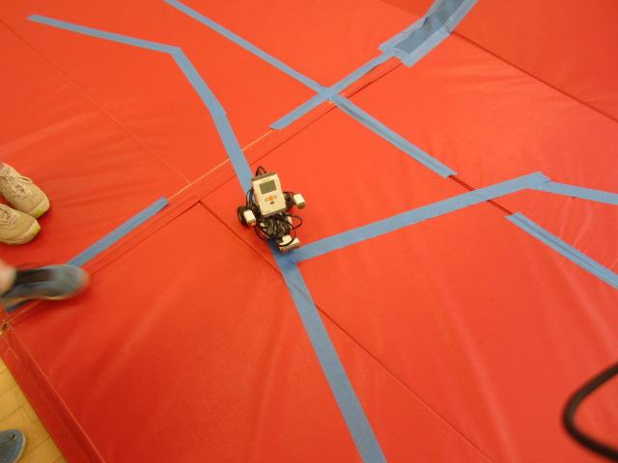
Hematite Trail

Slide 14
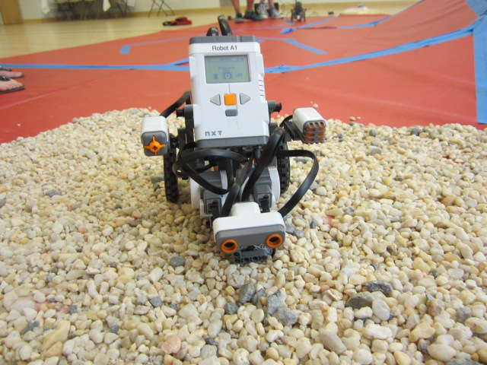
Terrain

Slide 15
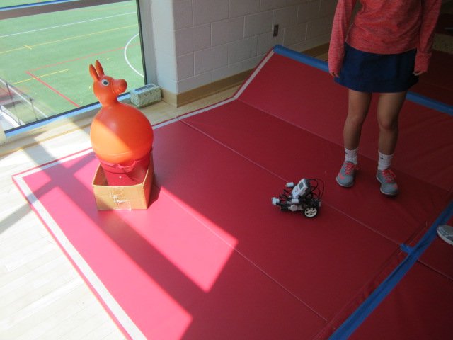
Exploring the Rock

Slide 16
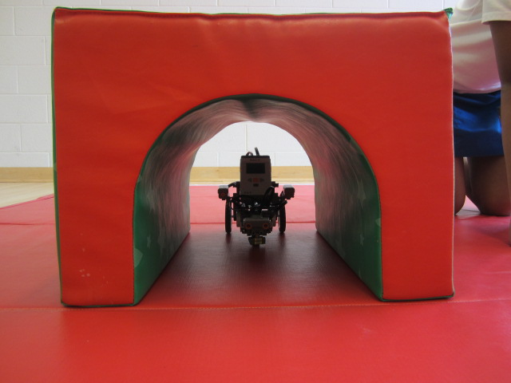
Tunnel

