Slide 1
3D Printing in Cardiology
Ilana Moffet
STEM 2A Final Project

Slide 2
What is 3D printing’s role in cardiology?

Slide 3
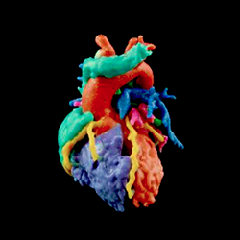
Why 3D printing?
cardiologists use 3D printing
print exact replica’s of their patient’s hearts
help the doctors see a tangible model of the heart

Slide 4
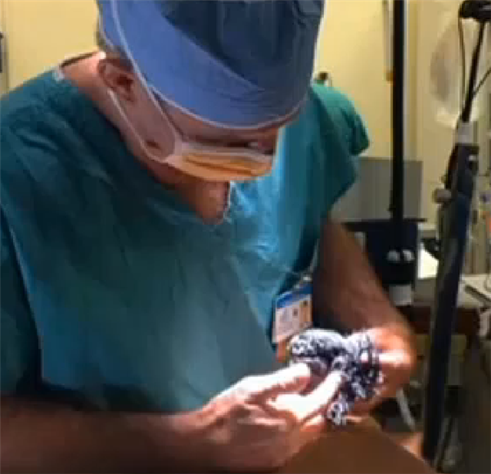
Help for Surgery
Use to practice the surgery beforehand
doctors can see exactly what they will see when they open up the patient for surgery eliminating the possibility for surprises in the OR (operating room)
Less complications possible and less time spent in OR

Slide 5
Teaching Students
Dr. Seckeler, University of Arizona, uses 3D printing to teach his medical students and pediatric cardiologist residents
Gives ability to see difference between a healthy heart and an unhealthy heart
helpful to learn from because they are real tangible objects that are the closest you can get to a heart without using a real heart

Slide 6
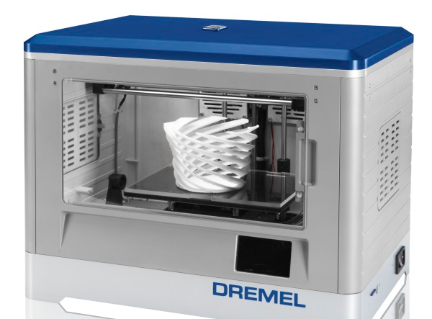
Printer used by Dr. Steckeler
Dremel 3D Idea Builder
Cost $9,400
Given grant from:
UA Sarver Heart Center

Slide 7
Teaching Patients
Show patient what is going on in their heart
Show the difference between a patient’s unhealthy heart and a healthy heart
Easier to understand and see blockages

Slide 8
Steps to creating a 3D print of a patient’s heart
Patient must undergo a CT or MRI (a series of x-ray pictures taken by machines)
CT- x-ray machine that make cross-sectional pictures of the body
MRI-magnetic resonance imaging, takes pictures and shows many more internal organs than what can be seen on x-rays or CT’s

Slide 9
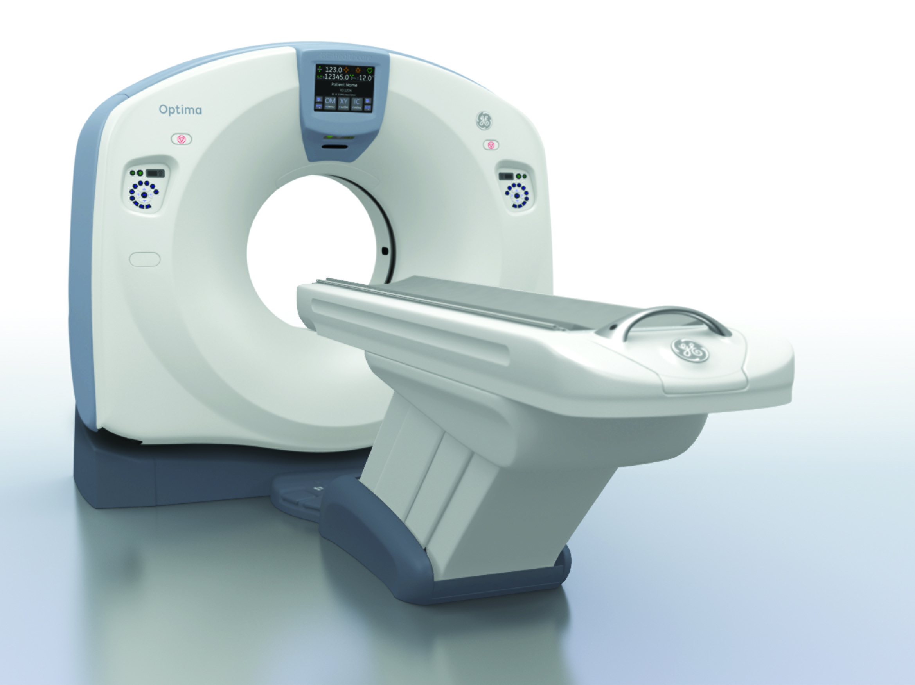
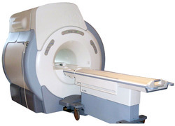
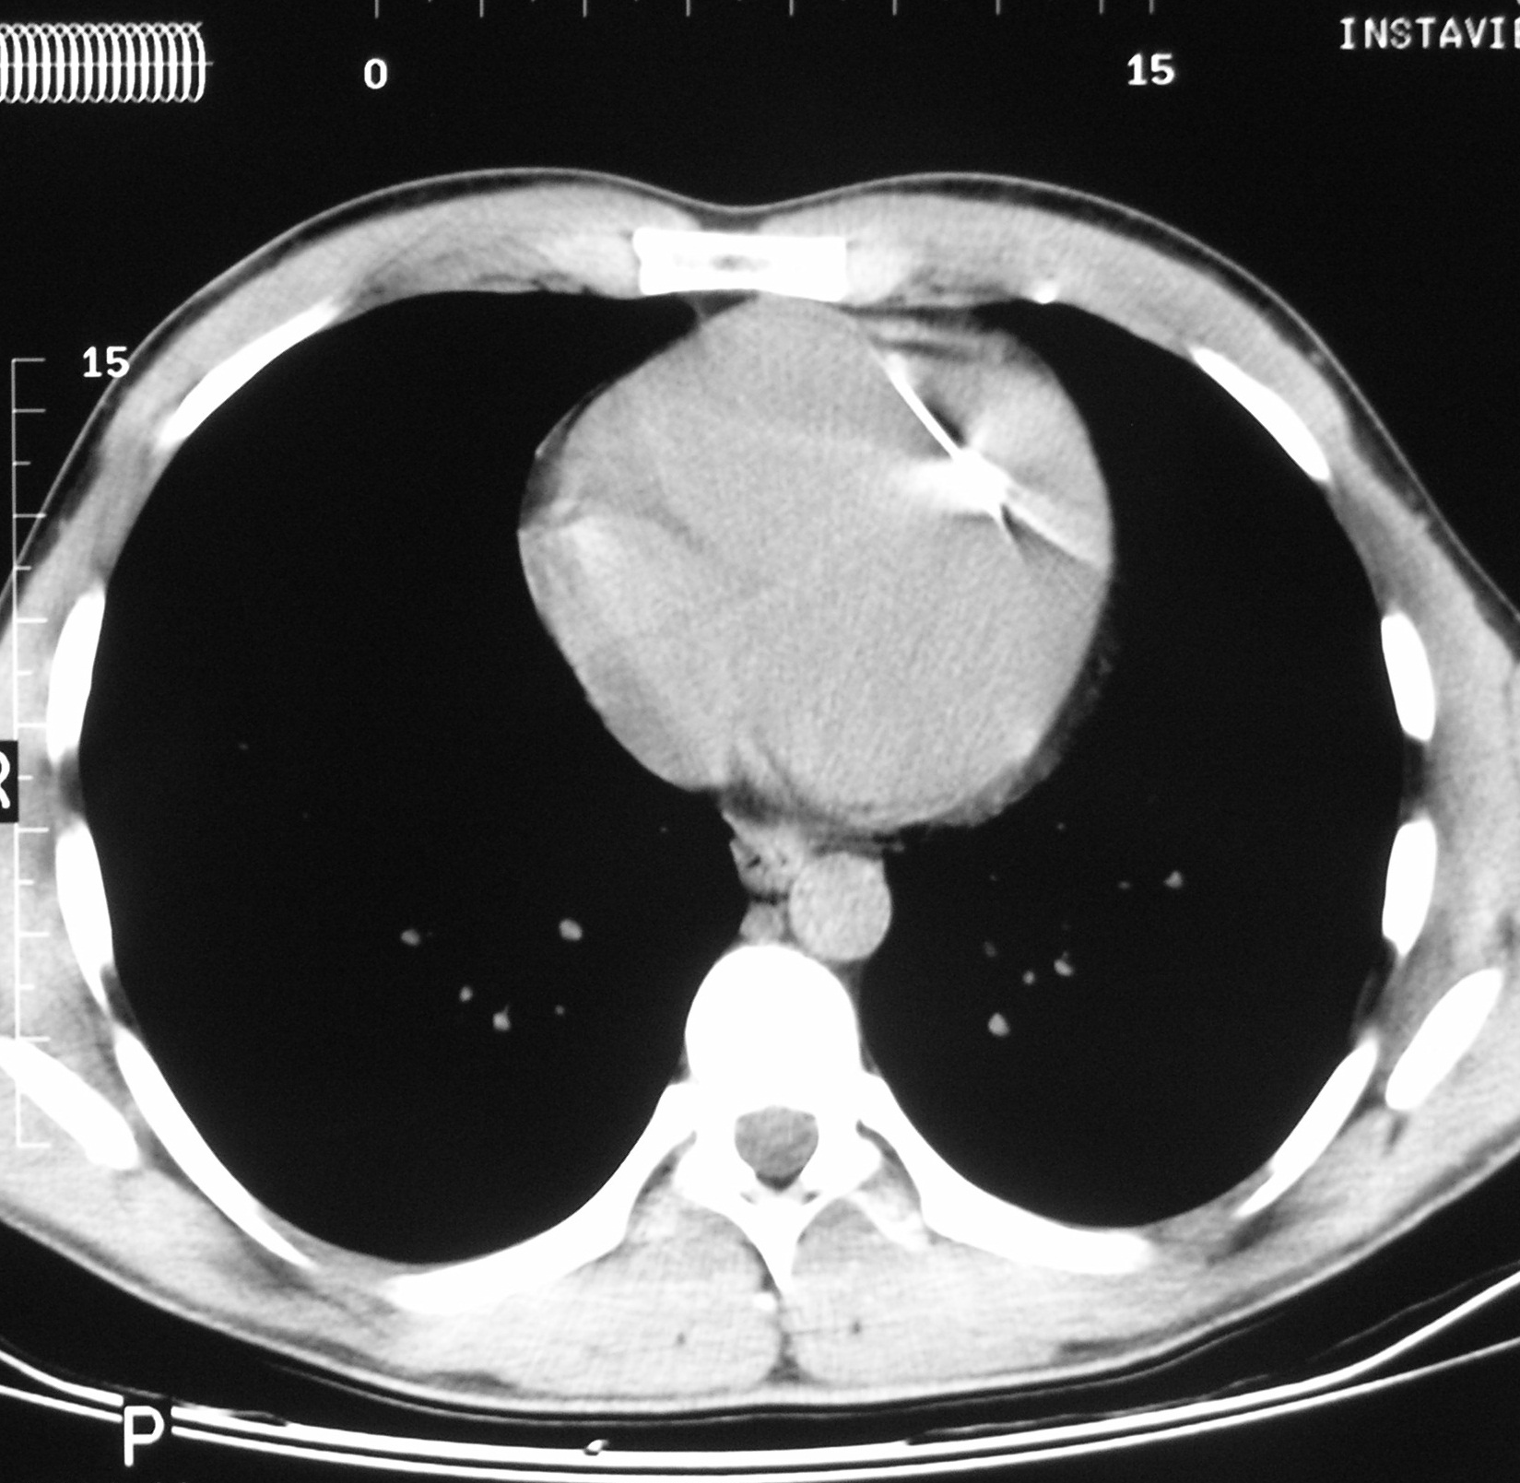
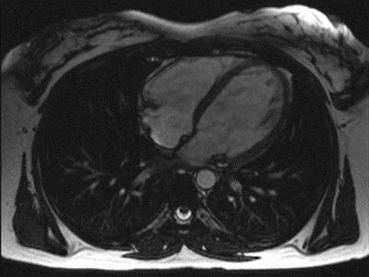
CT and MRI
CT machine
MRI machine
MRI picture of a heart
CT picture of a heart

Slide 10
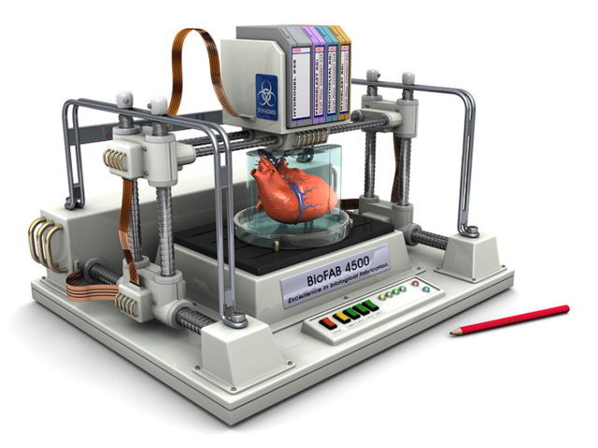
….steps continued
Doctor aligns the series of pictures that were taken so that all the parts of the heart match up
Doctor can now see and identify what part of the heart needs to be 3D printed and examined further
The pictures are sent to the printer and printed

Slide 11
Video
http://www.voanews.com/content/three-d-printers-heart-surgery/1713293.html

Slide 12
Picture Sources
http://www.3ders.org/images2014/doctors-use-3d-printing-aid-successful-open-heart-surgery-four-year-old-5.png
http://www.3ders.org/images2014/Dremel-3D-Idea-Builder-1.jpg
http://www.prpimaging.com.au/Images/Interesting%20Images/needle%20in%20heart%20CT.jpg
http://www.theharleystreetcardiologypractice.com/cardiac-mri-scan
http://3.imimg.com/data3/OW/TV/MY-1614093/mri-machine-250x250.jpg
http://www.medicalwesthospital.org/tyfoon/site/fckeditor/image/OCT660_slant_photoHR-1.jpg
http://usglobalimages.stratasys.com/en/Resources/Case%20Studies/Medical/Nicklaus%20Childrens/mia_heart_200.jpg?v=635797384581994220
http://3dprintingindustry.com/wp-content/uploads/2014/07/feature-materialize-3d-printed-heart-3dpi.png
http://cdn2.ubergizmo.com/wp-content/uploads/2015/03/3d-printer-heart-640x480.jpg

Slide 13
Sources and Notes

Slide 14
http://heart.phoenixchildrens.org/3d-print-lab-jemmas-story
Use models to personalize the surgery before going into surgery
Less time in OR and less complications
Print allows doctors to see everything so they don’t learn something new in surgery
Use model to practice, can practice the procedure
Print aneurisms on a heart

Slide 15
http://opa.ahsc.arizona.edu/newsroom/news/2015/new-3d-printer-enables-ua-pediatric-cardiologist-expand-teaching-methods
Used to help teach medical students at University of Arizona and residents
Print replica's of real people's healthy and unhealthy hearts so students can learn using real visuals and tangible objects
Teach patients about what's going on in their heart

Slide 16
http://www.medscape.com/viewarticle/842486:
Patient must undergo a CT or MRI
Take data set which is a series of pics that cover every part of the heart when put together
Select which part to print, can take few minutes or few hours
Can hollow out or cut image that they want printed
Pegs can be put in to connect parts of models

