Slide 1
David Hilbert’s Space Filling Curve
By: Payton and Ilana

Slide 2
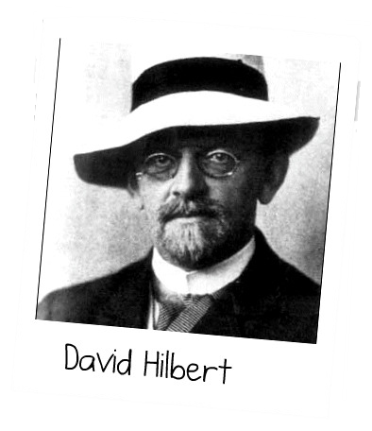
Background on David Hilbert
Born on January 23, 1862 in Konigsburg, Prussia (now called Kaliningrad in Russia)
Parents: Otto Hilbert and Maria Therese Erdtmann
His fathers family was involved with the law
relatives on his mothers side were merchants.
His mother was the person that got him interested in science and math because those were her interests.
He was enrolled at a school for students that were gifted academically
he then went to a school that specifically focused on math and science.
was academically excellent and was able to go to a European university.

Slide 3
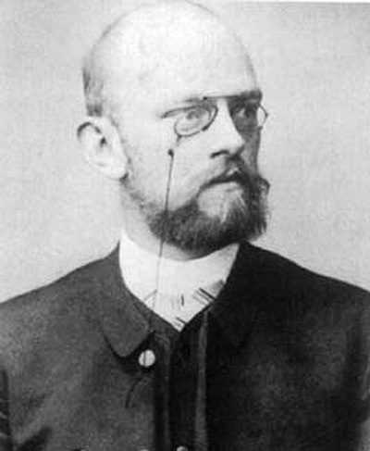
More background
Studied at the university of Konigsberg
He got a degree in mathematics as well as a Ph.D.
He became a math teacher (lecturer and professor)
He was good friends with Hermann Minkowski and Adolf Hurwitz who were also academically excellent and made him brighter.
He then went to the University of Gottingen on Germany to work which had been one of the worlds top universities in the study of Mathematics
Was the editor of a mathematical journal

Slide 4
What Hilbert accomplished
He proved the basis theorem for endless amounts of variables by using a new proof
He discovered and made new axioms of geometry that took the place of those made by Euclid about flat and spherical surfaces.
He created his 23 problems which were questions that are to this day still being attempted to be solved. Some are solved, but others are not.
Those that are not yet solved: Riemann Hypothesis, Kronecker-Weber thorem extension, and the problem of topology
HIS FILLING CURVE

Slide 5
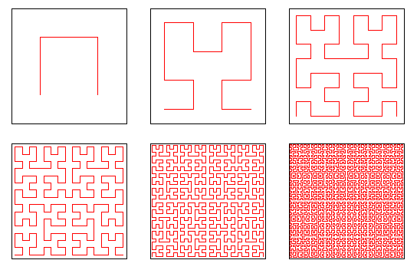
THE FILLING CURVE
WHAT IT IS:
There is only one Hilbert curve in a 2D world, but 1536 different ones in a 3D world.
Maps 1D and 2D space together
Points will be near the same point whether dealing in 1D or 2D dimensions
The filling curve is called the space filling curve because as it progresses it fills up more and more space within the same amount of space for each transformation.
https://www.maa.org/external_archive/CVM/1998/01/vsfcf/article/sect11/hilall.gif

Slide 6
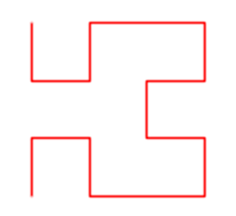
HOW THE FILLING CURVE IS CREATED
You start with four dots that would serve as the vertex’s of a square. Then connect the four dots by three lines leaving the bottom of the square open. Then reflect it three times: once next to it to the right facing the open side in the same direction as the first one, once underneath it having the open side facing out to the left, and once reflected from that one, with the open side facing out to the right. Then connect it continuously while leaving the bottom open again. Then do this over and over using the shape that was made by the previous resulting shape of the model.

Slide 7
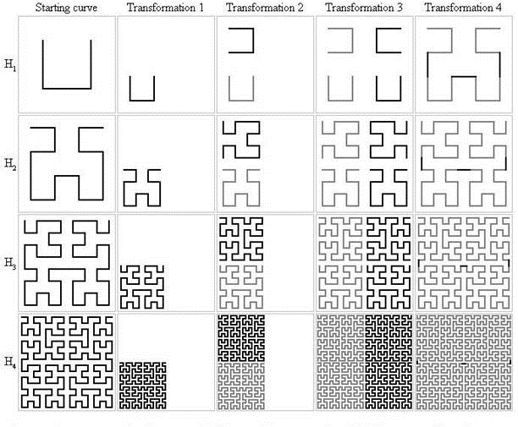
Note: as long as its consistent, the open side of the starting square can be on any of the four sides

Slide 8
Video Showing Example of Space Filling Curve
https://www.youtube.com/watch?v=dkGJIIdQQI8

Slide 9
Lets create your own!!
Please pull out the sheets that we handed out at the beginning of the presentation.

Slide 10
Sources
https://people.csail.mit.edu/jaffer/Geometry/HSFC
http://www.bic.mni.mcgill.ca/~mallar/CS-644B/hilbert.gif
http://poj.org/images/1246_1.jpg
https://www.jasondavies.com/hilbert-curve/
http://www.famousscientists.org/david-hilbert/
http://totallyhistory.com/wp-content/uploads/2013/12/DavidHilbert01.jpg
http://270c81.medialib.glogster.com/media/61/61fd9b37ca687de889844e435e1d59e6ae1ff770d6640fc3cc136362f24497cd/david-hilbert.jpg

