Slide 1
Strengthening Sea Life Initiative
Catherine Knipp, Olivia Cohen, Ilana Moffet

Slide 2
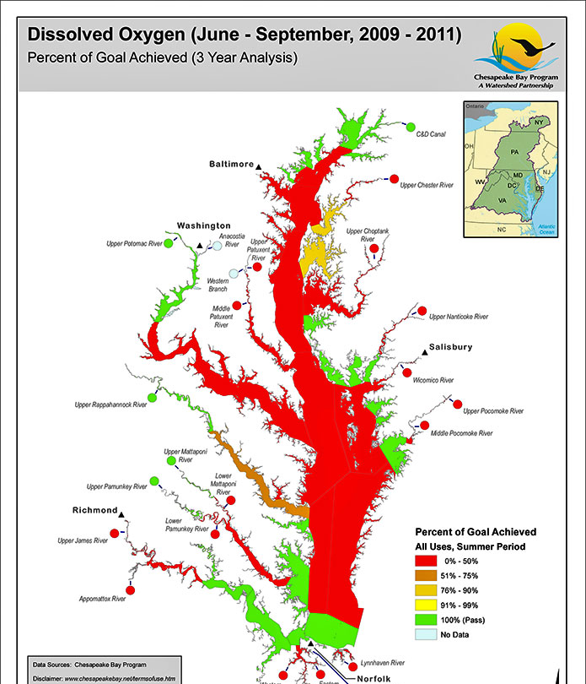
Background Information about Sea Life
Dissolved oxygen is amount of oxygen in water
Makes it harder for fish to breath through gills
Causes: temperature, nutrient pollution, flow and shape of Chesapeake Bay
Areas with less than .2 mg/L are called “dead zones”

Slide 3
Research Question
How can more oxygen be brought down to lower parts of the sea in order to strengthen sea life?
Why is this important?
Health of oceans is vital to our lives and ecosystem
Ocean’s are our largest support systems
When sea life is dying, it messes up many different cycles

Slide 4
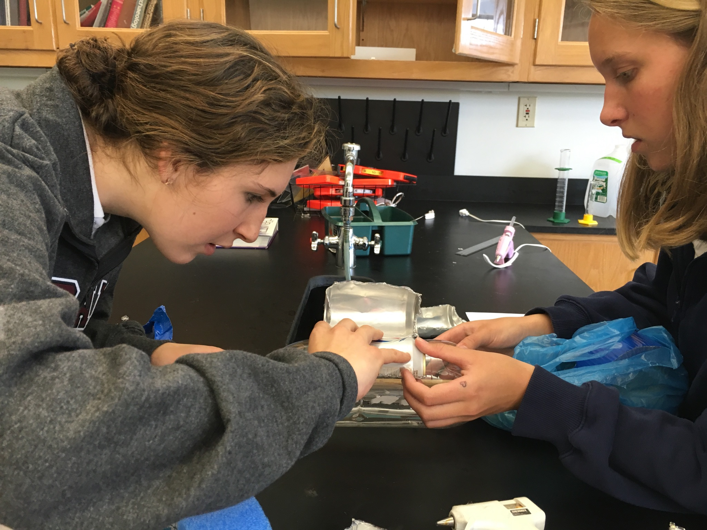
Project Constraints
Following the goal, make a device that circulates and moves oxygen from the top of the water to the bottom
Spend least amount of money on materials
Be eco friendly while being efficient

Slide 5
Summary and Explanation of Cost Analysis
Material | Cost
Wooden rod (axle) | $2.99
Glue sticks (20) | $7.98
Soda can and bottles | $0.00
Total Cost | $10.97
Low cost due to recycled materials
These costs will change for real thing
Material | Cost
Aluminum | $1.50 per pound
Wood rod | $2.70 per 72 inches
Plastic Bottle | $2.50 per pound
Cost Analysis for Bulk Recycled Materials:

Slide 6
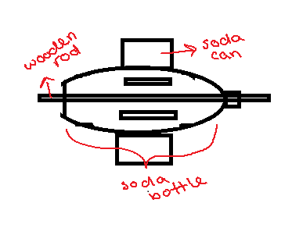
Design
Dimensions of Wheel:
Soda can paddles - all about 6.6cm X 12.2 cm
Soda bottle - 1 L 30.48 in X 8.89 cm
Wooden rod - 1.5 cm X 45.5 cm
About Design:
Changed the soda cans from scoops to flat paddles
Hole in bottom and top of soda bottle for wooden rod
9 can paddles placed 4.3 cm apart
After testing, removed 5 cans and punched holes in remaining paddles

Slide 7
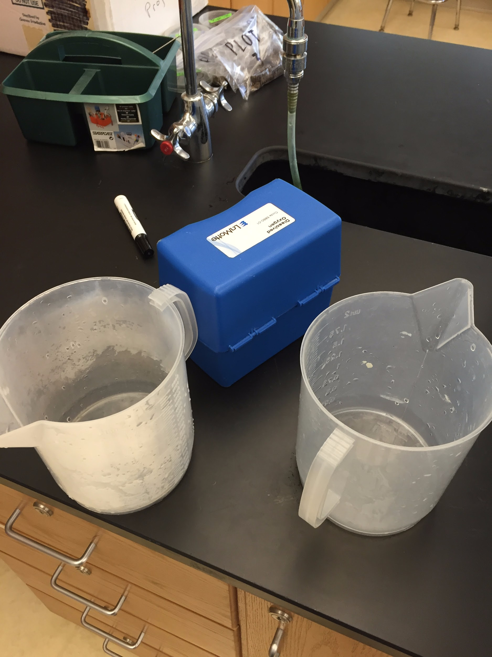
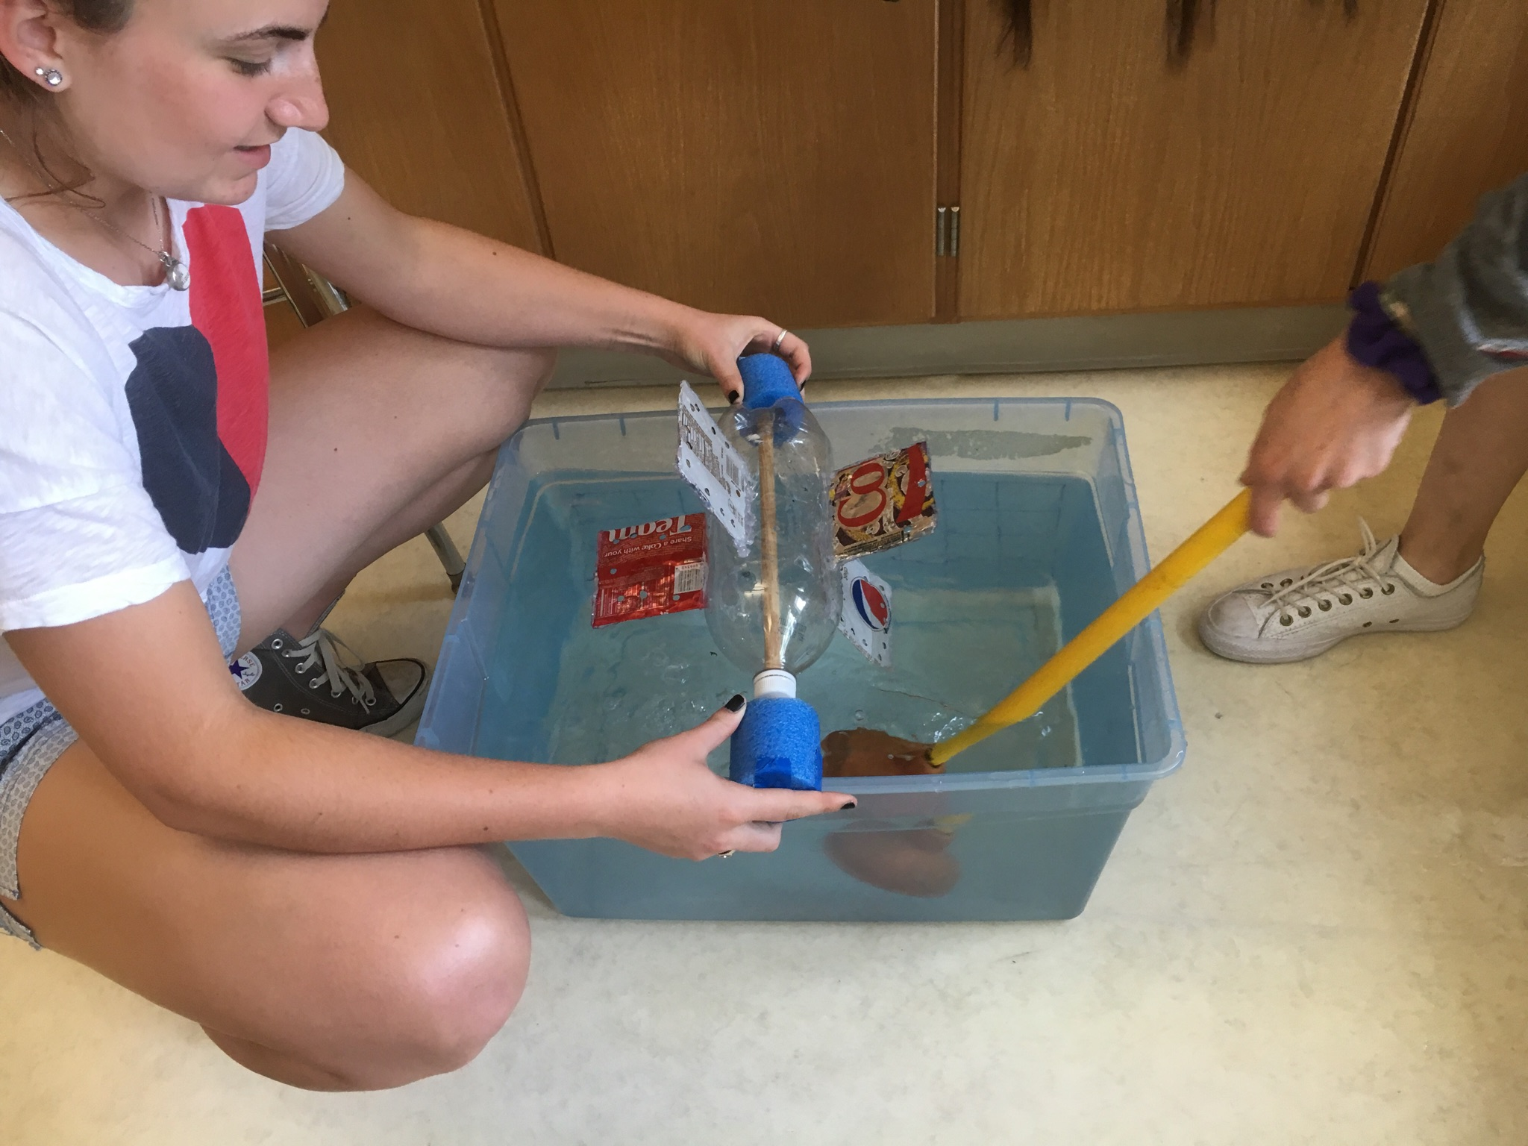
Testing Set-Up
Fill bucket with water and rest wheel on top so that the bottom half is in the water and the other half can pick up air and turn
Once the bucket is filled and the wheel has turned for 2 minutes, use the dissolved oxygen kit to check for oxygen at the bottom of the water
Want to simulate a wheel resting on river banks in a smaller setting

Slide 8
Current Testing Results
We have not conducting any testing on the oxygen levels because more adjustments need to be made before collecting any data and due to time constraints we did not get our final design together
We did find valuable information about how NOT to build the wheel
We ruled out scoops as the spokes
We found that just poking holes was not enough to move through the water

Slide 9
Plans Moving Forward
Discoveries:
The paddles are not being propelled enough by the current to turn the wheel
Moving Forward:
Put the paddles at angle so that Bernoulli’s principle will apply and turn the wheel, possibly make them curved
Once the wheels move, test the dissolved oxygen

Slide 10
Sources
http://www.chesapeakebay.net/discover/bayecosystem/dissolvedoxygen
http://www.cbf.org/image/fishkill9-2-08-_695x352.jpg
http://www.michaels.com/creatology-wood-dowels-0.4375%22/10031027.html#start=416
http://earthworksrecycling.com/prices/metalsellingprices.html
http://www.michaels.com/surebonder-glue-sticks/M10203515.html

